Slide 1

The ALEKS Gradebook
ALEKS Training Series

Slide 2
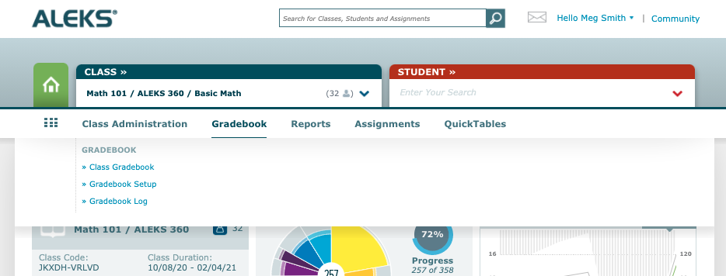
Navigating to the ALEKS Gradebook
To locate your gradebook, select your Class, then roll over “Gradebook” in the top navigation bar. You’ll see Gradebook Setup, which is where you can set up your categories and weighting, the Gradebook Log, which lists adjustments made to the students’ scores by any instructors with access to the class, and finally the Class Gradebook, which will take you into the gradebook. You can also click the Gradebook header to take you directly in.

Slide 3
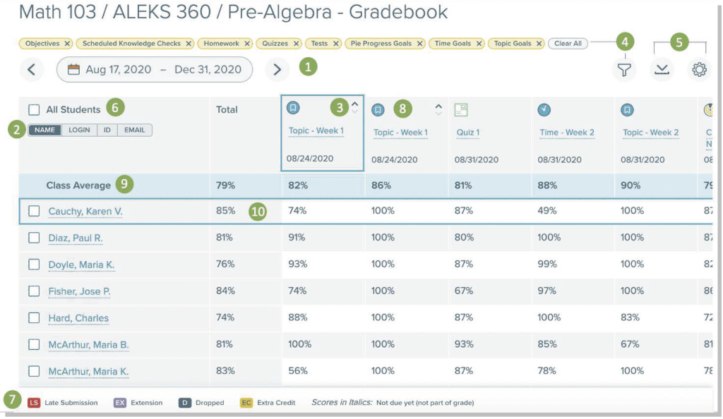
What’s inside the Gradebook?
1. The date range selector, which will help you streamline the assignment view.
2. You’ll use this toggle to change the view of your student list to display by name, login, ID, or email. Note that the email displayed will be the one students used to register.
3. Change your columns to be sorted in ascending or descending order, or view alphabetically.
4. Select the filter to show specific assignment categories. To remove filters, simply click the X on the yellow bubble above the date range.

Slide 4
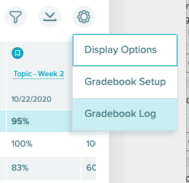
What’s inside the Gradebook?
Other tools in the top right include an option to download your data and navigate to the gradebook log or gradebook setup. By clicking on the settings wheel, you’ll find more options including navigating to the gradebook log or gradebook setup.

Slide 5
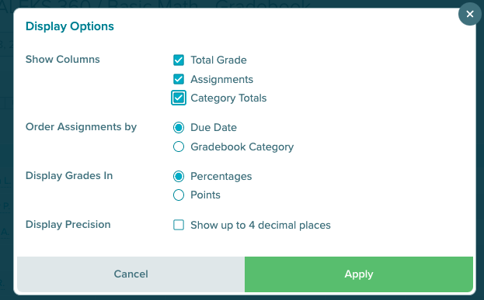
What’s inside the Gradebook?
With the Display Options, you’ll see the option to show Category Totals. When Category Totals is selected, a column to show the totals for each Gradebook Category by student is inserted into the Gradebook table before the columns of assignments.

Slide 6
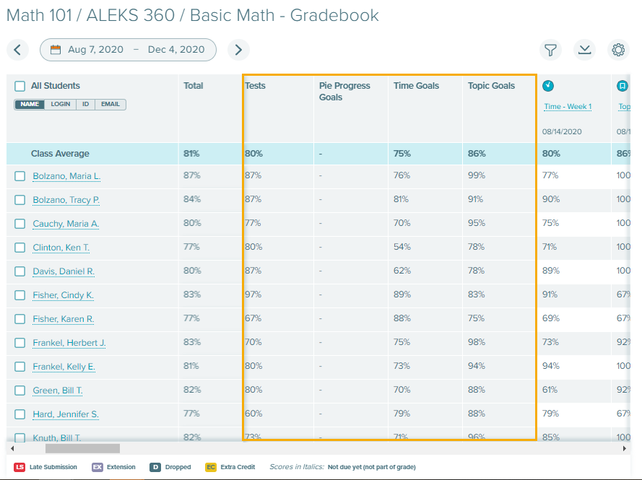
What’s inside the Gradebook?
With Settings -> Display Options, you’ll see the option to show Category Totals. When Category Totals is selected, a column to show the totals for each Gradebook Category by student is inserted into the Gradebook table before the columns of assignments.

Slide 7
What’s inside the Gradebook?
6. Checking the box next to All Students selects all students listed in the Class Gradebook and presents the option to message students in ALEKS.
7. The Gradebook Legend defines the colored badges within the gradebook that indicate late submission, extension, dropped, and extra credit. Scores in Italics indicate that the due date hasn’t passed yet, therefore they aren’t part of the grade.
8. Selecting the assignment name in a column opens a popup with details about the assignment and edit options.
9. The first row shows Class Average.
10. To help you orient yourself, note that hovering over a row or column header outlines the header in dark blue.

Slide 8
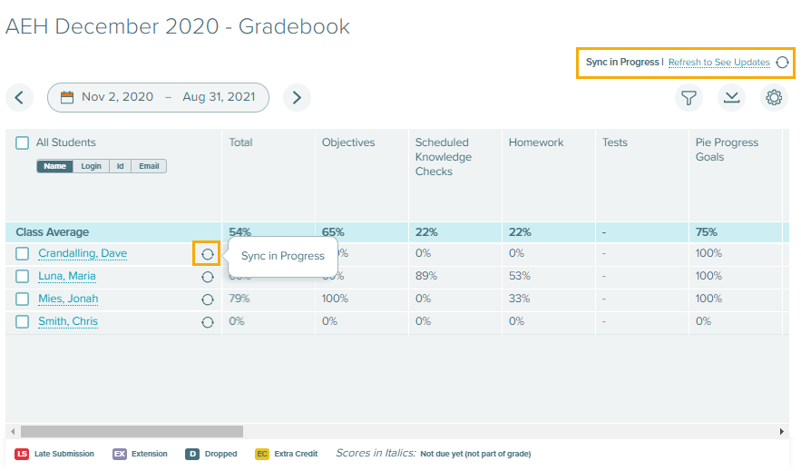
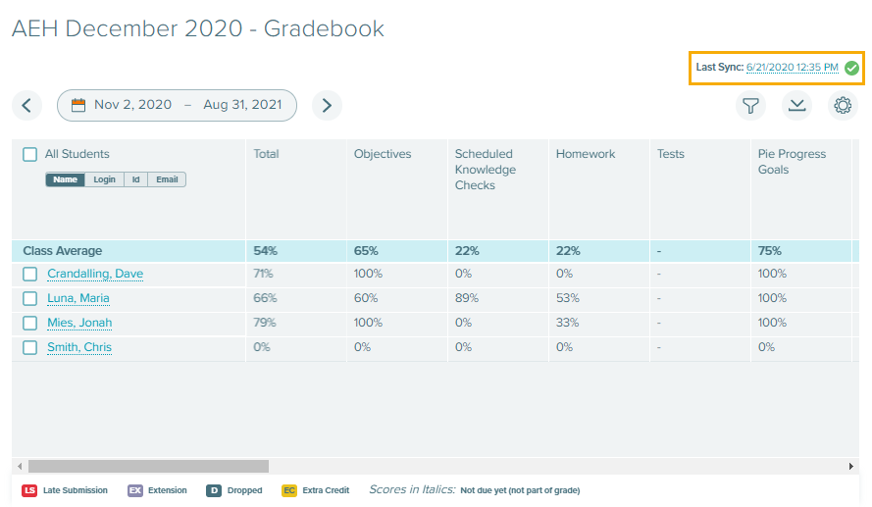
What’s inside the Gradebook?
If you’re using an LMS, you’ll also see sync status above these three icons. It will tell you when a sync is in progress and when the last sync occurred.

Slide 9
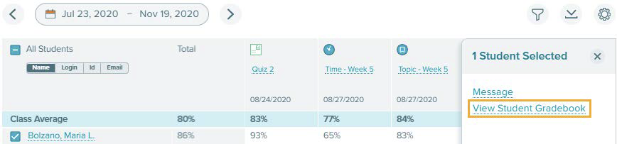
Navigating from the Gradebook
To get to the Student Gradebook from the Class Gradebook, click on the linked name. Note, you can also message the student or a group of students by clicking the check box next to the name.

Slide 10
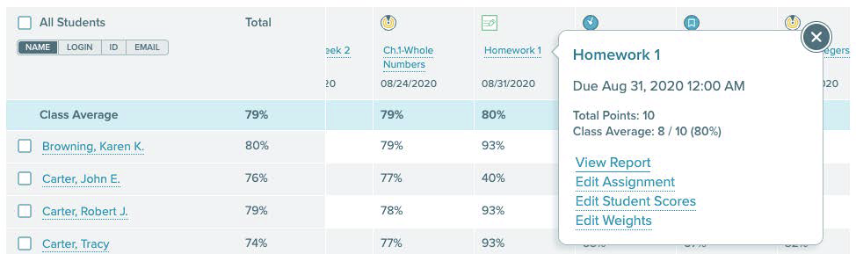
Navigating from the Gradebook
You can also quickly navigate to assignment-level reporting from the Gradebook by selecting the assignment name in the Class Gradebook, then selecting View Report. As you can see, you’re also able to quickly edit the assignment, scores, and weights from this pop out.

Slide 11
Support and Resources
TECH SUPPORT & FAQ:
CALL: (800) 258-2374
EMAIL & CHAT: aleks.com/support
MONDAY-THURSDAY: 7 AM – 1 AM EST
FRIDAY: 7 AM – 9 PM EST
SUNDAY: 4 PM – 1 AM EST
FIND MORE SUPPORT:
supportateverystep.com
FIND MORE TIPS:
mheducation.com/highered/ideas

