Slide 1
eBook Student Registration
Students

Slide 2
Make the Most of Your Time
Low-Cost
Purchase access of the eBook from your campus bookstore or directly from McGraw Hill at https://www.mheducation.com/highered
Digital Features
Highlight and take notes directly in the eBook for automatic syncing across all devices
Access to all your McGraw Hill eBooks in one location
Learn On-the-Go
Download the free ReadAnywhere app to take your eBook* and SmartBook with you – online and offline
*ReadAnywhere supports newer eBooks and SmartBook may not be available in your Connect course.

Slide 3
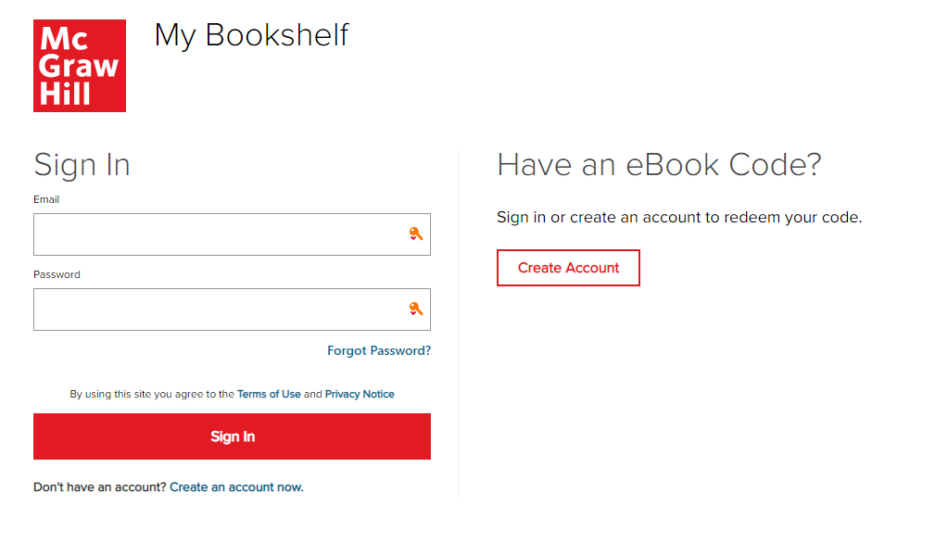
Step 1
Go to the Bookshelf website at myebooks.mheducation.com and sign in.
If you have not yet purchased your access code, you can do so at mheducation.com, and from there, you will be taken directly to your Bookshelf.

Slide 4
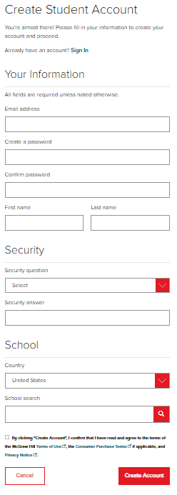
Step 2
If you don’t have a Connect account, you can create it now. We recommend using your school email address so that all your courses are in one Connect account.
It is essential that you use the same username and password when you login to both the Bookshelf site and the ReadAnywhere app so you have full access to your account.

Slide 5
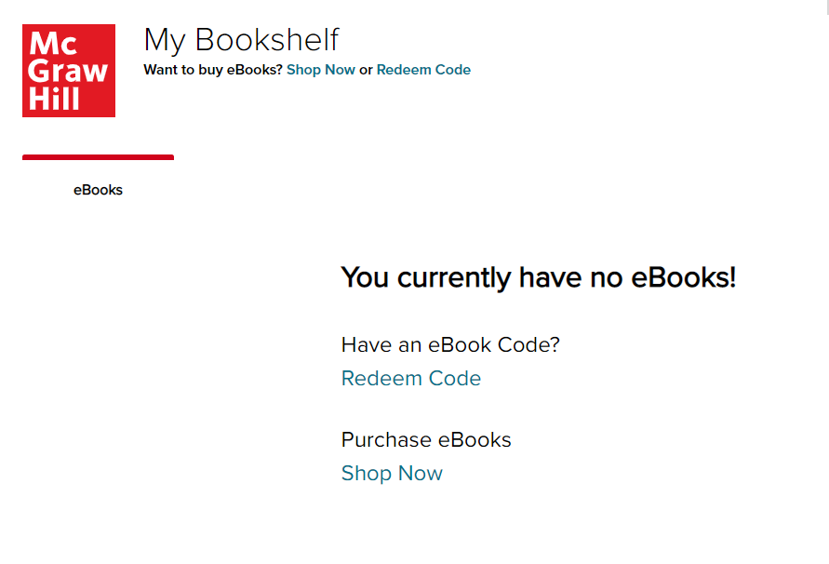
Step 3
If you purchased an access code card, go ahead and click Redeem Code to enter it now on your Bookshelf site.
Check that the correct title and edition for your textbook comes up in the bookshelf before you complete the process.
Now when you sign into your Bookshelf account, you’ll have access to all your McGraw Hill eBooks, including any that you have with a Connect course.

Slide 6
Support and Resources
TECH SUPPORT & FAQ:
CALL: (800) 331-5094
EMAIL & CHAT: WWW.MHHE.COM/SUPPORT
MONDAY-THURSDAY: 24 hours
FRIDAY: 12 AM - 9 PM EST
SATURDAY: 10 AM - 8 PM EST
SUNDAY: 12 PM – 12 AM EST
FIND MORE TIPS:
WWW.SUPPORTATEVERYSTEP.COM

