Slide 1
SmartBook 2.0 Reports
Connect Training Series
Instructors

Slide 2
Using Reports to Understand Course Data
For instructors, SmartBook 2.0 tracks student progress and provides insights that guide teaching strategies and advanced instruction, for a more dynamic class experience.
To this end, SmartBook 2.0 reporting data is viewed by individual assignment, and the data is available in a variety of reports.
The SmartBook 2.0 reporting dashboard is broken into a series of five tiles that give you a variety of data on your course and your students.

Slide 3
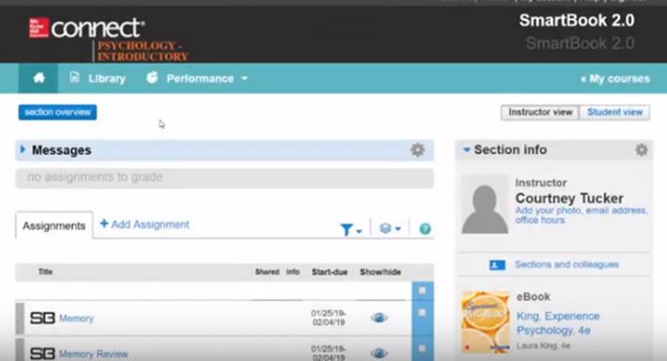
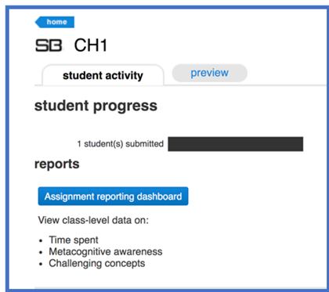
Locating SmartBook 2.0 Reports
On the section home page. In the middle of the page, locate the Assignments tab. Under the Assignments tab is a list of your assignments.
Click on a SmartBook 2.0 assignment.
Under the Student Activity tab, click on the Assignment Reporting Dashboard button.

Slide 4
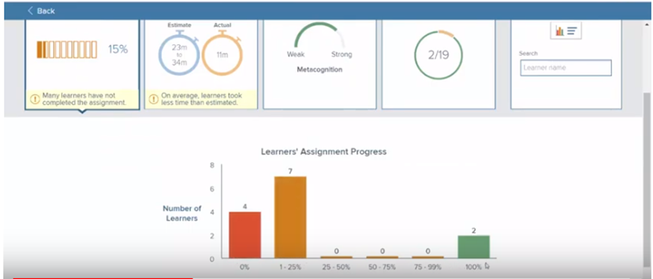
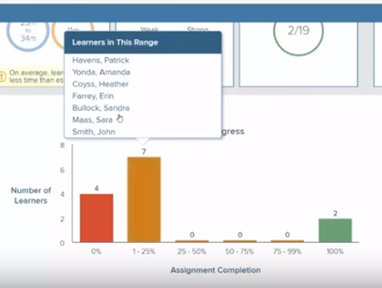
The SmartBook 2.0 Dashboard – First Tile
The first tile shows what percentage of students have completed the assignment.
Below this tile is a bar chart arranged by number of students in each percentage of completion category.
Clicking a bar shows a list of students who fall into that completion percentage.

Slide 5
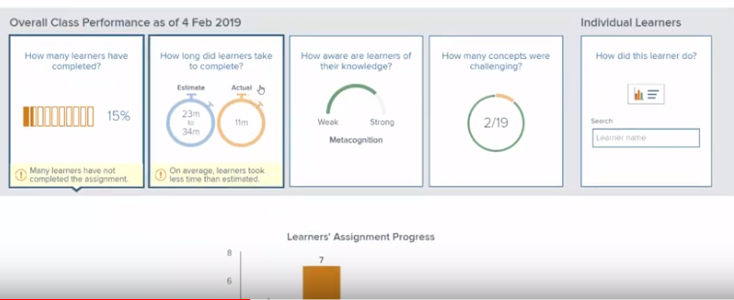
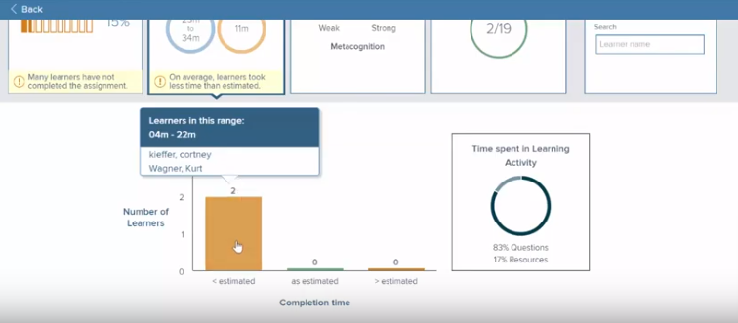
The SmartBook 2.0 Dashboard – Second Tile
The second tile shows the estimated time of completion versus actual time of completion.
In this example, the estimated time was 23 to 34 minutes.
Below this tile is a breakdown of who was below the estimate, who was as estimated, and who was over the estimate.
To the right of the bar graph, you’ll also see how much time they're spending in the assignment on questions versus looking at resources.

Slide 6
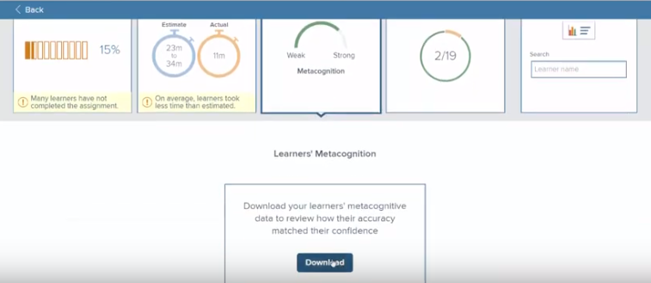
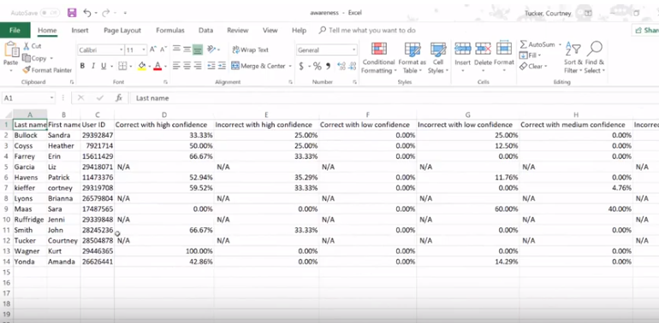
The SmartBook 2.0 Dashboard – Third Tile
By clicking on the metacognition tile, you’re able to download a report.
In the report you’ll see when the students were correct or incorrect along with what level of confidence they chose —high, low or medium.

Slide 7
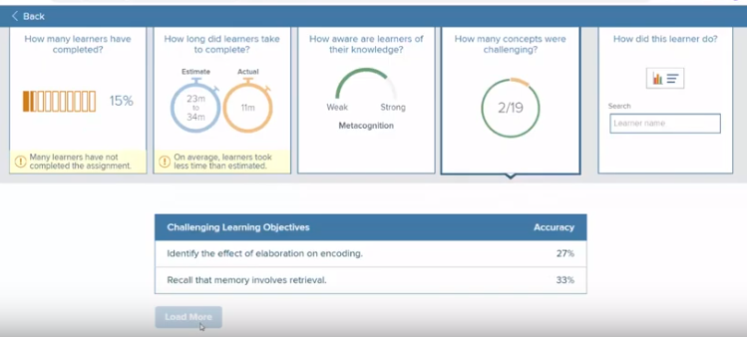
The SmartBook 2.0 Dashboard – Fourth Tile
The fourth tile identifies challenging concepts.
In this example, you’ll see that 2 out of 19 total concepts have been identified as challenging.
By clicking on this tile, the list of challenging concepts populates below. Concepts are defined as “challenging” when the accuracy is less than 65% across the class.
For additional challenging concepts, click on the Load More button.

Slide 8
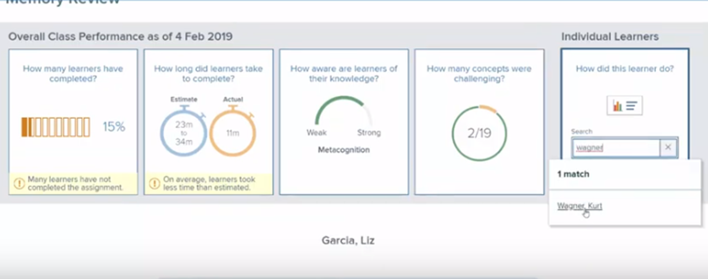
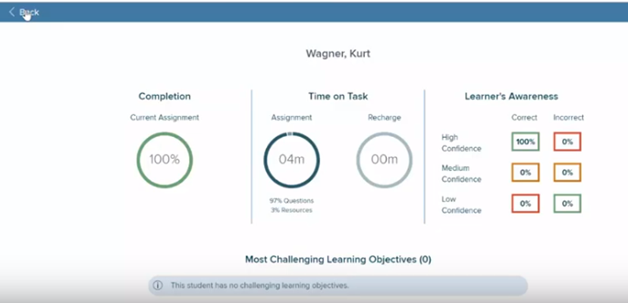
The SmartBook 2.0 Dashboard – Fifth Tile
The fifth tile on the dashboard provides data on individual learners. In this tile, you can search by student name.
Here you’ll see data for completion percentage, time on task, if the assignment and recharge have been completed and the learner’s awareness or confidence levels.
Below the student summary, you can view that individual student’s list of challenging learning concepts.

Slide 9
Support and Resources
TECH SUPPORT & FAQ:
CALL: (800) 331-5094
EMAIL & CHAT: mhhe.com/support
MONDAY-THURSDAY: 24 hours
FRIDAY: 12 AM - 9 PM EST
SATURDAY: 10 AM - 8 PM EST
SUNDAY: 12 PM – 12 AM EST
FIND MORE SUPPORT:
supportateverystep.com
FIND MORE TIPS:
mheducation.com/highered/ideas

