Slide 1
SmartBook 2.0 Overview
Connect Training Series
Instructors

Slide 2
What is SmartBook 2.0?
Available within Connect, SmartBook 2.0 personalizes learning to individual student needs, continually adapting to pinpoint knowledge gaps and focus learning on concepts requiring additional study.
For instructors, SmartBook 2.0 tracks student progress and provides insights that guide teaching strategies and advanced instruction, for a more dynamic class experience.

Slide 3
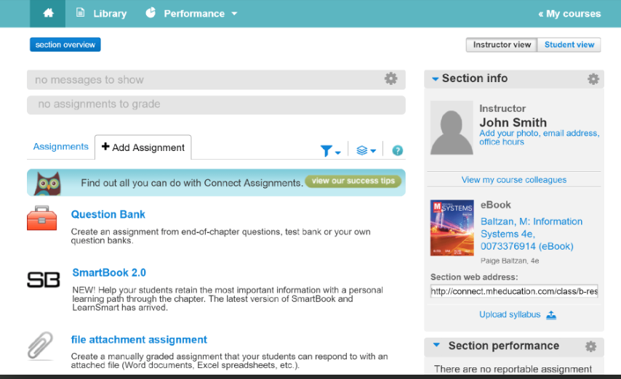
SmartBook 2.0 Assignments
SmartBook 2.0 is a specific assignment type where students are required to engage with reading material and answer questions.
Instructors must create assignments for students to use SmartBook 2.0.

Slide 4
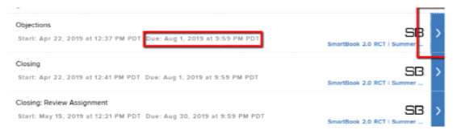
Student Experience
To understand how SmartBook 2.0 works, let’s begin with the student experience.
Once assigned, SmartBook 2.0 assignments will appear on the student’s assignment list. A SmartBook 2.0 assignment is indicated by the SB icon.

Slide 5
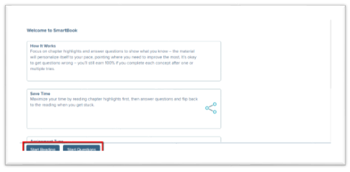
Start Options
Upon opening the first SmartBook 2.0 assignment, the student will be taken to a Welcome page that provides a quick tutorial.
Next, the student may either Start Reading or Start Questions. For the most effective learning experience, students should always Start Reading first.

Slide 6
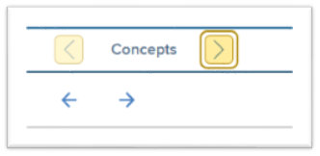
Reading the Chapter
Next, the student will be prompted to read the chapter and focus on the highlighted concepts.

Slide 7
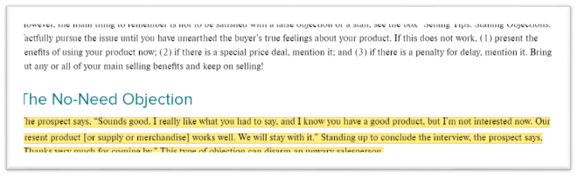
Highlights
These highlights will be determined by you through the assignment creation process.

Slide 8
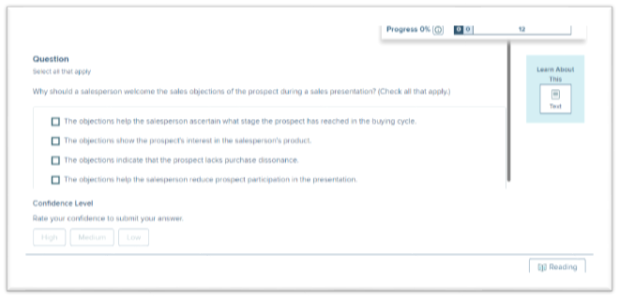
Question Mode
Once they’ve finished reading, they will be presented with questions.

Slide 9
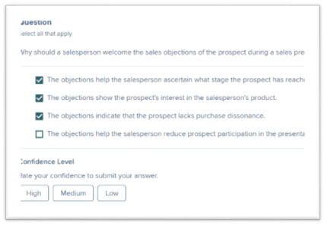
Adaptive Experience
On the question page there is
the question
a confidence rating
a progress bar in the top right corner of the page.
To complete a question, the student selects an answer AND rates confidence in the answer.
This is where SmartBook 2.0 begins to adapt to an individual student. The confidence level encourages them to assess their own level of understanding. Behind the scenes, SmartBook 2.0 is learning to pinpoint what a student really understands and where they might need additional help.

Slide 10
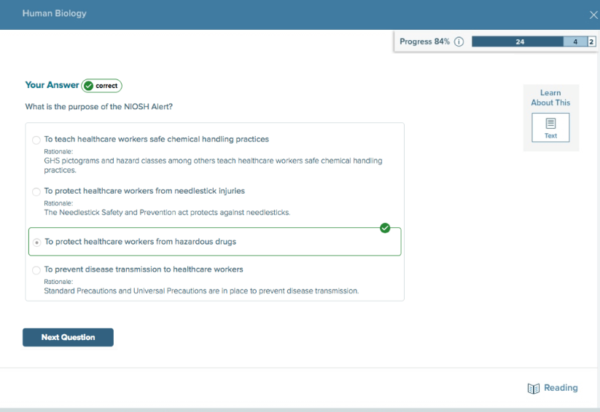
Feedback
Students receive immediate feedback for both correct and incorrect answers throughout the assignment.

Slide 11
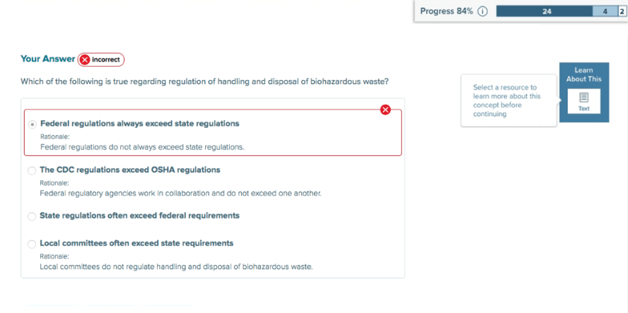
“Learn About This”
In the event students are clearly struggling with a concept, SmartBook 2.0 will force a pause in the questions and direct students to “Learn About This.”
This guidance into the reading resolves their knowledge gap on a concept before allowing them to proceed with more questions.

Slide 12
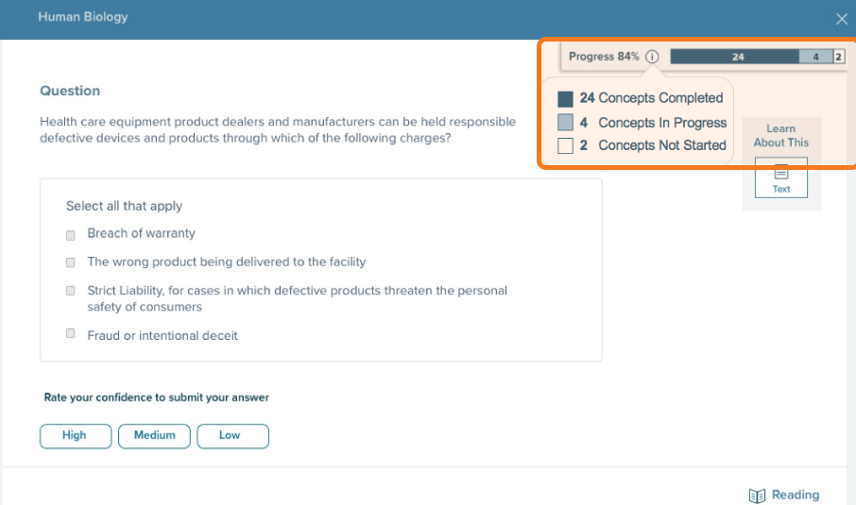
Assignment Progress
The progress bar breaks down assignment progress into three categories: concepts not started, concepts in progress, and concepts completed.
Only concepts that are currently being worked on (which is a maximum of 5 at any one time) are shown in the light blue section.

Slide 13
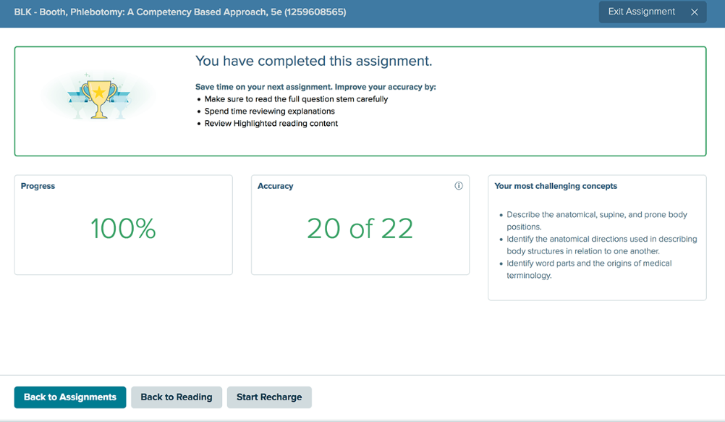
Progress Reports
Immediate real-time reports follow each assignment.

Slide 14
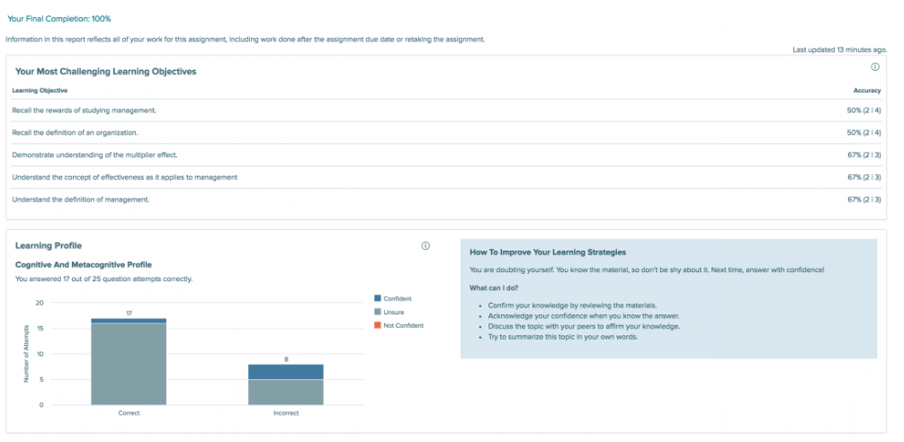
Improving Learning
Students utilize the progress reports to track overall progress, as well as receive strategies to improve learning.

Slide 15
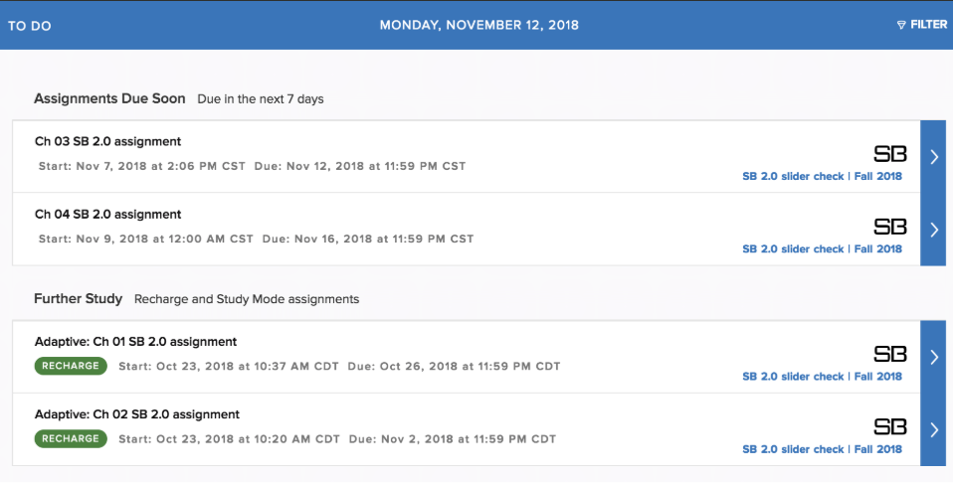
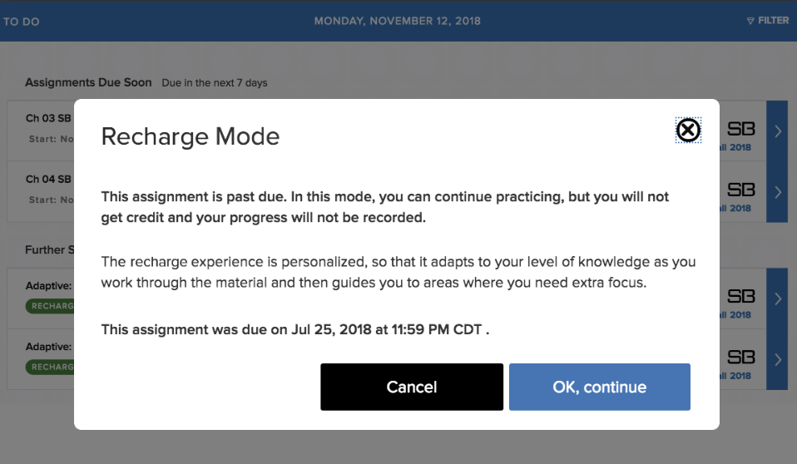
Recharge
At any time, students can review and recharge their learning.
Once an assignment is past the due date, the assignment enters Recharge mode. Recharge allows students to continue practicing concepts and receiving feedback, but progress is no longer recorded.

Slide 16
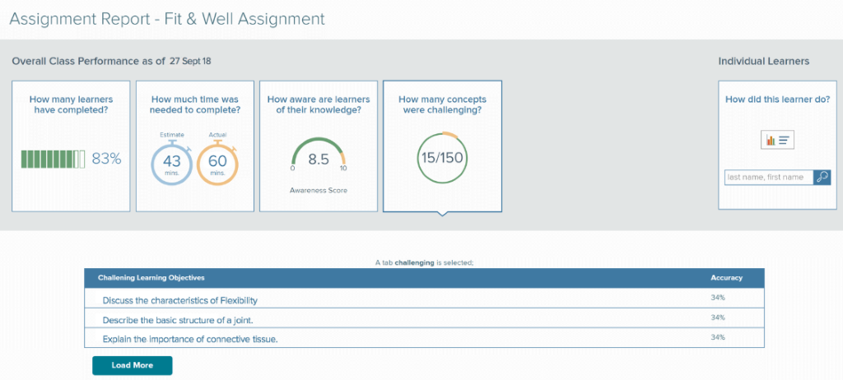
Dynamic Class Experience
For instructors, SmartBook 2.0 tracks student progress and provides insights that guide teaching strategies for a more dynamic class experience.

Slide 17
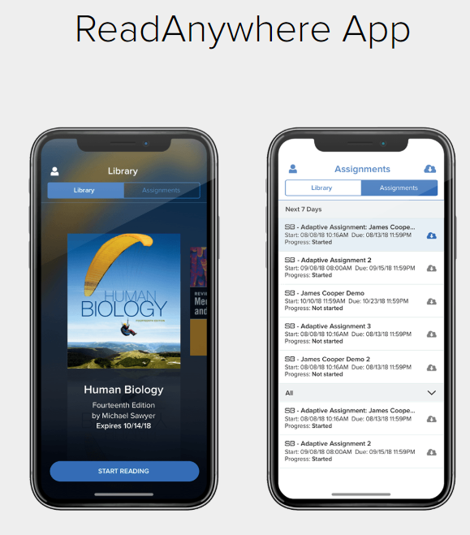
ReadAnywhere App
Just like our eBook, SmartBook 2.0 is available in our ReadAnywhere app for mobile use on smart devices.

Slide 18
Support and Resources
TECH SUPPORT & FAQ:
CALL: (800) 331-5094
EMAIL & CHAT: mhhe.com/support
MONDAY-THURSDAY: 24 hours
FRIDAY: 12 AM - 9 PM EST
SATURDAY: 10 AM - 8 PM EST
SUNDAY: 12 PM – 12 AM EST
FIND MORE SUPPORT:
supportateverystep.com
FIND MORE TIPS:
mheducation.com/highered/ideas

