Slide 1
Assigning SmartBook 2.0
Connect Training Series
Instructors

Slide 2
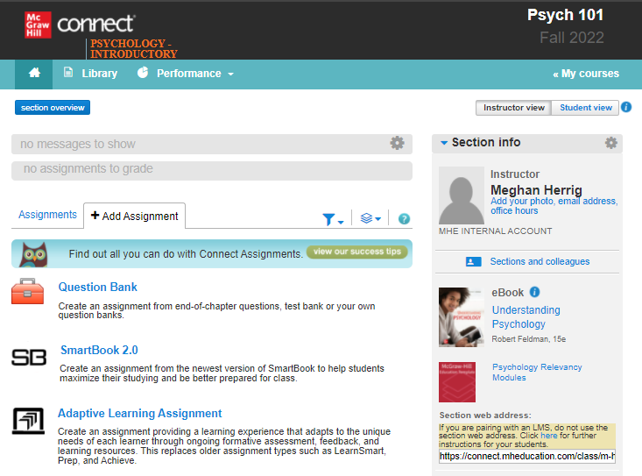
Add a SmartBook Assignment
Starting on your Connect section home page, click Add Assignment to view all assignment options.
To create a SmartBook assignment, click on SmartBook 2.0.

Slide 3
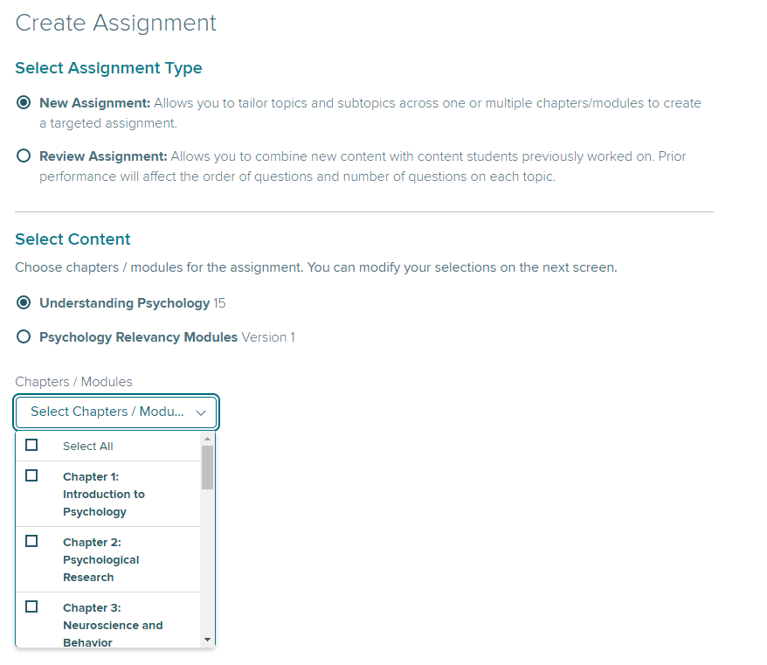
New Assignment
Within SmartBook 2.0, you have two assignment types: New Assignment and Review Assignment.
Under Select Assignment Type, click on New Assignment.
Under Select Content click desired chapter(s) and then click Continue at the bottom of the page.

Slide 4
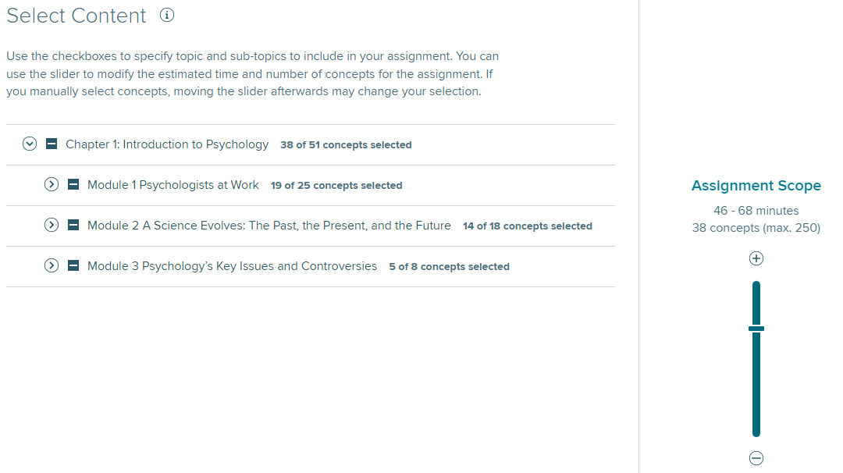
Slider Bar
You have three main starting points for selecting chapter content: slider bar, section, or learning objective.
The first option is the Slider Bar.
By moving the slider bar down, you decrease the depth of coverage, which results in less time to complete.
This strategy is effective when you want to include broad coverage but control the estimated Time to Complete.

Slide 5
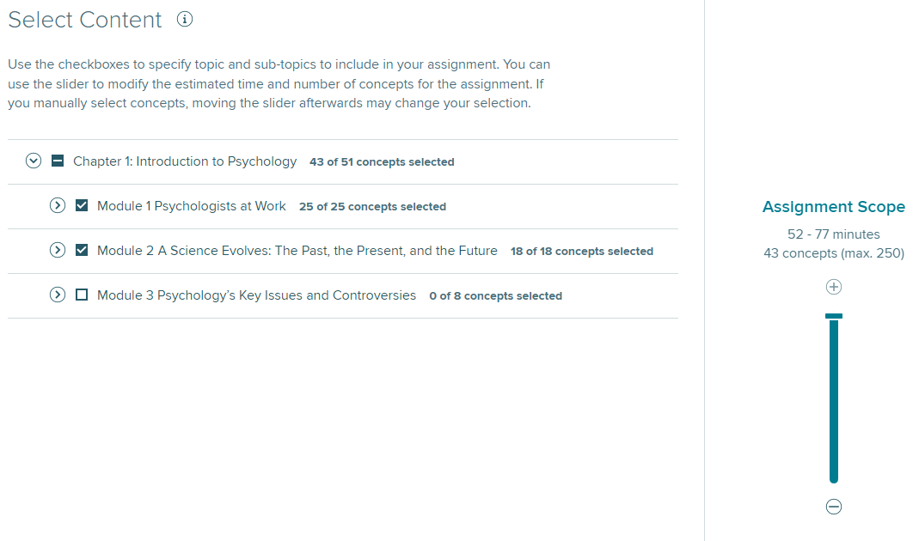
Assign by Section
The second option is to select content based on Section.
By default all content will be selected.
To delete an entire section, click on the check box at the section header.
Note: If you manually select concepts, moving the slider afterwards may change your selection.

Slide 6
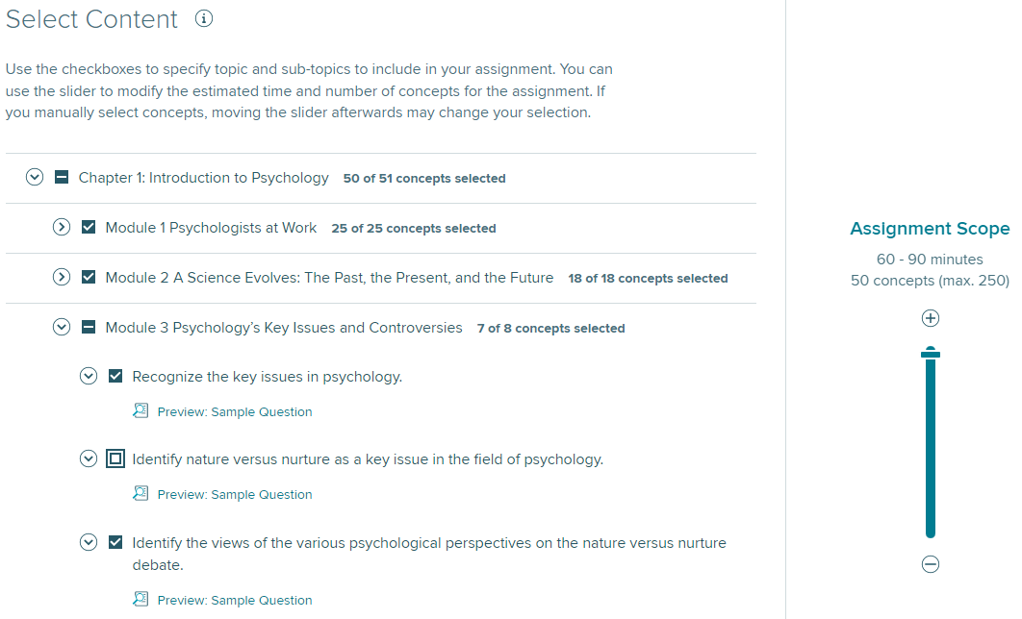
Assign by Learning Objectives
Selecting content based on Learning Objectives, results in the most specific content coverage.
To view content by learning objectives, simply expand the Section and Sub-section, then choose deselect content you do not wish to cover by Learning Objectives.
Note: If you manually select concepts, moving the slider afterwards may change your selection.

Slide 7
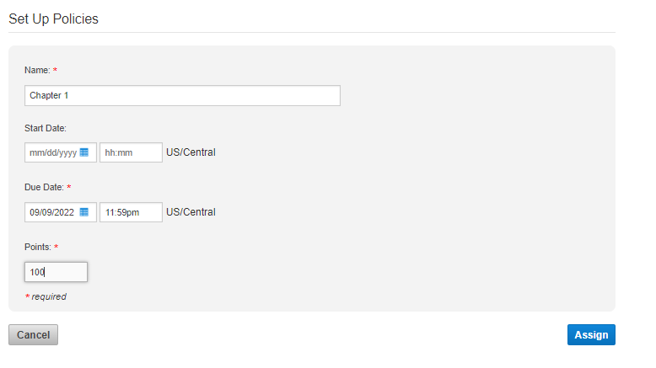
Set Up SmartBook Assignment Policies
To complete assignment set up the next screen will ask you to give the assignment a name, set a due date and set points possible. When done, click Assign.

Slide 8
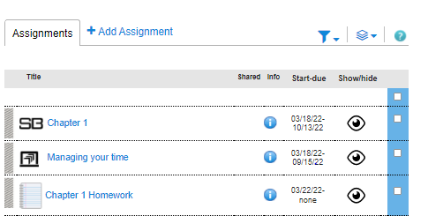
SmartBook Assignment on Course Homepage
Your assignment can now be found on the course homepage.

Slide 9
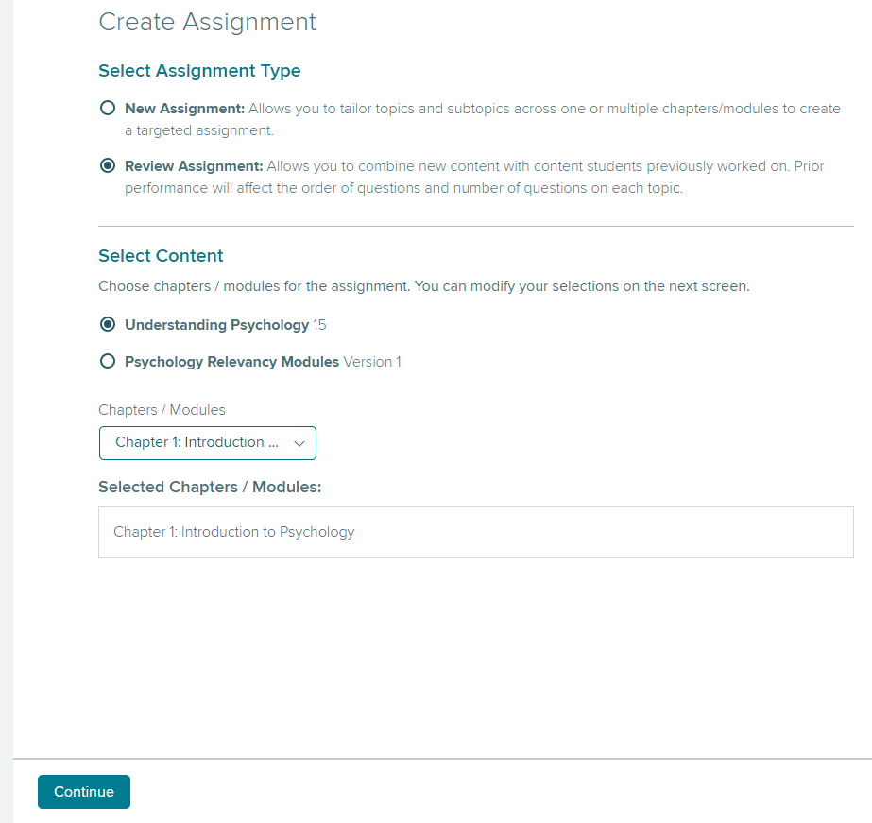
Review Assignment
Creating a Review Assignment is the same process as creating a New Assignment. The difference is that review assignments incorporate a student's previous performance to create a personalized review experience.
To get started, click on Review Assignment, select content and then click Continue at the bottom of the page and assign as in previous steps.

Slide 10
Review Assignment Notes
Review Assignments serve two primary purposes:
To create review assignments that include previously assigned chapters—typically for test preparation or course review.
To create assignments based on topic rather than chapter—review assignments allow instructors to select content from various chapters.
Note: For the Review Assignment to be a direct reflection of the previously assigned content, the Review Assignment must be created using the exact same Learning Objectives.
Otherwise, the Review Assignment could potentially cover content that has not been previously assigned.

Slide 11
Recharge Mode
Note: With SmartBook 2.0, students can no longer access SmartBook in self-study mode.
Content MUST be assigned for students to access SmartBook.
To create self-study opportunities, you may assign content for ZERO points.
Additionally, assignments that are past due convert to Recharge mode—which allows students to continue practicing concepts and receiving feedback, but progress is no longer recorded.

Slide 12
Support and Resources
TECH SUPPORT & FAQ:
CALL: (800) 331-5094
EMAIL & CHAT: WWW.MHHE.COM/SUPPORT
MONDAY-THURSDAY: 24 hours
FRIDAY: 12 AM - 9 PM EST
SATURDAY: 10 AM - 8 PM EST
SUNDAY: 12 PM – 12 AM EST
FIND MORE TIPS:
WWW.SUPPORTATEVERYSTEP.COM

