Slide 1
Where to go for help
Connect Training Series
STUDENTS

Slide 2
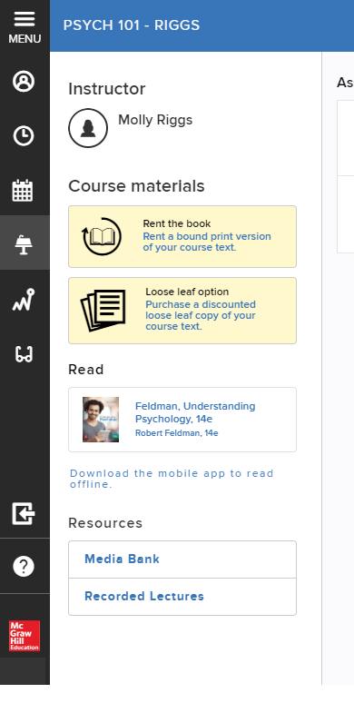
Digital Technical Support
Prior to entering your Connect course, access the support site directly at mhedu.force.com/CXG.
From within your Connect course, locate the course menu on your home page.
If your course menu is in banner mode, scroll to the bottom and click on the question mark icon.

Slide 3
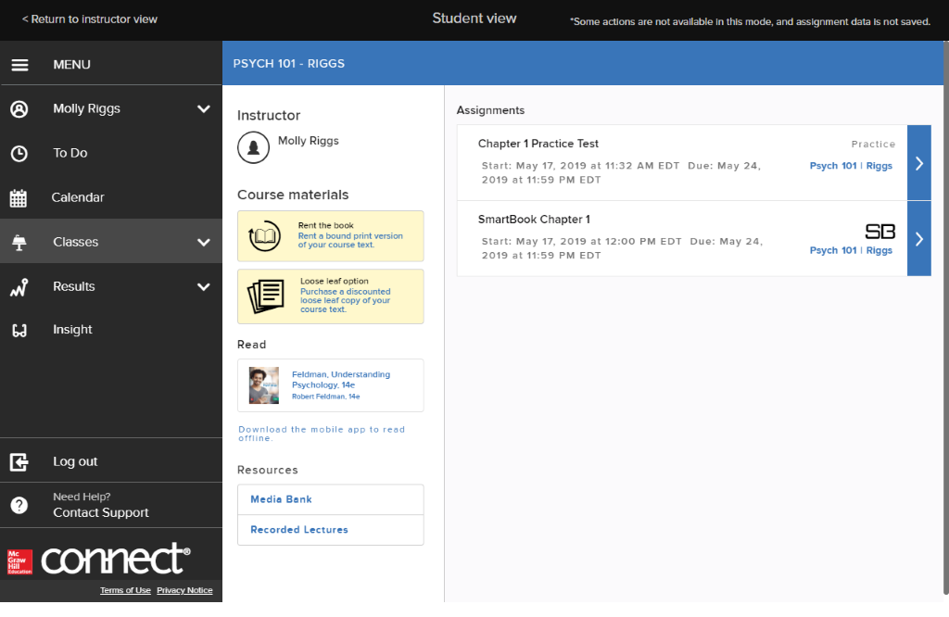
If your course menu is in expanded mode, scroll to the bottom and click on “Need Help? Contact Support.”

Slide 4
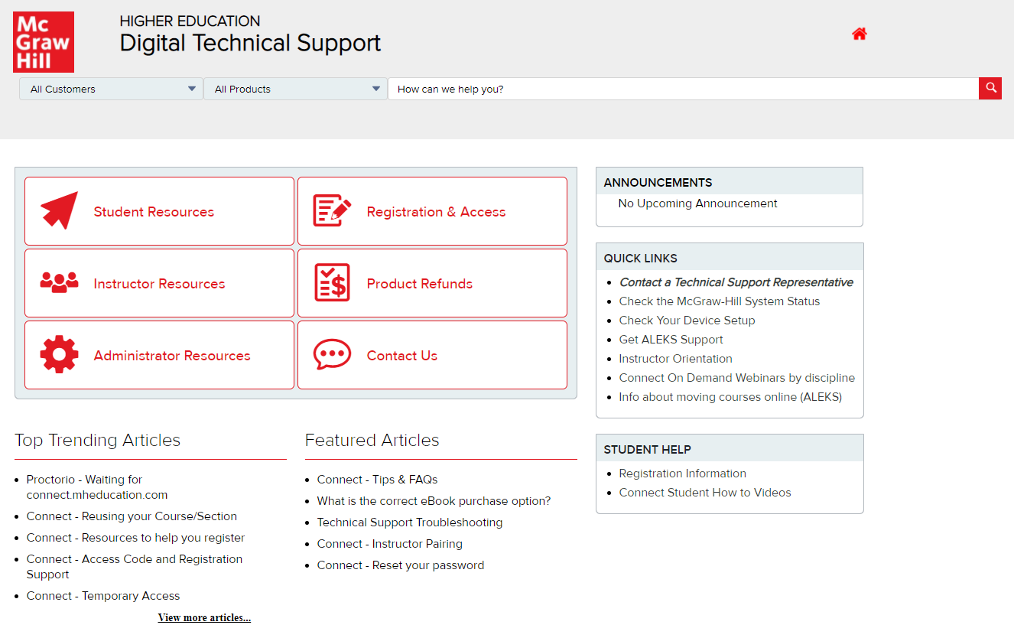
You will be sent to the support home page.

Slide 5
Support Details
On the support site, you can search to find a solution, or you contact a customer support agent via
Email
Chat
Phone
Save your case number!
When contacting a support agent, you will always receive a case number.
It will be important to save this case number if additional follow-up or documentation is needed.

Slide 6
Support and Resources
TECH SUPPORT & FAQ:
CALL: (800) 331-5094
EMAIL & CHAT: WWW.MHHE.COM/SUPPORT
MONDAY-THURSDAY: 24 hours
FRIDAY: 12 AM - 9 PM EST
SATURDAY: 10 AM - 8 PM EST
SUNDAY: 12 PM – 12 AM EST
FIND MORE TIPS:
WWW.SUPPORTATEVERYSTEP.COM

