Slide 1
Viewing Grades
Connect Training Series
Student

Slide 2
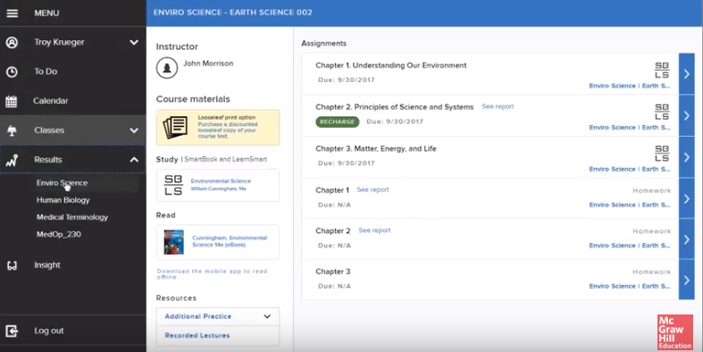
Results Tab
In this tutorial, we’ll discover how to view your grades.
Begin by navigating to the upper left corner of your home page and click on the Menu icon. Next, click on the Results tab and select your course.

Slide 3
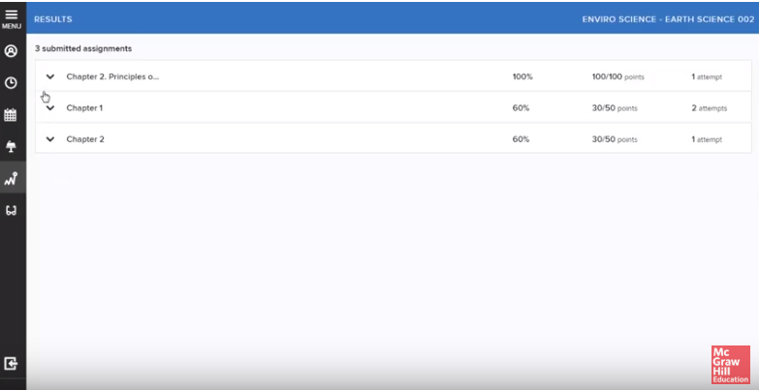
Viewing Results
On your course results page, you’ll see a list of your graded assignments, scores and number of attempts.
Your score will be provided in either points, percentages, or both—depending on how your instructor set up the course.

Slide 4
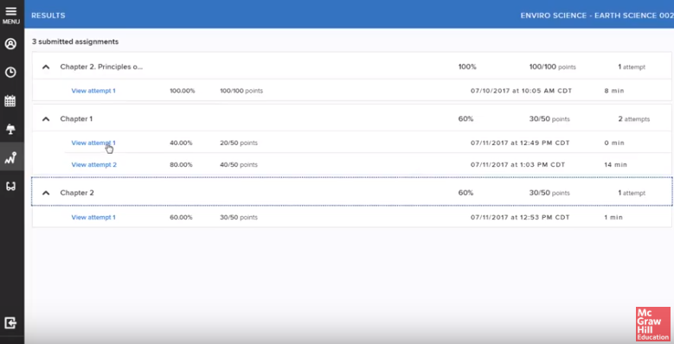
Individual Attempt Grades
For detail on your individual attempts, click the down arrow to the left of the assignment title.
You can see scores for each attempt, as well as the date and time of submission and time on task.

Slide 5
Feedback
After an assignment has been submitted and graded, you will receive feedback for each individual question.
Reviewing assignment feedback allows you to learn from incorrect answers.
To view assignment feedback, click View Attempt.

Slide 6
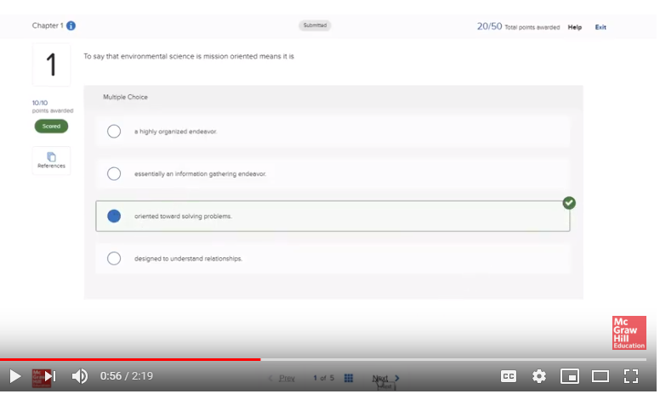
Seeing Correct Answers
To see the correct answers, click the blue show correct answers button.
To return to seeing what you answered originally, click show my answers.
To navigate through the questions, use the Next button.
To return to the Results page, click on the Menu icon, then click on the Results tab.

Slide 7
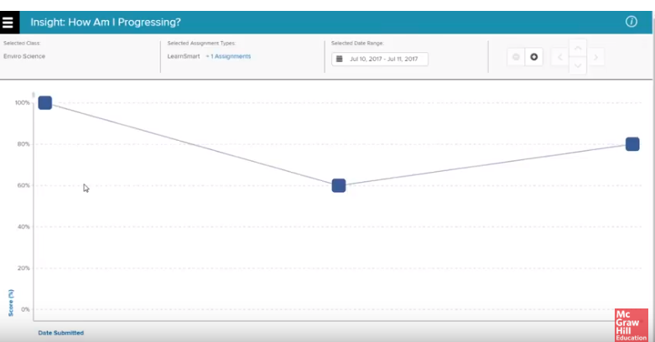
Insight
Navigate to the upper left corner of your home page and click on the Menu icon.
Next, click on the Insight tab.
Insight is a visual tool designed to chart your course progress.
For example, in the “How Am I Progressing” view, each data point represents a submitted assignment.

Slide 8
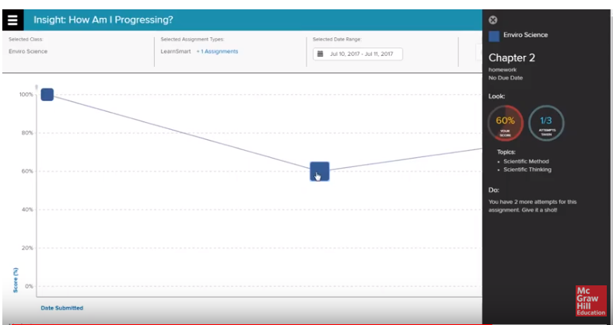
Insight Details
Assignment details may be viewed by clicking on each data point.
Assignment details will provide helpful tips, such as, you may still have additional attempts. This helpful feedback could result in improved grades.
To exit Insight, navigate to the upper left corner of the Insight menu and click the Leave Insight.

Slide 9
Support and Resources
TECH SUPPORT & FAQ:
CALL: (800) 331-5094
EMAIL & CHAT: mhhe.com/support
MONDAY-THURSDAY: 24 hours
FRIDAY: 12 AM - 9 PM EST
SATURDAY: 10 AM - 8 PM EST
SUNDAY: 12 PM – 12 AM EST
FIND MORE TIPS:
mhhe.com/collegesmarter

