Slide 1
SmartBook 2.0 Overview
Connect Training Series
STUDENTS

Slide 2
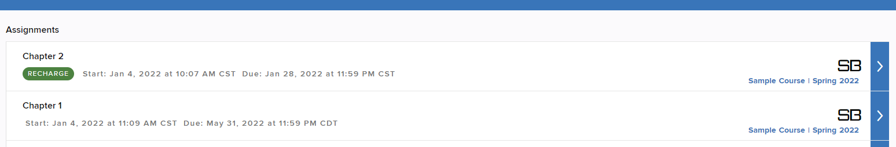
What is SmartBook?
SmartBook 2.0 is an adaptive reading experience that personalizes learning to meet your individual needs.

Slide 3
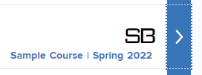
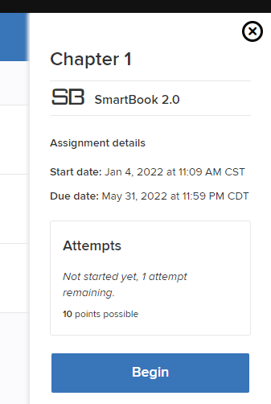
SmartBook Assignments
From your assignment list, locate a SmartBook 2.0 assignment, as indicated by the SB icon.
Click on the Blue > symbol, then click Begin.
Assignments must be completed by the indicated due date in order to receive scoring credit.

Slide 4
Recharge
It’s important to know that after the due date, scores are no longer recorded, and assignments are converted to Recharge mode.
Recharge allows you to continue practicing concepts and receiving feedback, but remember, progress is no longer recorded.

Slide 5
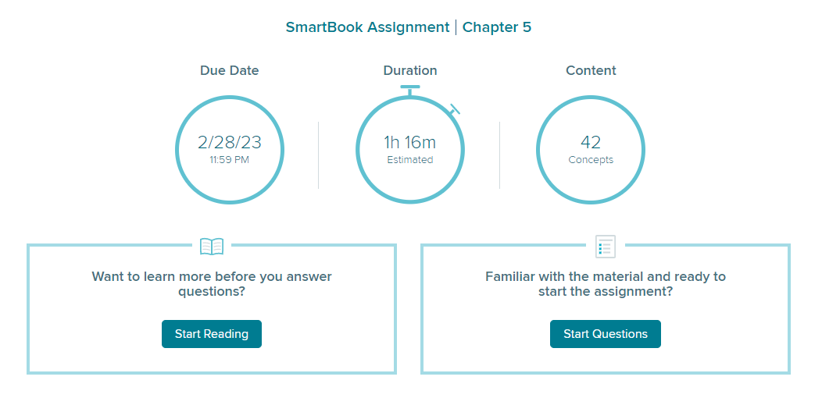
Start by Reading
After you click Begin, you will be taken to a Welcome page.
You may either Start Reading or Start Questions. For the most effective learning experience, you should always Start Reading first.

Slide 6
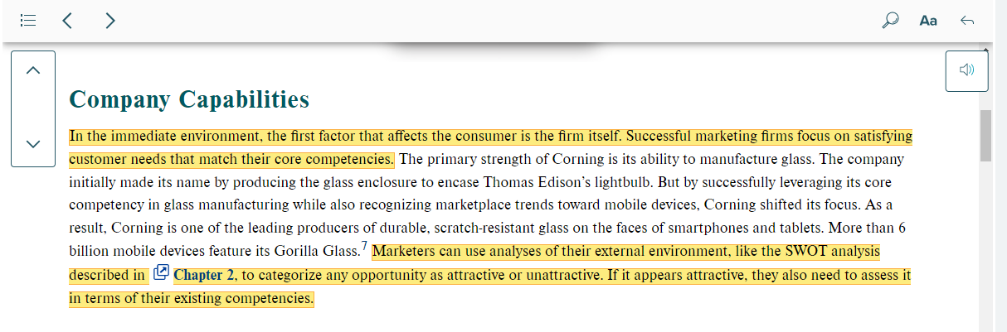
Reading in SmartBook
Here, we are taken to the chapter. You will see sections of the text have been highlighted for you. You have the option to navigate by page or by key, highlighted concepts.

Slide 7
Highlighting in SmartBook
These concepts have been selected by your instructor to highlight important learning objectives. While reading the entire chapter provides full context, you may want to focus on the highlighted content.

Slide 8
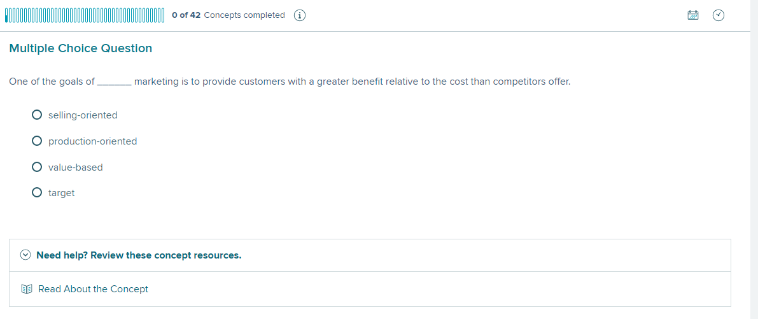
Question Mode
Once you've read through the assigned content, click To Questions to start answering questions on the key concepts you’ve just learned.
It is through the question and answer process that you will make progress towards earning the points designated for this assignment.

Slide 9
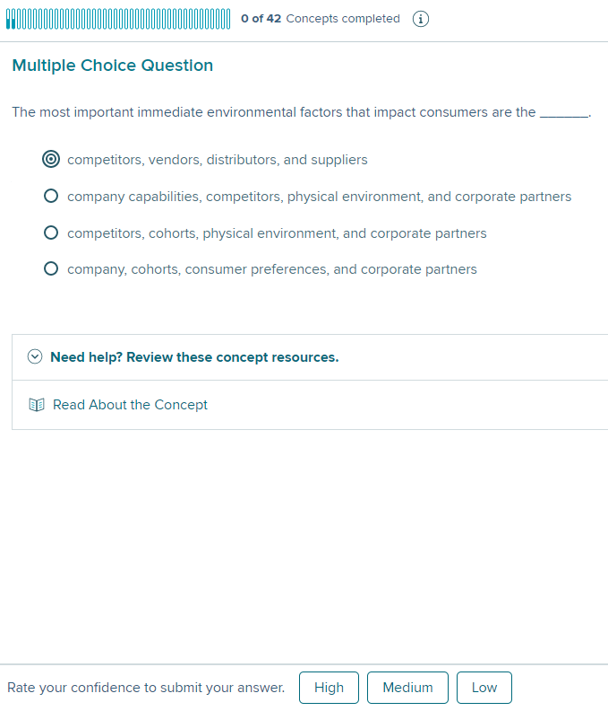
Question Format
On the question page, you will see the question, a confidence rating, and your progress bar in the top right corner of the page.
To complete a question, you will check your answer AND rate your confidence in your answer.

Slide 10
The Adaptive Experience
This is where SmartBook 2.0 begins to adapt to you.
The confidence level does NOT affect your progress bar, but it DOES encourage you to think about your level of understanding.
Behind the scenes, SmartBook 2.0 is learning to identify what you REALLY know and where you might need additional help.

Slide 11
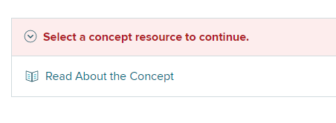
Feedback
You will receive immediate feedback for both correct and incorrect answers.
If you incorrectly answer multiple questions on the same concept, you may be provided with a learning resource—often a section of the text. This is designed to help you learn and move forward with your progress.

Slide 12
Your Score
Your assignment score will be based upon percentage complete on due date as indicated by the progress bar.

Slide 13
Things to Remember
The highlights represent key concepts, and all the questions you are answering are designed to assess them.
The light blue bar will indicate concepts you have started
The dark blue will indicate the concepts you have learned.
To demonstrate learning and advance the progress percentage, you must correctly answer multiple questions for a single concept.
Keep in mind that answering a single question correctly does not advance the progress bar—the percentage only increases when multiple questions for a single concept have been answered correctly.

Slide 14
Recharge and Grades
As a reminder, once an assignment is past the due date, the assignment enters Recharge mode.
Recharge allows you to continue practicing concepts and receiving feedback, but progress is no longer recorded.
To learn more about how to view your grades, please continue to the next tutorial, SmartBook 2.0 Student Reports.

Slide 15
Support and Resources
TECH SUPPORT & FAQ:
CALL: (800) 331-5094
EMAIL & CHAT: www.mhhe.com/support
MONDAY-THURSDAY: 24 hours
FRIDAY: 12 AM - 9 PM EST
SATURDAY: 10 AM - 8 PM EST
SUNDAY: 12 PM – 12 AM EST
FIND MORE TIPS:
www.supportateverystep.com

