Slide 1
Navigating Connect
Connect Training Series
Students

Slide 2
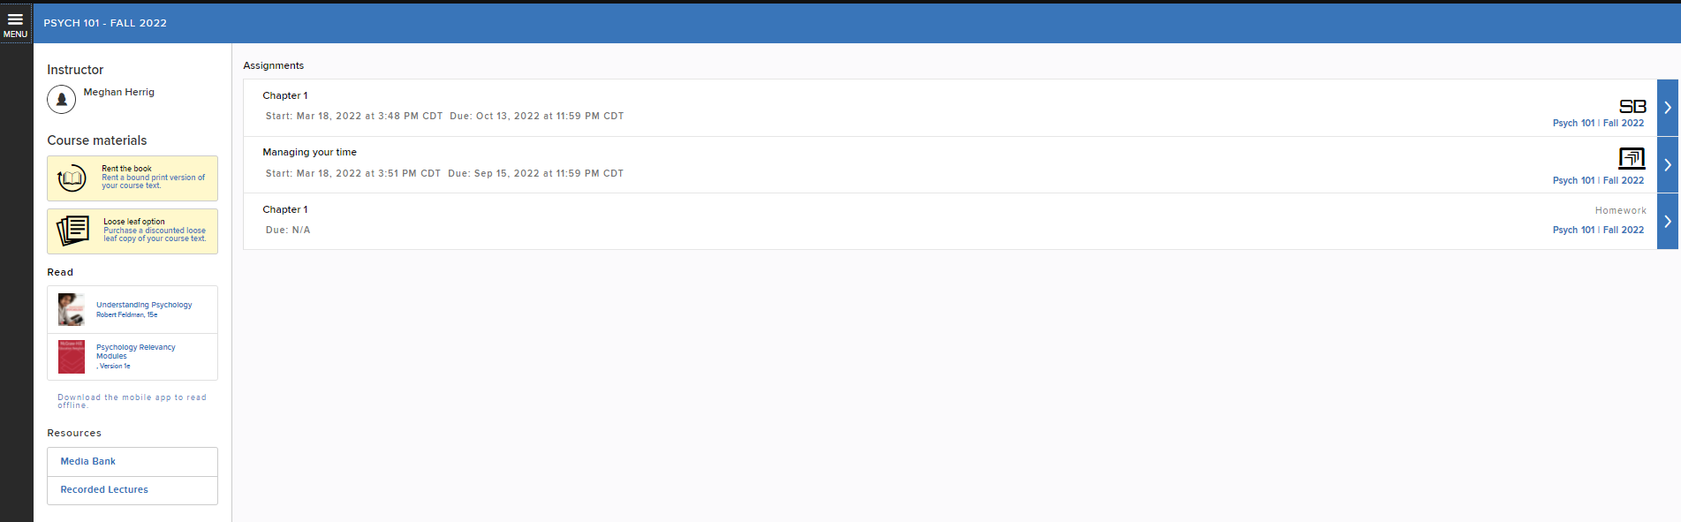
Connect Home Page
Welcome to your Connect course!
In this tutorial, we’ll explore your Connect course, which was designed with you and ease-of-use in mind!

Slide 3
Connect Home Page Details
Moving left to right, you’ll see the black menu bar, your instructor information, course materials, the eBook, access to the ReadAnywhere app, course resources, and your Assignment list.
Click on the Menu Icon located in the top left corner.

Slide 4
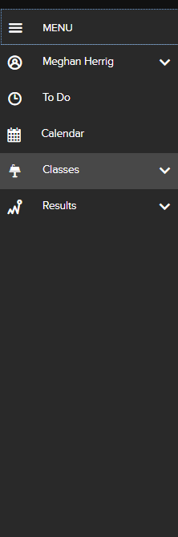
Course Menu
Your course menu provides the following tabs:
account information
a to-do list of your assignments and their due dates
a calendar view of assignments
access to all your Connect courses
your course results

Slide 5
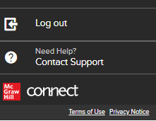
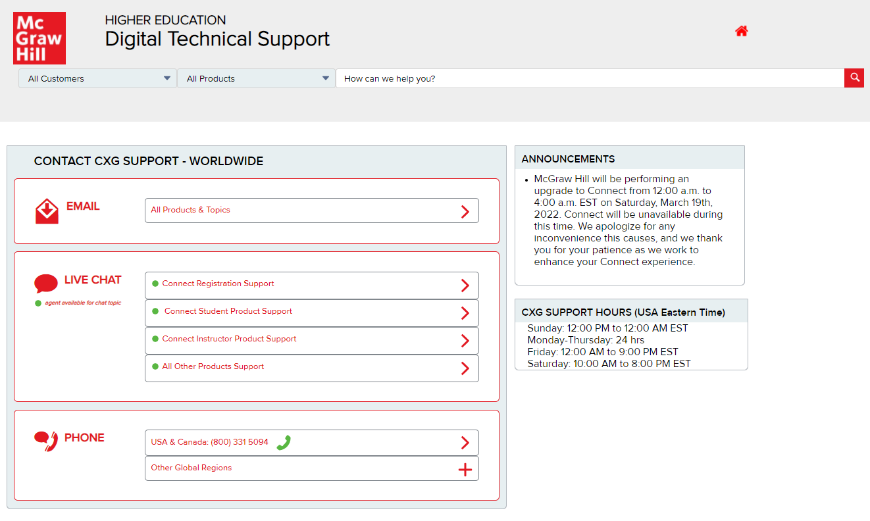
Course Menu: Support
At the bottom of the course menu, you may log out or contact our Customer Support team for immediate assistance.

Slide 6
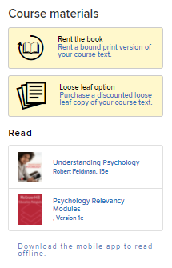
Course Home Page Details
Returning to your course home page, you will find options for accessing a printed copy of your textbook, as well as access to your eBook.
Under Read, click on the image of your textbook to open the eBook.
Just below the eBook, you’ll see “Download the mobile app to read offline,” which will provide information on the mobile app, ReadAnywhere.

Slide 7

ReadAnywhere
The ReadAnywhere app allows you to access your eBook anytime, anywhere on your smartphone or tablet, even if you’re offline.
You simply login with your Connect username and password and start reading – anywhere. ReadAnywhere is available for iOS in the Apple App Store, as well as for Androids in the Google Play store.

Slide 8
Support and Resources
TECH SUPPORT & FAQ:
CALL: (800) 331-5094
EMAIL & CHAT: WWW.MHHE.COM/SUPPORT
MONDAY-THURSDAY: 24 hours
FRIDAY: 12 AM - 9 PM EST
SATURDAY: 10 AM - 8 PM EST
SUNDAY: 12 PM – 12 AM EST
FIND MORE TIPS:
WWW.SUPPORTATEVERYSTEP.COM

