Slide 1
Completing Assignments
Connect Training Series
STUDENTS

Slide 2
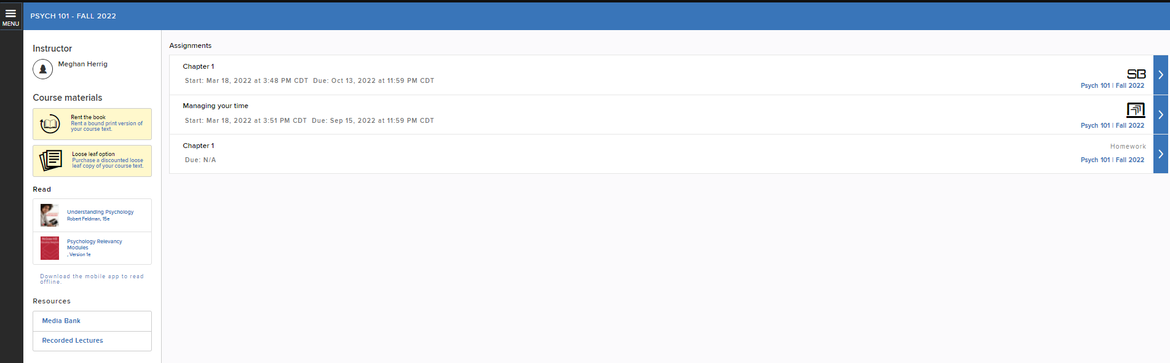
Locating Assignments
In the middle of your course home page, you’ll find your list of assignments.

Slide 3
Assignment Details
Connect offers a variety of assignment types. Your instructor has set specific policies for each assignment type.
To view these assignment details, click on the arrow at the end of the assignment line.

Slide 4
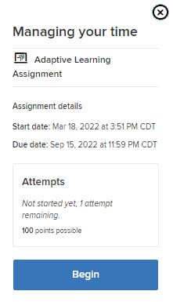
Review Assignment Details
It’s important to carefully review the assignment details before starting the assignment.
Some assignments, for example, only allow a limited number of attempts or have a time limit, so be careful before jumping in!
When you are truly ready to start the assignment, click on Begin.

Slide 5
Resources on Assignments
If your instructor allows the use of resources for assignment completion, they will be located on the left side of the page and under the question.
The references icon provides information about the question type.
Your assignment may be timed, in which case the clock will still run even if you choose to Save and Exit the assignment.
If it is not timed, you may click Save and Exit at any time to save your work and return to it later.
When you have completed the assignment, click the Submit button.
Once submitted, click the Exit button and return to the main menu.

Slide 6
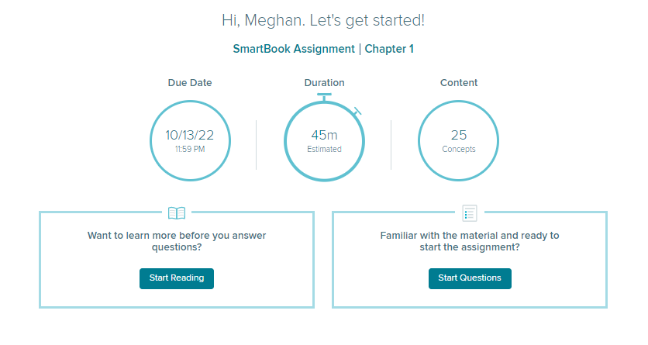
SmartBook Assignments
In addition to other assignments, Connect offers a unique assignment called SmartBook.
SmartBook provides personalized learning to you as an individual, continually adapting to pinpoint where you need help to ensure that you master the course content.

Slide 7
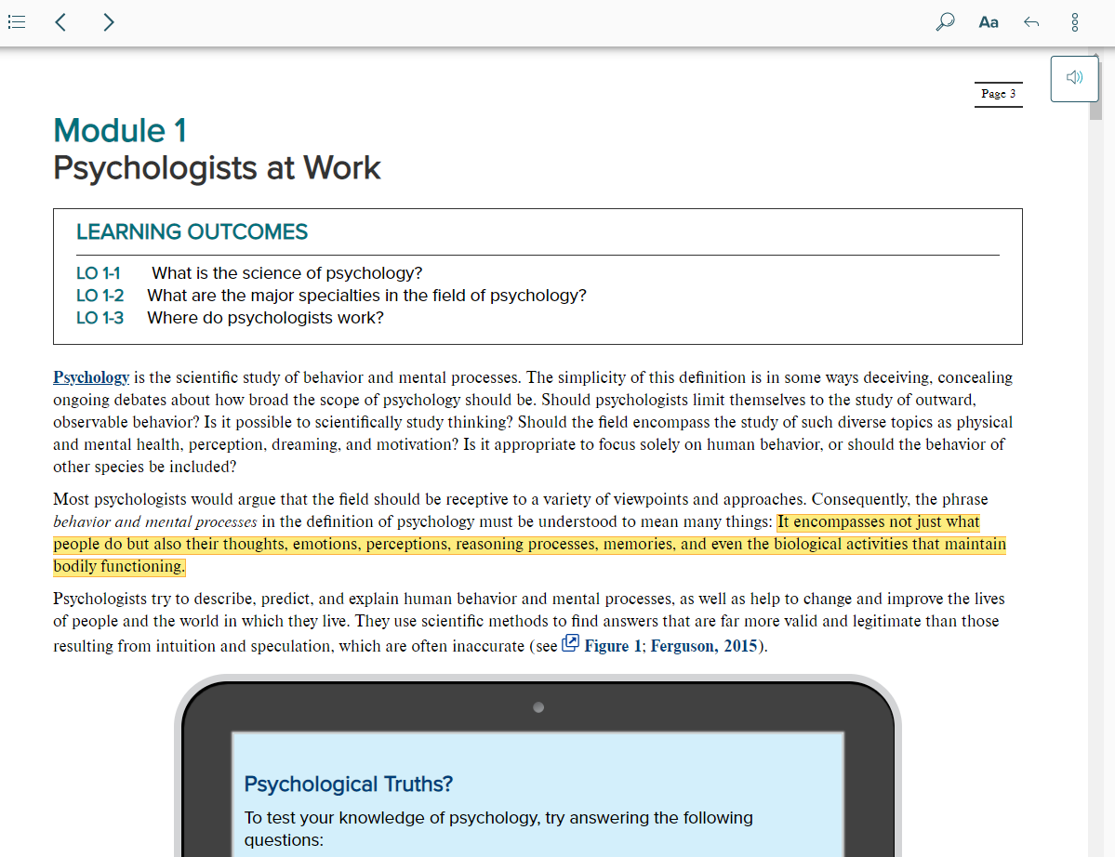

ReadAnywhere
SmartBook takes the guesswork out of what to study and helps you better prepare for class.
With the ReadAnywhere mobile app, you can now read and complete SmartBook 2.0 assignments both online and off-line.

Slide 8
Support and Resources
TECH SUPPORT & FAQ:
CALL: (800) 331-5094
EMAIL & CHAT: WWW.MHHE.COM/SUPPORT
MONDAY-THURSDAY: 24 hours
FRIDAY: 12 AM - 9 PM EST
SATURDAY: 10 AM - 8 PM EST
SUNDAY: 12 PM – 12 AM EST
FIND MORE TIPS:
WWW.SUPPORTATEVERYSTEP.COM

