Slide 1
Building Objective Gaps and Review Objectives in ALEKS

Slide 2
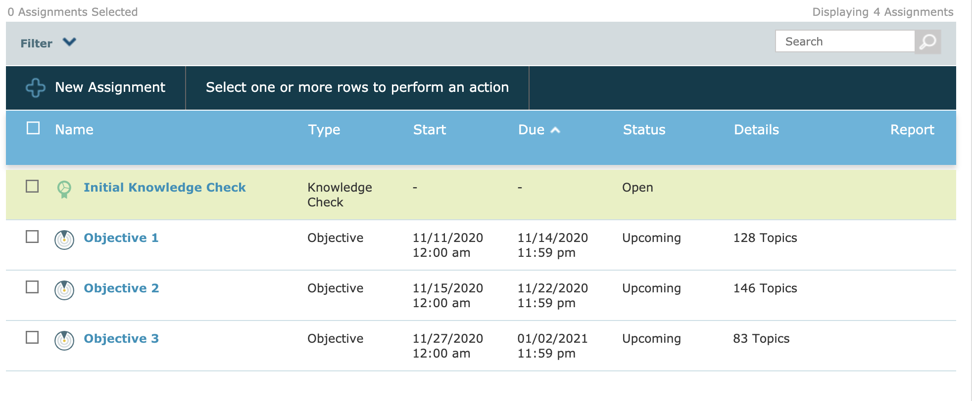
In this example course, we’ve already identified topics and Objectives and are now ready to customize the course timing, add in non-adaptive assignments and/or create review objectives.

Slide 3
From this Assignment List, you can edit Objective Start and Due dates to be continuous or include gaps between to reflect the pacing of your course or syllabus. By default, the start date of the subsequent objective will follow the due date of the current Objective, as between Objective 1 and 2.
9/15/2020

Slide 4
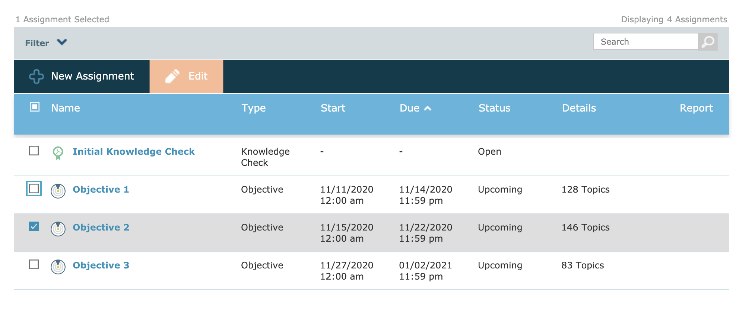
We are going to adjust our dates to leave a gap between Objectives by making Objective 2 start on the 18th instead of the default 15th. Edit the Start and Due dates by selecting the box to the left of the Objective and clicking Edit.

Slide 5
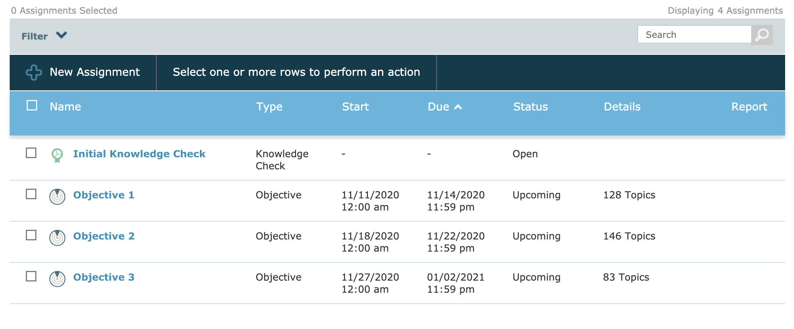
We now have a gap of four days between Objective 1 and Objective 2.

Slide 6
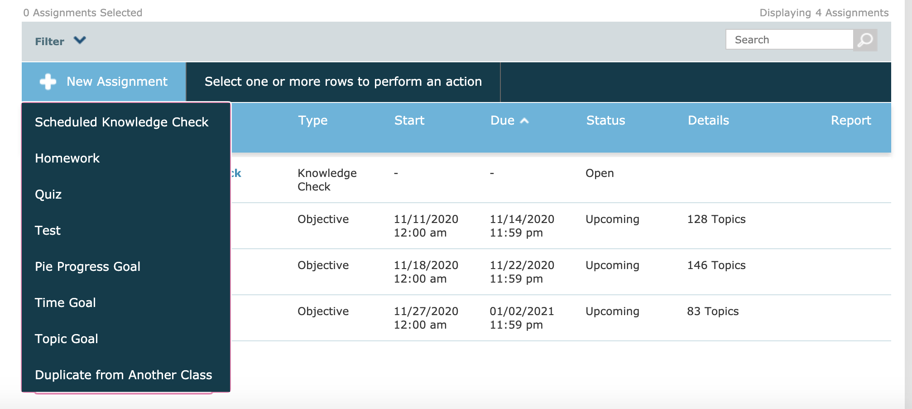
With this gap, you have a couple of options. One option is to create a non-adaptive homework assignment, test, or quiz for students to complete between Objectives. Do this by selecting "New Assignment" and choosing the appropriate assignment type. We are using Quiz in this example.

Slide 7
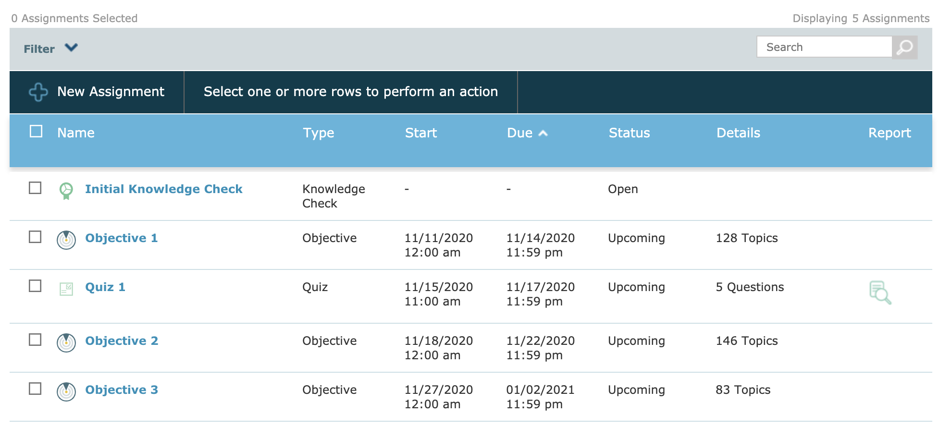
You can now see that Quiz 1 occurs between Objective 1 and 2.

Slide 8
Another option is to create gaps between Objectives to provide time for students to review.
When we have a gap between objectives, such as between Objective 2 and 3 below, students are able to catch up on topics from past Objectives and then work ahead.

Slide 9
This review is personalized as students are only focusing on what they have not yet learned. A quick test preparation strategy is to schedule a Knowledge check just before this gap between objectives to identify what students need to work on just before they enter the review period. Students also automatically enter this review period when they complete an Objective prior to the due date.

Slide 10
For more tutorials, go to: www.mheducation.com/highered/aleks.html

