Slide 1
Week 1 to 3 Tasks
ALEKS Training Series
Instructors

Slide 2
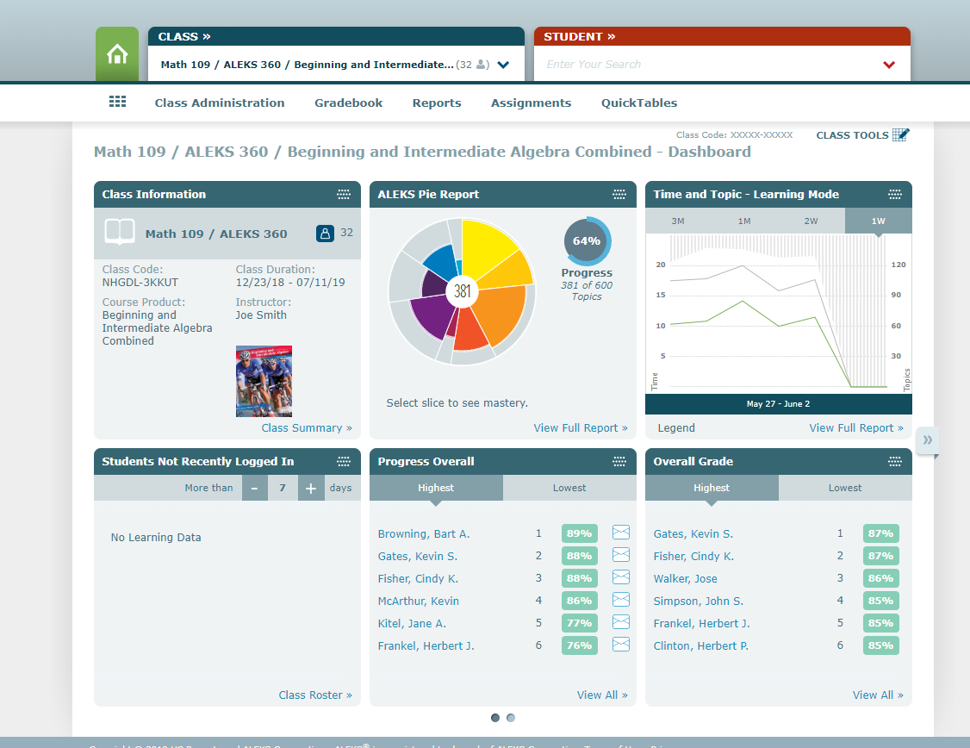
The Course Dashboard
Navigate to your course dashboard. On the course dashboard there are six tiles.

Slide 3
The Class Information Tile
Locate the Class Information tile.
Make sure the number of students registered in ALEKS matches the number of students in your class.

Slide 4
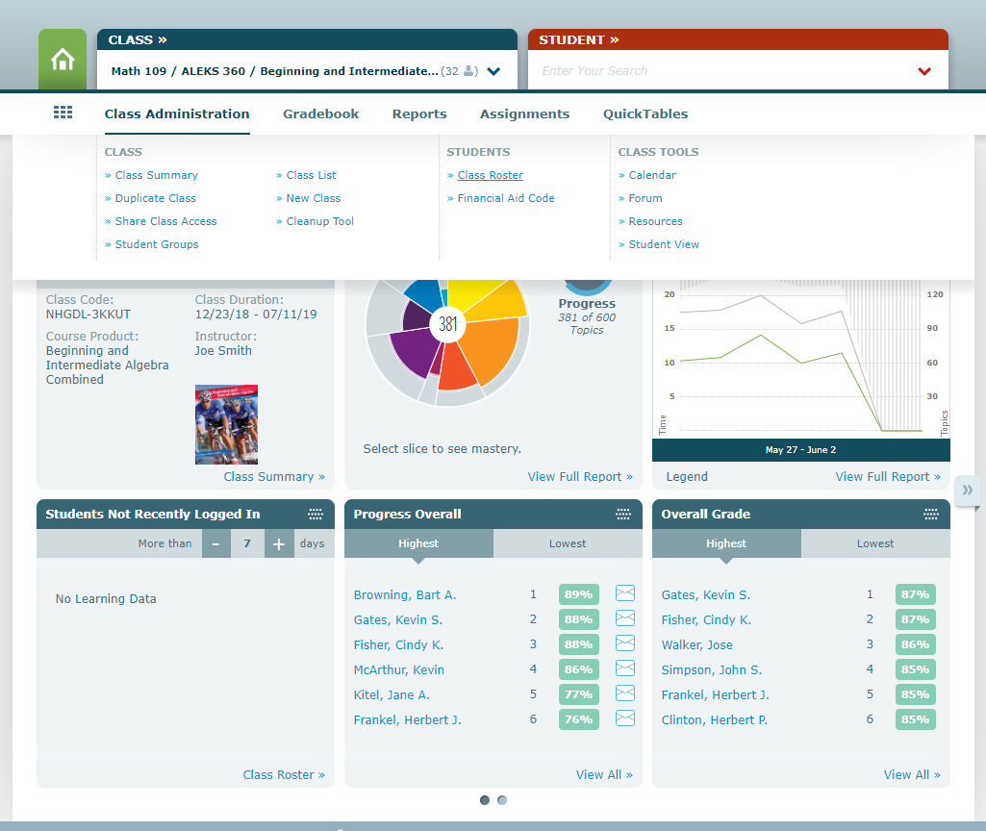
Checking ALEKS Accounts
The course roster will show if students have temporary course access or paid access and will show when the access expires.
Remind students to get their paid codes as soon as possible to help eliminate accounts getting locked right before an exam.

Slide 5
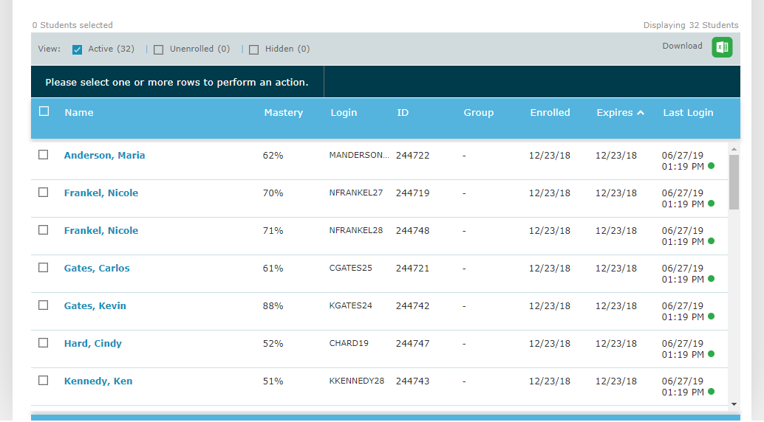
Checking Expiration of ALEKS Accounts
If a student’s account is about to expire, you can click on the student and send them an email reminder about buying a code.
A common error that students make early on is to create multiple accounts.
Contact the ALEKS support desk at 1-800-258-2374 to resolve any multiple account issues.

Slide 6
Students Not Recently Logged In Tile
On the course dashboard, ALEKS will let you know who has not logged in recently.
Locate the Students Not Recently Logged In tile.
By clicking on the mail icon you can send each student an email and coach them to log into ALEKS and work on their skills.

Slide 7
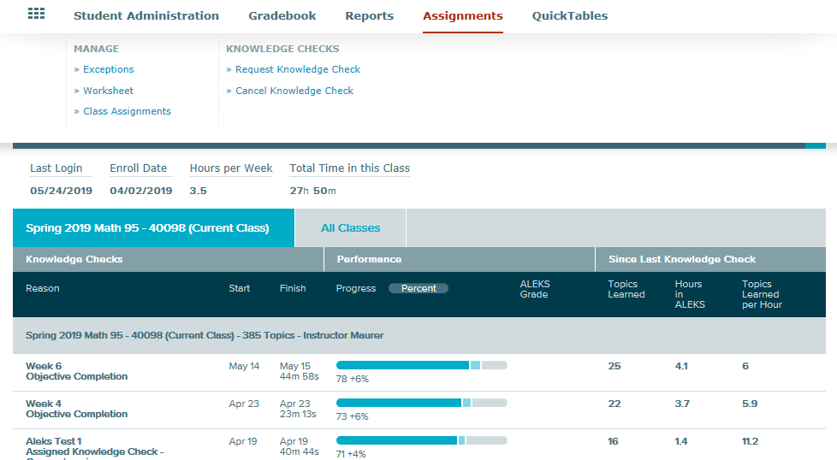
What to Do With High and Low Knowledge Checks
After all your students have completed the initial knowledge check it is important to assess the results.
The initial knowledge check can be reassigned to reassess student knowledge under a proctor.
To do this, click on the name of the student and select Assignments and Request Knowledge Check.

Slide 8
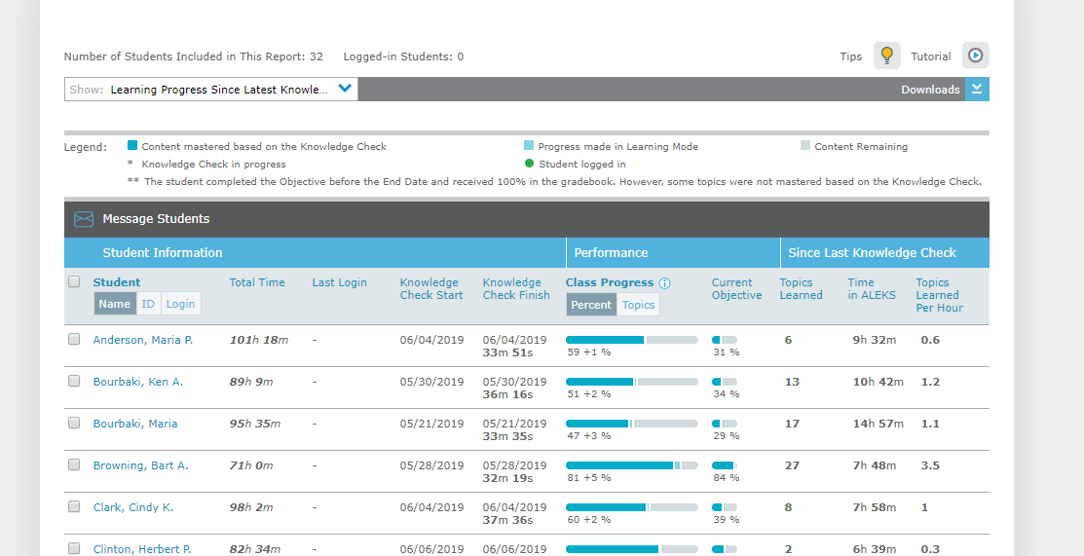
Monitoring Student Progress Through The Progress Report
The Progress shows at a glance who is working on the current objective.
Students who are not making progress can be emailed by clicking on their names and then selecting the Message Students icon.

Slide 9
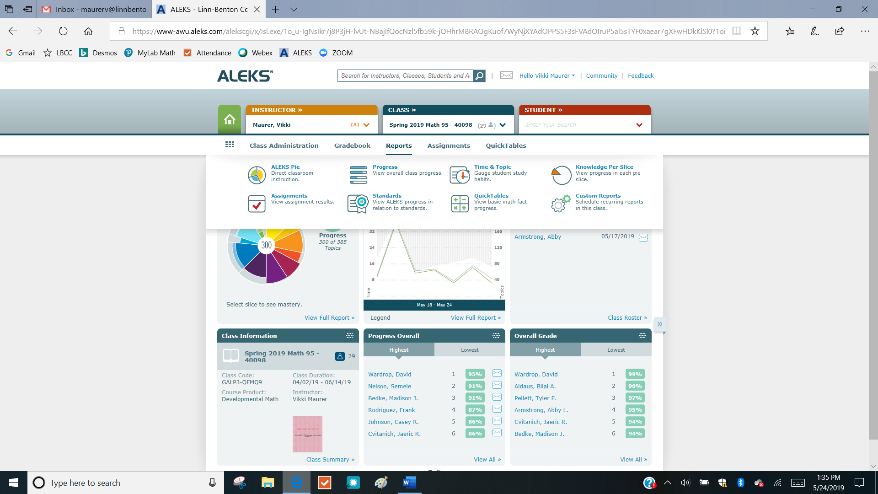
Monitoring Time and Topics
To verify how often students are logging into ALEKS and learning skills, return to the course dashboard and select Reports and then Time and Topic.

Slide 10
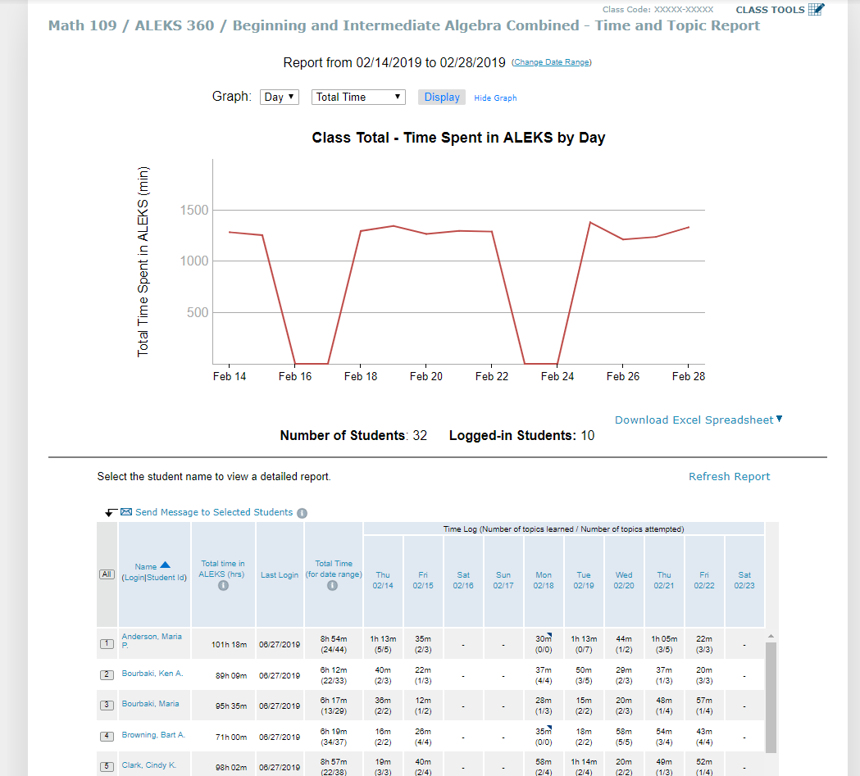
Monitoring Time Using The Line Graph
The line graph shows you at a glance how many minutes your class spends in ALEKS each day.
As work habits are being established early in a term it is important to coach students to work in ALEKS several times each week.

Slide 11
The Time and Topics Report
The Time and Topic Report also shows individual students daily progress, including the time spent and number of topics attempted and learned.
Students who are not logging in need coaching.

Slide 12
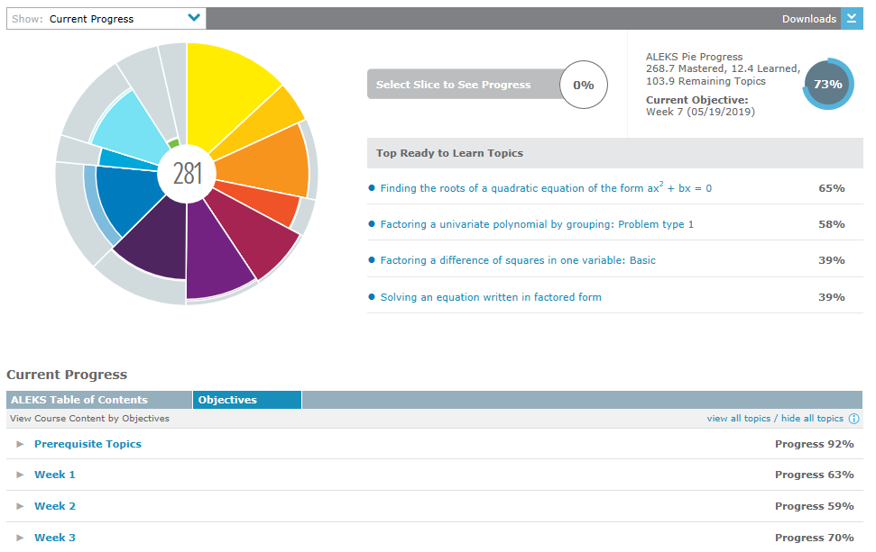
Week By Week Reporting
The ALEKS Pie Report will give you a week-by-week breakdown of how your students are progressing through the topics.

Slide 13
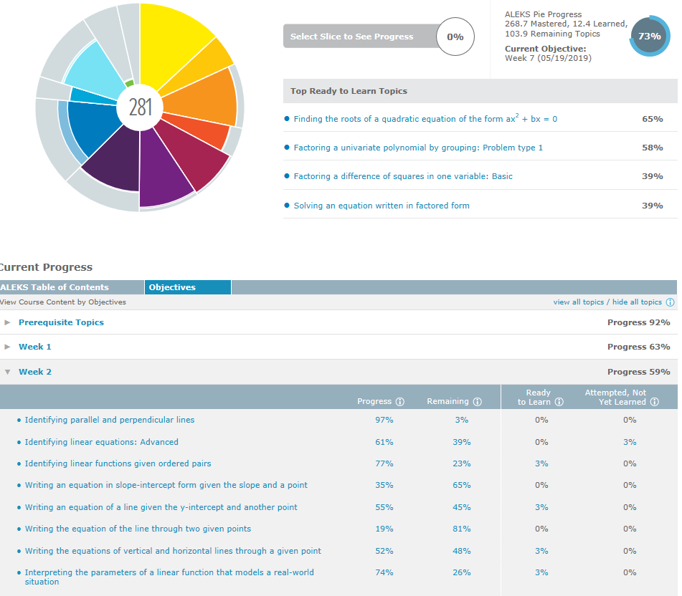
Topics Reporting
By selecting an objective, you will see which topics your class is mastering and which topics your class is struggling with.

Slide 14
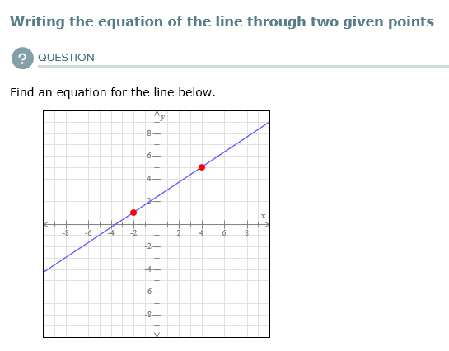
Examples Based on Topics Reporting
By clicking on the topic, an example question will pop up which can be used as a warm-up exercise during class.
Not only would this remind students to work in ALEKS but it would be a good time for students to ask questions about ALEKS and let you know if they are having any issues.
In the first few weeks of the course, monitoring these reports and coaching students will encourage them to use time wisely, make steady progress, and keep communication open.

Slide 15
Support and Resources
TECH SUPPORT & FAQ:
CALL: (800) 258-2374
EMAIL & CHAT: aleks.com/support
MONDAY-THURSDAY: 7 AM – 1 AM EST
FRIDAY: 7 AM – 9 PM EST
SUNDAY: 4 PM – 1 AM EST
FIND MORE SUPPORT:
supportateverystep.com
FIND MORE TIPS:
mheducation.com/highered/ideas

