Slide 1

Duplicating a Course from Last Term:
Math and Chemistry (Modern Objectives Editor)
ALEKS Training Series
Instructors

Slide 2
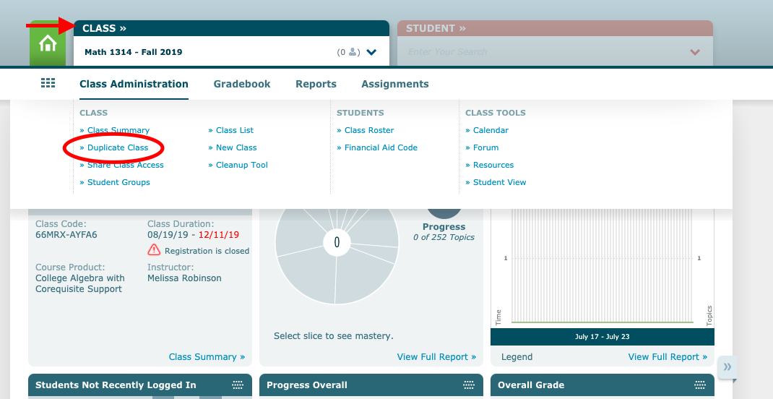
Duplicating your Previously Built Course
Choose the course you wish to duplicate by clicking on the blue CLASS tab in the upper left part of the screen.
Hover over Class Administration. Then select Duplicate Class.

Slide 3
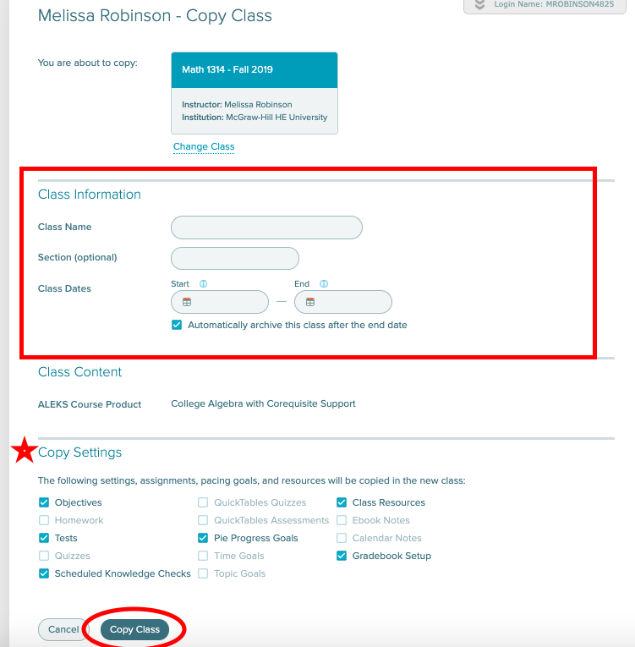
Fill in the appropriate Class Information, confirm the Copy Settings, and then select Copy Class

Slide 4
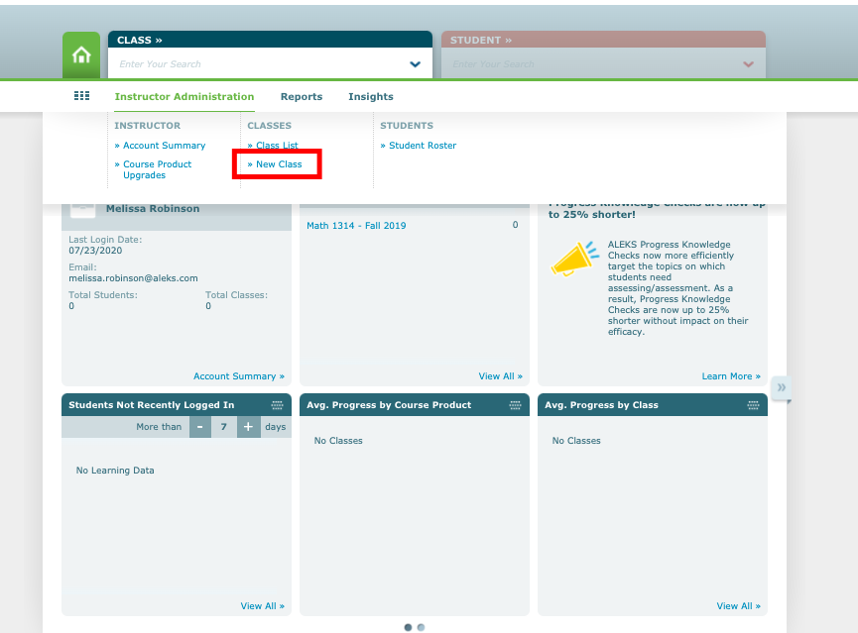
Copying a Previously Built Course from another Instructor
Hover Over Instructor Administration. Then select New Class.

Slide 5
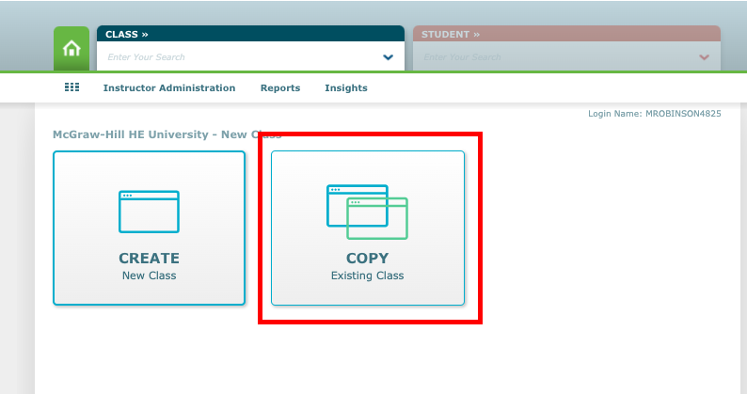
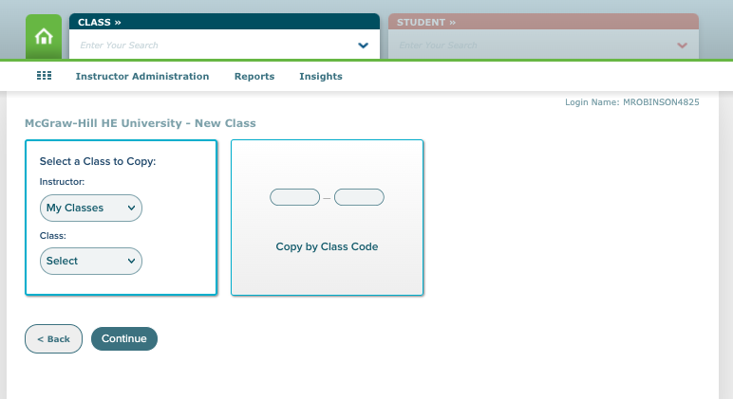
Select Copy Existing Class
You can then copy a course from your
school or by class code
*If you get the warning message “the class you are attempting to duplicate is not public,” then
the course owner needs to allow for copying in their Account Settings

Slide 6
Fill in the appropriate Class Information, confirm the Copy Settings, and then select Copy Class

Slide 7
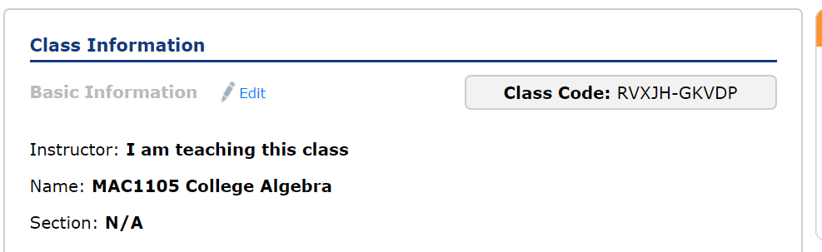
The Course Code
The class code will need to be provided to your students on the first day of class.
They need this code to register for your ALEKS course EXCEPT if they register for this course through an LMS course page, they will not need the Course Code.

Slide 8
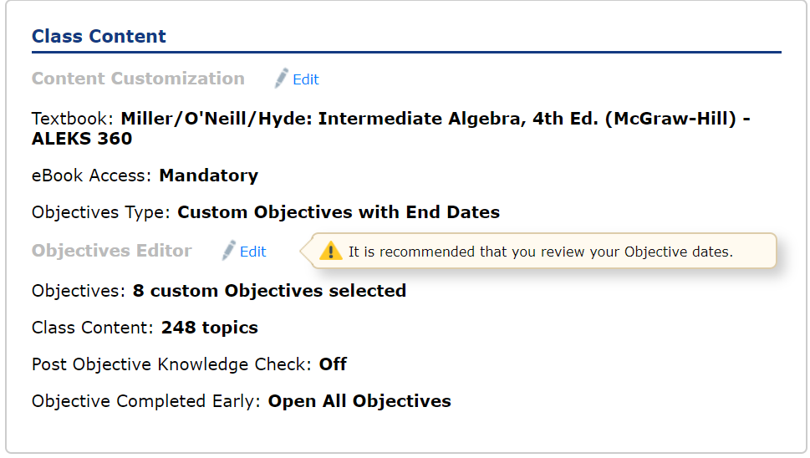
The Objective Editor
Objective Due Dates are adjusted to the date range that is set when your course from last term is copied.
Check and adjust these dates before starting a new term.
Scroll down to the Class Content section from the Class Summary page and click on Edit next to Objectives Editor.

Slide 9
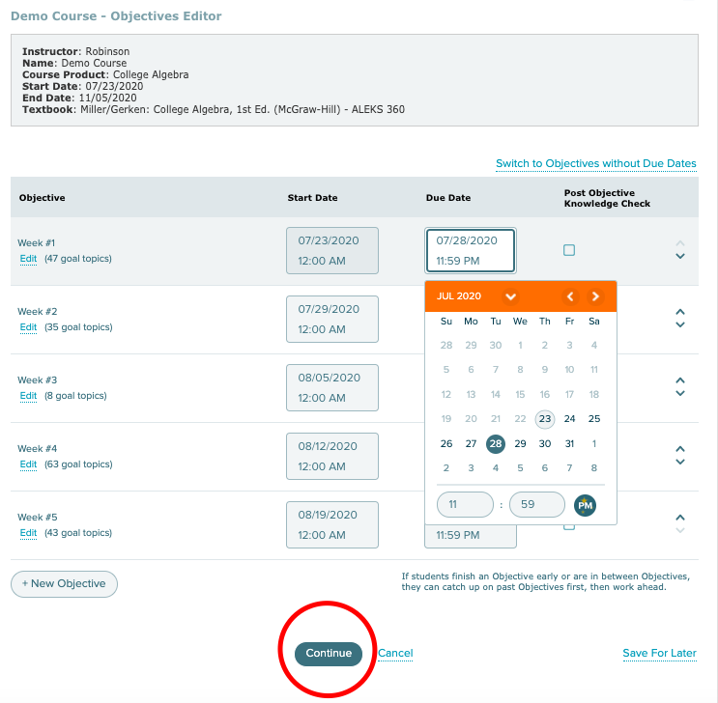
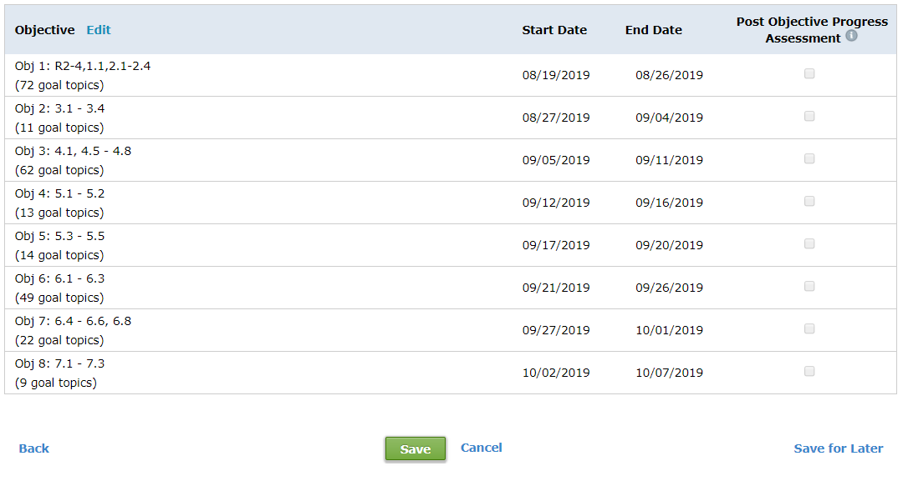
Changing Due Dates
Start Dates and Due Dates can be changed by clicking on the Date. From a pop-up calendar, choose the due date and time you want for that Objective then click elsewhere on the screen to close out the calendar box when you're done.
Saving these changes requires two steps:
FIRST, click on the green Continue button at the bottom center of the page.
SECOND, click on the green Save button at the bottom center of the subsequent page.

Slide 10
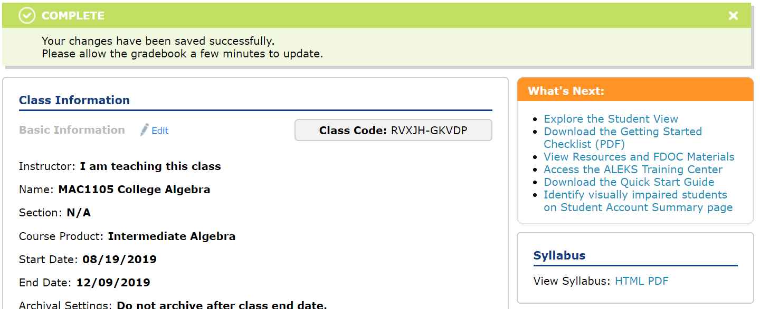
Viewing the ALEKS Syllabus
On the Class Summary page the View Syllabus: HTML, PDF provides you with an overview of your ALEKS course setup.
This is a good reference for you and you can post it for your student’s reference as well.

Slide 11
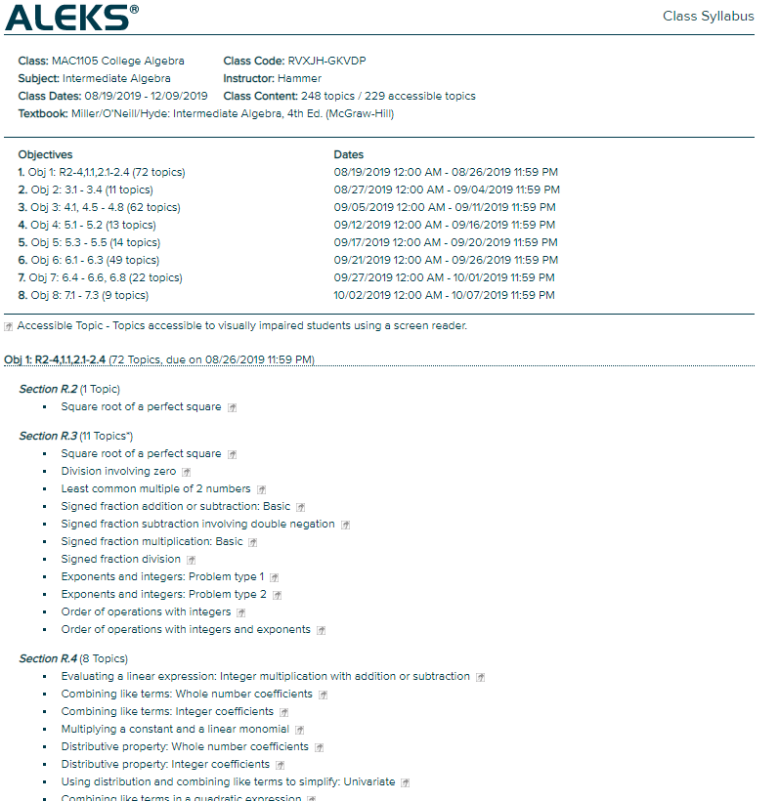
The ALEKS Syllabus
This is a small preview of the ALEKS syllabus. It provides a nice overview of the schedule and course content that you have selected.

Slide 12
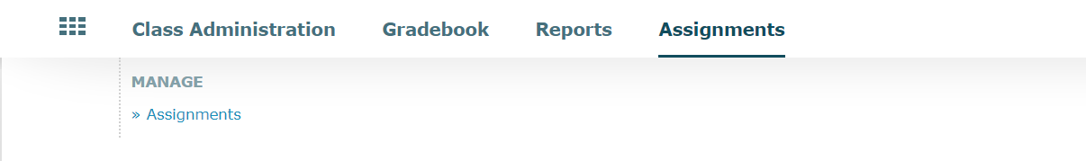
Changing Assignment Due Dates
If you have any Assignments in your ALEKS course other than the Objectives, you’ll want to change those now.
Hover over the Assignments tab.
Then click on Assignments.

Slide 13
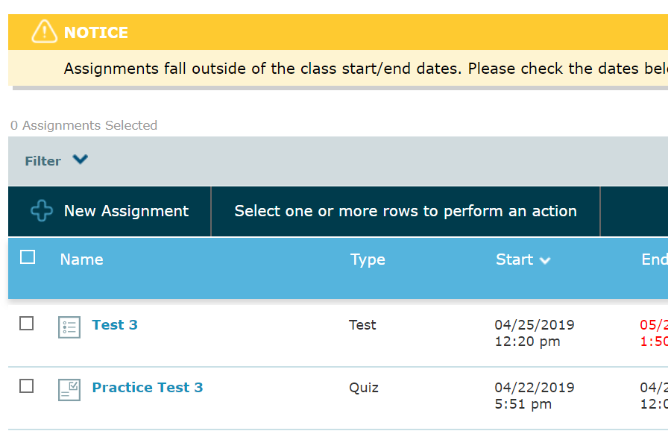
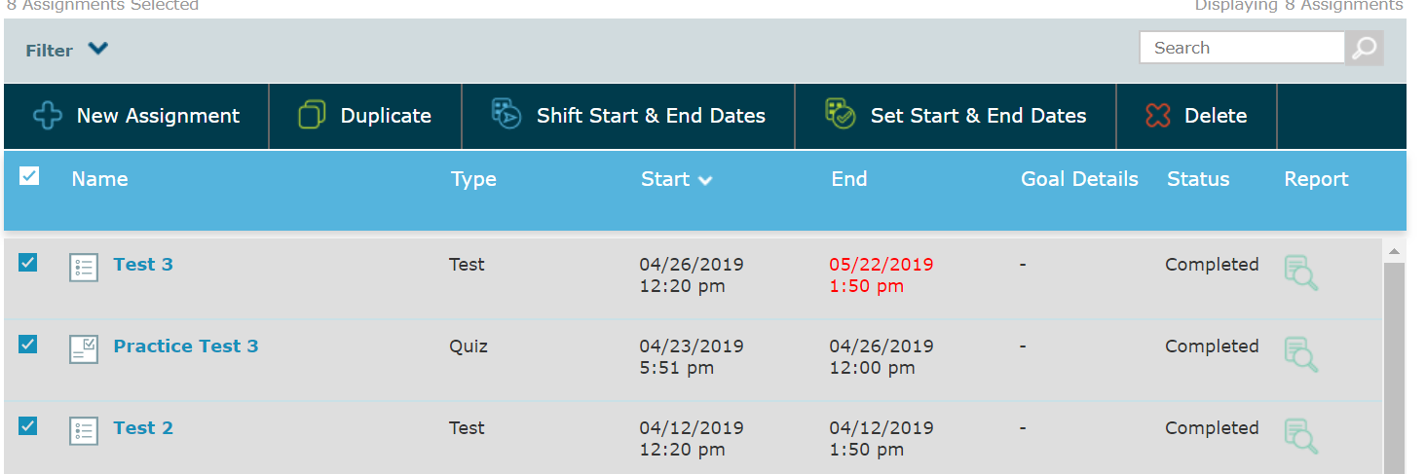
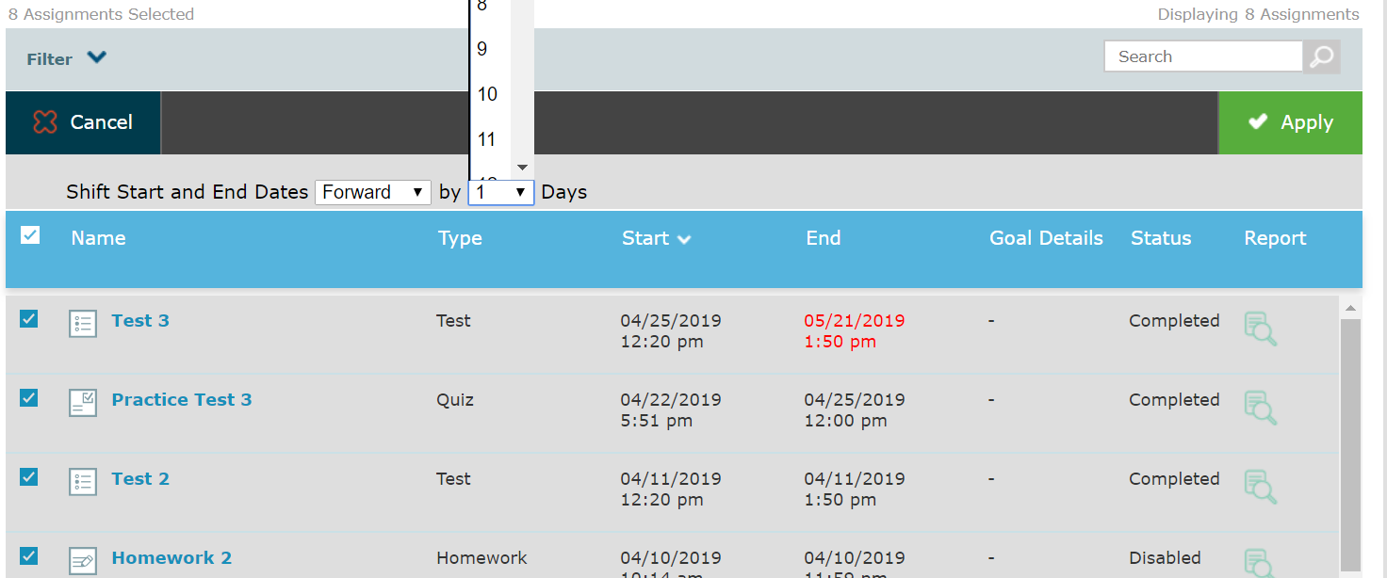
Method 1: Changing Assignment Due Dates in Bulk
Check the main box next to “Name” to select all the assignments at once.
Selecting the Shift Start & End Dates allows you to click on the drop-down arrow and choose how many days into the future you wish to shift your assignment dates.
Be sure to click on the green Apply button in the upper-right of the assignment box to save your changes.

Slide 14
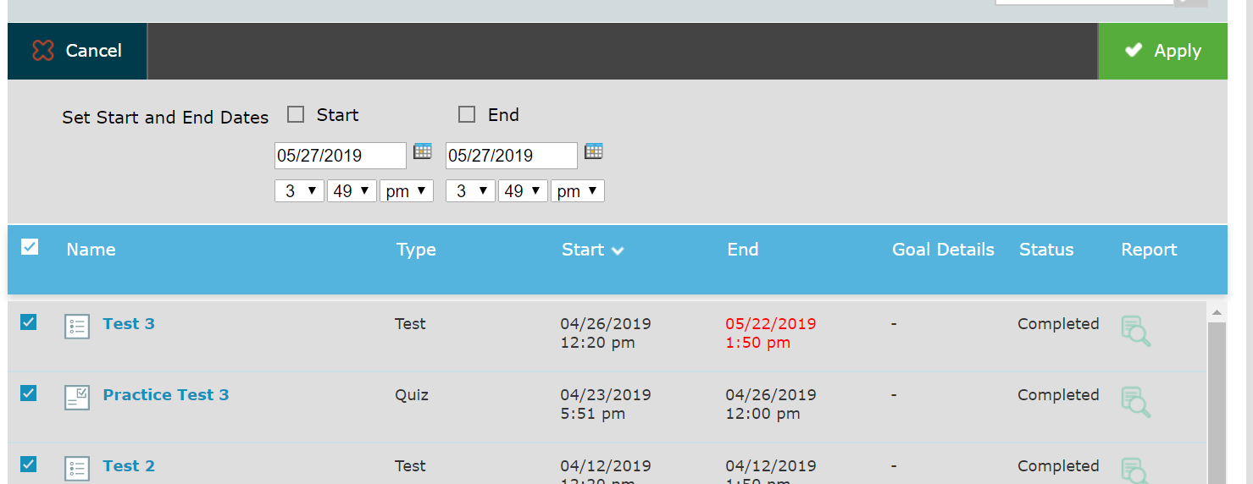
Method 2: Changing Assignment Due Dates in Bulk
Selecting the Set Start & End Dates option gives you the opportunity to choose a date and time range for the assignments.
Once you have selected the Start Date, End Date and Time, make sure to click on the green Apply button in the upper-right of the assignment box to save your changes.

Slide 15
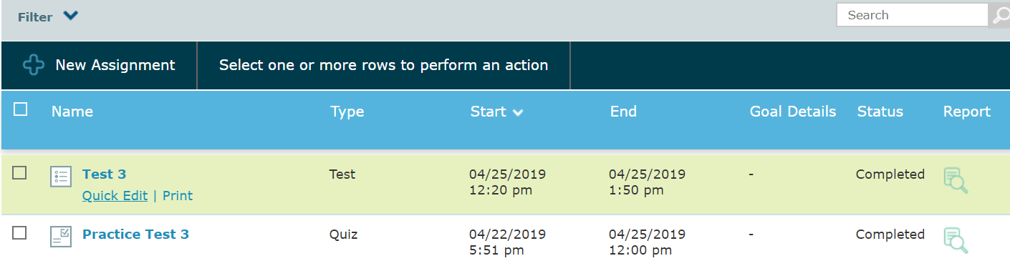
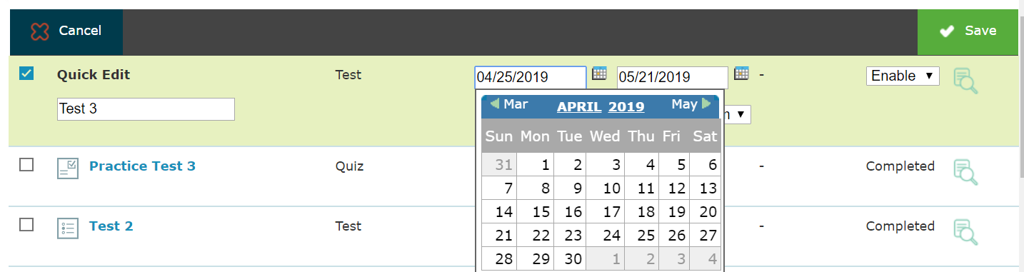
Changing One Assignment Due Date
To change an individual assignment date, hover the cursor below the assignment name.
This will bring up the Quick Edit link which will reveal the Start and End date and Time.
These can be edited by clicking on the date and choosing the new Start and End date from the calendar.
Remember to hit the Save button when done changing each individual assignment’s date.

Slide 16
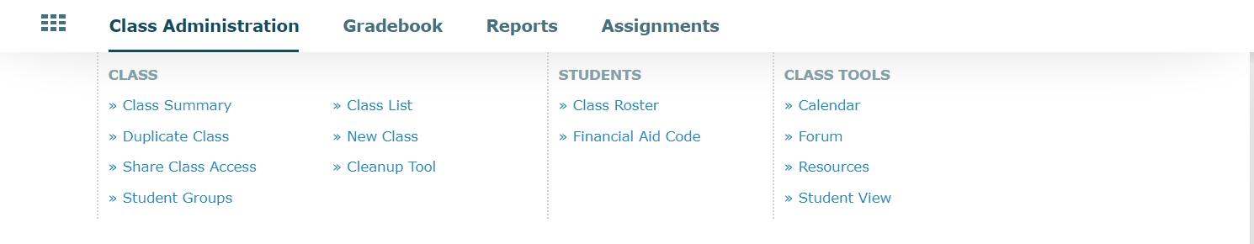
The Financial Aide Access Code
The Financial Aid Access Code (FAAC) allows students to register for your course quickly and begin working right away.
The two weeks of temporary access gives your students time to purchase the code they will use for the remainder of the term, yet allows them to enroll in your ALEKS course on the very first day of class.
Hover over Class Administration. Then select Financial Aid Code.

Slide 17
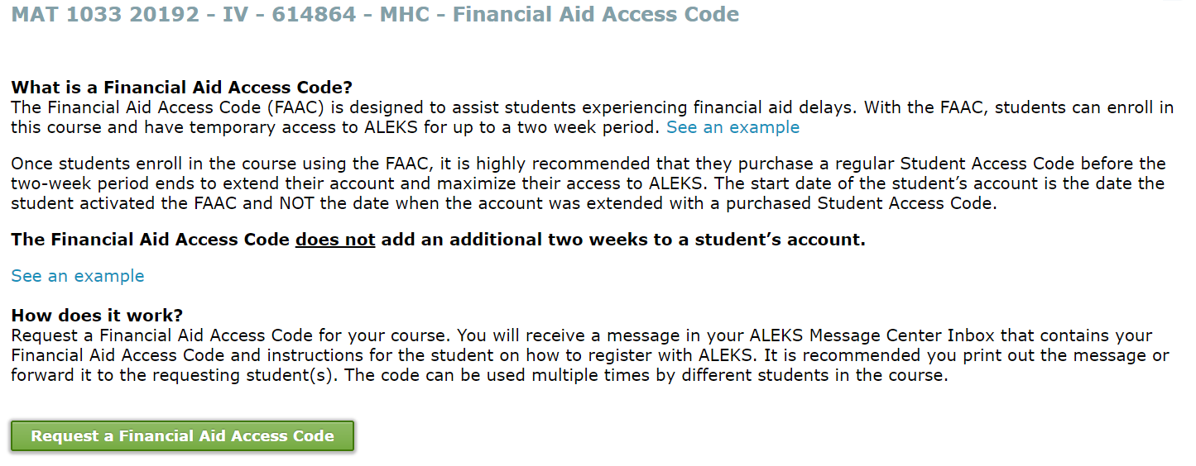
Information about the Financial Aide Access Code
You can read all the details about the FAAC, as well as click on Request a Financial Aid Access Code.

Slide 18
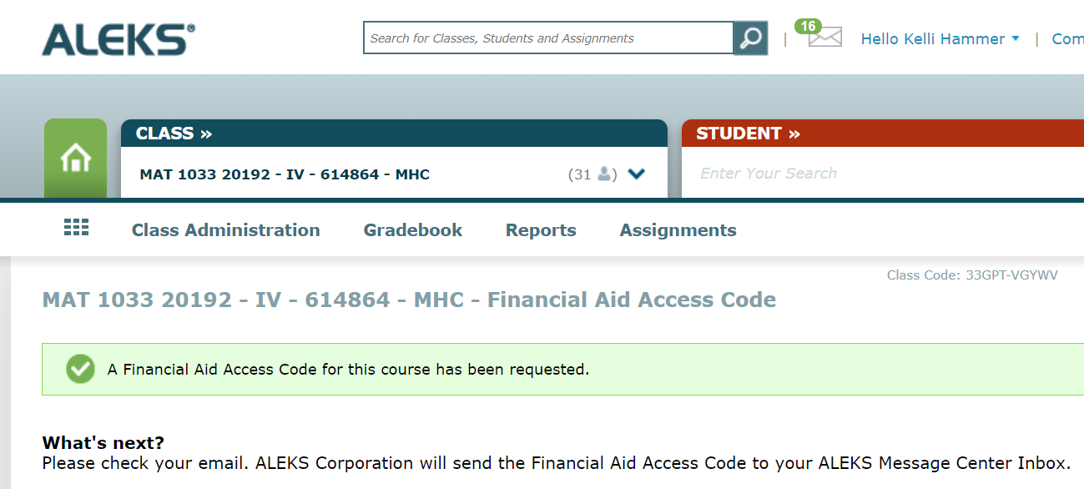
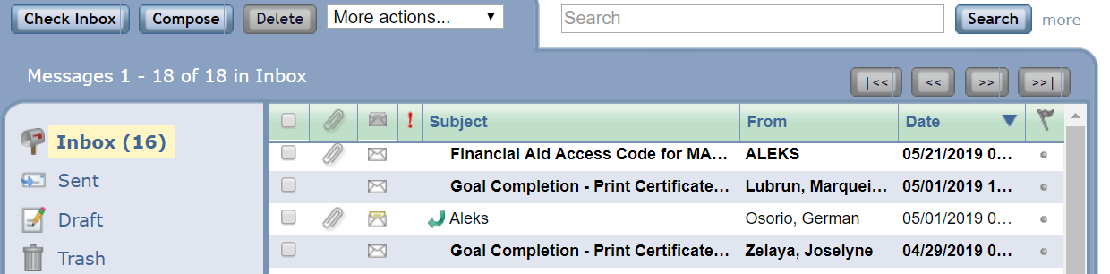
Locating the Financial Aide Access Code
From the confirmation page, click on the envelope at top of the page next to your name.
You will immediately be able to see and open the Financial Aid Access Code email queued at the topic of your ALEKS Message Center inbox. This FAAC will work for every student enrolled in this particular ALEKS class.

Slide 19
Support and Resources
TECH SUPPORT & FAQ:
CALL: (800) 258-2374
EMAIL & CHAT: aleks.com/support
MONDAY-THURSDAY: 7 AM – 1 AM EST
FRIDAY: 7 AM – 9 PM EST
SUNDAY: 4 PM – 1 AM EST
FIND MORE SUPPORT:
supportateverystep.com
FIND MORE TIPS:
mheducation.com/highered/ideas

