Slide 1
Insights and Reports Basics
ALEKS Training Series
Instructors

Slide 2
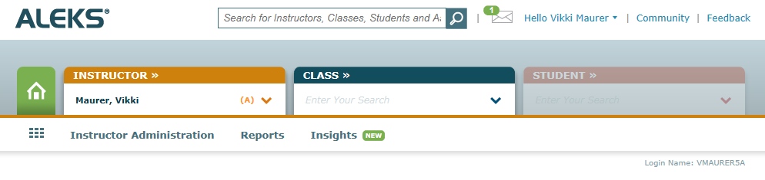
ALEKS Insights and Reports
ALEKS Insights will alert you to certain behaviors
students who are failing topics
students who are procrastinating
students who have a change in behavior such as an unusual decrease or increase in learning
From your instructor main page you will find Insights through the sub-menu.

Slide 3
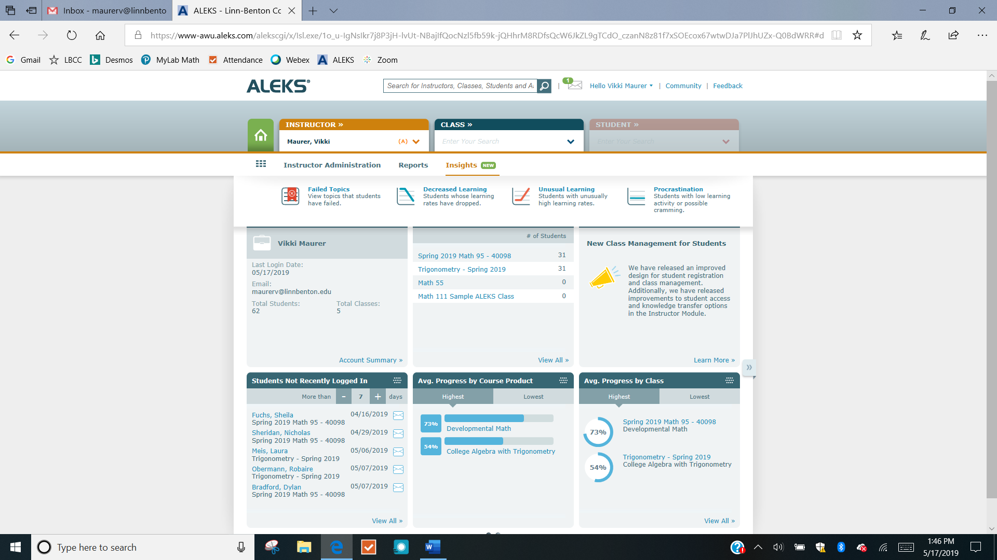
Types of Insights
Locate Insights and then click on any one of the four learning behavior categories to explore.

Slide 4
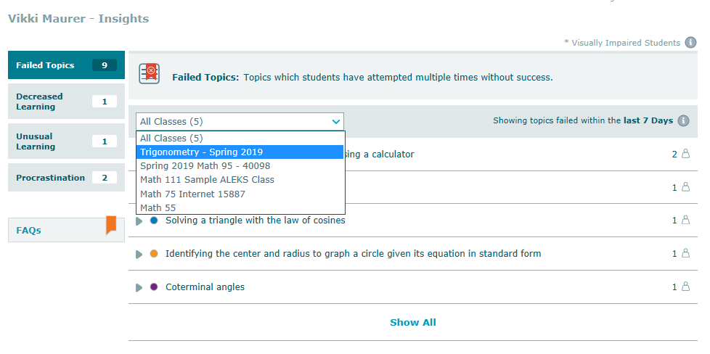
The Failed Topics Insight
Students who have attempted and failed topics multiple times over the past week will show up in this report. The report can be filtered by class.

Slide 5
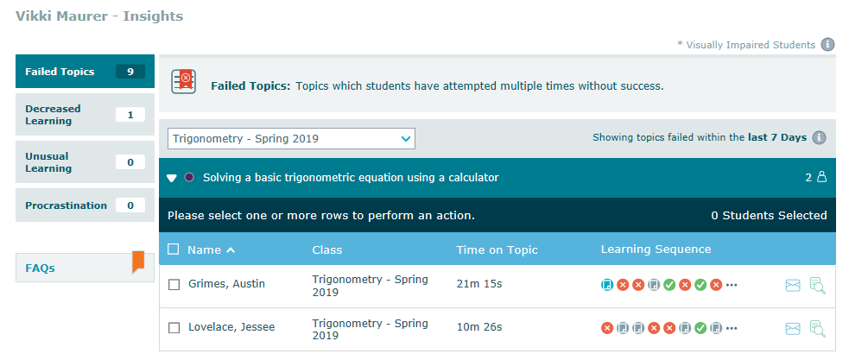
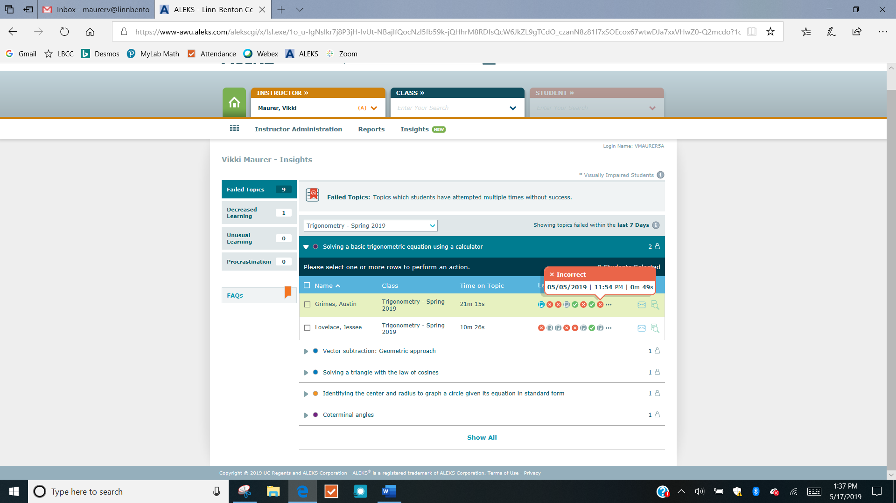
Using the Failed Topics Insight
Students who are experiencing difficulties in learning topics they have attempted multiple times without success will fall into the failed topic category.
This category is updated in real time and you can click on one or more of the “X” icons to see the questions the student was asked and how they answered them.

Slide 6
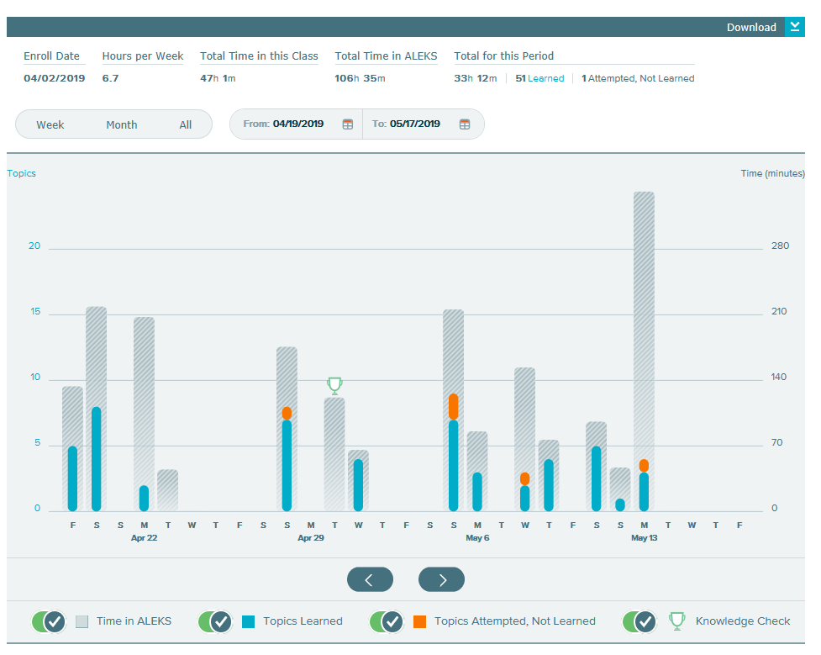
The Time-and-Topic Report
You can gain more information about this student’s work habits by clicking on the magnifying glass icon.
This will take you to the Time-and-Topic report for that student where you can quickly see how often the student is working in ALEKS and explore their other problem attempts and answers.

Slide 7
Emailing Students
Your students may need an email reminder from you about logging in and working more often during the week or a reminder of resources such as videos, the eBook or the instructor’s office hours.

Slide 8
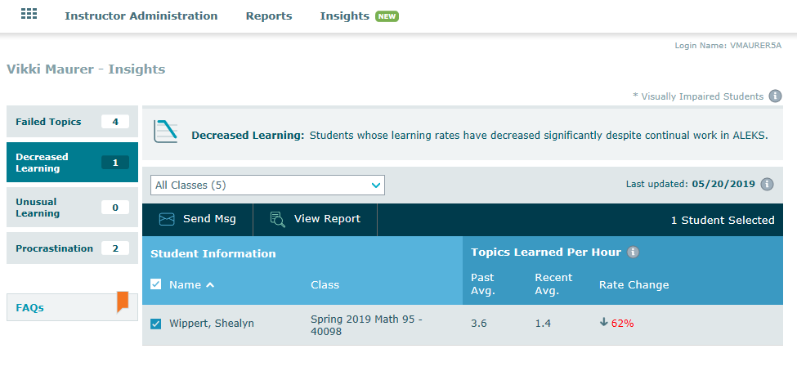
The Decreased Learning Insight
Decreased Learning identifies students whose learning rate has decreased significantly despite continual work in ALEKS.
This Insight is updated weekly and shows the student’s past average number of topics learned per hour and the new, lower average. The magnifying glass icon will display the time-and-topic report for this student.

Slide 9
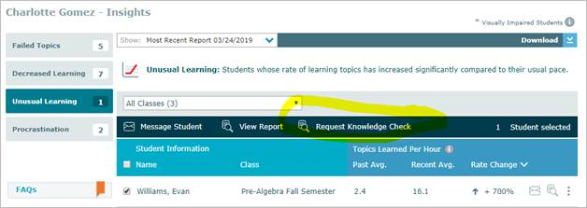
The Unusual Learning Insight
The Unusual Learning Insight identifies an unusual increase in the number of topics learned per hour.
You can select the student and View Report to see the time-and-topic report.
If the student’s learning behavior is a concern, you can send the student an email or you can request a new knowledge check for this student to verify that their knowledge state is accurate.

Slide 10
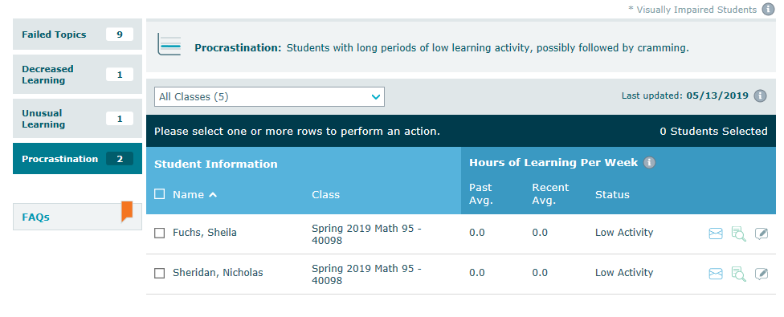
The Procrastination Insight
The procrastination Insight will identify students in ALEKS exhibiting extremely long periods of inactivity followed by possible cramming.

Slide 11
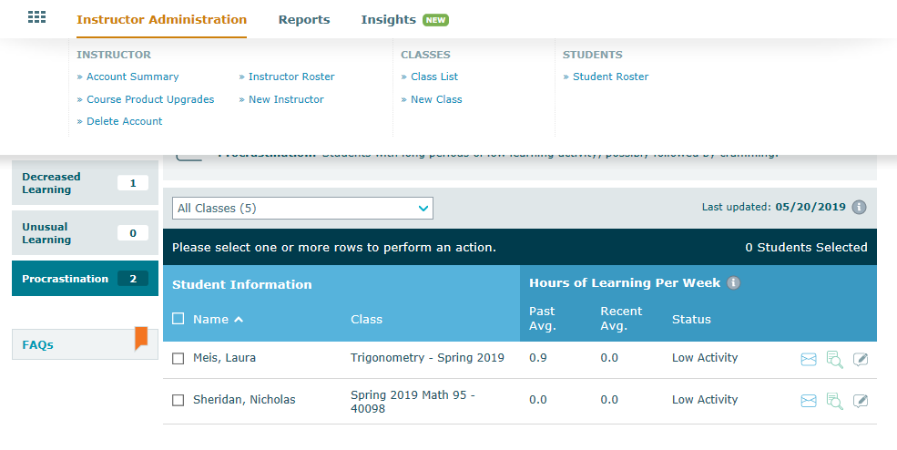
The Student Roster
Students included in the Procrastination Insight may have dropped the course or they may just not be working on homework. If a student has dropped the class, you can go to your Student Roster by hovering on Instructor Administration and selecting Student Roster.

Slide 12
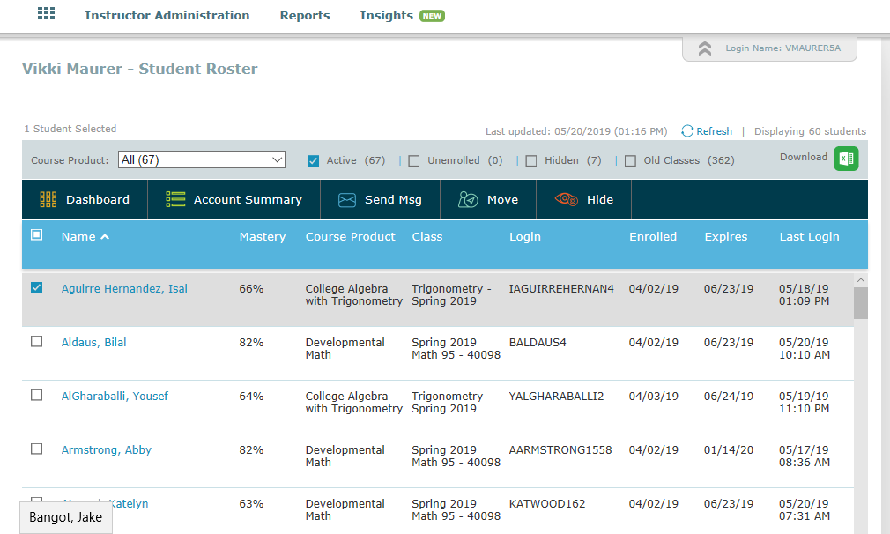
Disabling Student Access
You can hide and disable access for students who are no longer in your class.

Slide 13
Using the Insights Tab
ALEKS updates all of the Insights each Sunday evening and continuously updates the Failed Topics Insight.
ALEKS will also email you a notification when there are new insights.
Exploring the ALEKS Insights each week offers you an opportunity to get to know students, coach students, and influence student behavior to increase success.

Slide 14
Support and Resources
TECH SUPPORT & FAQ:
CALL: (800) 258-2374
EMAIL & CHAT: aleks.com/support
MONDAY-THURSDAY: 7 AM – 1 AM EST
FRIDAY: 7 AM – 9 PM EST
SUNDAY: 4 PM – 1 AM EST
FIND MORE SUPPORT:
supportateverystep.com
FIND MORE TIPS:
mheducation.com/highered/ideas

