Slide 1
Chemistry: Knowledge Checks (Classic Editor)
ALEKS Training Series
Instructors

Slide 2
Knowledge Checks
ALEKS will periodically check to see if students have learned a topic short term or if they have mastered the topic for long term retention.
Knowledge checks are a vital formative assessment for the students’ progress and material retention.
To institute a knowledge check, navigate to your course main page. Under “Class Administration”, select “Class Summary”.

Slide 3
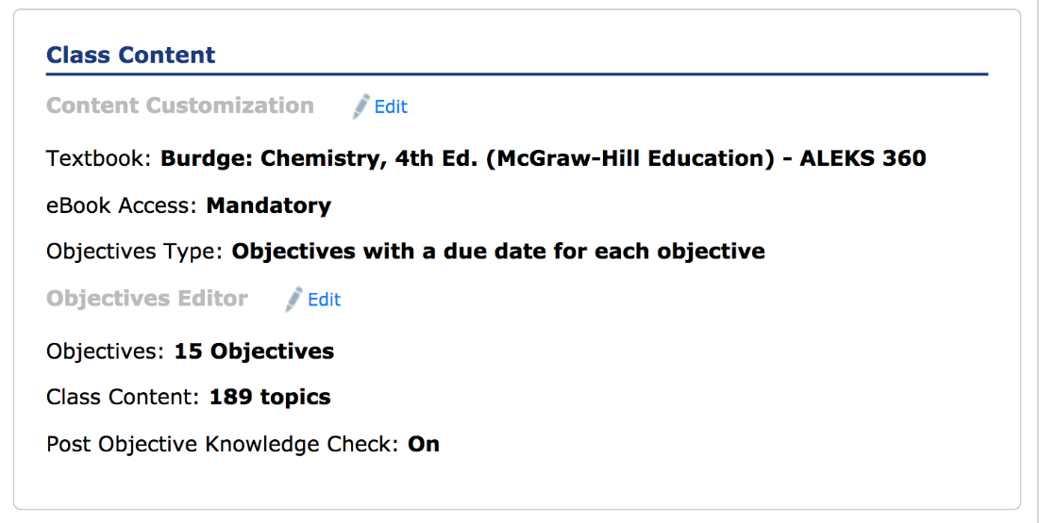
Objectives Editor
You will a list of modules describing the course. Under “Class Content”, you will see “Objectives Editor”. Click on the “Edit” link next to the Objective editor.

Slide 4
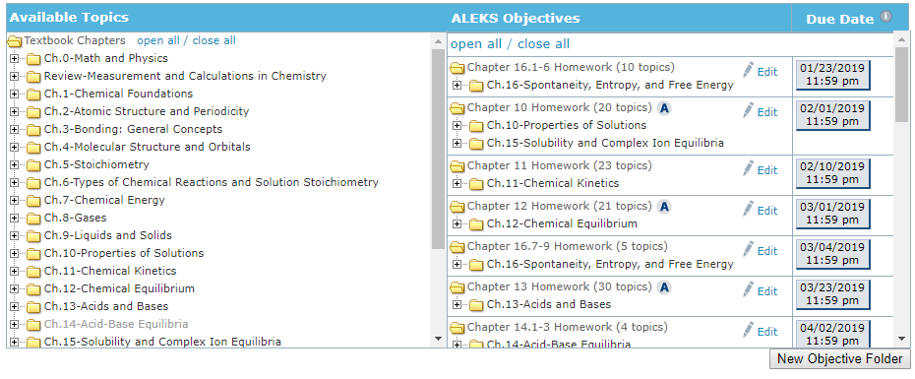
Content and Objective Editor
On the right are your created objective assignments.
A small blue A located next to the assignment name, indicates that students will be assessed on their most recently learned material when they complete the Objective.
If you would like to put in or remove a knowledge check after a specific objective, click on “edit” of that specific objective.

Slide 5
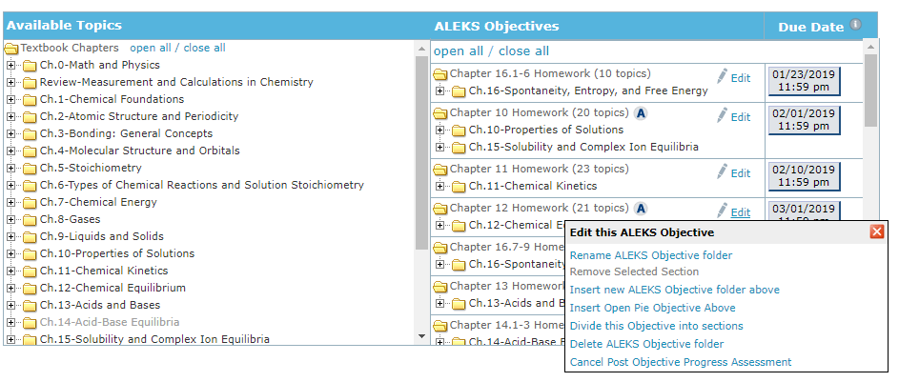
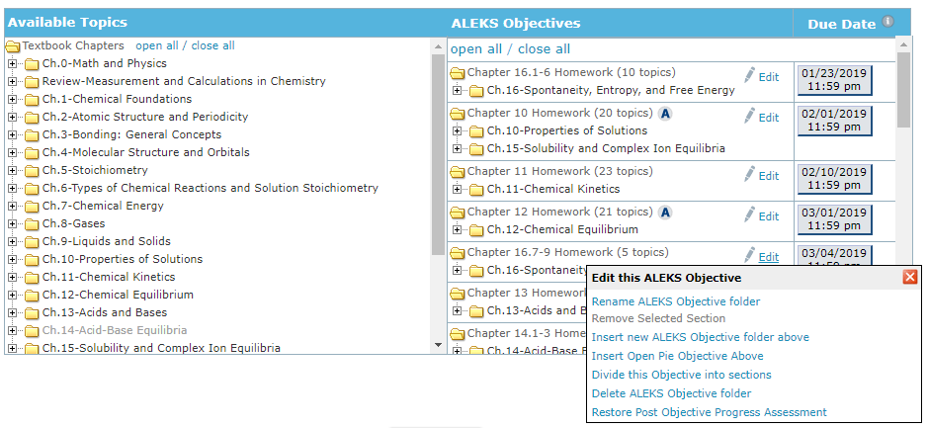
Adding and Removing Knowledge Checks
In the drop down menu you will see a list of possible edits to the assignment.
The last option is “Post Objective Progress Assessments”.
If an assessment is scheduled, it will say “Cancel Post Objective Progress Assessment”
If an assessment is not scheduled, it will say “Restore Post Objective Progress Assessment”. Click on the link to schedule.

Slide 6
Placing Knowledge Checks
In Placing a Knowledge Check,
students will be tested on the topics that they have most recently learned to see if they have retained that knowledge.
assessments will take approximately 30 - 45 minutes and allow for students to master a topic.
if a student misses a topic during the knowledge check, it will remove the topic from their pie.

Slide 7
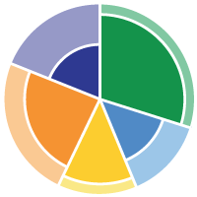
Implementing Knowledge Checks in ALEKS Chemistry
Common Questions:
How often should I assign knowledge checks?
About every 2 weeks
Every 20 to 30 topics learned
Can I alter knowledge checks while course is running?
Yes, you can always change as demonstrated in this video
What are the benefits?
A non-punitive review to prepare for upcoming exams
Allow students to revisit topics where they need more practice

Slide 8
Support and Resources
TECH SUPPORT & FAQ:
CALL: (800) 258-2374
EMAIL & CHAT: aleks.com/support
MONDAY-THURSDAY: 7 AM – 1 AM EST
FRIDAY: 7 AM – 9 PM EST
SUNDAY: 4 PM – 1 AM EST
FIND MORE SUPPORT:
supportateverystep.com
FIND MORE TIPS:
mheducation.com/highered/ideas

