Slide 1

Creating an ALEKS Chemistry Course
ALEKS Training Series

Slide 2
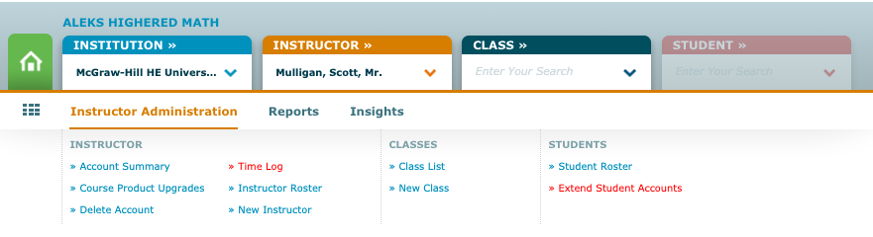
Creating an ALEKS Chemistry Course
To create a new course, login to your ALEKS account to enter the Instructor Dashboard.
Click on Instructor Administration. Then select New Class.

Slide 3
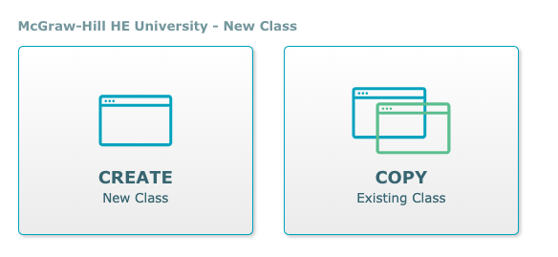
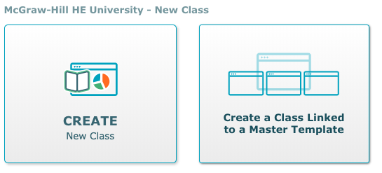
Create an ALEKS Chemistry Course
Select Create New Class to start the initial course build process.
Select Create a Class Linked to a Master Template if your course will be linked to a pre-made Master Template. Select from Master Templates available.

Slide 4
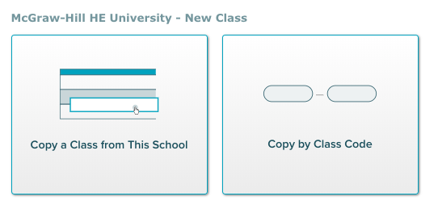
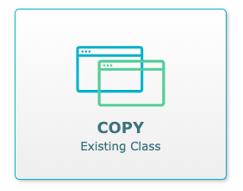
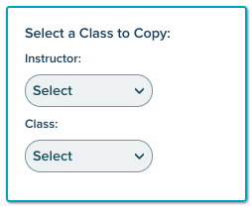
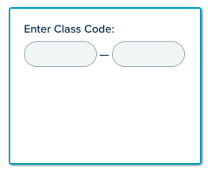
Create an ALEKS Chemistry Course
Select Copy Existing Class if you will be copying a class from the same institution. Copy by Class Code can be used if you are copying a class with its unique 10-digit course code.

Slide 5
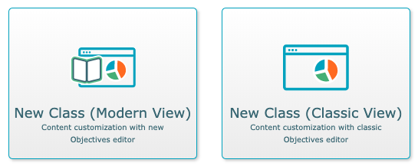
Create an ALEKS Chemistry Course
Select Modern View or Classic View to build Objectives.
Select Modern View to create class within the updated template. Classic View will reflect classic Objectives editor.

Slide 6
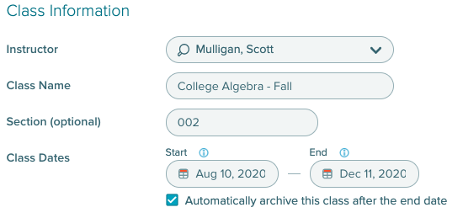
Create an ALEKS Chemistry Course
Class Information will include Instructor, Class Name, Section, and Class Dates.
Select whether to automatically archive class after the end date.

Slide 7
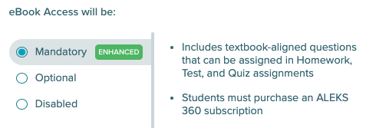

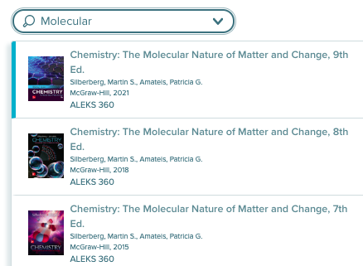
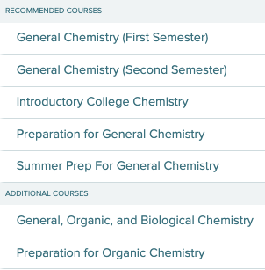
Create an ALEKS Chemistry Course
For Class Content, select desired textbook. A search bar is available with textbook cover visuals if needed to find correct textbook.
Select eBook Access options for students.
Select Course Product from dropdown menu.

Slide 8
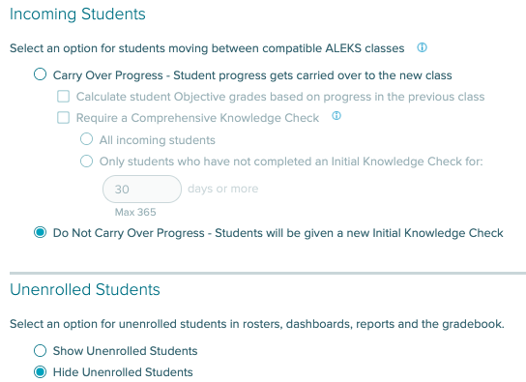
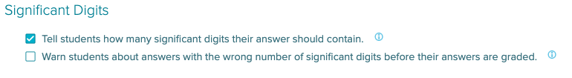
Create an ALEKS Chemistry Course
Under Class Options, select if you wish students to carry over progress from previous ALEKS courses or start with new Initial Knowledge Check.
Select if unenrolled students will show or be hidden from class roster, dashboards, reports and gradebook.
Select Significant Digits behavior.

Slide 9
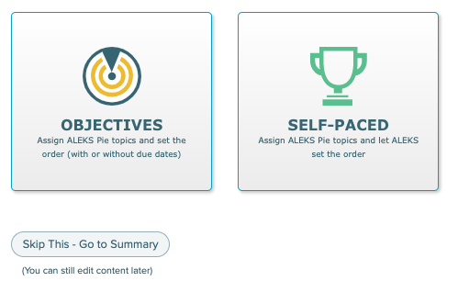
Creating an ALEKS Chemistry Course
Select if you wish to build a course with Objectives (ALEKS Pie topics with or without due dates) or a Self-Paced course.
You also have the option to complete this step at a later time by selecting the Skip This – Go to Summary option.

Slide 10
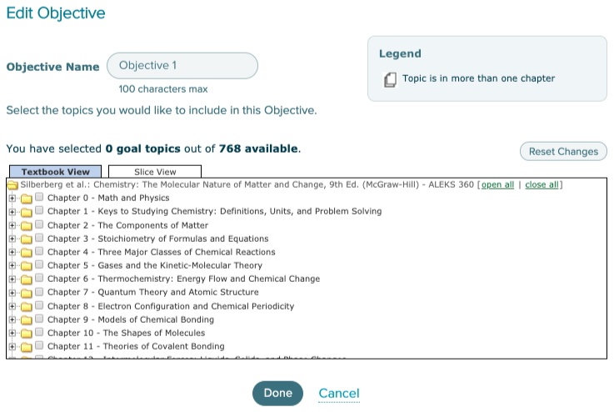

Creating an ALEKS Chemistry Course
To create Objectives within Objective Editor, select the + New Objective button. All ALEKS topics will be aligned to textbook if previously selected. Slice View is available to see topics organized by ALEKS Curriculum.

Slide 11
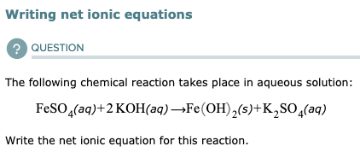
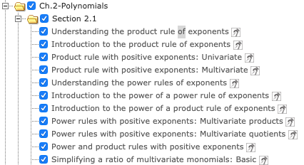

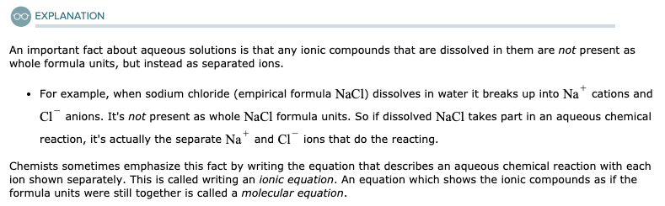

Creating an ALEKS Chemistry Course
Topics will display by selecting the chapter and section title. Double click on topic to see examples of topic questions and explanations. Select box next to topic to assign to current Objective.
Accessible Topic icon will surface next to all accessible topics.

Slide 12
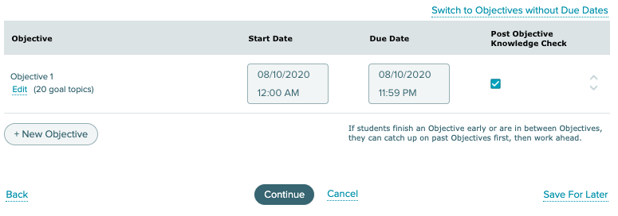
Creating an ALEKS Chemistry Course
Completed Objectives will list with number of goal topics selected.
Select Start Date and Due Date for Objectives by clicking on date boxes.
Post Objective Knowledge Checks will trigger Progress Knowledge Check upon completion of Objective and/or Due Date.

Slide 13
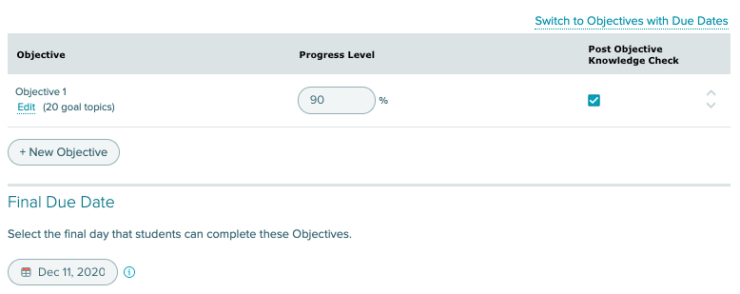

Creating an ALEKS Chemistry Course
Select Switch to Objectives without Due Dates to replace due dates with percentage completion goals. Next Objectives will unlock once student reaches percentage goal.
Select final due date for the course. Select Continue.

Slide 14
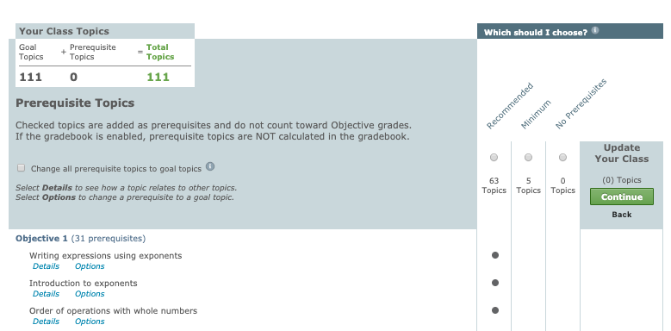
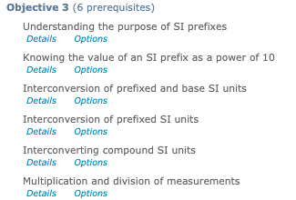
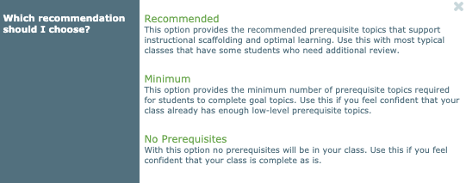
Creating an ALEKS Chemistry Course
Select Prerequisite Topics from Recommended Topics list. Recommended, Minimum or No Prerequisite options can be selected.

Slide 15
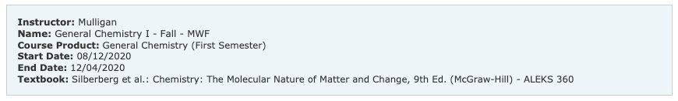
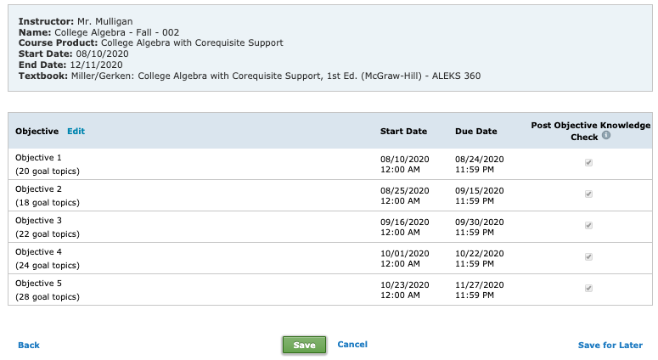
Creating an ALEKS Chemistry Course
Review and Confirm Objectives and select Save.

Slide 16
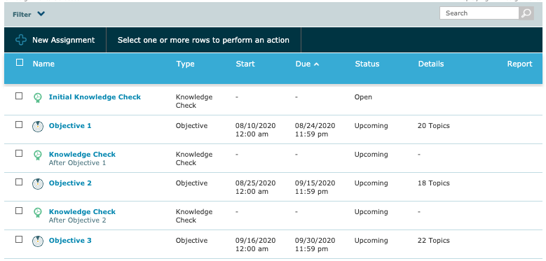
Creating an ALEKS Chemistry Course
All Objectives can be found and edited from the Assignment list.
Select the Objective box and select Edit from the menu to edit any topics within the Objective.

Slide 17
Support and Resources
TECH SUPPORT & FAQ:
CALL: (800) 258-2374
EMAIL & CHAT: aleks.com/support
MONDAY-THURSDAY: 7 AM – 1 AM EST
FRIDAY: 7 AM – 9 PM EST
SUNDAY: 4 PM – 1 AM EST
FIND MORE SUPPORT:
supportateverystep.com
FIND MORE TIPS:
mheducation.com/highered/ideas

