Slide 1
Best Practices for Pacing and Progress
ALEKS Training Series
Instructors

Slide 2
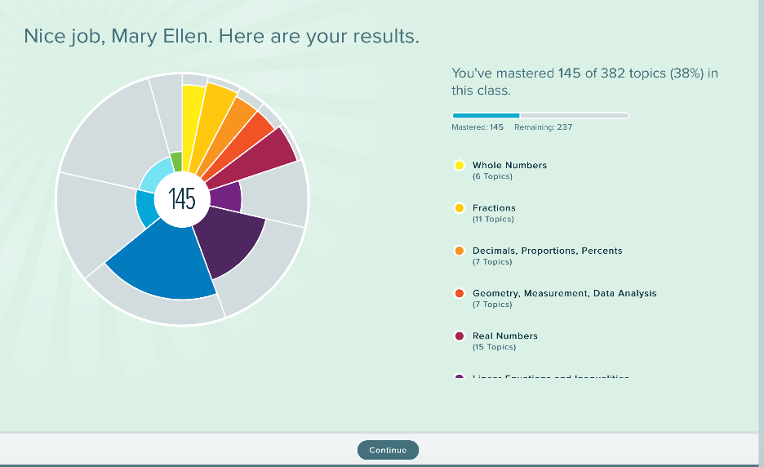
The ALEKS Pie
ALEKS Initial Knowledge Check results show:
Every student’s pie is unique
What topics students already know
Students will not have to re-learn topics they already know in ALEKS. They start where they are ready to learn.
Here are 4 Strategies to Keep Students on Pace

Slide 3
Strategy 1: Set a Proper Pace
Choose a realistic quantity of topics that students are able to successfully complete within your course format.
A student might see learning 15 topics in ALEKS as an easy, quick assignment.
ALEKS requires students to answer 3-4 questions correctly per topic.
15 topics in ALEKS might actually be 60+ practice problems
Setting realistic goals is important.

Slide 4
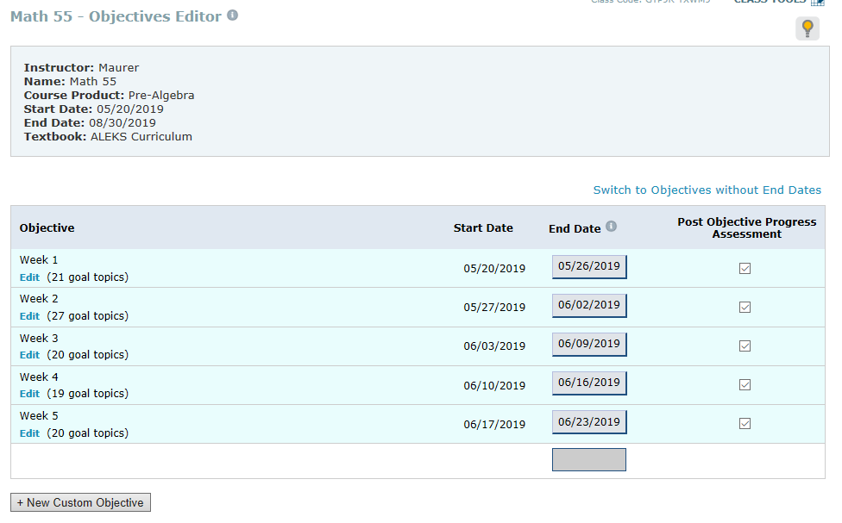
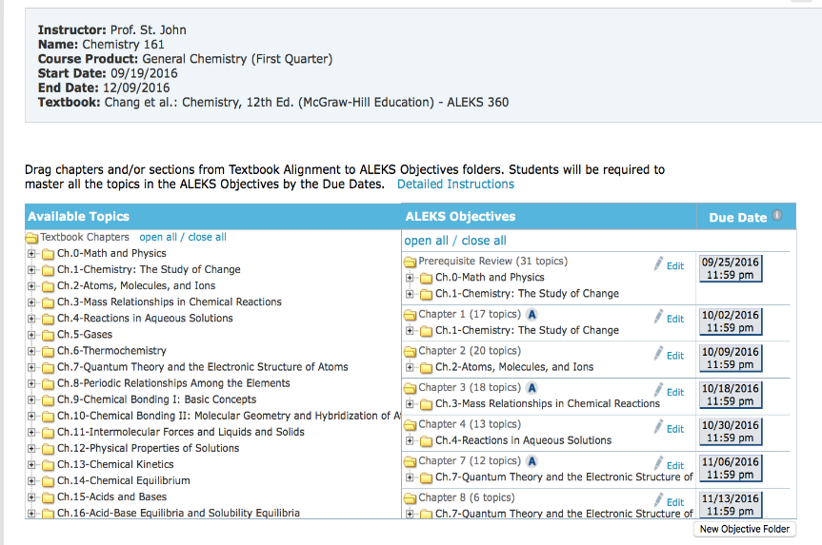
Strategy 2: Use Objectives With Due Dates
Using Objective goals with due dates in ALEKS is recommended to keep students on task. These can be set for both math and chemistry objectives.

Slide 5
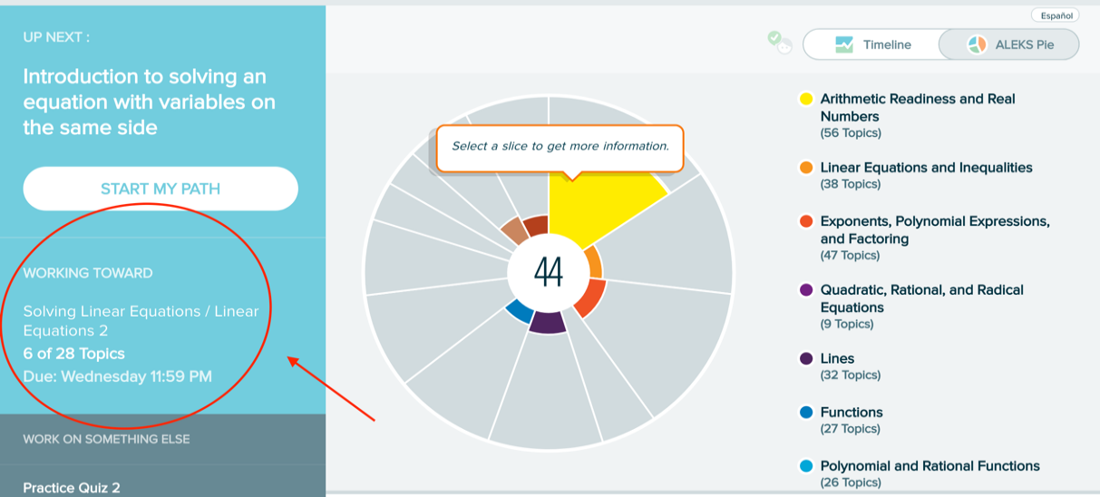
Strategy 2: Topics
When a student logs in to ALEKS they will see how many topics they are expected to complete and the due date.

Slide 6
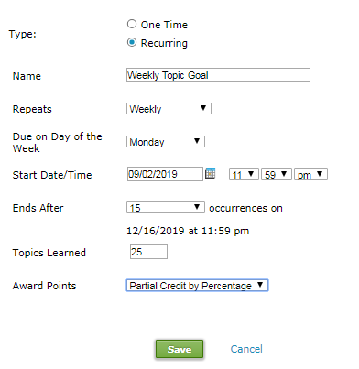
Strategy 3: Weekly Topic Goal Assignments
A weekly topic goal assignment sets expectations on how many topics a week need to be completed to be successful in the course. Go to Assignments>>click Manage Assignments>>Click +New Assignment>>Pick Topic Goal and select your options.

Slide 7
Strategy 4: Help Students Meet Their Weekly Goals
ALEKS can help students stay accountable through objective or topic goals.
learning 15-20 topics in one week is challenging to complete in 1 day
a few topics each day is more realistic and will lead the student to progress effectively.

Slide 8
Support and Resources
TECH SUPPORT & FAQ:
CALL: (800) 258-2374
EMAIL & CHAT: aleks.com/support
MONDAY-THURSDAY: 7 AM – 1 AM EST
FRIDAY: 7 AM – 9 PM EST
SUNDAY: 4 PM – 1 AM EST
FIND MORE SUPPORT:
supportateverystep.com
FIND MORE TIPS:
mheducation.com/highered/ideas

