Slide 1
Managing Exceptions and Extensions
ALEKS Training Series
Instructor

Slide 2
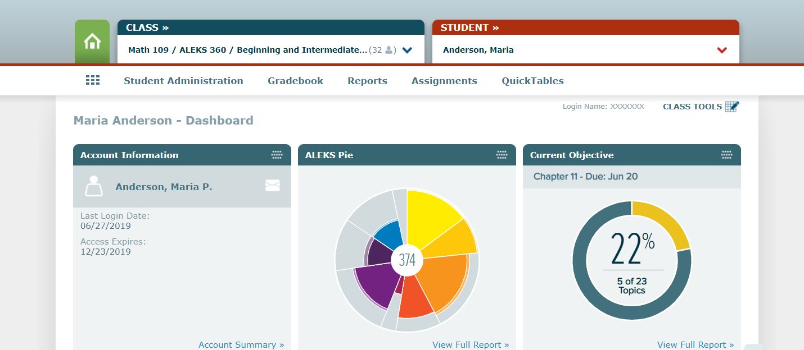
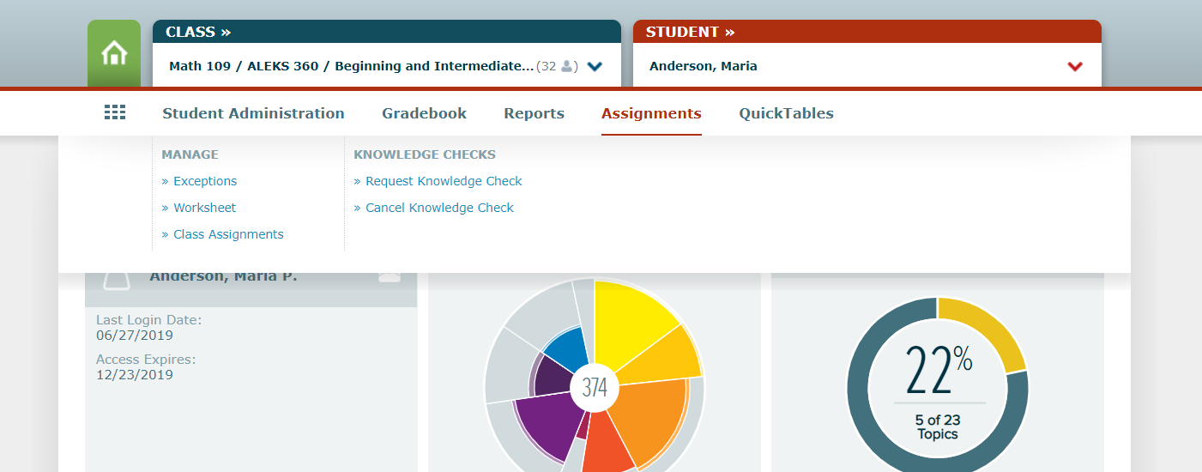
Managing Exceptions
To allow for extensions and other exceptions in ALEKS, first select the students name in the “student” field in the upper right corner of your course home page.
Then click on the assignments link in the middle and select “exceptions” under the manage column on the left.

Slide 3
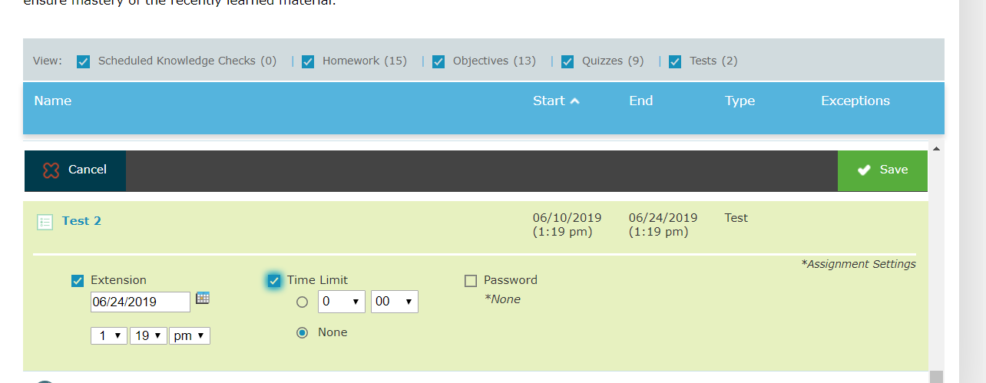
Setting an Extension
You will now see a screen of all of the student’s assignments and objectives with the course due dates.
To add an extension, click on the assignment that you need to extend it will say “Extension”.
Clicking that box will add a date and time that you can edit for the individual student.
Once you are satisfied with the change, make sure to hit the Green save box in the upper right-hand corner of the assignment.

Slide 4
Support and Resources
TECH SUPPORT & FAQ:
CALL: (800) 258-2374
EMAIL & CHAT: aleks.com/support
MONDAY-THURSDAY: 7 AM – 1 AM EST
FRIDAY: 7 AM – 9 PM EST
SUNDAY: 4 PM – 1 AM EST
FIND MORE SUPPORT:
supportateverystep.com
FIND MORE TIPS:
mheducation.com/highered/ideas

