Slide 1
How To Talk To Your Students About Knowledge Checks
ALEKS Training Series
Instructors

Slide 2
Student Frustration
After a few cycles of working in ALEKS followed by a Progress Knowledge Check, most students will make peace with them.
However, others will get frustrated as they see them as a barrier to completing other course work.
This especially true if they try to cram a lot of work into a small time frame (like trying to add 50 topics in a weekend) as they may encounter several Progress Knowledge Checks during that time frame.
As with all courses, it is in the best interest of students to work consistently through the course and not procrastinate.
One way to combat frustration and cramming behavior is to be sure students are aware of the structure, benefits, and notifications surrounding Knowledge Checks

Slide 3
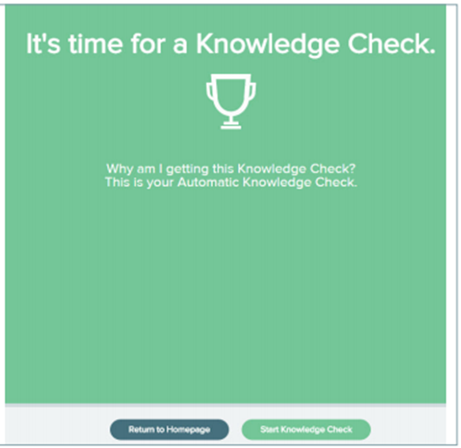
The Progress Knowledge Check
Encourage students to think of Progress Knowledge Checks as a non-punitive Review.
After a student spends 5 hours in ALEKS and learns 20 topics, they will take their Knowledge Check.
ALEKS uses their individual learning path to guide the questions. It is important that students always do their best, and only use “I Don’t Know” if they truly don’t know what to do.

Slide 4
Benefits of Knowledge Checks
In a non-ALEKS course, students who may not perform well on an often do not know what they need to do to improve. ALEKS takes care of this for students by identifying topics that need more practice.
Other benefits to Knowledge Checks:
Immediate feedback on topics to review
  Student Knowledge Check results will show any topics they had learned, but did not show mastery of, and therefore need to revisit. Students can then review those specific topics that need more practice prior to a graded assignment or assessment.
Credit for mastery of material
    If students are showing mastery of their learned material on a Knowledge Check ALEKS will reach into their Ready-to-Learn topics. This means students can gain topics without practicing them in Learning Mode!

Slide 5
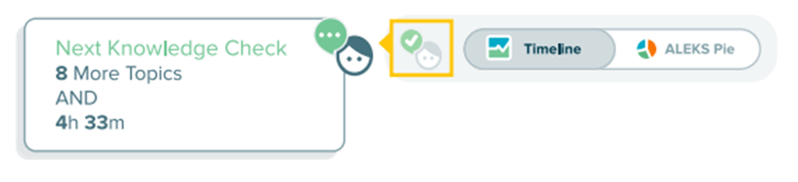
Knowledge Check Notifications
The Knowledge Check icon eliminates the surprise of a Progress Knowledge Check popping up during a work session.
It is important to note that the time mentioned, 5 hours in ALEKS, is time spent actively working in ALEKS not regular clock hours.

Slide 6
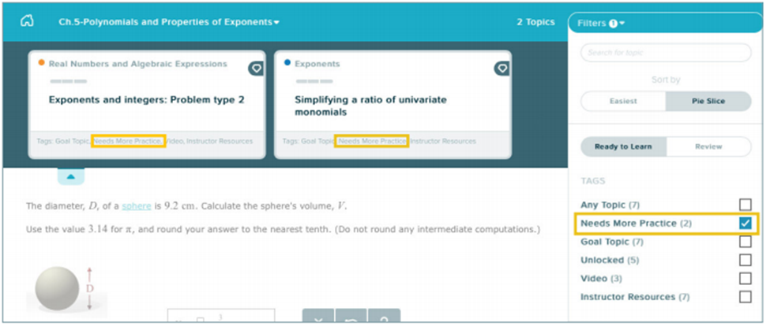
Needs More Practice Topics
If students fail to retain topics on a Knowledge Check they can immediately go into Learning Mode and use the “Needs More Practice” filter to identify those topics they need to relearn.
Note: it takes fewer correct answers to gain topics back than it did to “learn” them, students need only complete a 3-segment learning cycle instead of the original 5-segment cycle.

Slide 7
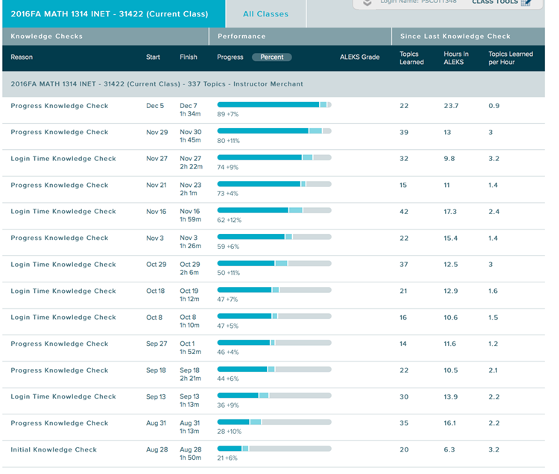
The Detailed Progress Report
Progress Knowledge Checks are where growth occurs. You can see a student’s learning progress by looking at the Detailed Progress Report.

Slide 8
Scheduling Knowledge Checks
You have the option to schedule Knowledge Checks at appropriate times for your class to assess student retention and mastery.
There are two types of knowledge checks that can be scheduled:
Scheduled Progress Knowledge Checks
    These are good for review of recent material and fit in nicely in place of traditional Quizzes.
Scheduled Comprehensive Knowledge Checks
    These are good for assessing knowledge of the entire course and are an excellent substitute for a traditional Test, or even a traditional Final Exam, as it can accurately determine a student’s knowledge of all course topics.

Slide 9
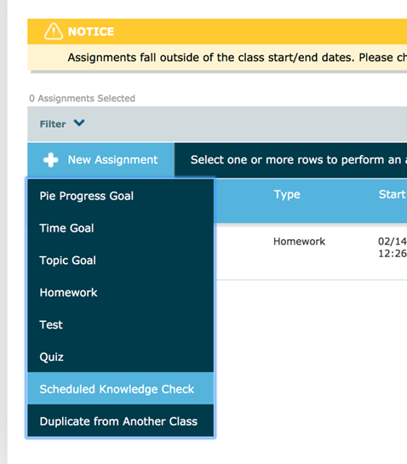
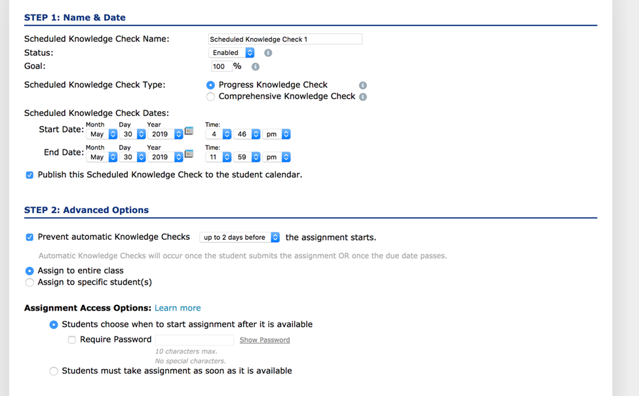
Assigning a Scheduled Knowledge Check
Go to the Assignments tab, select “Schedule Knowledge Check” and follow the steps to assign.

Slide 10
Support and Resources
TECH SUPPORT & FAQ:
CALL: (800) 258-2374
EMAIL & CHAT: aleks.com/support
MONDAY-THURSDAY: 7 AM – 1 AM EST
FRIDAY: 7 AM – 9 PM EST
SUNDAY: 4 PM – 1 AM EST
FIND MORE SUPPORT:
supportateverystep.com
FIND MORE TIPS:
mheducation.com/highered/ideas

