Slide 1
Accessing Support
ALEKS Training Series
Students

Slide 2


Getting Help: Contact Us Link
Any time you have technical issues or are not sure how to proceed in ALEKS, there are many ways to get help.
From the ALEKS login page at www.aleks.com, select the Contact Us link in the top, right corner.
Select the Contact ALEKS Support link and choose your preferred form of contact.

Slide 3

Getting Help: Support Link
You can also check out the technical support articles and videos.
From the ALEKS home page, select the Support link in the top, right corner.

Slide 4
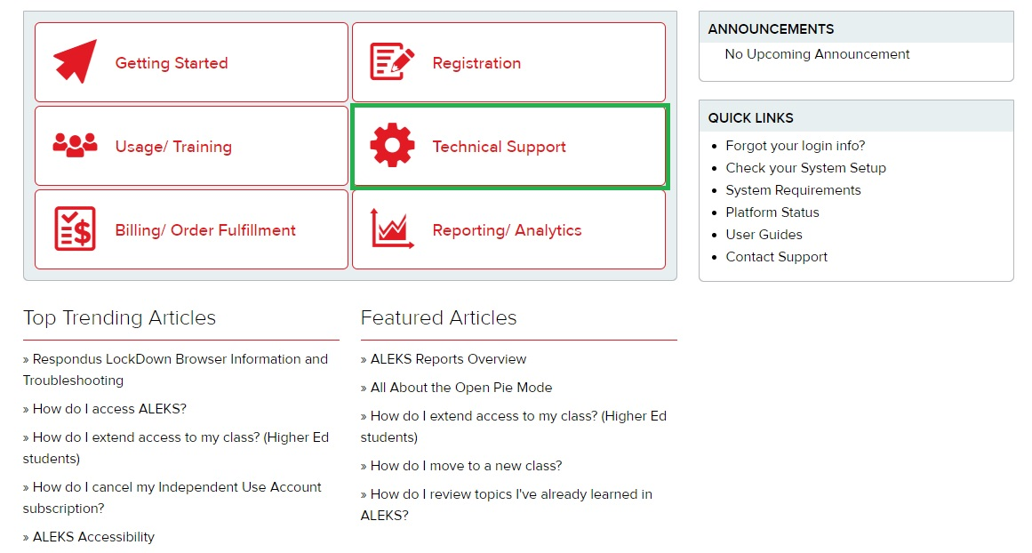
Technical Support
From the main Support page. The Technical Support button will help you with any technical issues you may be having.
Getting Started, Usage/Training, and Registration, can help you learn more about navigating ALEKS and its features.
Select a button to access the tutorials and videos.

Slide 5
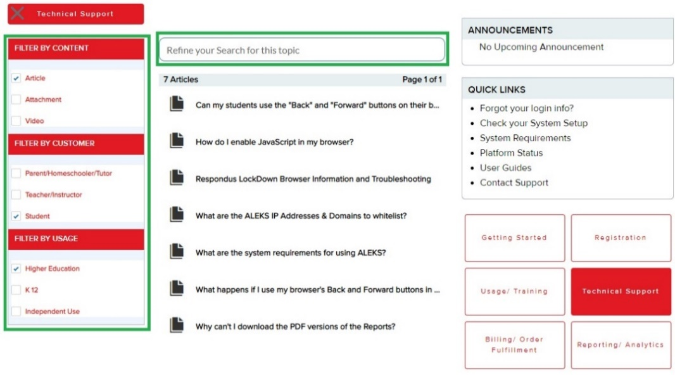
Technical Support Options
Use the filter and Search box to refine your search of resources that can help resolve your issue.

Slide 6
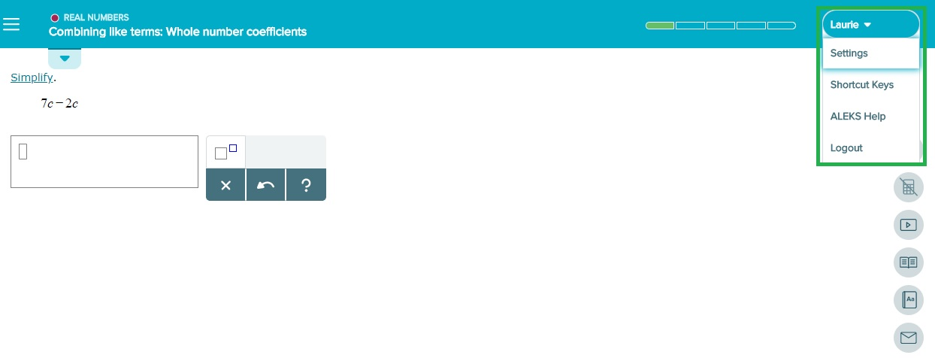
Getting Help Within ALEKS
If you need help while working in ALEKS, select the triangle next to your name in the upper, right corner and select Help from the menu.

Slide 7
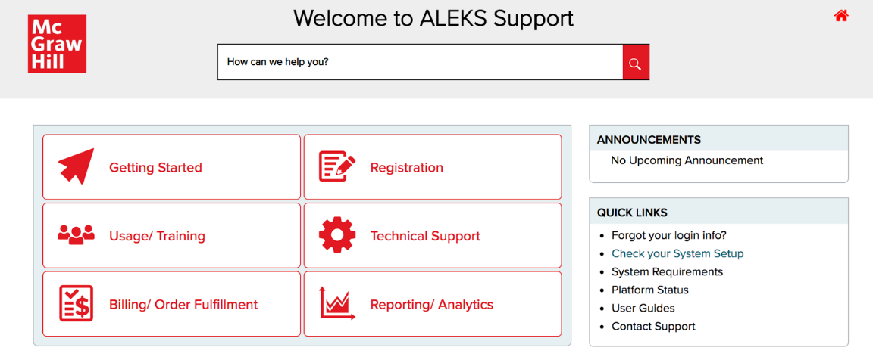
Checking System Requirements
You can also access system requirements for running ALEKS effectively on your computer or tablet.
From the Support page, the Check your System Setup and System Requirements links are located on the right-hand side.

Slide 8
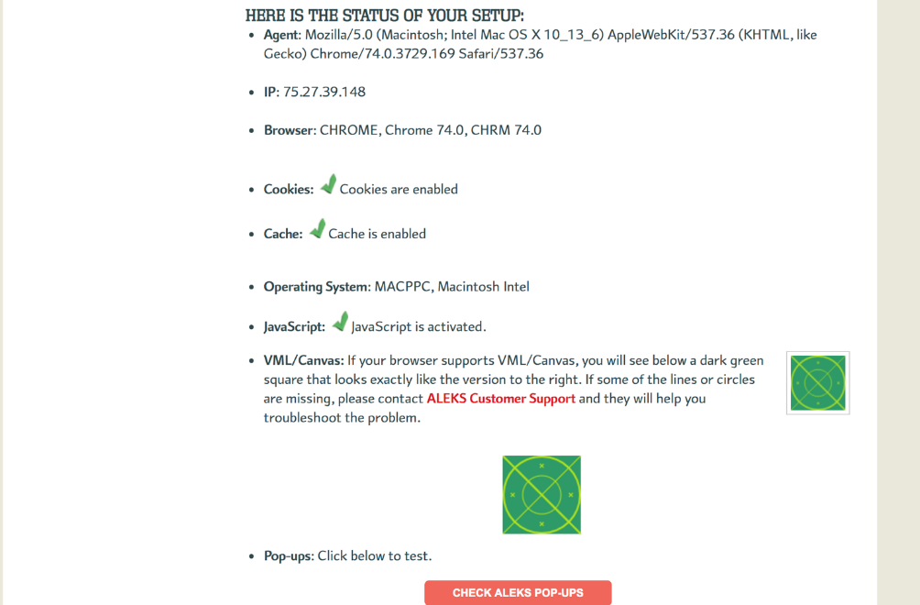
System Setup Summary
Selecting the Check your System Setup link will summarize your computer’s settings and whether they meet the ALEKS requirements.

Slide 9
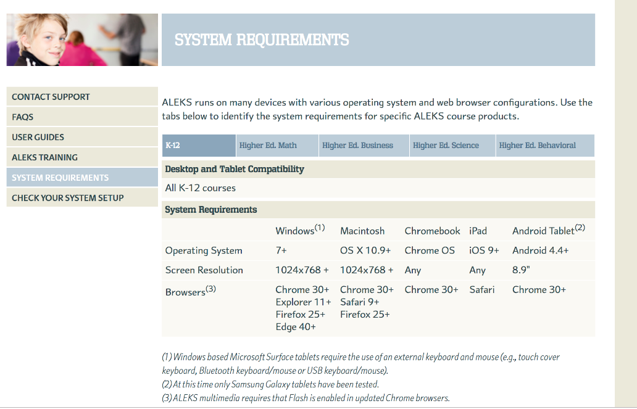
System Requirements Summary
For details on what ALEKS requires to work smoothly on your device, view the System Requirements for that device.
If you continue to have technical difficulty, please contact support.

Slide 10
Support and Resources
TECH SUPPORT & FAQ:
CALL: (800) 258-2374
EMAIL & CHAT: aleks.com/support
MONDAY-THURSDAY: 7 AM – 1 AM EST
FRIDAY: 7 AM – 9 PM EST
SUNDAY: 4 PM – 1 AM EST
FIND MORE SUPPORT:
supportateverystep.com
FIND MORE TIPS:
mheducation.com/highered/ideas

