Slide 1
Study Tips
ALEKS Training Series
Students

Slide 2
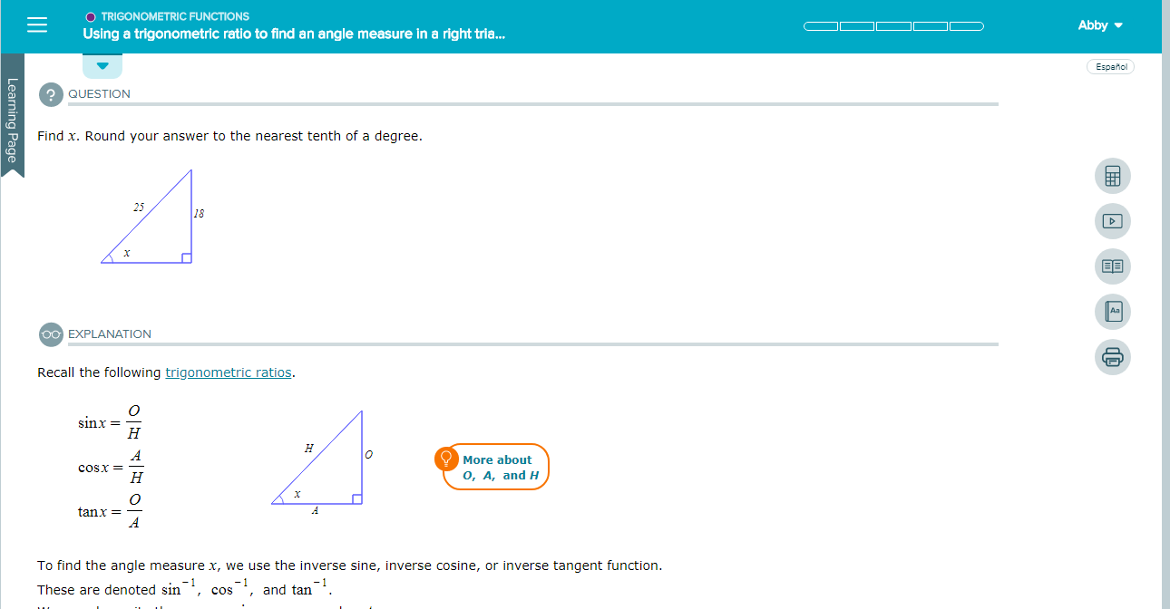
Starting a New Topic
To start a new topic, select “Start My Path” or “Continue My Path” on the homepage. If you aren’t on the homepage, open the Menu button in the top left-hand corner of the screen and select “Learn.”
In either case, the topic you are most ready to learn will appear first.

Slide 3
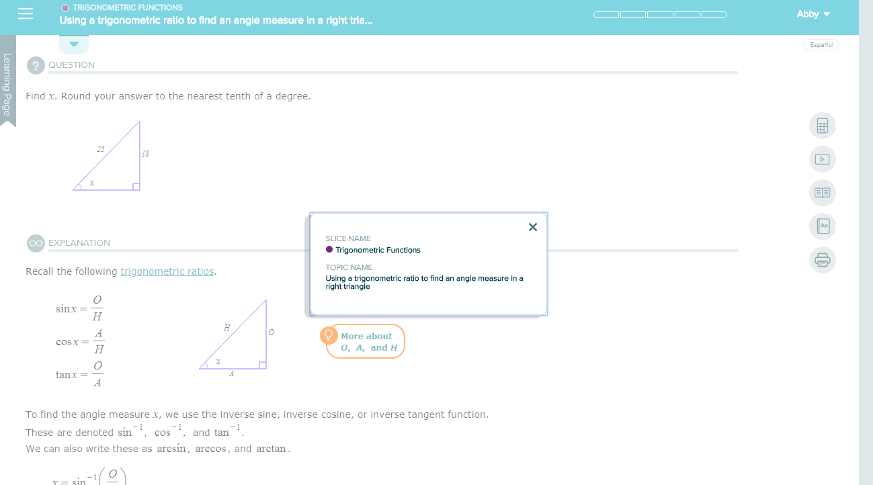
Viewing Information About a Topic
You can find the name of the topic in the blue bar at the top of the screen. If the title is cut off, select the topic’s name and a pop up window will appear. This will show you the entire topic name as well as which pie slice it comes from.

Slide 4
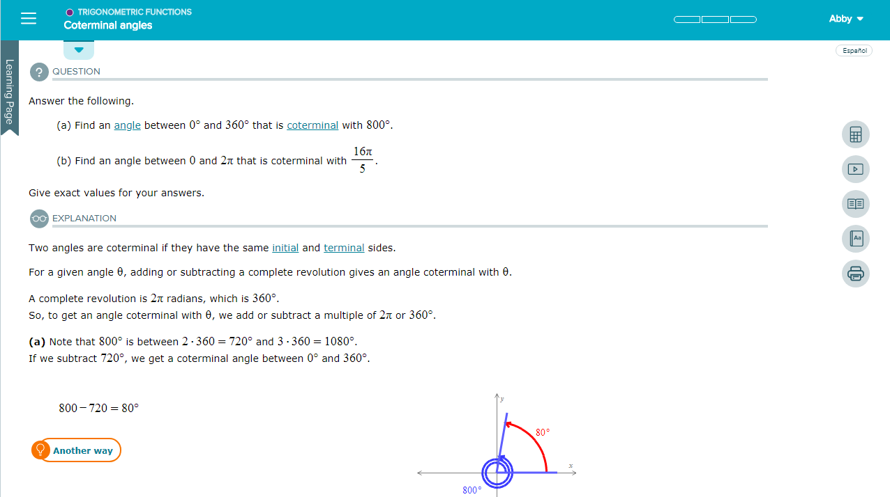
Tips About Using Learning Page
In a Learning Page, you will see a question with a stepped-out explanation.
Read through the example carefully, taking notes in your notebook.
Note the tools and resources on the learning page.
Observe the hyperlinks giving definitions, helpful hints, or examples.
There may be an orange button with a lightbulb that says “More” or “Another Way.” Select to see an alternate solution or more details.

Slide 5
General Tips
On the learning page, there are icons on the right-hand side of the screen offering helpful resources including a calculator, videos, the eBook, a dictionary, the ability to print, and a way to email your instructor.
After reading an example, select Start at the bottom of the page.
Try copying the problem into your own notebook.
If you are stuck, use a resource.
If you want to see another problem worked out, you can choose to see the explanation.

Slide 6
Support and Resources
TECH SUPPORT & FAQ:
CALL: (800) 258-2374
EMAIL & CHAT: aleks.com/support
MONDAY-THURSDAY: 7 AM – 1 AM EST
FRIDAY: 7 AM – 9 PM EST
SUNDAY: 4 PM – 1 AM EST
FIND MORE SUPPORT:
mhhe.com/collegesmarter

