Slide 1
Reports
Aleks Training Series
Students

Slide 2
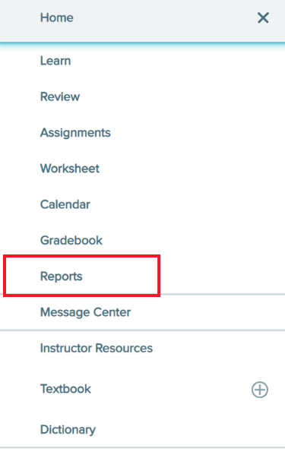
Reports Menu
ALEKS Reports lets you monitor how much you’ve learned, how much is left to learn, your time logged, and the virtual steps left to reach your goals.
To access Reports, go to your course home page, open the menu in the top, left corner and select Reports.

Slide 3
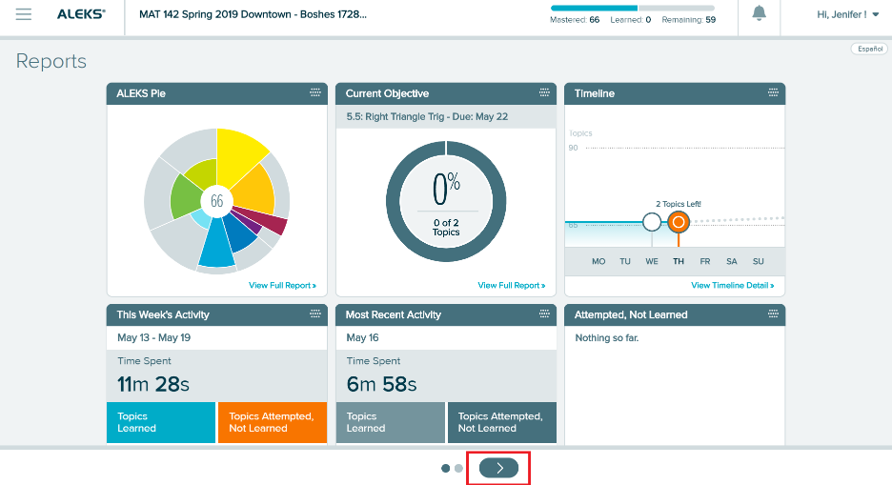
Reports Tiles
Reports consists of 10 tiles, spread out of over 2 pages.
You can navigate between pages using the arrows on the bottom of the screen.
You can also rearrange the tiles, by selecting the dots icon in the upper, right corner of each tile.
Each report tile gives a snapshot of information, while selecting the tile will provide more in-depth information.

Slide 4
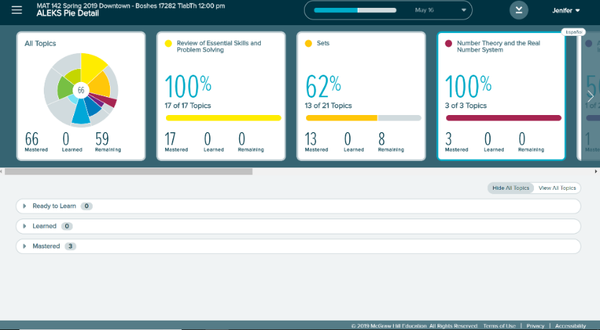
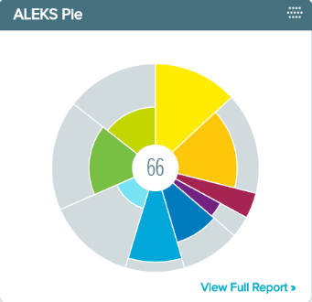
The ALEKS Pie Tile
The ALEKS Pie tile tells you how many topics you have mastered so far.
View Full Report in the bottom right corner will open a summary of your overall progress.
You can further investigate your progress in each pie slice by selecting it from the menu.
On the bottom half of the screen, you see sub-menus for the topics you are Ready to Learn, have learned, and have mastered.
Select a topic to see a sample question.

Slide 5
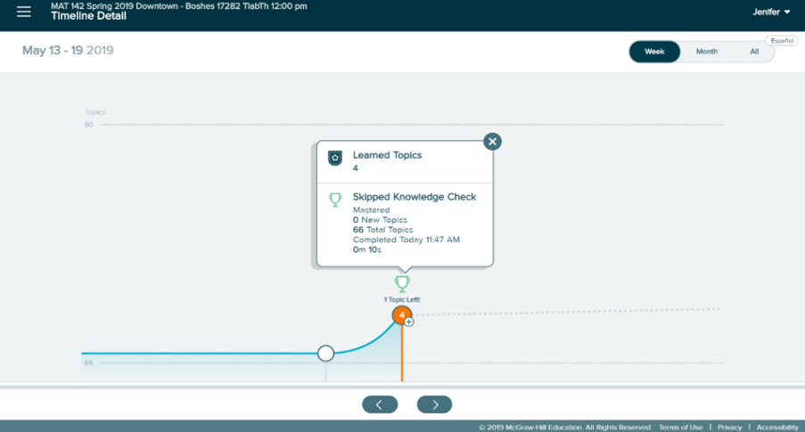
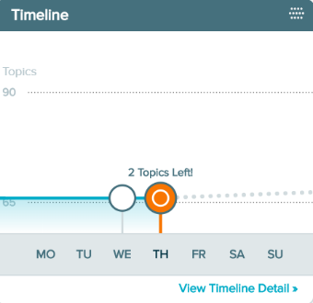
The Timeline Tile
The Timeline tile will tell you how many topics you have left to complete your current Objective assignment.
Select View Timeline Detail in the bottom right corner to see more information.
You have the option to view progress for the week, the month, or, so far in the course.
The timeline shows the amount of time you spent completing topics and Objective assignments, and which ones are completed.
By selecting a circle, you see more information about what happened on that day.

Slide 6
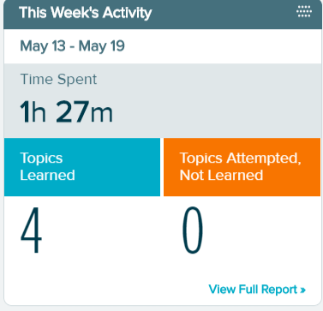
This Week’s Activity Tile
The This Week’s Activity tile is a snapshot of how much time you’ve spent going through topics this week, and how many topics you have successfully learned.
Select View Full Report in the bottom right corner to see more information.

Slide 7
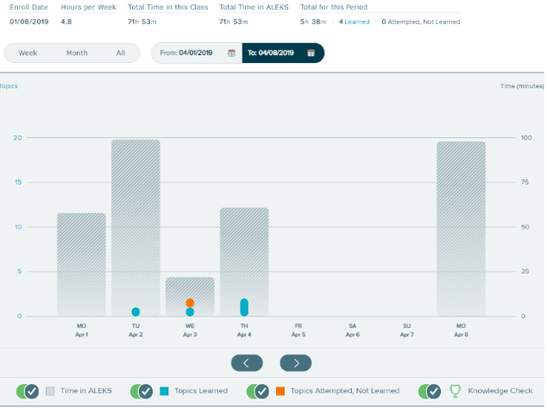
This Week’s Activity: View Full Report
Here, you can look at the progress for the week, the month, or since the course began.
You can also filter between specific dates.
Once you choose the time period you’d like to look at, this tile gives you information on the topics you’ve tried, learned, or mastered in that time.

Slide 8
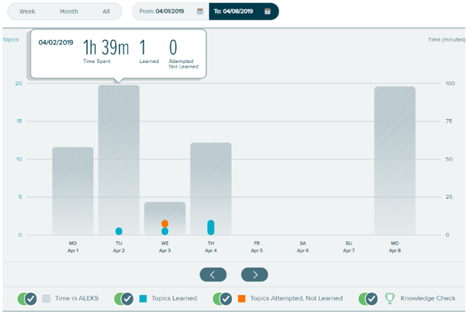
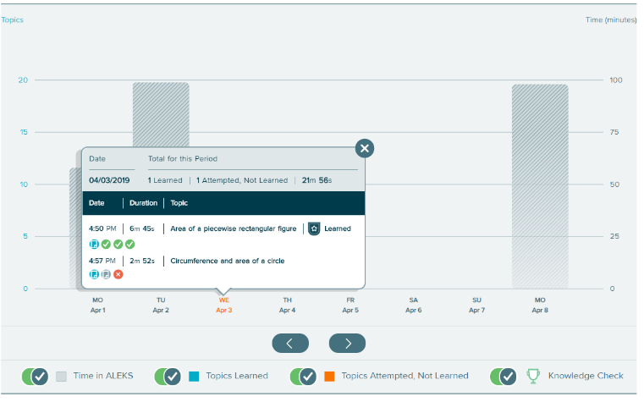
Reading This Week’s Activity Report
If you hover over the wide, shaded bars, you’ll see the amount of time you spend in ALEKS on that day.
Select one of the smaller bars centered on the date to see every question you’ve attempted for a topic.
The circle icons show your progression for the topic: whether you read an Explanation, got a problem correct, or got a problem wrong.
Selecting any of these icons will show you the exact problem and lesson you worked through.

Slide 9
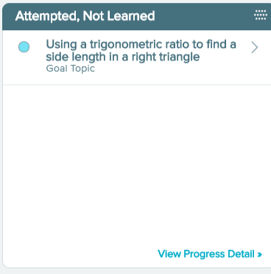
The Attempted, Not Learned Tile
The Attempted, Not Learned tile is one of the more important tiles you’ll want to use.
It shows topics that you have attempted to learn, but not yet successfully completed.
If you select View Progress Detail in the bottom right corner, you will be taken back to the ALEKS Pie report.
From here, you can narrow your focus to the topics you need to help you get through the ones that are more difficult, like the prerequisite topics.

Slide 10
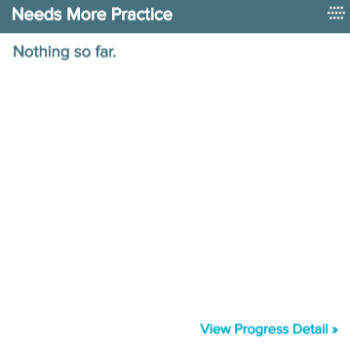
The Needs More Practice Tile
The Needs More Practice tile suggests topics that you should practice.
These are based on the Knowledge Checks that you take. In other words, these are the topics you “missed” on your Knowledge Checks.
Selecting View Progress Detail will take you back to ALEKS Pie Report so you can access the topics you need to practice.

Slide 11
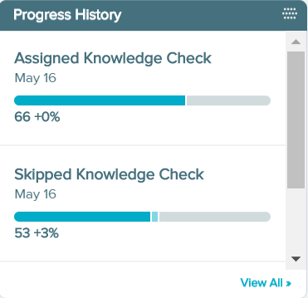
The Progress History Tile
The Progress History tile is a snapshot of how well you’ve done on the latest Knowledge Checks. Remember, Knowledge Checks are checking to see what you’ve mastered so far in the course. The first number is the percentage of the course material you’ve mastered. The second shows how much you’ve learned between each Check.
Select View All to see the complete list of the Knowledge Checks you have taken so far. As long as the blue line keeps growing, you’re doing ok!

Slide 12
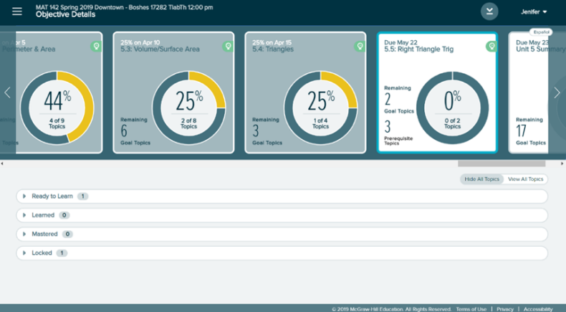
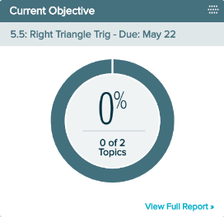
The Current Objective Tile
If your class is using Objective assignments, the Current Objective tile will be very useful to you.
The tells you the due date of the next Objective, as well as how many topics are in it.
Select View Full Report in the bottom right corner to see more information.
Here, you will see your progress and completion of each Objective assignment. Prerequisite topics that need to be covered to unlock an Objective, will be here as well.

Slide 13
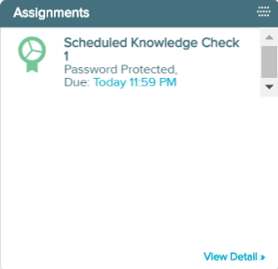
The Assignments Tile
The Assignments tile lists your upcoming assignments and their due dates.
Selecting View Detail will show you a complete listing of any available assignments for the course.

Slide 14
Reports Tiles Tips
Gradebook and Most Recent Activity are also helpful tiles to consider.
Remember you can rearrange these tiles in whatever order works best for you. Just be sure to check out the information in each one.
If you find yourself needing guidance on what to focus on, or just want to know how well you are doing or how much you have to do before reaching a goal, look at your Reports.

Slide 15
Support and Resources
TECH SUPPORT & FAQ:
CALL: (800) 258-2374
EMAIL & CHAT: aleks.com/support
MONDAY-THURSDAY: 7 AM – 1 AM EST
FRIDAY: 7 AM – 9 PM EST
SUNDAY: 4 PM – 1 AM EST
FIND MORE SUPPORT:
mhhe.com/collegesmarter

