Slide 1
Managing your Time with ALEKS
ALEKS Training Series
Students

Slide 2
Best Practices for Managing Time
To be successful in ALEKS requires time management
Work in ALEKS on a regular basis.
Learn as many topics as you can, while logged into ALEKS.

Slide 3
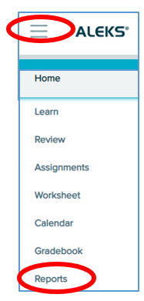
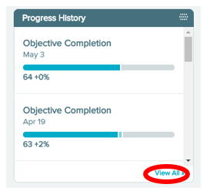
Know Your Learning Rate
Knowing your learning rate will help you plan out your week of studying and help you avoid cramming to meet a deadline.
To get an idea of your learning rate, you’ll want to check out your Progress report. Open the Main Menu in the upper left hand corner and choose Reports.
Then find the Progress History tile and select “View All”.

Slide 4
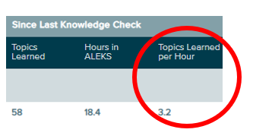
Using Your Learning Rate
On the right hand side of the full report, you will see the column “Topics Learned per Hour.”
This is based on your learning rate while working in the ALEKS Pie.
If you have a rough idea of how much time is needed, you can plan out how you will spread out your study hours.
One thing you should avoid is trying to do all everything the day before it is due. Procrastinating and cramming is not helpful!

Slide 5
Staying on Track in ALEKS: Situation One
Situation One: you are working on a topic and you get into a cycle of getting a question correct and then missing the next question.
When this happens, there is usually one part of the topic’s concept that you aren’t understanding correctly.
In most cases, you will find that these misconceptions can quickly and easily be corrected with some guidance.
Ask your instructor for help.
Take a break from the topic.
Try working on something else for a while.
Understand that some topics are more difficult for you to learn than others. When you get to one of those, just take a break or ask for help.

Slide 6
Staying on Track in ALEKS: Situation Two
Situation Two: You are working in ALEKS and learning topics, but your grade for your current Objective assignment doesn’t seem to change.
When this happens, you may have some essential, prerequisite topics from a previous Objective assignment that you need to complete first. You can see the list of topics that you can work from the current Objective, known as goal topics.

Slide 7
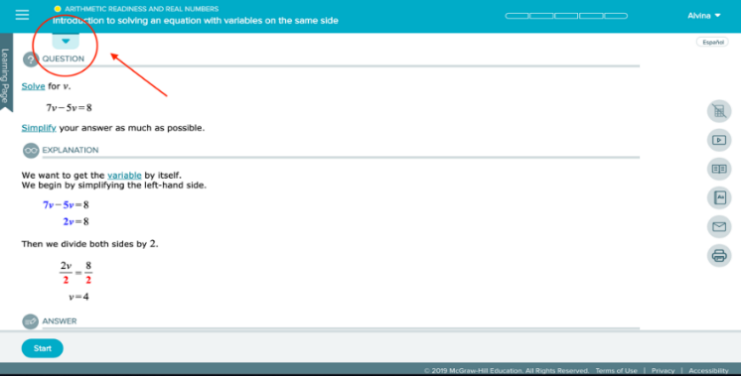
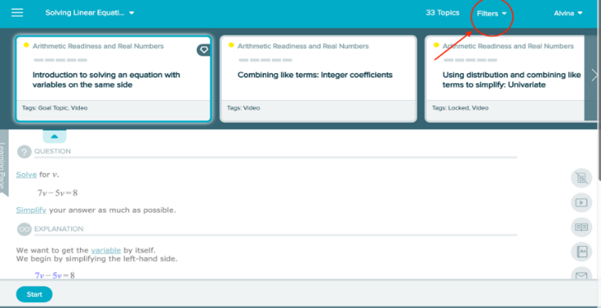
Seeing Your Goal Topics
From learning mode, click the blue tab to reveal the topic carousel.
Click on “Filters” in the upper right corner.

Slide 8
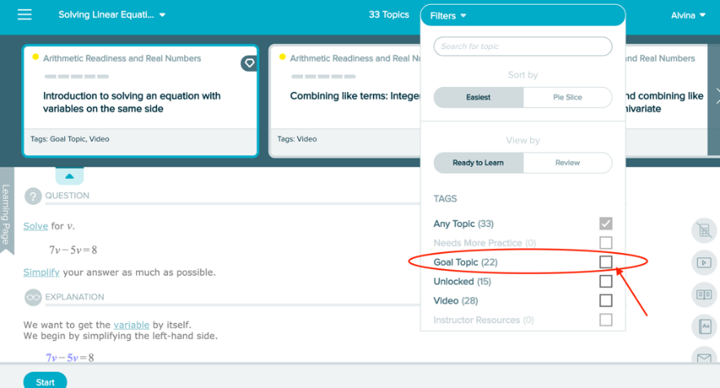
Using Filters to See Your Goal Topics
Check the “Goal Topic” box to show just goal topics in the learning carousel (denoted by the diamond icon).
These are the topics that count toward your current Objective assignment grade.
There may come a point where ALEKS will want you to work on essential, prerequisite topics first before finishing up goal topics.
These essential topics are necessary to help you learn and understand the concepts in the goal topics.

Slide 9
Staying on Track in ALEKS: Situation Three
Situation Three: Even though you’re accomplishing a lot, sometimes it feels like you still have a long way to go.
When this happens, all you need is a little reminder of how far you’ve come.
Seeing your ALEKS pie fill in can be motivating, but it doesn’t show your journey.
To see how far you’ve come, check out the details in your timeline.
You can view your timeline in two ways.

Slide 10
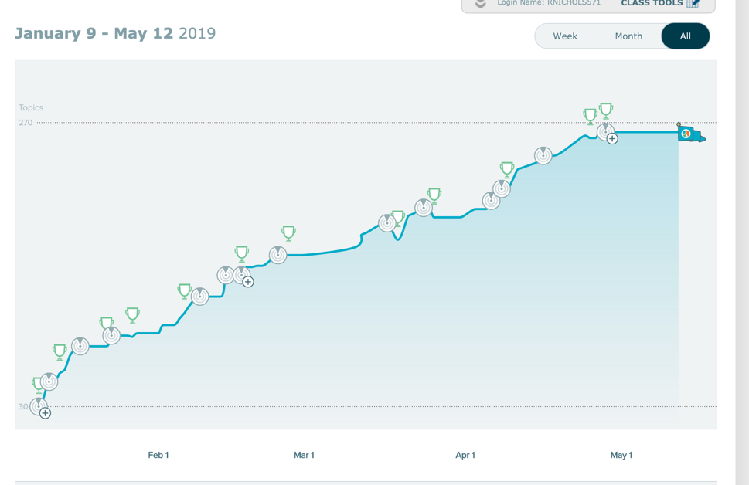
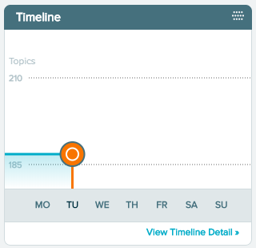
Viewing Your Timeline
Select Timeline from the toggle buttons on the course home page, or
go to the Reports menu from the Main Menu in the top, left corner. Select View Timeline Detail from the Timeline report tile.

Slide 11
Support and Resources
TECH SUPPORT & FAQ:
CALL: (800) 258-2374
EMAIL & CHAT: aleks.com/support
MONDAY-THURSDAY: 7 AM – 1 AM EST
FRIDAY: 7 AM – 9 PM EST
SUNDAY: 4 PM – 1 AM EST
FIND MORE SUPPORT:
mhhe.com/collegesmarter

