Slide 1
Managing To Dos-Assignments Objectives and Pie
ALEKS Training Series
Students

Slide 2
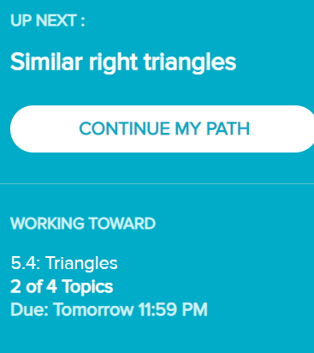

Meeting Deadlines: Continue My Path
From the course main page, you should see the option to “Continue My Path”. In selecting this option, you will complete a topic that is a part of the current objective.
You will also see which objective you are working toward.
Upon successful completion of a topic, you will be notified of your success, and will see how many topics remain in that objective.

Slide 3
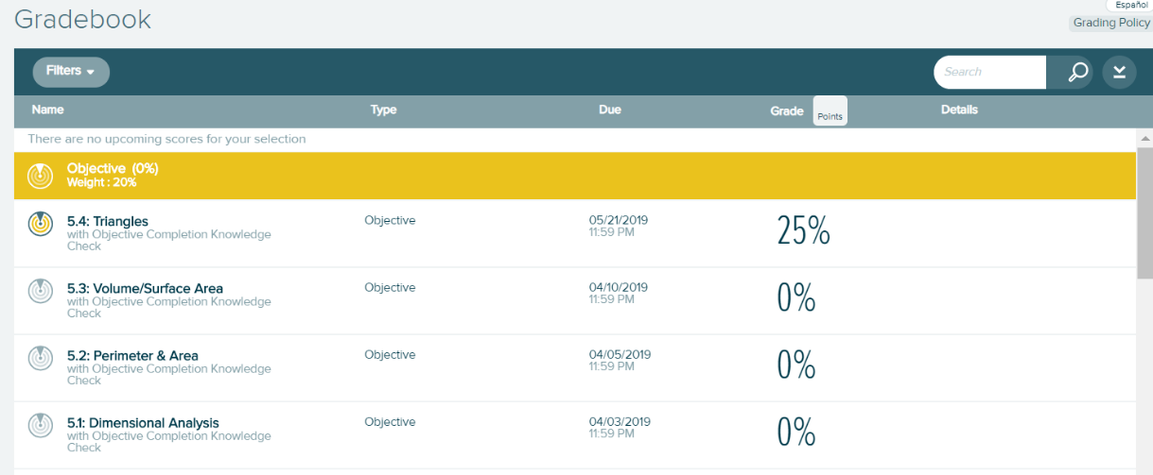
Meeting Deadlines Using the Gradebook
Find the three small horizontal lines on the left of the home page. Click on them to open the menu, then click on Gradebook. In doing so, you will see a complete listing of the course objective assignments, as well as any grades you have earned on them.

Slide 4
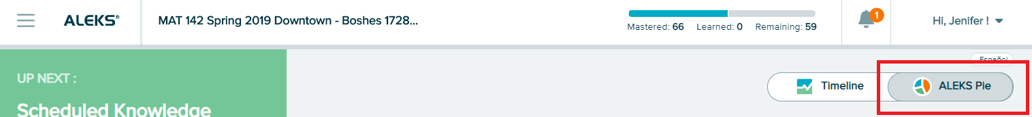
Accessing the ALEKS Pie
From the main course page, you will see the ALEKS Pie. If you do not see it, you may have to select ALEKS Pie from the top right corner.

Slide 5
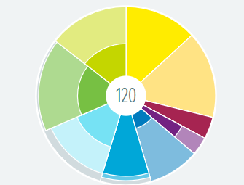
Understanding the ALEKS Pie
The ALEKS Pie is a visual representation of your overall progress.
Each slice represents a grouping of topics
The darker color in a slice represents the topics mastered
The lighter color represents topics learned
The outside shaded part represents the topics you have yet to learn
The number listed in the middle of the pie is the number of topics you have successfully completed already

Slide 6
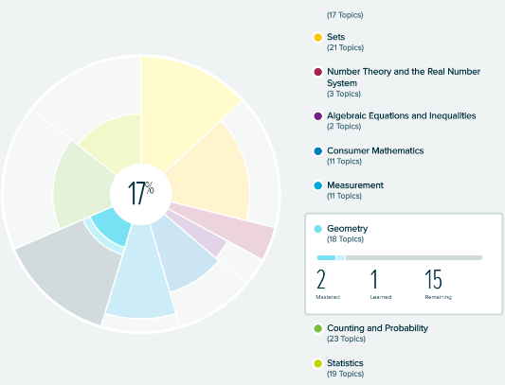
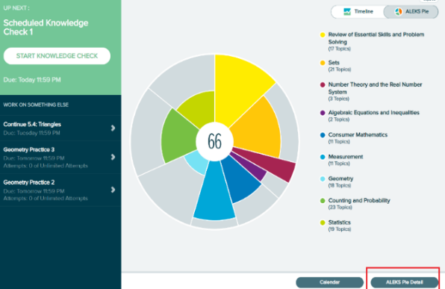
Slices Within the ALEKS Pie
If you Click on any slice of the ALEKS pie, you will see the actual number of topics mastered, learned, and remaining.
If you would like to see more detail any a slice, you can click on “ALEKS Pie Detail” on the bottom right corner of the home screen.

Slide 7
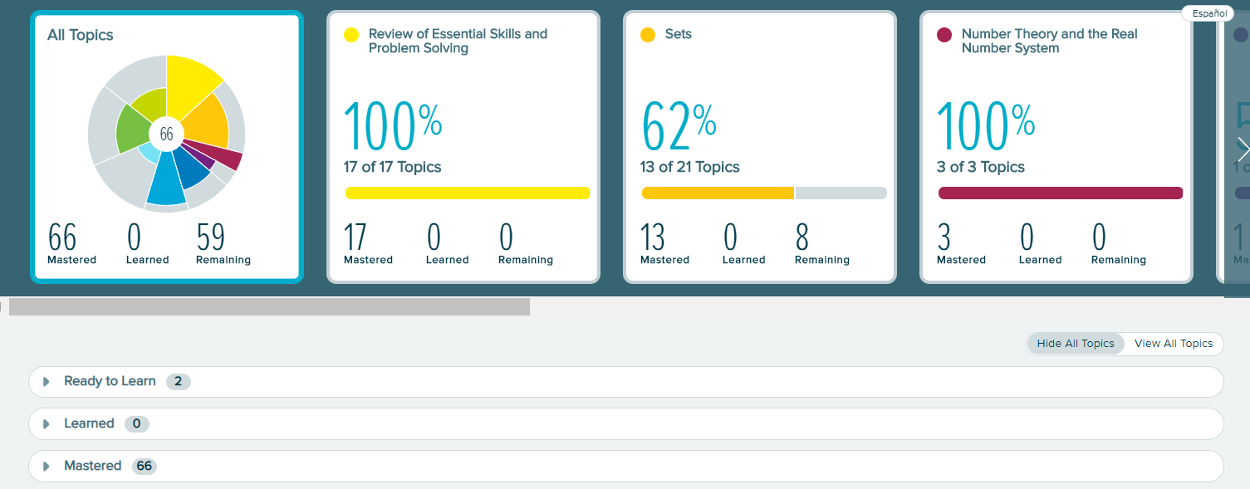
ALEKS Pie Detail
Clicking ALEKS Pie Detail will let you navigate through all of the pie slices, and see a specific list of topics contained in every slice or Objective. These topics are organized by topics that are ready to learn, topics that have been learned, and topics that have been mastered.

Slide 8
Finding your Assignments
The three small horizontal lines on the left of the home page are the menu.
Click on them to open the menu, then click on Assignments.

Slide 9
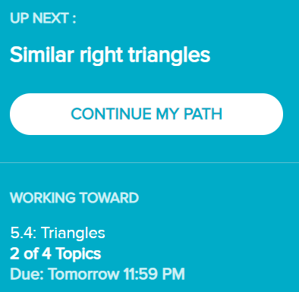
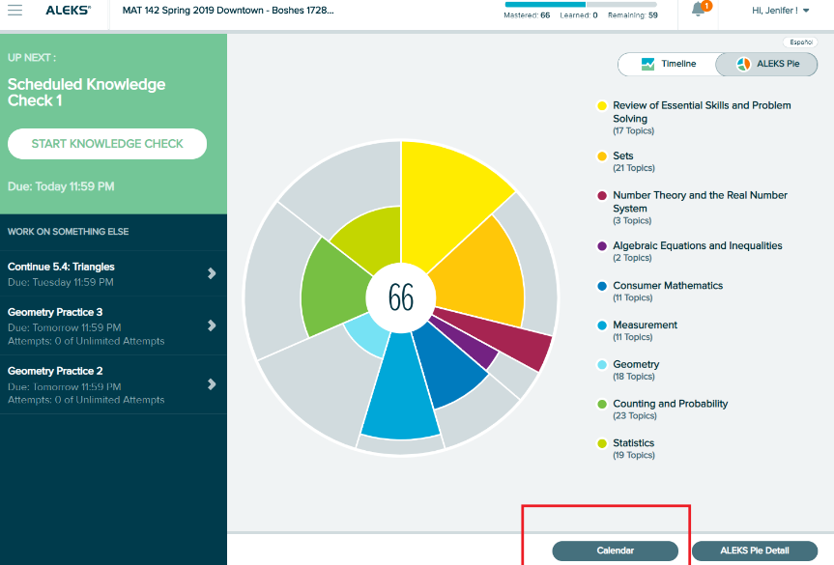
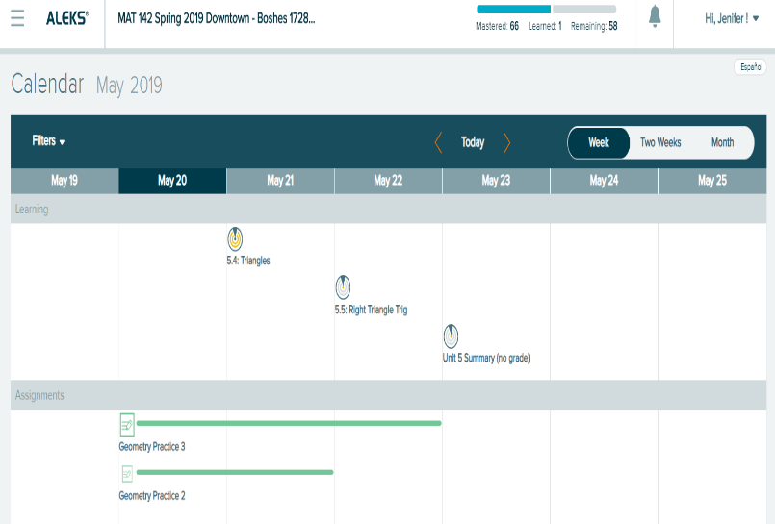
Finding Deadlines
  You can find assignment deadlines in several places
  From the course home page, look for “Working Toward”.
  From the Assignments and Gradebook menus.
  Use the calendar near the bottom right corner of the course home page.

Slide 10
Support and Resources
TECH SUPPORT & FAQ:
CALL: (800) 258-2374
EMAIL & CHAT: aleks.com/support
MONDAY-THURSDAY: 7 AM – 1 AM EST
FRIDAY: 7 AM – 9 PM EST
SUNDAY: 4 PM – 1 AM EST
FIND MORE SUPPORT:
mhhe.com/collegesmarter

