Slide 1
Accessing your ALEKS 360 eBook
ALEKS Training Series
Students

Slide 2
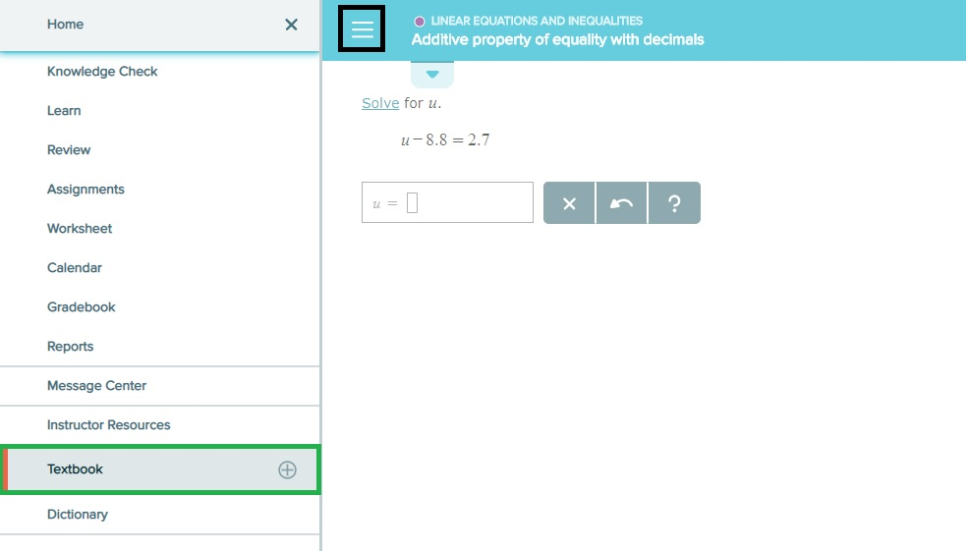
Accessing the eBook from the Main Menu
On the top left of the home page, you will see three small horizontal lines. The eBook can be opened from this menu.

Slide 3
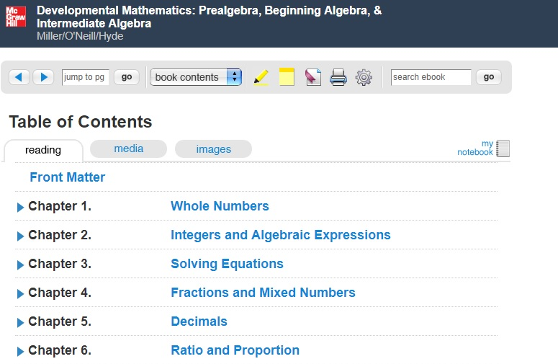
Using the eBook
Within the eBook, you can go directly to a specific page, search for a specific topic or view videos under the Media tab. Use the highlighter, notepad and bookmark to notate items that are especially helpful for you.

Slide 4
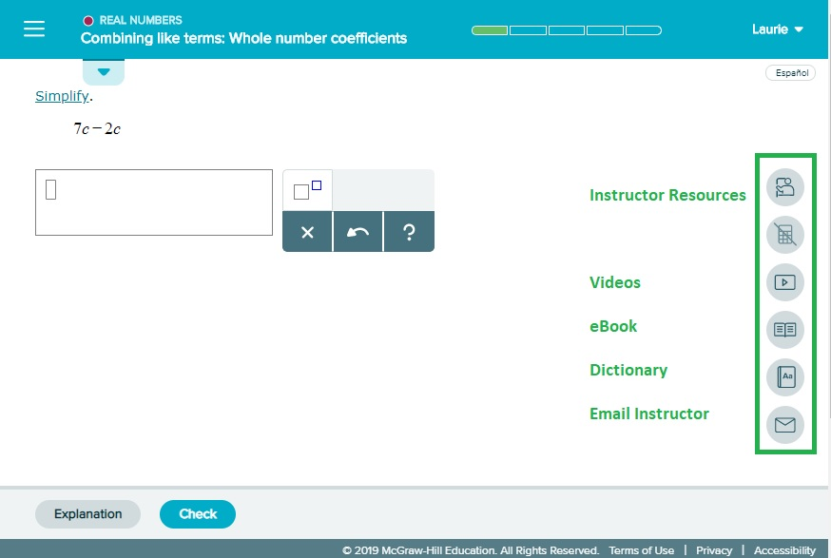
Accessing the eBook in Learning Mode or Review Mode
The eBook and its associated videos will always be accessible from any topic while you are in 'Review' mode or in 'Ready to Learn' mode.

Slide 5
Support and Resources
TECH SUPPORT & FAQ:
CALL: (800) 258-2374
EMAIL & CHAT: aleks.com/support
MONDAY-THURSDAY: 7 AM – 1 AM EST
FRIDAY: 7 AM – 9 PM EST
SUNDAY: 4 PM – 1 AM EST
FIND MORE SUPPORT:
mhhe.com/collegesmarter

