Slide 1
SIMnet®
Student Registration
Moodle with Inclusive Access

Slide 2
Benefits of Registering
What do you get when you register for SIMnet?
Hands-on practice with the Microsoft applications you will use in college and your career.
The ability to earn digital badges to showcase on LinkedIn, resumes, and more.
The ability to continue accessing content in your SIMnet library after your course ends.

Slide 3
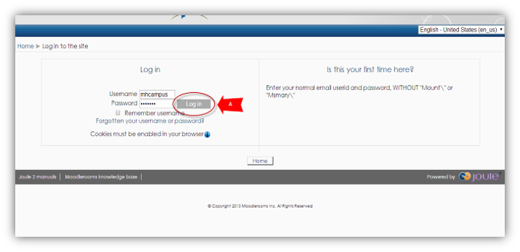
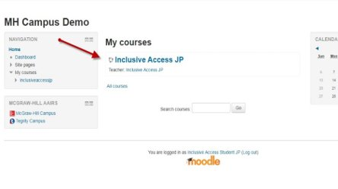
Step 1
Log in to your Moodle account and navigate to your course.
If you are not sure if you have a Moodle account, check with your instructor.

Slide 4
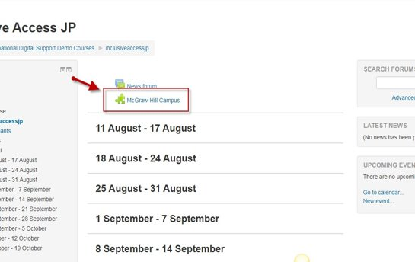
Step 2
On your course homepage, locate and click on the McGraw-Hill Campus tool link.​
Click on it to start the registration process.​

Slide 5
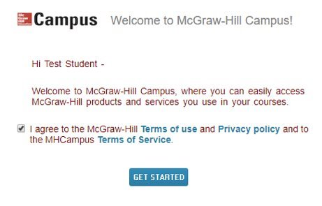
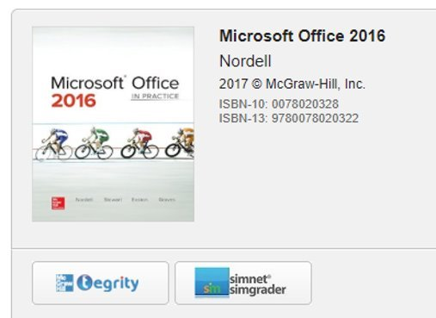
Step 3
If this is your first time using McGraw Hill Campus, you will need to agree to the terms of service and privacy policy and then click Get Started. ​
​
Then click on the SIMnet
button to continue.

Slide 6
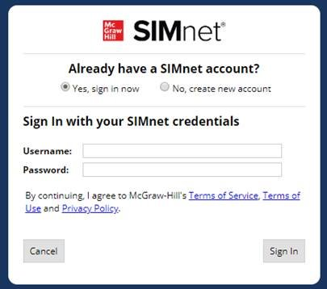
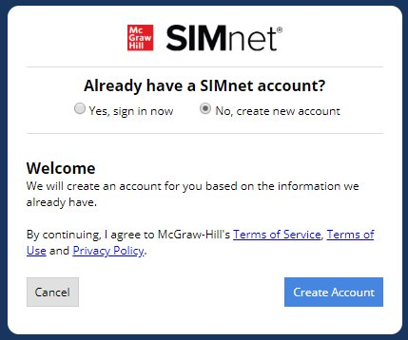
Step 4
Existing SIMnet login:
Select Yes, Sign in Now. ​
Enter your username and password and click Sign-in. ​
New to SIMnet:
Select No, Create new
account. ​
Click Create Account to have your account automatically created for you. ​

Slide 7
Support & Resources
Tech Support & FAQ:
Call:
(800) 331-5094
Email & Chat:
www.mhhe.com/support
Find More Tips:
http://www.supportateverystep.com/

Slide 8
QUESTIONS?

