Slide 1
SIMnet®
Student Registration
D2L Brightspace with Inclusive Access

Slide 2
Benefits of Registering
What do you get when you register for SIMnet?
Hands-on practice with the Microsoft applications you will use in college and your career.
The ability to earn digital badges to showcase on LinkedIn, resumes, and more.
The ability to continue accessing content in your SIMnet library after your course ends.

Slide 3
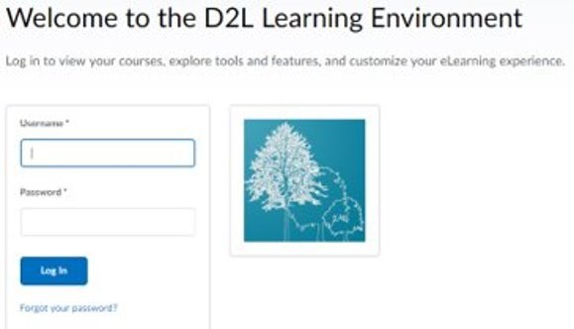
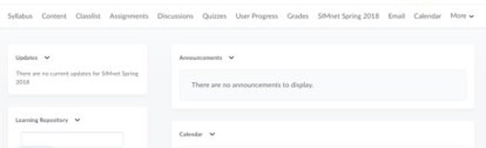
Step 1
Log in to your D2L Brightspace account and navigate to your course. ​
If you are not sure if you have a D2L/Brightspace account, check with your instructor.​

Slide 4
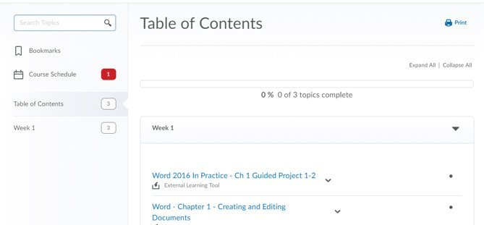
Step 2
In your course, navigate to your content area to find a SIMnet assignment link. If you're not sure where to go, just ask your instructor.​
Click on a SIMnet assignment to start the registration process. ​

Slide 5
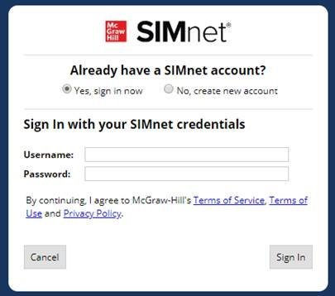
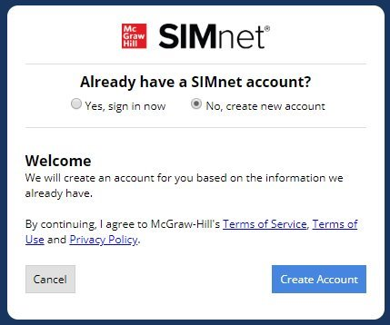
Step 3
Existing SIMnet login:
Select Yes, Sign in Now.
Enter your username and password and click Sign-in.
New to SIMnet:
Select No, Create new
account.
Click Create Account to have your account automatically created for you.

Slide 6
Support & Resources
Tech Support & FAQ:
Call:
(800) 331-5094
Email & Chat:
www.mhhe.com/support
Find More Tips:
http://www.supportateverystep.com/

Slide 7
QUESTIONS?

