Slide 1
SIMnet®
Student Registration
Blackboard with Inclusive Access

Slide 2
Benefits of Registering
What do you get when you register for SIMnet?
Hands-on practice with the Microsoft applications you will use in college and your career.
The ability to earn digital badges to showcase on LinkedIn, resumes, and more.
The ability to continue accessing content in your SIMnet library after your course ends.

Slide 3
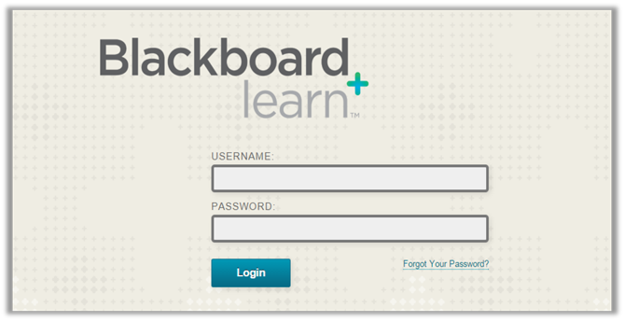
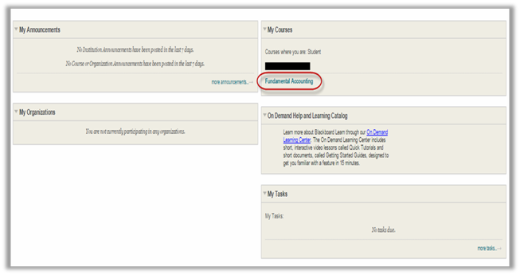
Step 1
Login into your Blackboard account and navigate to your course.
If you are not sure if you have a Blackboard account, check with your instructor.

Slide 4
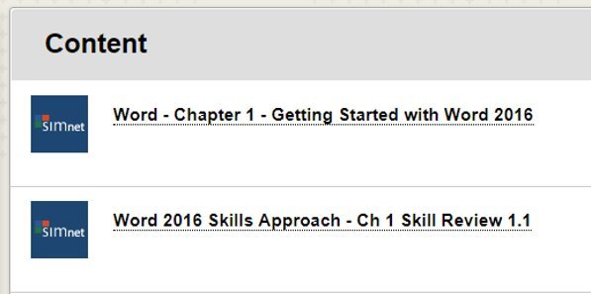
Step 2
In your course, navigate to a
SIMnet assignment link. If you are not sure where to find the link, ask your instructor. ​
Locate a SIMnet assignment, then click on a SIMnet assignment link to start the registration process. ​

Slide 5
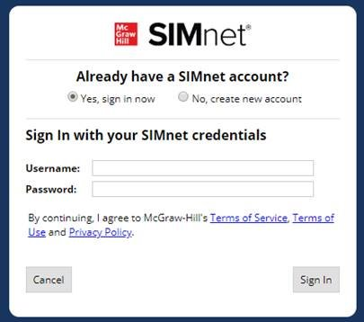
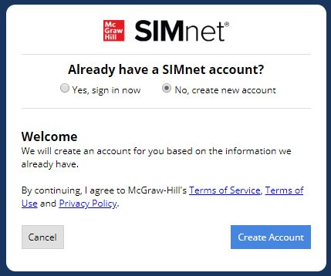
Step 3
Existing SIMnet login:
Select Yes, Sign in Now. ​
Enter your username and password and click Sign-in. ​
New to SIMnet:
Select No, Create new
account. ​
Click Create Account to have your account automatically created for you. ​

Slide 6
Support & Resources
Tech Support & FAQ:
Call:
(800) 331-5094
Email & Chat:
www.mhhe.com/support
Find More Tips:
http://www.supportateverystep.com/

Slide 7
QUESTIONS?

