Slide 1
SIMnet®
Student Registration
Canvas with Regular Deep Integration

Slide 2
Benefits of Registering
What do you get when you register for SIMnet?
Hands-on practice with the Microsoft applications you will use in college and your career.
The ability to earn digital badges to showcase on LinkedIn, resumes, and more.
The ability to continue accessing content in your SIMnet library after your course ends.

Slide 3
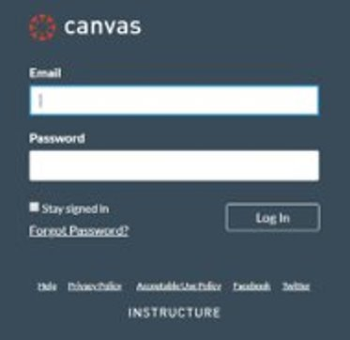
Step 1
Log in to your Canvas account and navigate to your course.
​
If you are not sure if you have a Canvas account, please ask your instructor.​

Slide 4
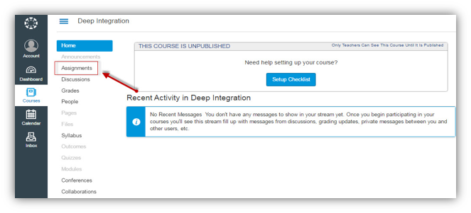
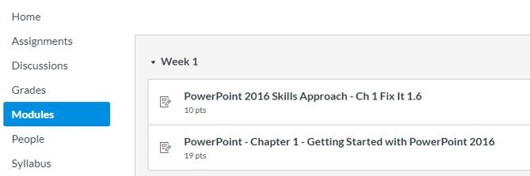
Step 2
Now you will want to find the SIMnet assignment link. It can be listed under the Assignments or Modules in the left navigation area. ​
Once you have found it, click on a SIMnet assignment link to start the registration process.​

Slide 5
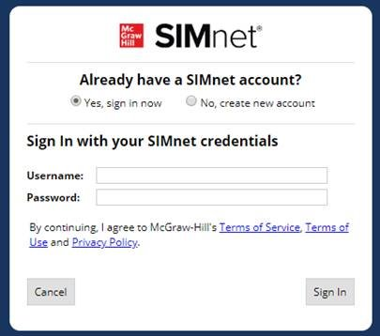
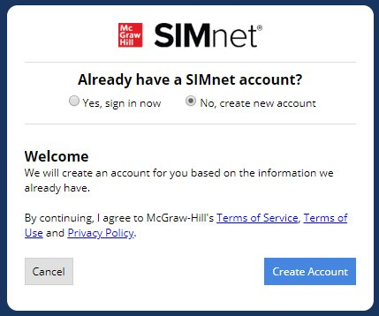
Step 3
Existing SIMnet login:
Select Yes, Sign in Now. ​
Enter your username and password and click Sign-in. ​
New to SIMnet:
Select No, Create new
account. ​
Click Create Account to have your account automatically created for you. ​

Slide 6
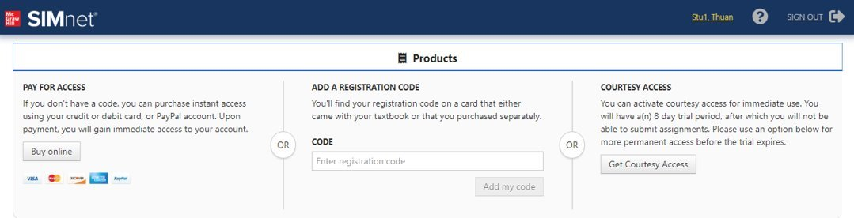
Step 4
You have three registration options.
Purchase Online: Click Buy online to use a credit card or PayPal.
SIMnet Code: Enter a SIMnet access code and click Add my code.
Courtesy Access: Click Get courtesy access for two-week access.
Once completed, you will be taken to your course.

Slide 7
Support & Resources
Tech Support & FAQ:
Call:
(800) 331-5094
Email & Chat:
www.mhhe.com/support
Find More Tips:
http://www.supportateverystep.com/

Slide 8
QUESTIONS?

