Slide 1
McGraw Hill Connect ®
Student Registration
Connect Standalone

Slide 2

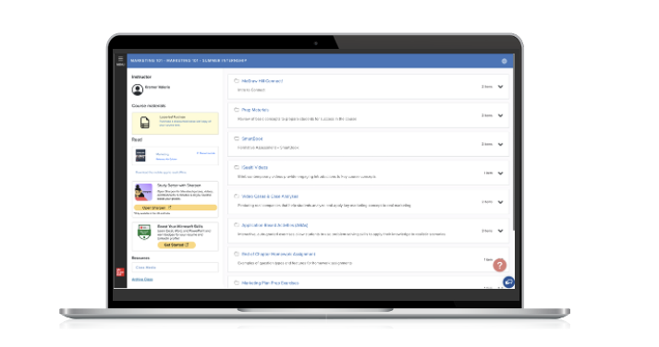
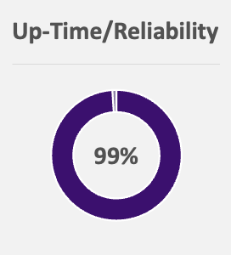
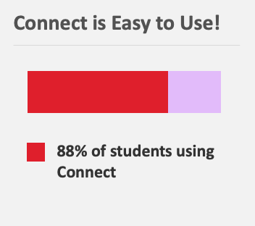
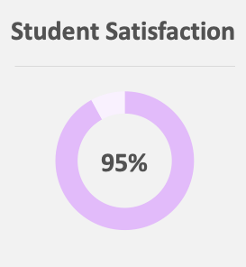
Connect is your personalized digital learning experience designed to help you optimize study time and ramp up your grade potential.
Personalized Learning
Interactive, Course-Specific Tools
Built-in AI
Mobile eBook Access
Affordable Materials
Quality Content
Support!

Slide 3





Make the Most of Connect!
Learn On-the-Go
Download the free ReadAnywhere app to take your eBook and SmartBook with you—online and offline.
Focus!
SUCCESS!
View the Reports in Connect to understand key concepts from the content.
Know What to Study
Recharge in SmartBook provides you with personalized studying of concepts you’ve learned. Built with the power of learning science, you’ll know just what to study!
Use Your Resources
Prep like a pro with exam-like quizzes, flashcards, videos, and study tools aligned with your textbook.
Get Support When Needed
Connect support is available 24/7 via chat or phone. Please reach out to them with any issues. They are there to help!
* ReadAnywhere supports newer eBooks and SmartBook - may not be available in your Connect course. Sharpen available in most courses.

Slide 4
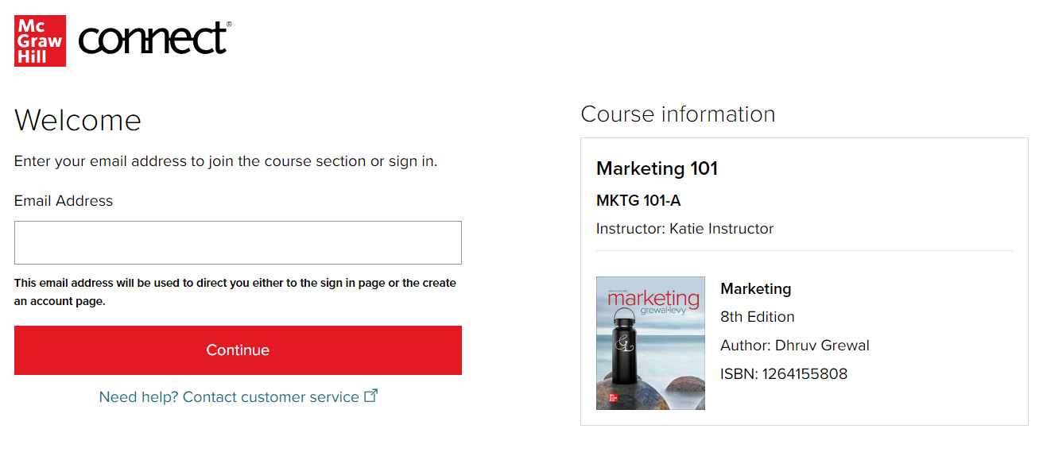
Step 1
Enter your course URL provided by your instructor.
Enter your email address and click Begin.
If you receive the message, You have a Connect Account but have forgotten your password, click Forgot Password.

Slide 5
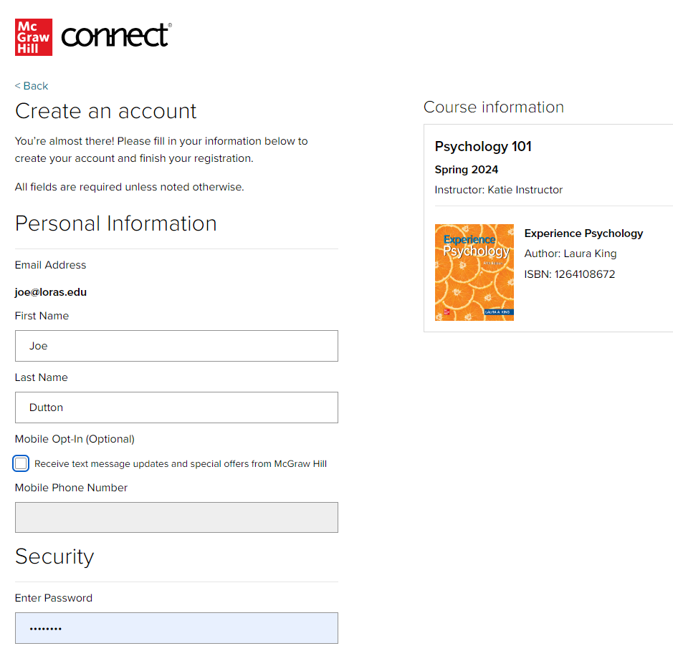
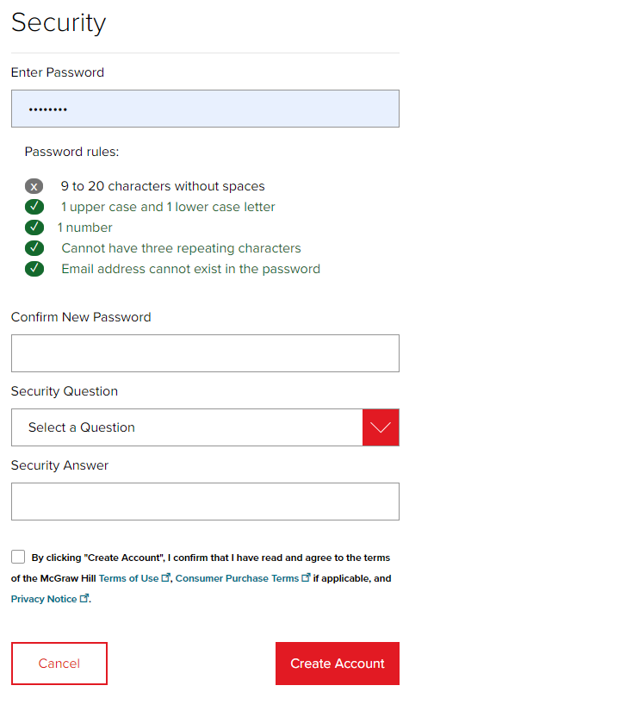
Step 2
Create your account: Enter email, First and Last Name, create a password and select a security questions.
We recommend using your school email address when creating an account.
To receive text alerts, enter your mobile number. Agree to the Terms and Conditions and then click Create Account.

Slide 6
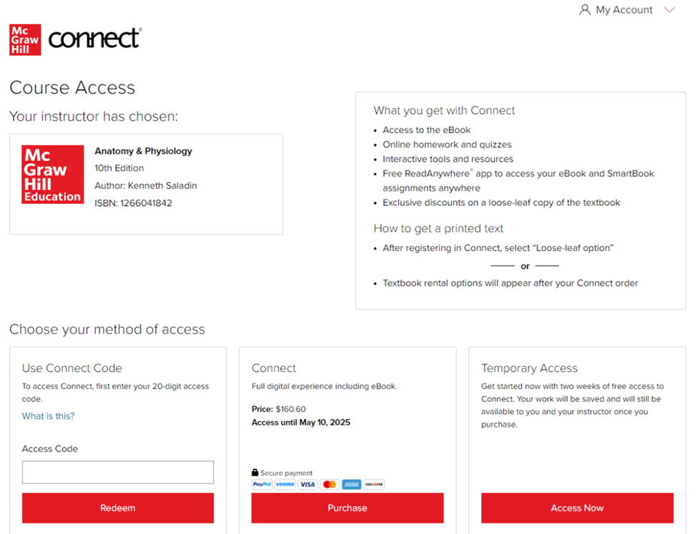
Step 3
You have three registration options.
Connect Code: Enter a Connect access code and click Redeem.
Purchase Online: Click Purchase to use a credit card, Venmo or PayPal.
Temporary Access: Click Access Now for two-week temporary access.

Slide 7
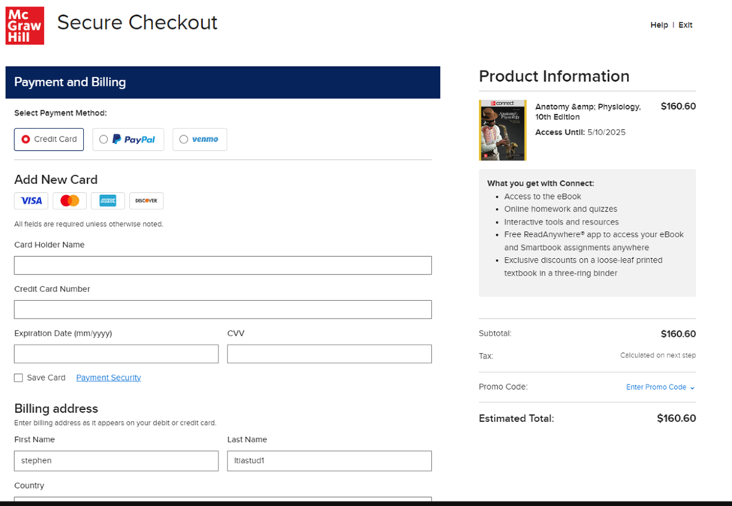
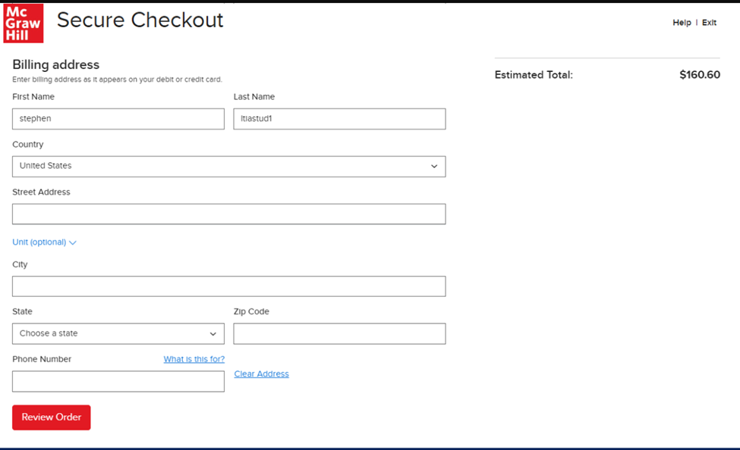
Step 4

Slide 8
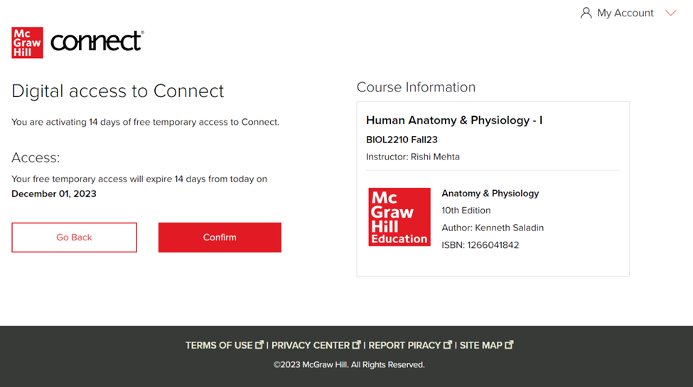
Step 5

Slide 9
Slides Available for the First Day of Class: Sharpen Companion, non-IA, Standalone
Getting Started with McGraw Hill
McGraw Hill Connect and Sharpen:
  Connect and Sharpen Companion FDOC Slides 10 – 17
  Connect Purchase Flows
    Non-IA: Connect without an LMS Slides 18 – 26
  Connect Log-In Flows
    Non-IA and IA: Connect without an LMS Slides 27 – 30

Slide 10

Getting Started with McGraw Hill Connect ® and Sharpen
What to Know on Your
First Day of Class

Slide 11
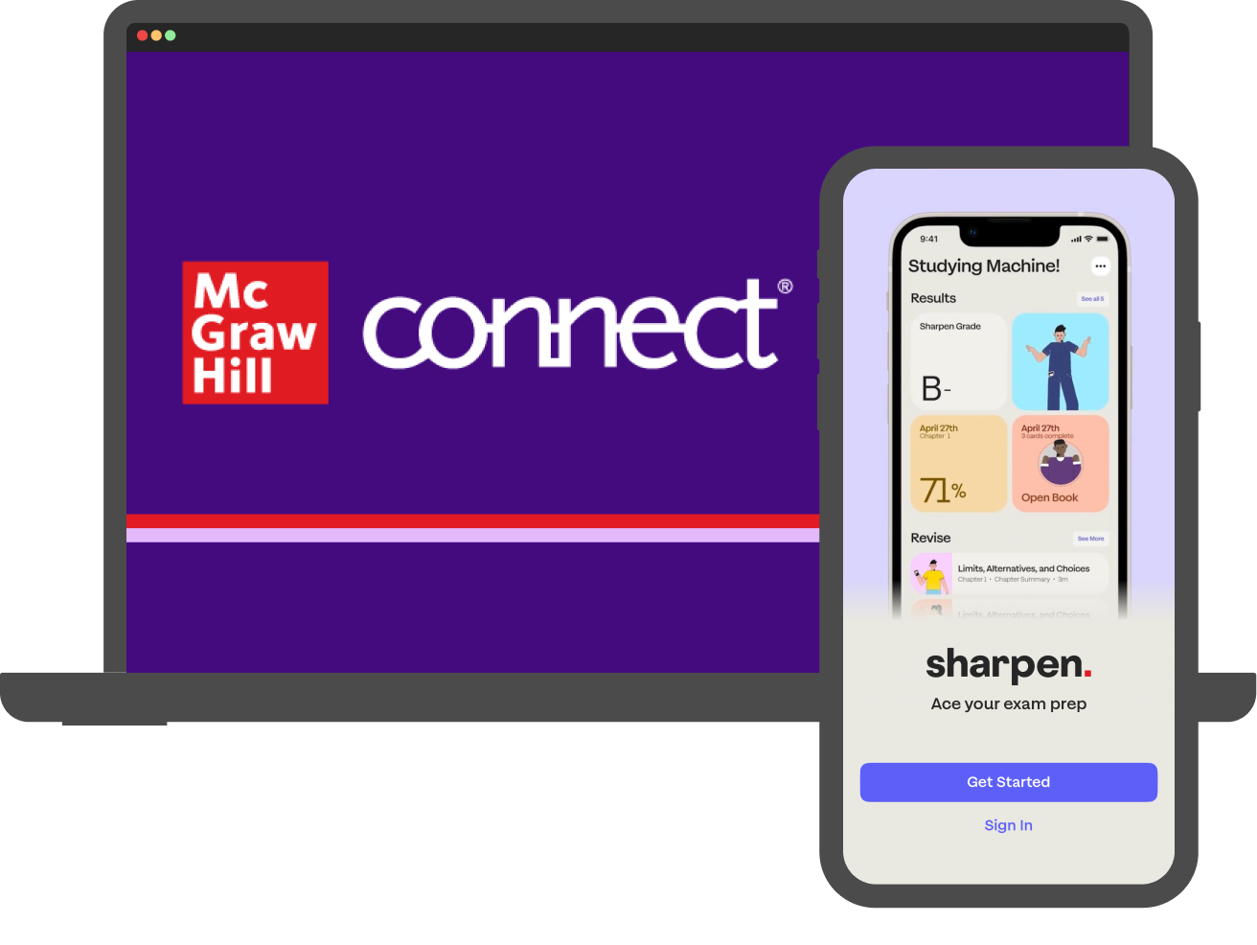
Students: What is Sharpen?
Getting Started with Connect®
Sharpen is McGraw Hill's newest study tool: an exam prep app included in Connect! By using these platforms together, you can master your course material and ace your exams.
Sharpen has hundreds of bite-sized tools customized for your course to help you learn in just 5 minutes. The app's AI engine delivers personalized study tips based on your progress, so you can see what you've mastered and what you need to review.
Since Sharpen is made by McGraw Hill, you can trust its content: accurate and focused on the most important concepts. You can launch Sharpen with one click from Connect or the LMS or log into Sharpen's web or mobile apps.

Slide 12
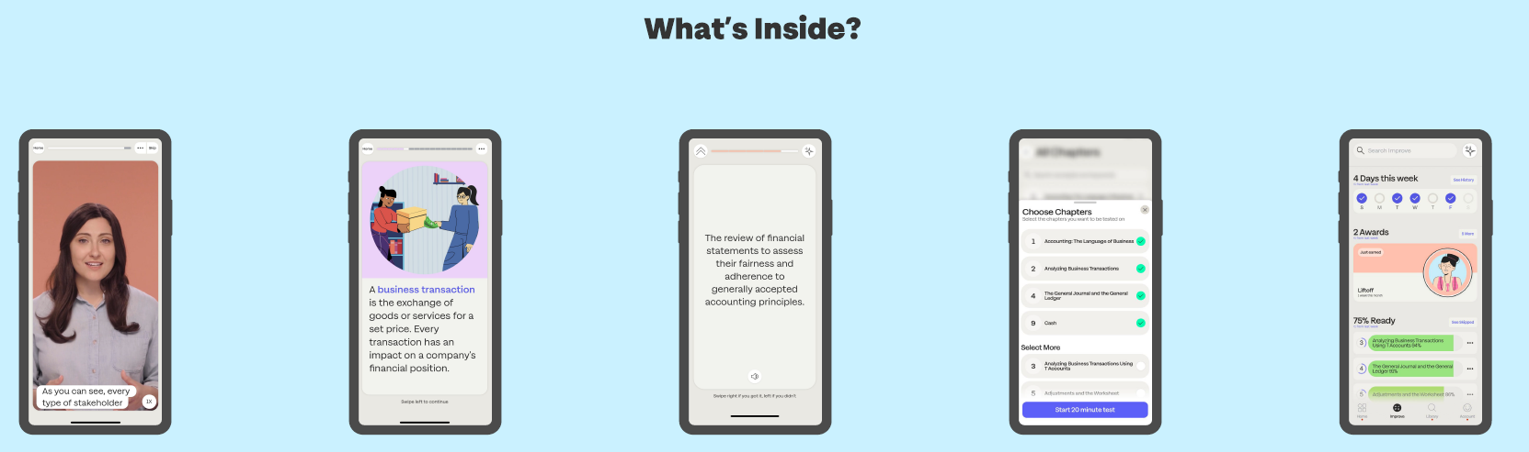
Sharpen is the ultimate college study app for exam prep
Getting Started with Connect®
CHAPTER
SUMMARIES
QUIZ BANK FOR EXAM PREP
IMPROVE SECTION
VIDEOS
FLASHCARDS

Slide 13



Download the Sharpen College Study App – Scan This Code​
Getting Started with Connect®

Slide 14
Students, here are tips to make the most of Connect:
Getting Started with Connect®
Stay Organized
  Digital Course Planner has all your upcoming Connect assignments in one place, and you can customize calendar alerts.
Focus On What Matters
  Use Reports to track your performance and understanding of key concepts.
Learn On-the-Go
  Download the free ReadAnywhere app to take your eBook* and SmartBook®* with you—online and offline, 24/7.
*ReadAnywhere supports newer eBooks and SmartBook. May not be available in your specific Connect course.

Slide 15
Students, here are some tips to ace your exams with Sharpen:
Getting Started with Connect®
Exam Prep
  Spend 10 minutes on Quiz Bank to confirm what you know and check Improve for tips to master concepts you missed.
Weekly Review
  Flip through Sharpen flashcards for 5 minutes to test yourself on chapters covered in class.
Refresher Before Class
  Spend 5 minutes on Sharpen summaries and videos to review key concepts.
24/7 Access
  Download the Sharpen mobile phone app for iOS or Android. On laptops or tablets, log into Sharpen at www.studysharpen.com or through Connect or LMS launch points.

Slide 16




Students: Study on your Smartphone or Tablet!
Getting Started with Connect®
ReadAnywhere® App
Download the free ReadAnywhere app to your Android or iOS smartphone or tablet and access your course eBook for offline study access anytime, anywhere.
More than 1 million students and instructors have downloaded the ReadAnywhere app, which has a 4.7 rating on the App Store.
Connect Tablet App
Log into Connect on your tablet browser and then add it to your home screen to complete assignments. The Connect Tablet App is not recommended for smartphone use.
Sharpen Exam Prep App
Find the Sharpen launch point in Connect, GO, or your LMS. Click get started!
Then download the Sharpen app to your Android or iOS smartphone to access your study content anytime, anywhere.
On your tablet or laptop? Log into Sharpen web at www.studysharpen.com to access your content. Always sign in with your school email address so your progress is up to date on any device.
Close to 1 million students have tried Sharpen, which has a 4.7 App Store rating.

Slide 17

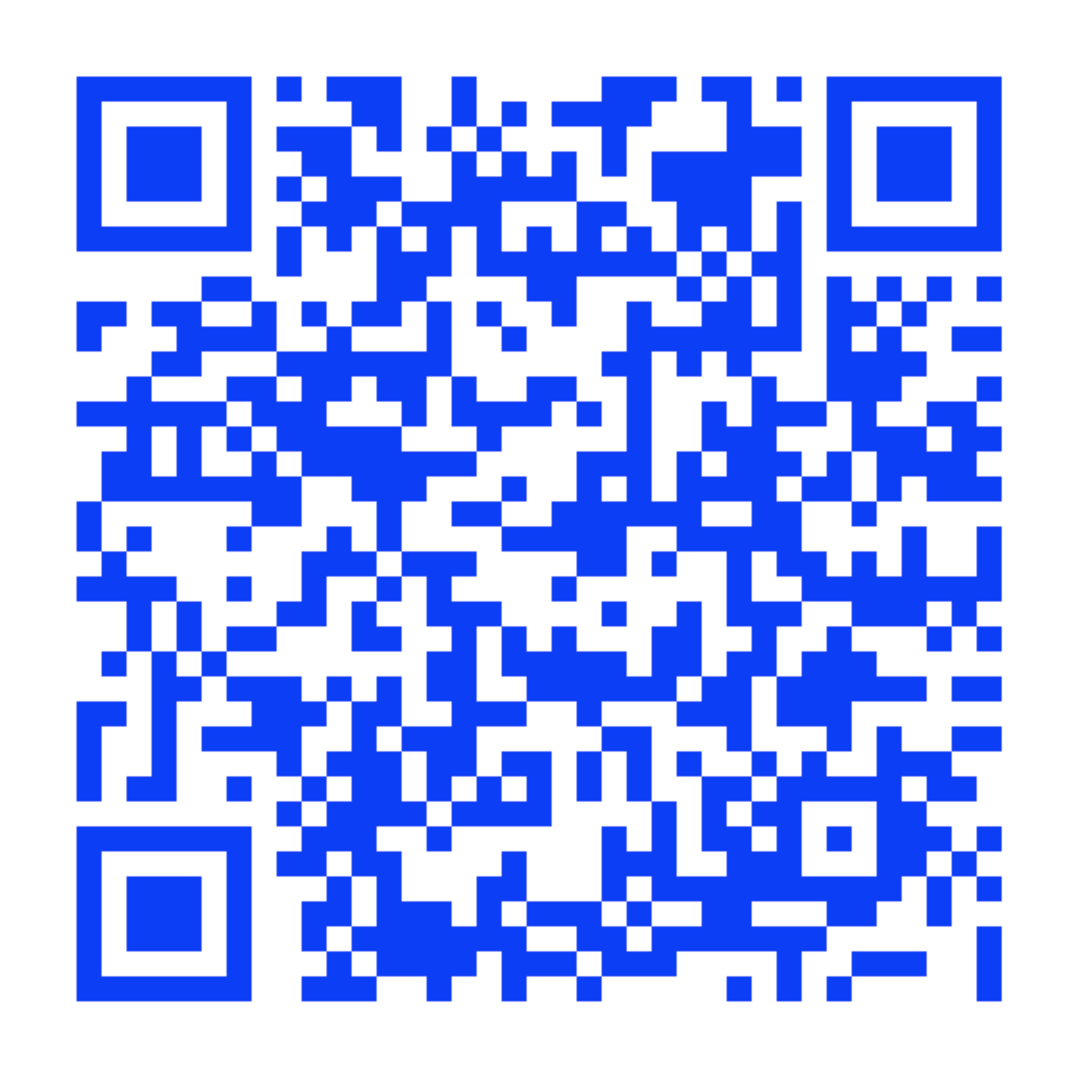
Connect Student Support
Learn how to register, navigate Connect, use SmartBook®, download the ReadAnywhere® app, and more! mheducation.com/highered/support/student/connect.html
Plus, access technical support via chat or phone at (800) 331-5094.
Hours of Operation:
Sunday: 12 PM to 12 AM ET
Monday–Thursday: 24 hours
Friday: 12 AM to 9 PM ET
Saturday: 10 AM to 8 PM ET
Getting Started with Connect®

Slide 18
Sharpen Companion Purchase Flow
Non-IA Registration: Connect without a Learning Management System (LMS)
Getting Started with Connect®
Getting Started with McGraw Hill Connect ® and Sharpen
What to Know on Your
First Day of Class

Slide 19
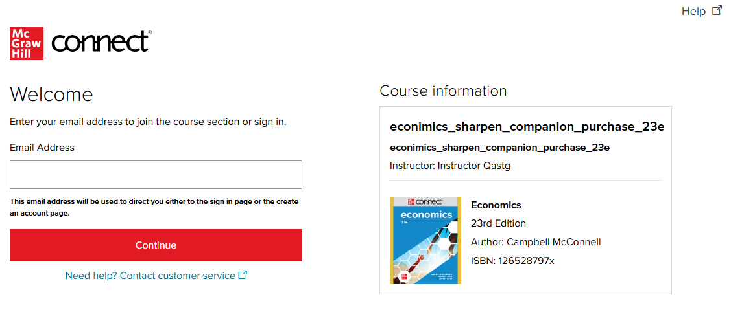
Step 1: Register Directly in Connect
Getting Started with Connect®
Enter your course URL provided by your instructor, something like connect.mheducation.com/class/abc1234
Enter your school email address and click Continue.
If you receive the message "You have a Connect Account but have forgotten your password," click Forgot Password.

Slide 20
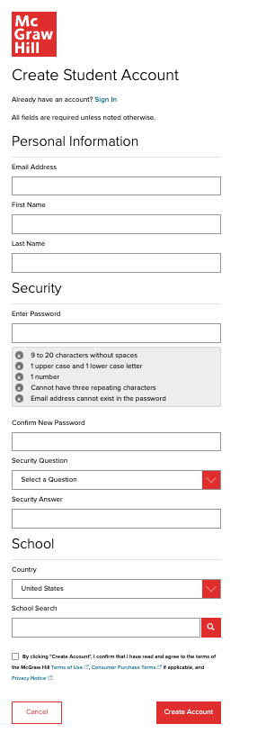
Step 2:
Getting Started with Connect®
Create your account:
Enter your school email, First and Last Name, create a password, and select a security question.
Always use your school email address when creating an account.
To receive text alerts, enter your mobile number. Agree to the Terms and Conditions and then click Create Account.

Slide 21
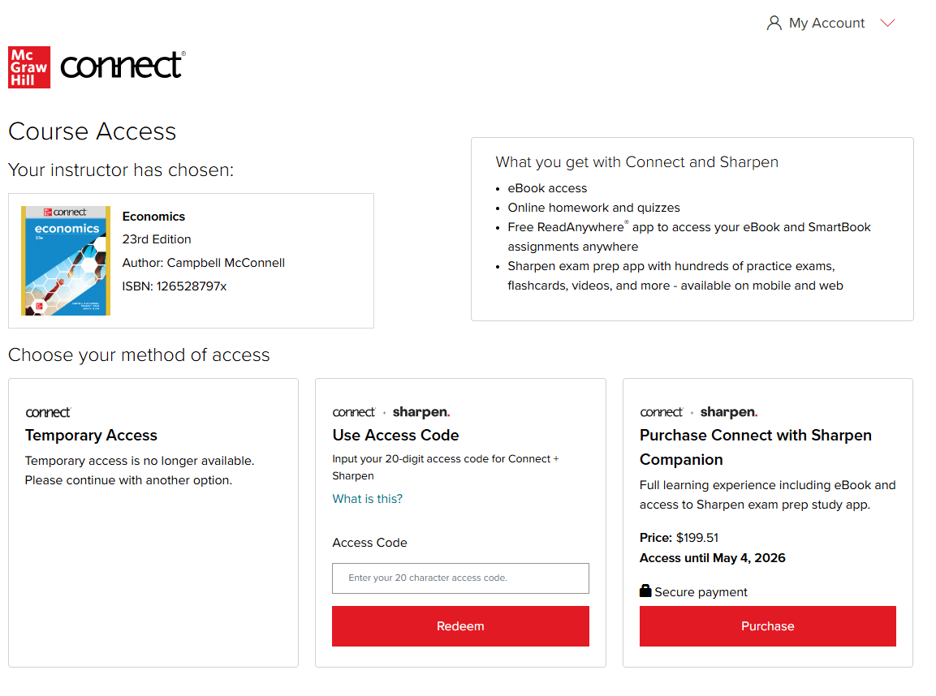
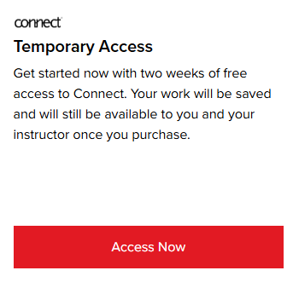
Step 3:
Getting Started with Connect®
You have three registration options (right to left):
Purchase Online: Click Purchase to use a credit card or PayPal.
Enter Code: Enter a Connect and Sharpen access code and click Redeem.
Temporary Access: Click Access Now for two-week temporary access. Note this unlocks Connect only and does not include Sharpen.

Slide 22
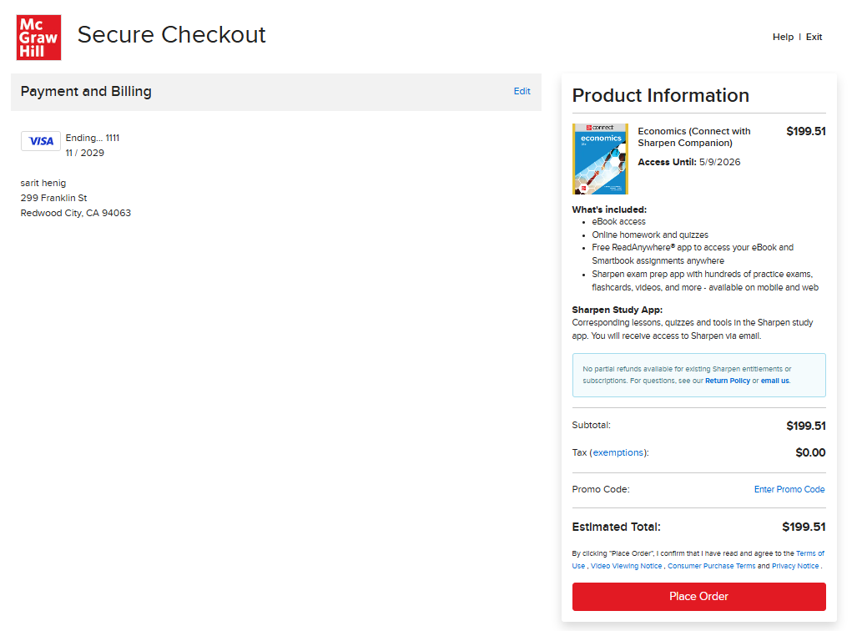
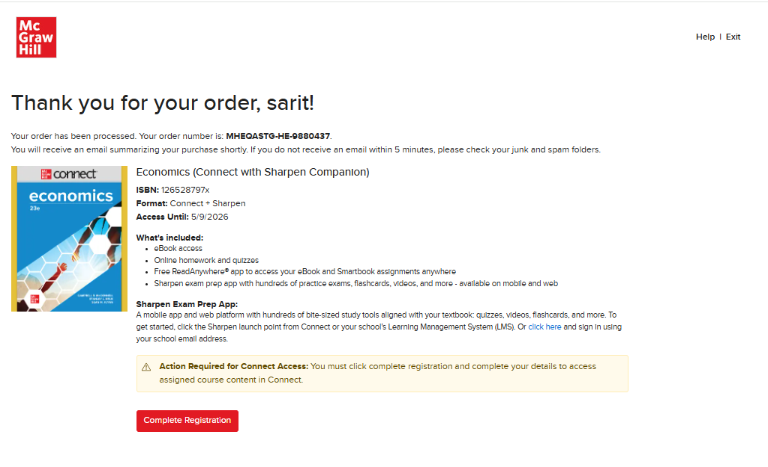
Step 4A:
Getting Started with Connect®
Purchase Online: Click Purchase to use a credit card or PayPal. Enter your payment information and click "Place Order". A purchase confirmation page will load.
Congratulations! You have successfully completed your Connect and Sharpen Companion purchase.

Slide 23
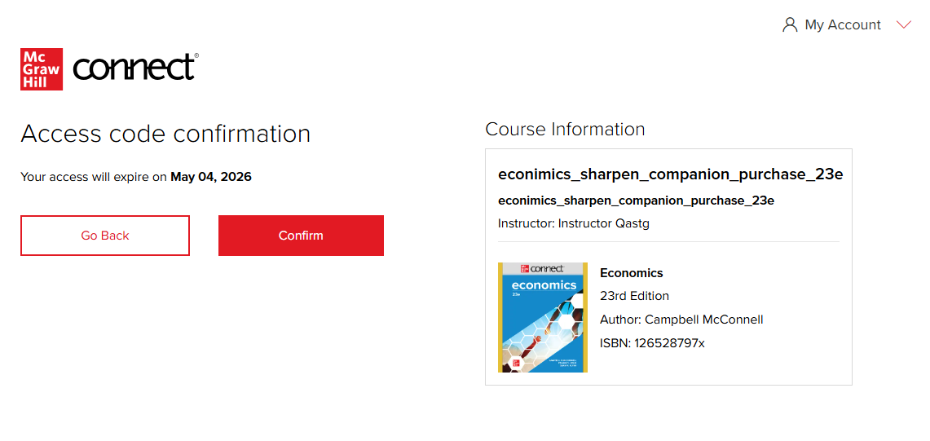
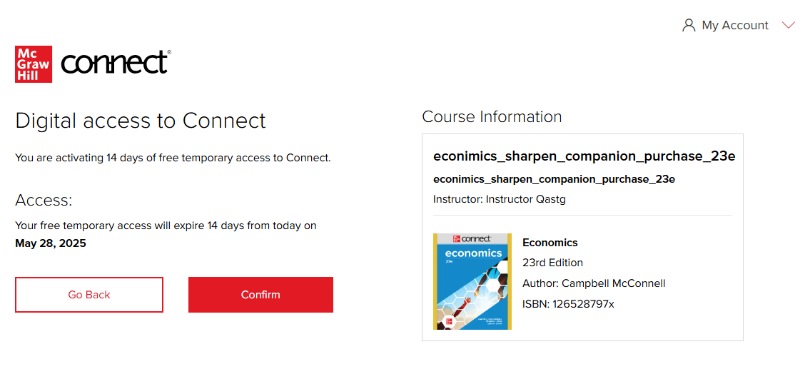
Step 4B-4C:
Getting Started with Connect®
B. Enter Code: The Access Code Confirmation Screen appears. Click Confirm.
C. Temporary Access: The Digital access confirmation screen appears. On the next screen, click Confirm.

Slide 24
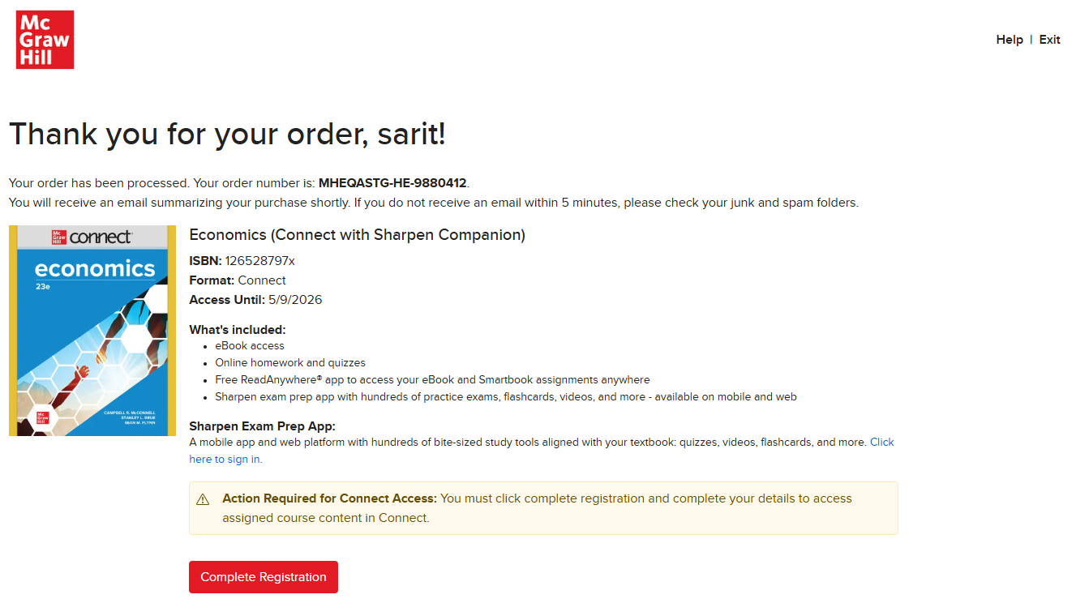
Step 5A:
Getting Started with Connect®
Purchase Online: On the purchase confirmation page, click Complete Registration.
Congratulations! You have successfully joined your course.

Slide 25
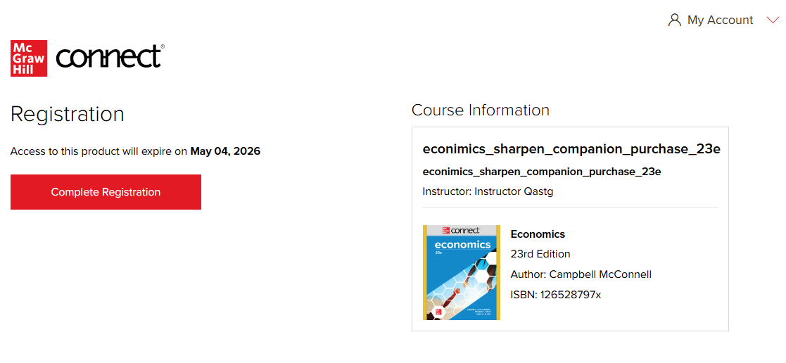
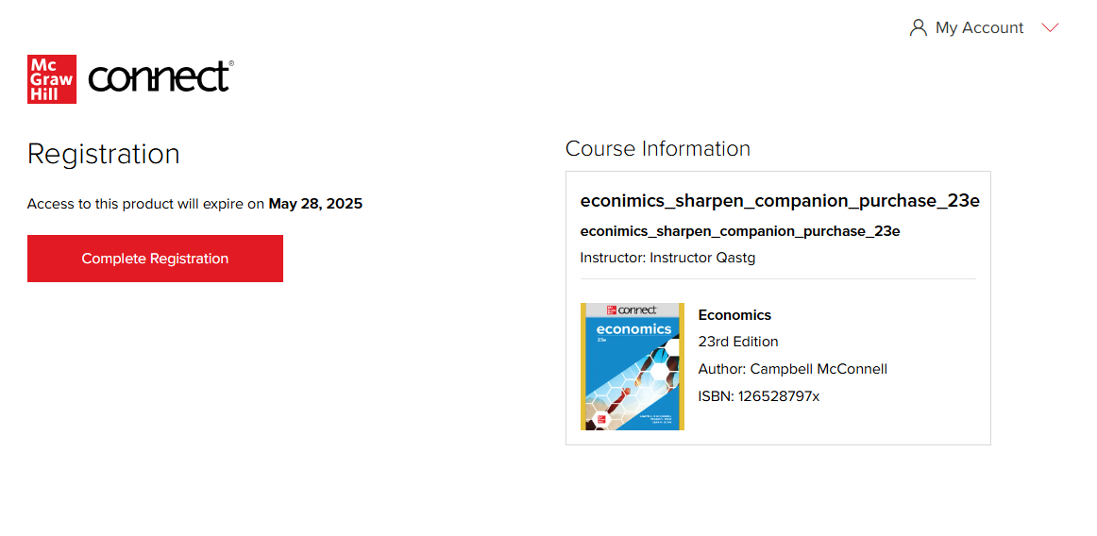
Step 5B-5C:
Getting Started with Connect®
B. Enter Code: Click Complete Registration.
Congratulations! You have successfully joined your course.
C. Temporary Access: Click Complete Registration.
Congratulations! You have successfully joined your course.
Reminder: if you used Temporary Access, this applies only to Connect and not Sharpen.

Slide 26
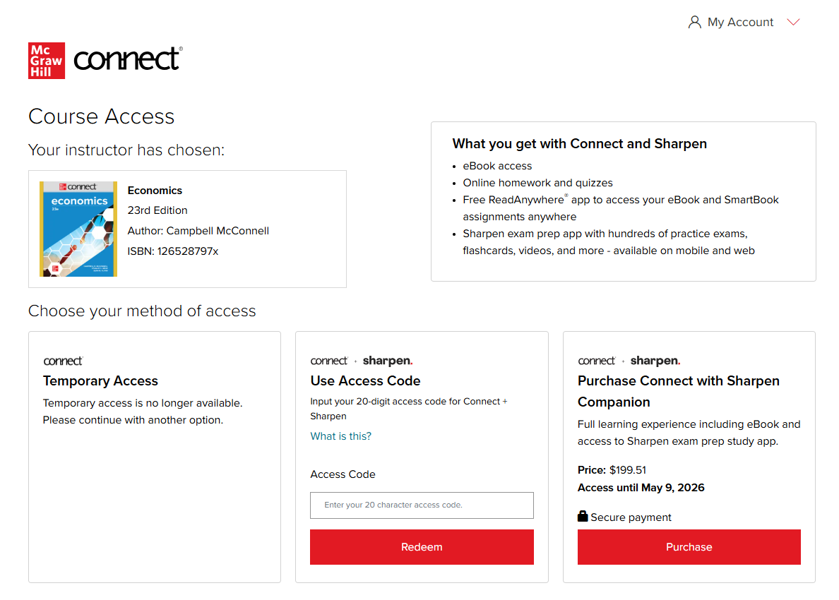
Step 6C:
Getting Started with Connect®
C. Temporary Access
When your two-week Temporary Access Expires, you will be directed to the Course Access Page to redeem the Connect and Sharpen Companion access code or purchase Connect and Sharpen Companion.
You can view more information and instructions here.

Slide 27
Sharpen Companion Log-In Flow
Non-IA and IA Registration: Connect without a Learning Management System (LMS)
Getting Started with Connect®
Getting Started with McGraw Hill Connect ® and Sharpen
What to Know on Your
First Day of Class

Slide 28
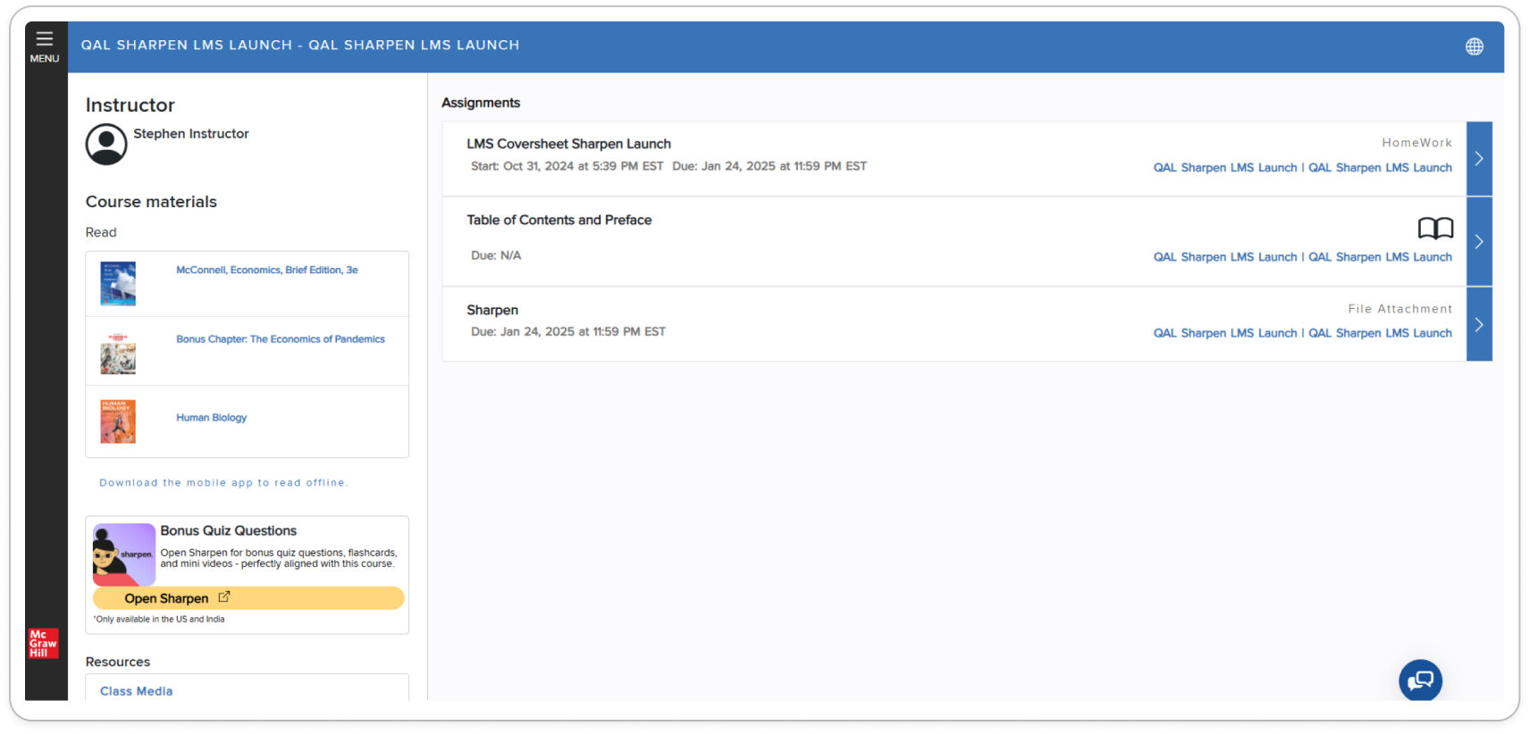

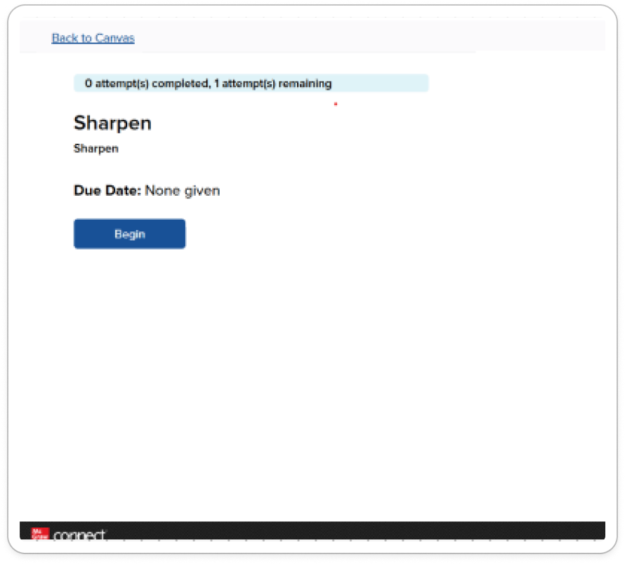
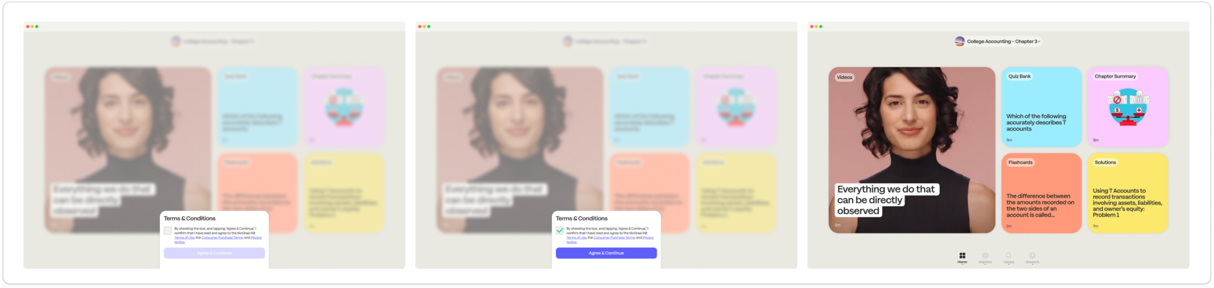
Sharpen Companion Log-In Flow
Part 1
Getting Started with Connect®
Sharpen Assignment: Connect includes two Sharpen launch points. The first one is listed under Assignments.
Click on the Sharpen assignment to open a new page with the Sharpen access point. Click Begin to launch Sharpen in a new web window.

Slide 29
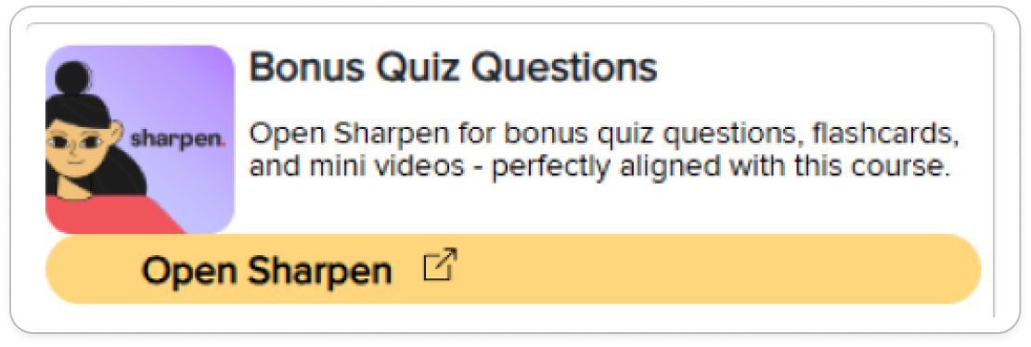
Sharpen Companion Log-In Flow
Part 2
Getting Started with Connect®
Sharpen widget: The second launch point is on the bottom left-hand navigation section.
Click on the Sharpen widget in the left-side navigation to launch the Sharpen app in a new window.

Slide 30
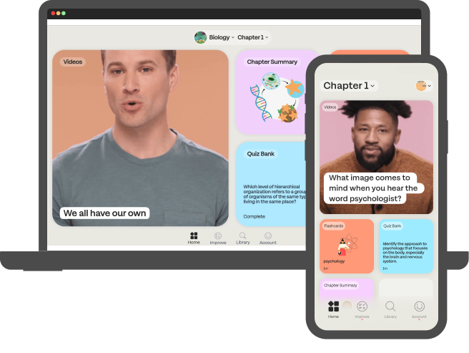
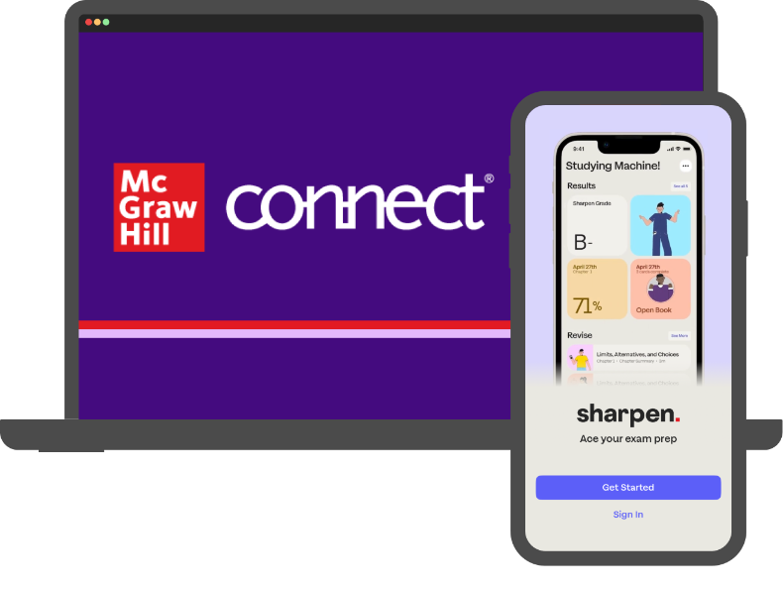
Thank you!
Getting Started with McGraw Hill Connect ® and Sharpen
What to Know on Your
First Day of Class

