Slide 1
Slides Available for the First Day of Class: Sharpen Companion, non-IA, Moodle
Getting Started with McGraw Hill
McGraw Hill GO 2 – 7
McGraw Hill GO and Sharpen:
  GO and Sharpen Companion FDOC Slides 8 – 12
  GO Purchase Flows
    Non-IA: GO with an LMS: Moodle Slides 13 – 21
  GO Log-In Flow – Slides 22 – 24

Slide 2
McGraw Hill GO
Student Registration
For Moodle Regular Integration

Slide 3
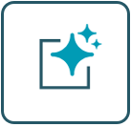

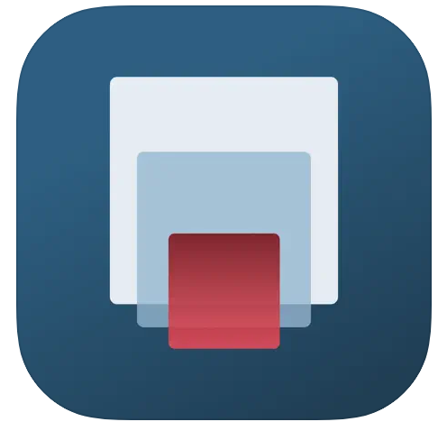

What is McGraw Hill GO?
McGraw Hill GO is an eBook+ embedded directly in your LMS course – no additional logins or access required
Actively Read using the AI Reader
Leverage the power of our gen AI tool embedded in the ebook to expand your understanding and boost your curiosity.
Quiz While You Read
Check your understanding and flip from readings to assessments to gauge your grasp of the concepts covered.
On-the-GO Access
Access your McGraw Hill GO eBook on mobile devices through the free ReadAnywhere app (must activate GO first).
College study app for exam prep that goes with our textbook and McGraw Hill GO, offering flashcards, quizzes, videos, and tools to stay on track.

Slide 4

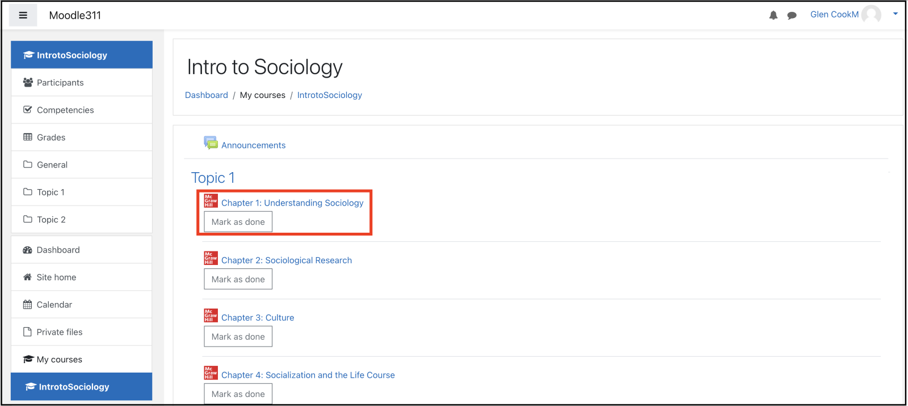
Step 1
To access McGraw Hill GO, select a GO assignment in the Content area of your D2L Moodle course.

Slide 5
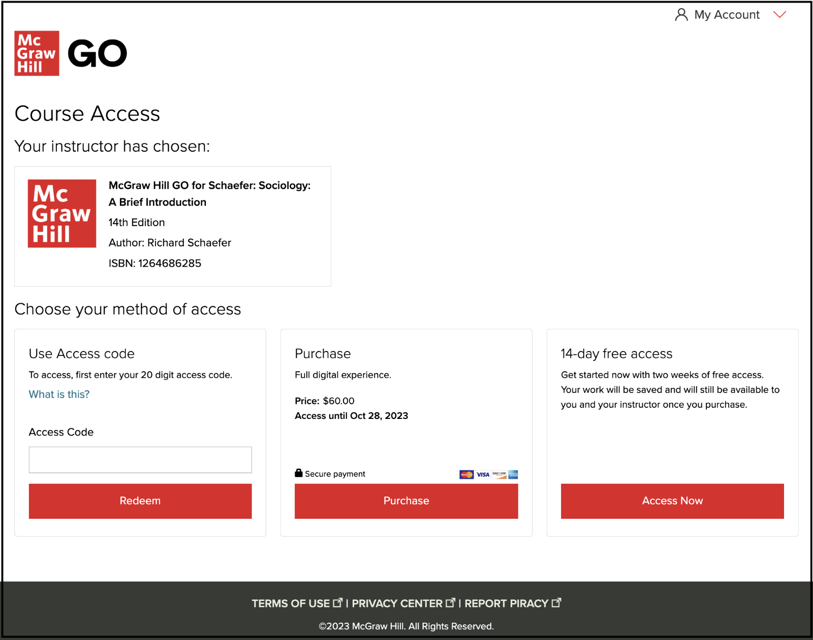
Step 2
The first time you launch a GO assignment, you will see three access options:
McGraw Hill GO Code: Enter a McGraw Hill GO access code and click Redeem.
Purchase Online: Click Purchase to use a credit card or PayPal.
Temporary Access: Click Access now for 14 days of temporary access.

Slide 6
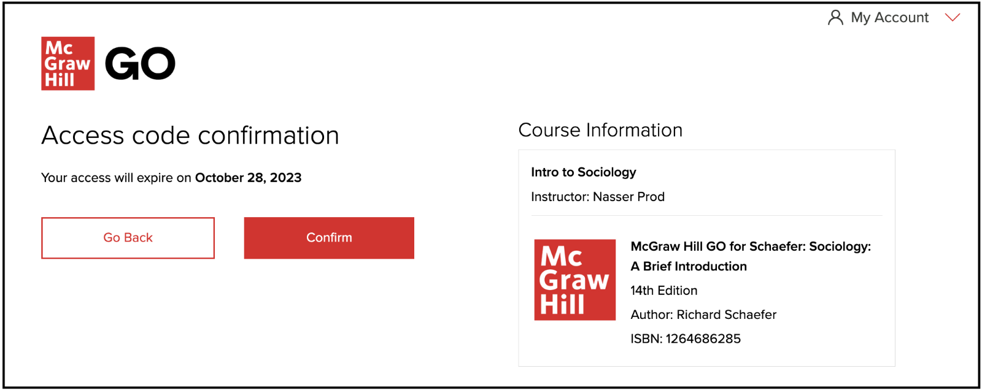
Step 3
After completing the steps for your selected access method, "confirm" your McGraw Hill GO access.

Slide 7
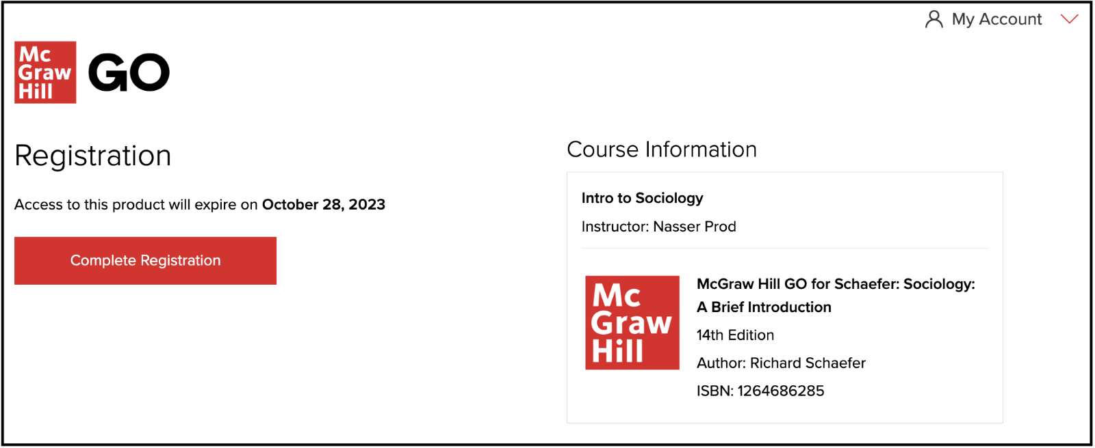
Step 4
Select Complete Registration and then you can access your first McGraw Hill GO assignment!

Slide 8

Getting Started with McGraw Hill GO® and Sharpen
What to Know on Your
First Day of Class

Slide 9

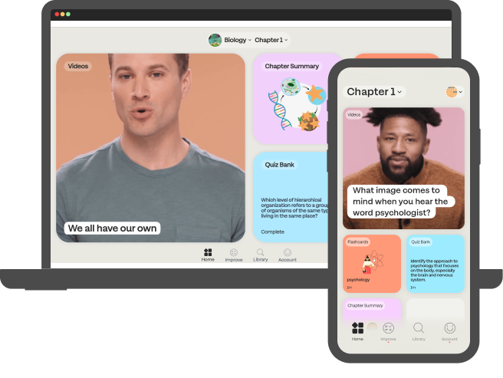


Students: What is GO with Sharpen?
Getting Started with GO®
Sharpen is McGraw Hill's newest study tool: an exam prep app included in GO! By using both GO and Sharpen, you can master your course material and ace your exams.
Sharpen has hundreds of bite-sized study tools customized for your course so you can learn in just 5 minutes. The app delivers personalized study tips based on your in-app performance, so you can see what you know and what you need to review.
Since Sharpen is made by McGraw Hill, you can trust its content: accurate and focused on the most important concepts. You can launch Sharpen with one click from GO or log into Sharpen's web or mobile apps.

Slide 10
Students, here are some tips to ace your exams with Sharpen:
Getting Started with GO®
Exam Prep
  Spend 10 minutes on Quiz Bank to confirm what you know and check Improve for tips to master concepts you missed.
Weekly Review
  Flip through Sharpen flashcards for 5 minutes to test yourself on chapters covered in class.
Refresher Before Class
  Spend 5 minutes on Sharpen summaries and videos to review key concepts.
24/7 Access
  Download the Sharpen mobile phone app for iOS or Android. On laptops or tablets, log into Sharpen at www.studysharpen.com or through the GO launch points.

Slide 11
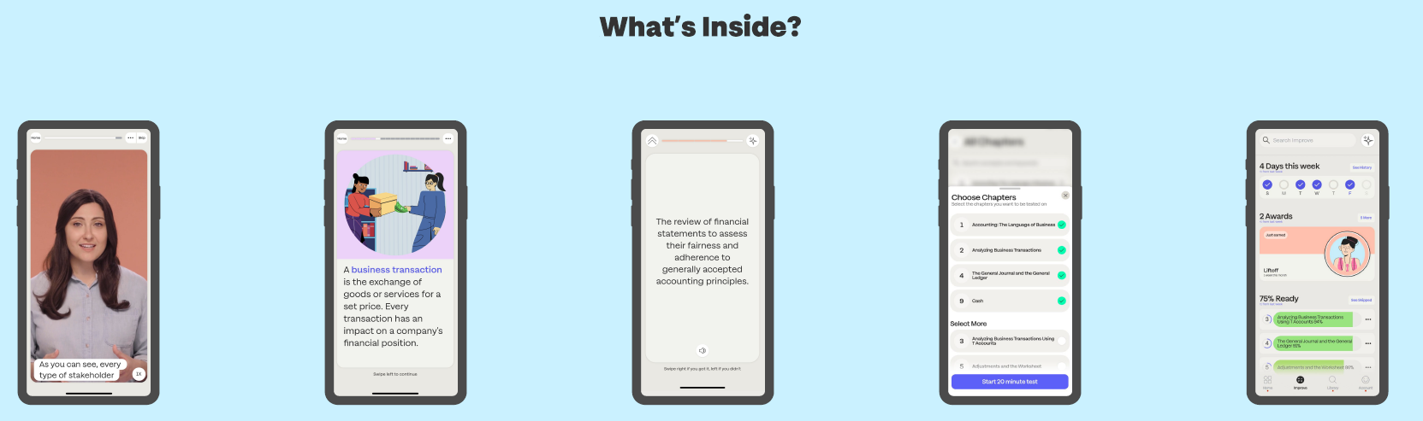
Sharpen is the ultimate college study app for exam prep
Getting Started with GO®
CHAPTER
SUMMARIES
QUIZ BANK FOR EXAM PREP
IMPROVE SECTION
VIDEOS
FLASHCARDS

Slide 12



Download the Sharpen College Study App – Scan This Code​
Getting Started with GO®

Slide 13
Sharpen Companion Purchase Flow
GO: Non-IA Integrated with a Learning Management System (LMS)
Getting Started with GO®
Getting Started with McGraw Hill GO® and Sharpen
What to Know on Your
First Day of Class

Slide 14

Accessing McGraw Hill GO:
Moodle
Getting Started with GO®
Step 1
To access McGraw Hill GO from your Moodle course, select a McGraw Hill GO assignment from a topic area.

Slide 15
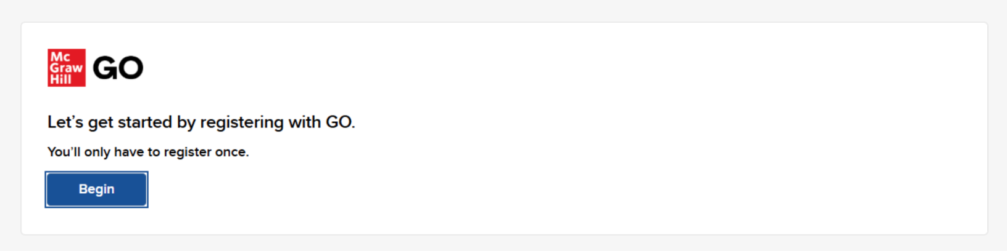
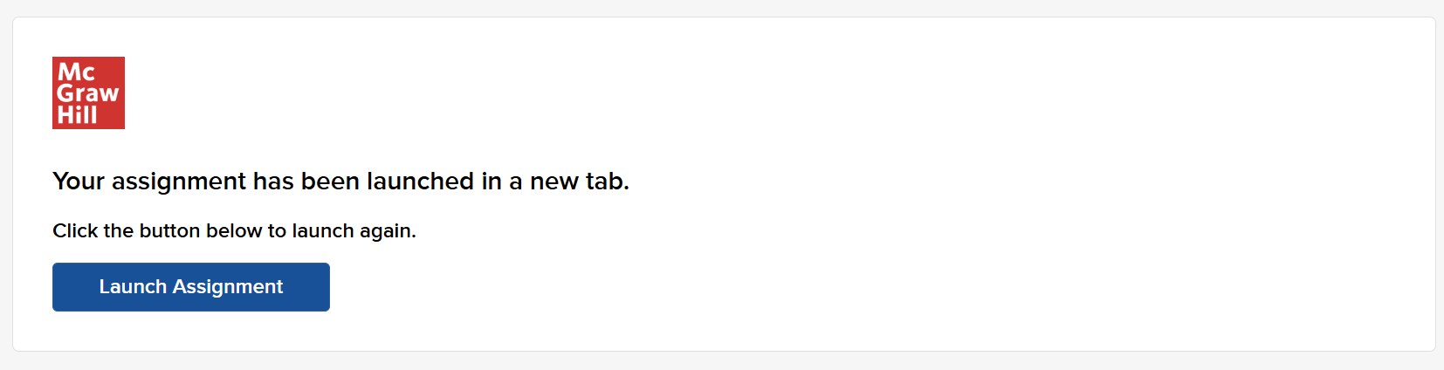
Accessing McGraw Hill GO:
Sharpen
Getting Started with GO®
Step 2
Clicking on a GO assignment launches the Course Access Page. On this page, click Begin.
If your assignment launches in a new tab but your browser does not open it, click Launch Assignment.

Slide 16
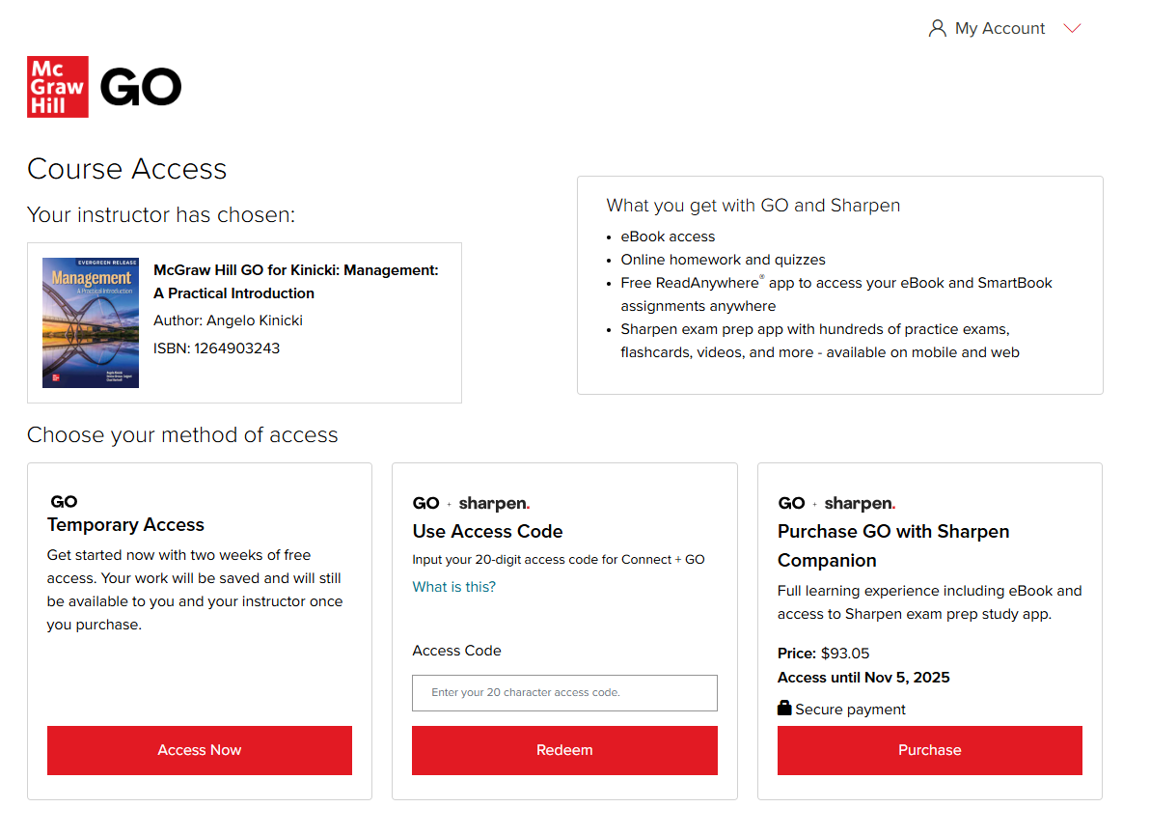

Accessing McGraw Hill GO:
Sharpen
Purchase
Getting Started with GO®
Step 3
The first time you launch a GO assignment, you will see three registration options (right to left):
Purchase Online: Click Purchase to use a credit card or PayPal.
Enter Code: Enter a Connect and Sharpen access code and click Redeem.
Temporary Access: Click Access Now for two-week temporary access. Note this unlocks GO only and not Sharpen.

Slide 17
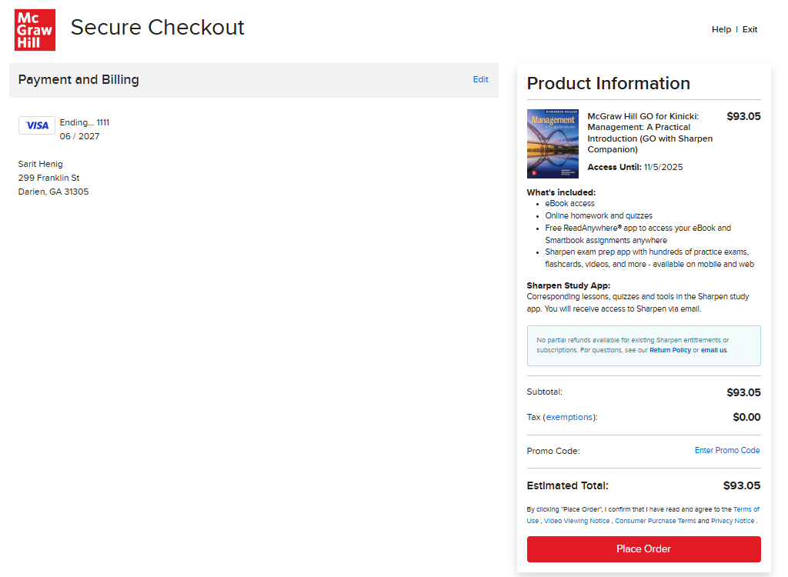
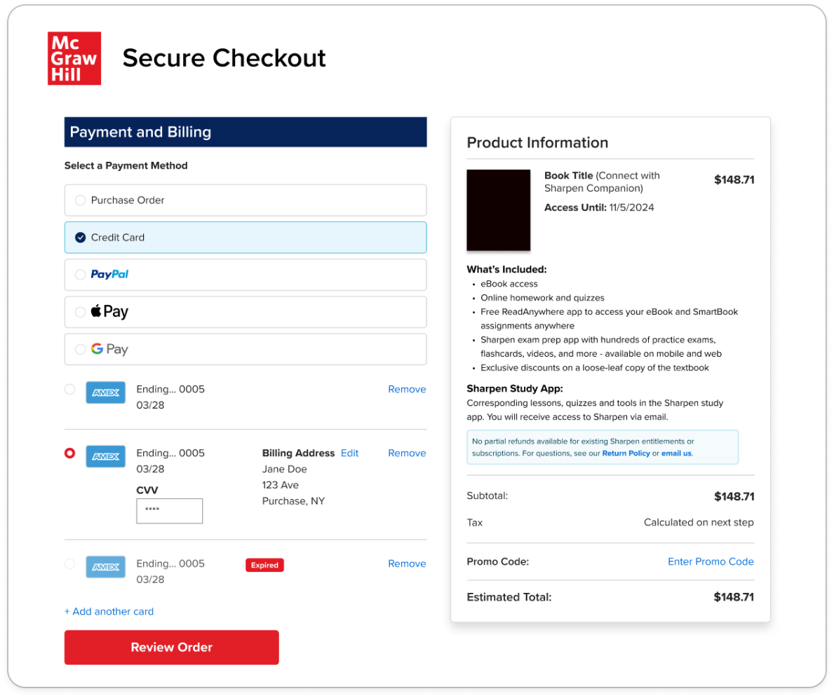
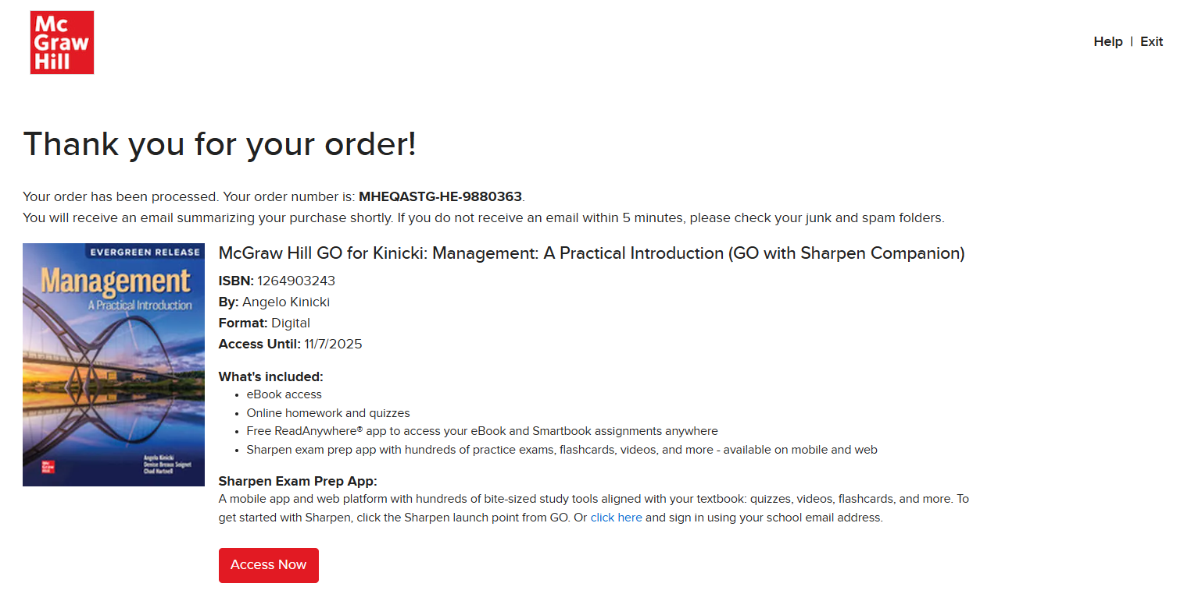
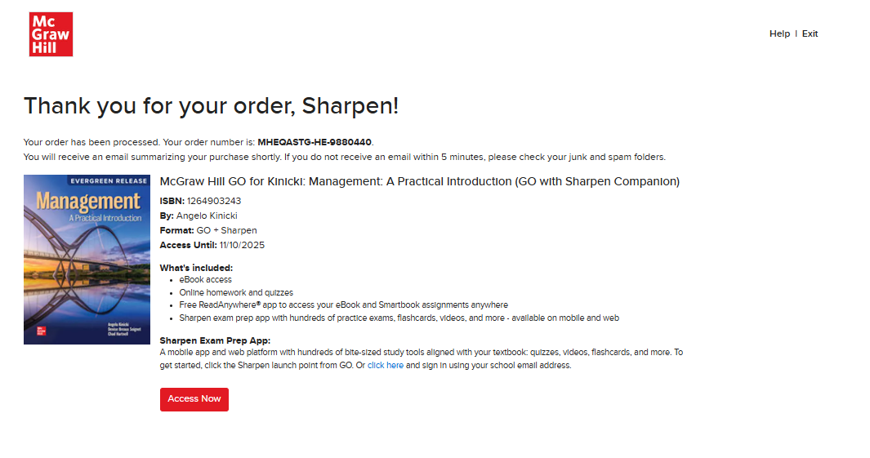
Step 4A:
Getting Started with GO®
Purchase Online: Click Purchase to use a credit card or PayPal. Enter your payment information and click "Place Order". A purchase confirmation screen will load.
Congratulations! You have successfully completed your GO and Sharpen Companion purchase.

Slide 18
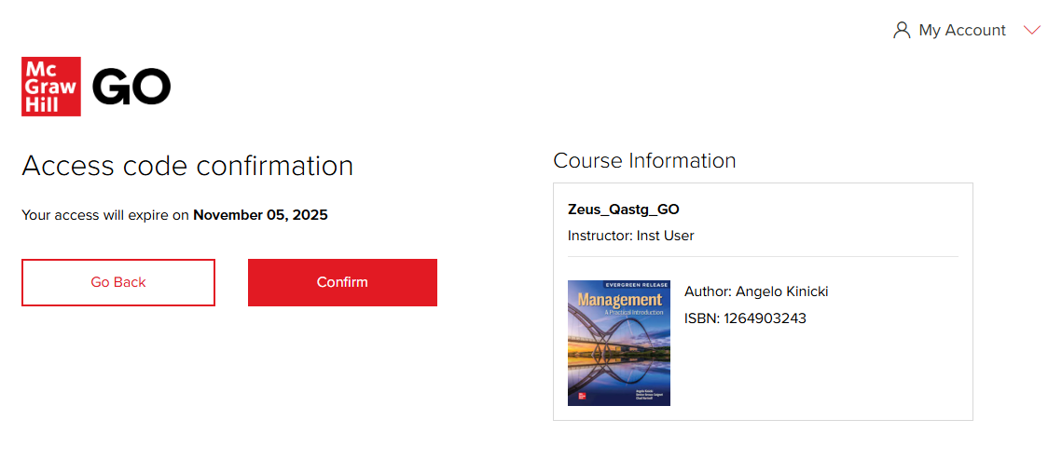
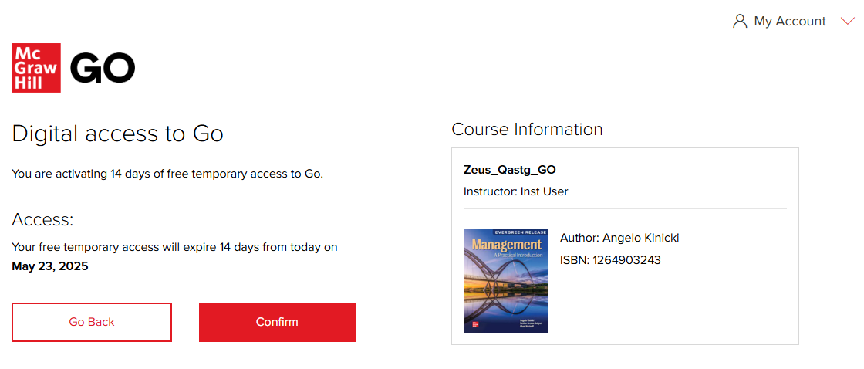
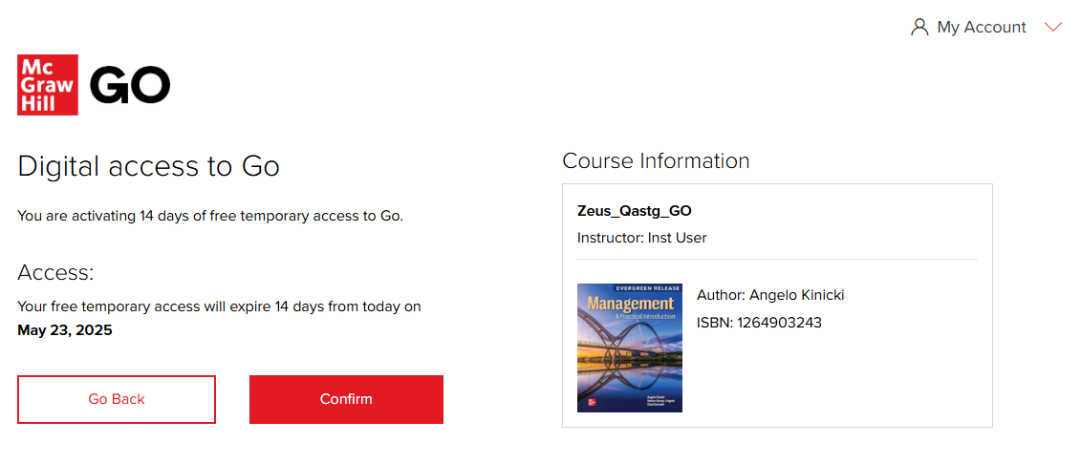
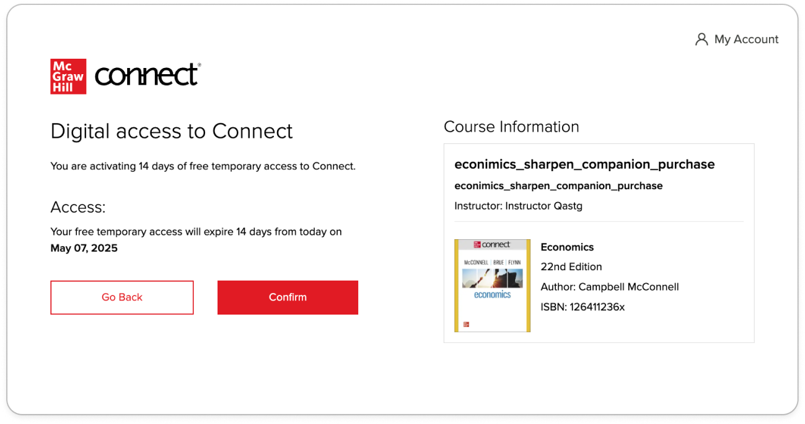
Step 4B-4C:
Getting Started with GO®
B. Enter Code: The Access Code Confirmation Screen appears. Click Confirm.
C. Temporary Access: The Digital access confirmation screen appears. On the next screen, click Confirm.
Intro to Sociology: GO with Sharpen

Slide 19
Step 5A:
Getting Started with GO®
Purchase Online: On the purchase confirmation page, click Access Now.
Congratulations! You have successfully joined your course.

Slide 20
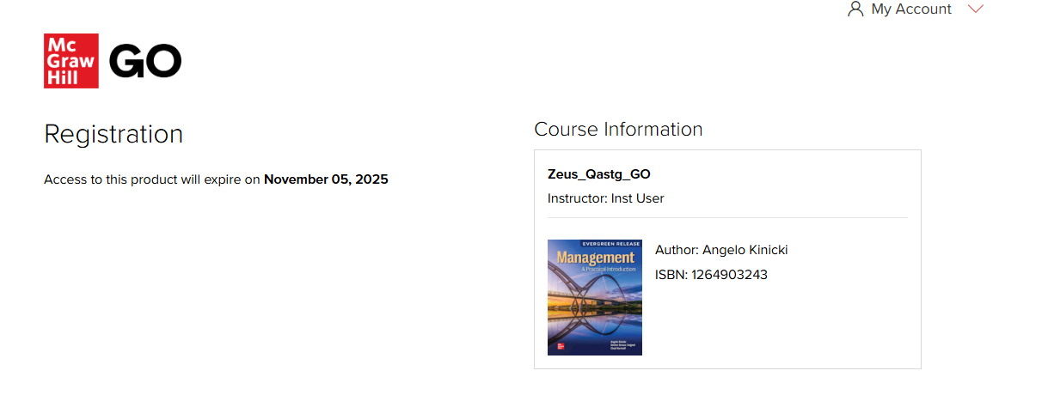
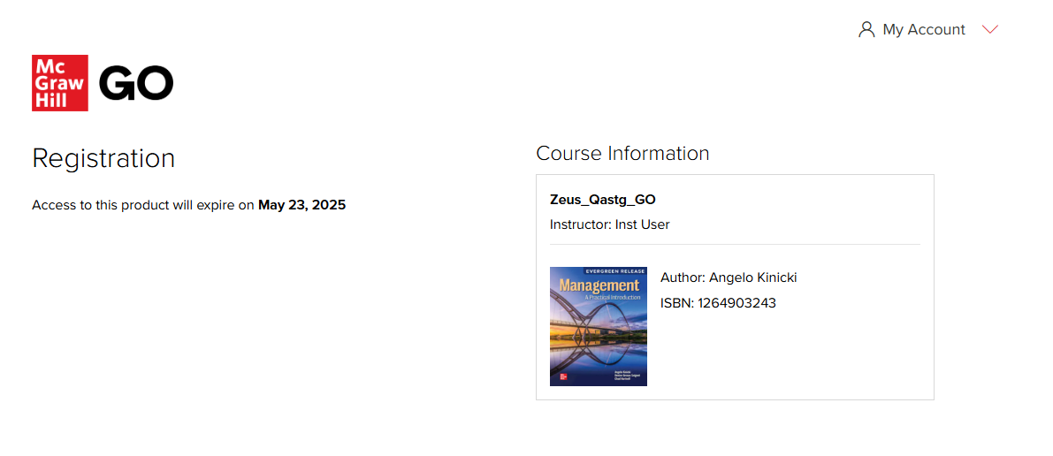
Step 5B-5C
Getting Started with GO®
B. Enter Code: Click Complete Registration. That's it- now you can access your first McGraw Hill GO assignment!
C. Temporary Access: Select Complete Registration and then you can access your first McGraw Hill GO assignment!
Reminder: if you used Temporary Access, this applies only to GO and not Sharpen.

Slide 21
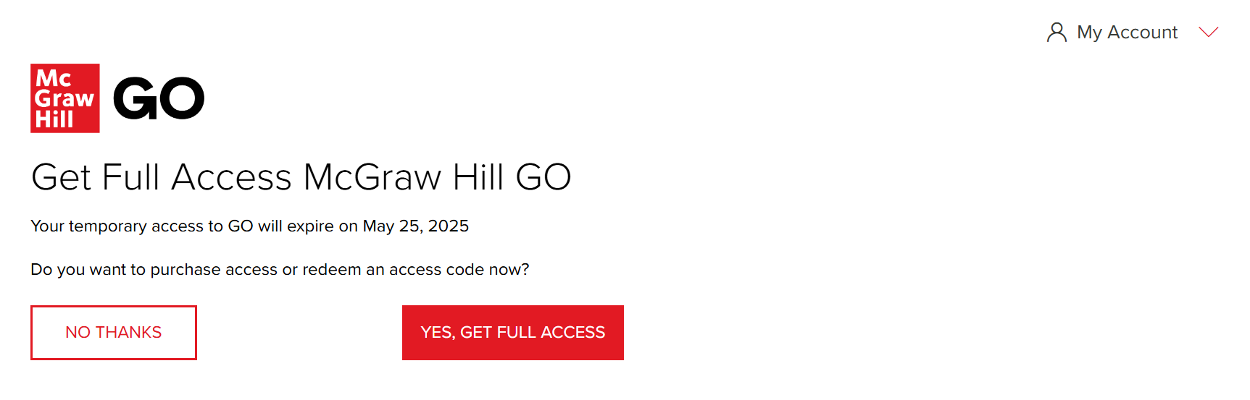
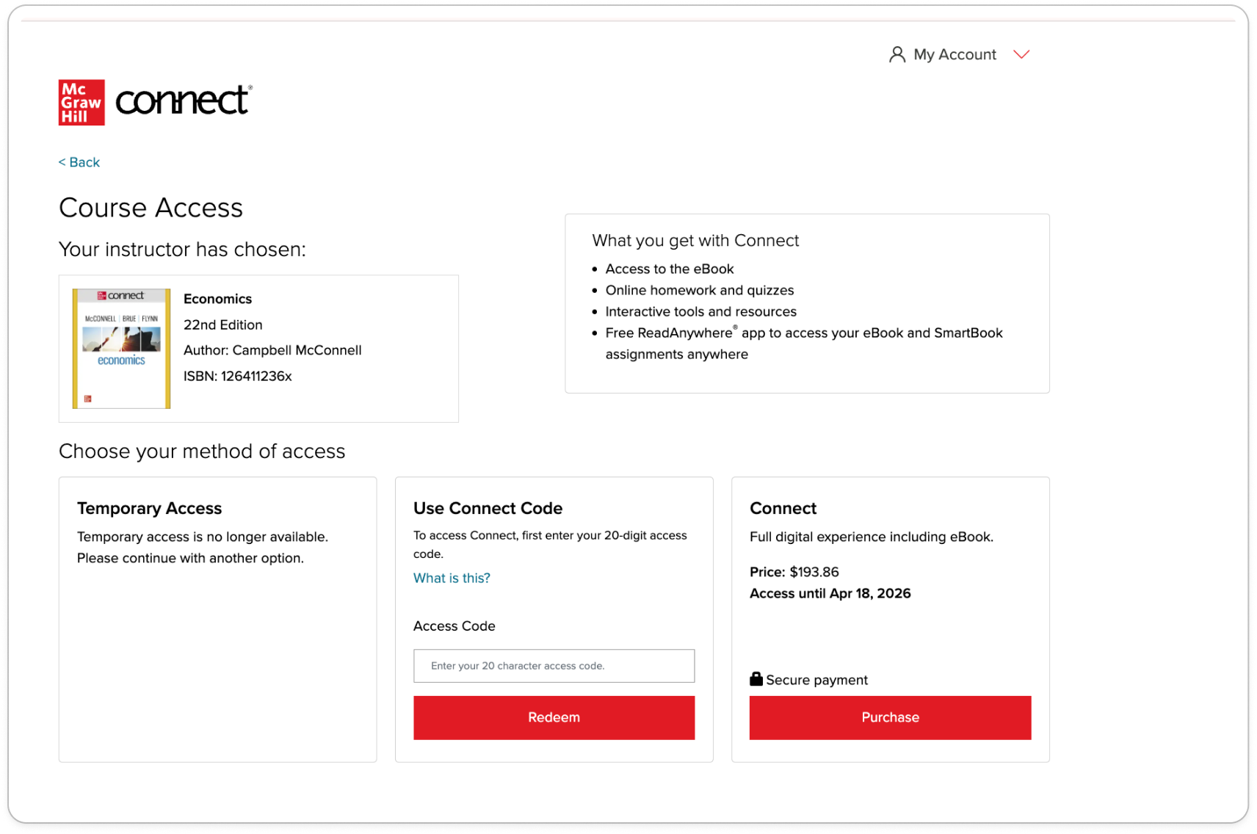
Step 6C:
Getting Started with GO®
C. Temporary Access
When your two-week Temporary Access Expires, you will be directed to the Course Access Page to redeem the GO and Sharpen Companion access code or purchase GO and Sharpen Companion.

Slide 22
Sharpen Companion Log-In Flow
GO: IA and non-IA
Getting Started with GO®
Getting Started with McGraw Hill GO® and Sharpen
What to Know on Your
First Day of Class

Slide 23
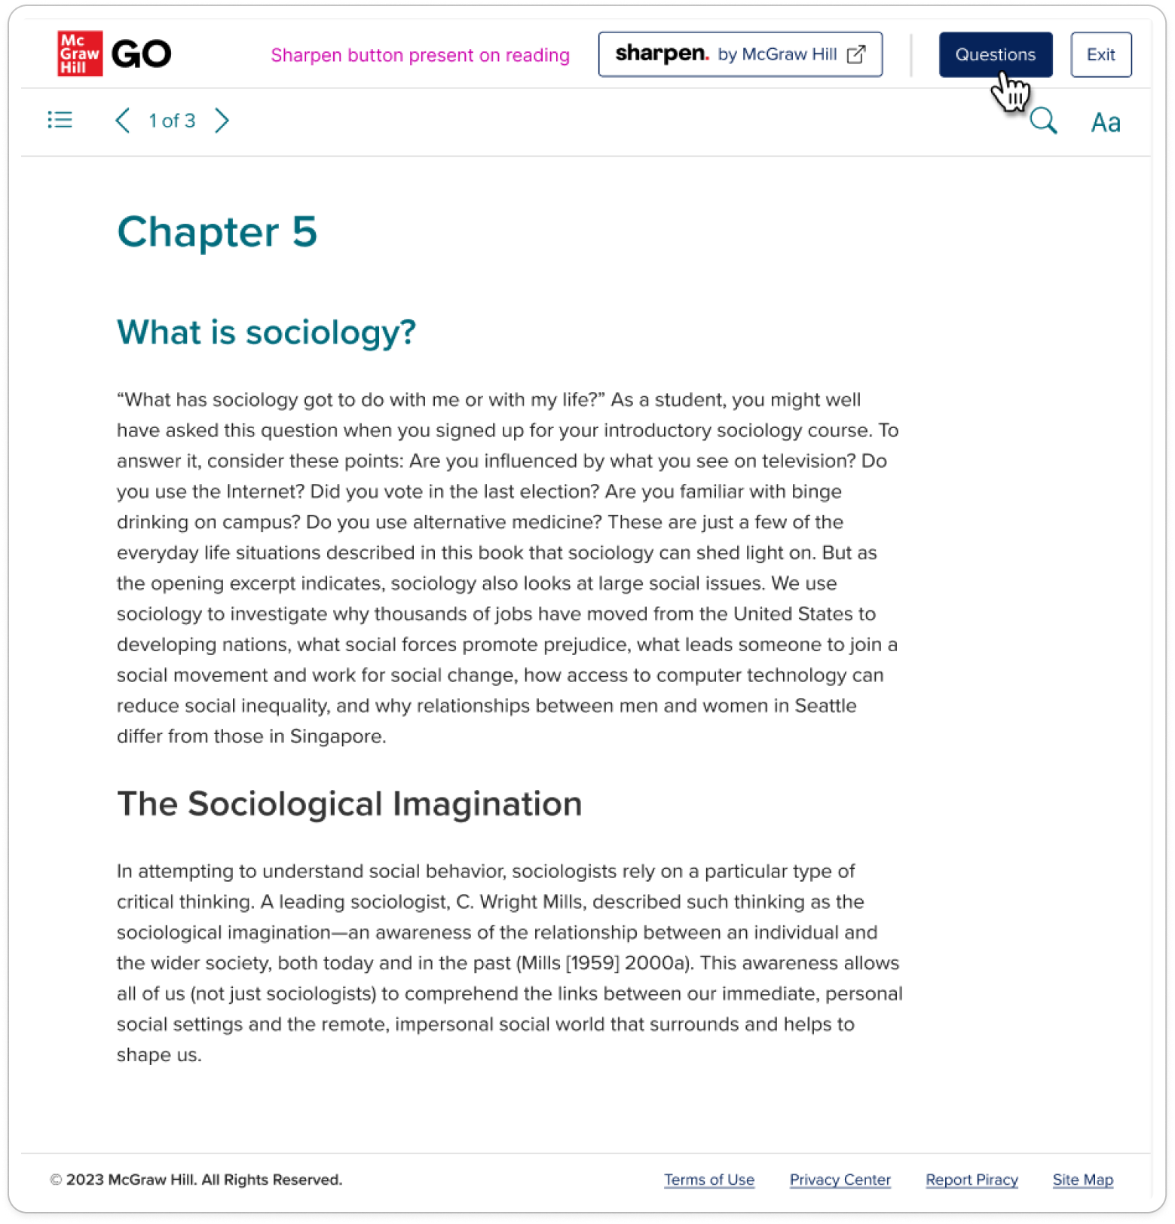
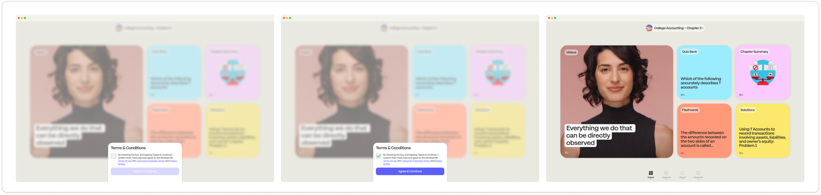
Sharpen Launch point: Once you have registered for Sharpen, you will always see the Sharpen launch point at the top of the GO reading screen. Click this to launch Sharpen in a new web window.
Getting Started with GO®
Logging into Sharpen: Registered Students
Step 1:

Slide 24
Thank you!
Getting Started with McGraw Hill GO and Sharpen
What to Know on Your
First Day of Class

