Slide 1
Slides Available for the First Day of Class: Sharpen Companion, IA, D2L Brightspace
Getting Started with McGraw Hill
McGraw Hill GO 2 – 5
McGraw Hill GO and Sharpen:
  GO and Sharpen Companion FDOC Slides 6-10
  GO Purchase Flows
    IA: GO with an LMS: D2L Brightspace Slides 11-15
  GO Log-In Flow – Slides 16-18

Slide 2
McGraw Hill GO
Student Registration
For D2L Brightspace with Inclusive Access

Slide 3


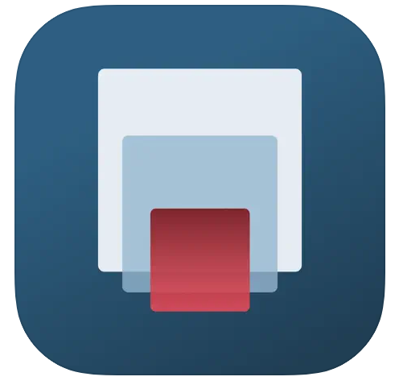

What is McGraw Hill GO?
McGraw Hill GO is an eBook+ embedded directly in your LMS course – no additional logins or access required
Actively Read using the AI Reader
Leverage the power of our gen AI tool embedded in the ebook to expand your understanding and boost your curiosity.
Quiz While You Read
Check your understanding and flip from readings to assessments to gauge your grasp of the concepts covered.
On-the-GO Access
Access your McGraw Hill GO eBook on mobile devices through the free ReadAnywhere app (must activate GO first).
College study app for exam prep that goes with our textbook and McGraw Hill GO, offering flashcards, quizzes, videos, and tools to stay on track.

Slide 4

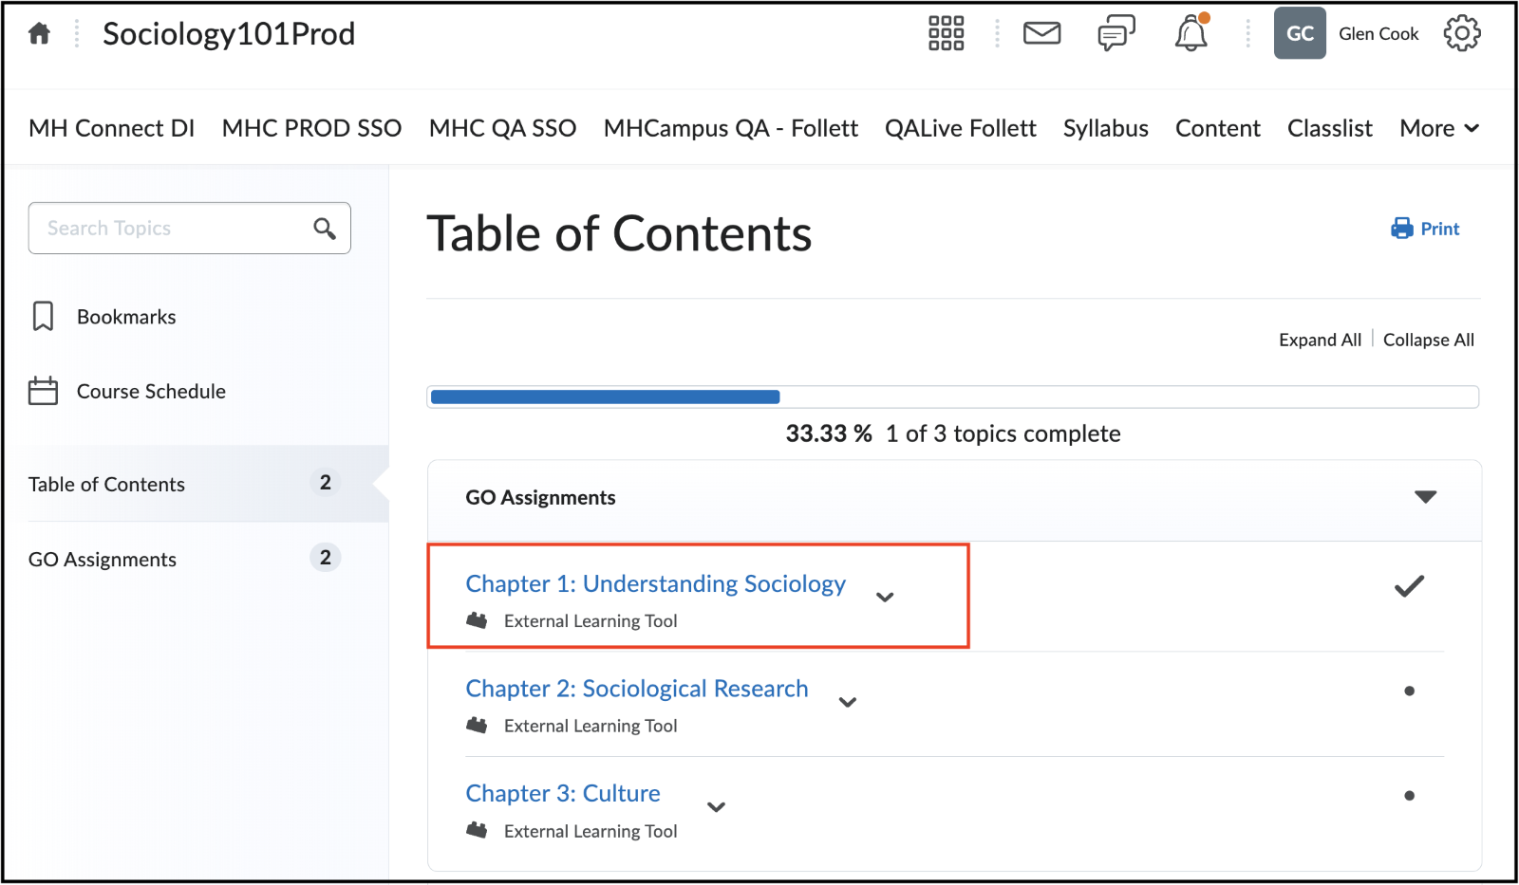
Step 1
To access McGraw Hill GO, select a GO assignment in the Content area of your Blackboard course.

Slide 5
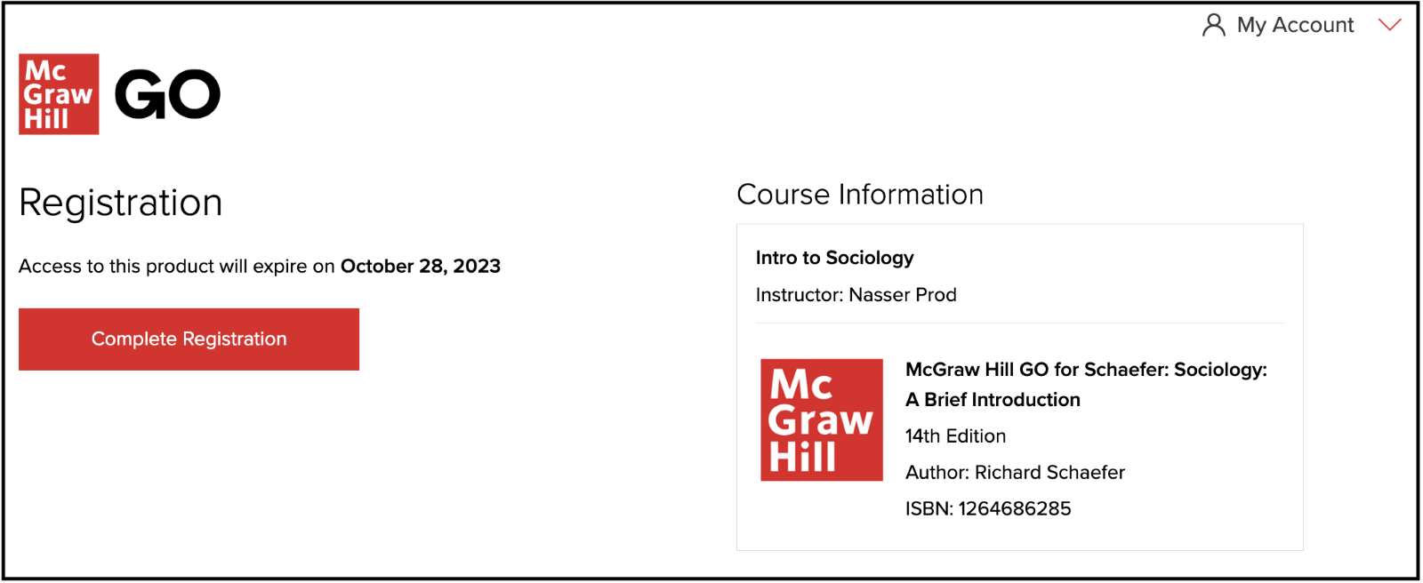
Step 2
Select Complete Registration and then you can access your first McGraw Hill GO assignment!

Slide 6

Getting Started with McGraw Hill GO® and Sharpen
What to Know on Your
First Day of Class

Slide 7

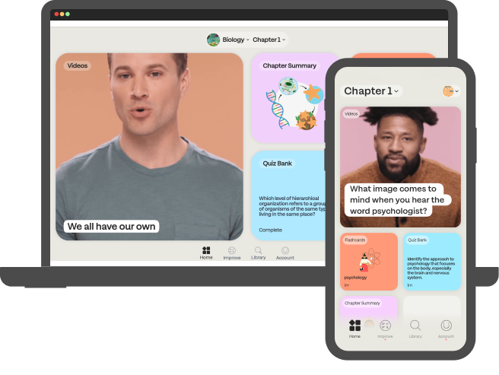


Students: What is GO with Sharpen?
Getting Started with GO®
Sharpen is McGraw Hill's newest study tool: an exam prep app included in GO! By using both GO and Sharpen, you can master your course material and ace your exams.
Sharpen has hundreds of bite-sized study tools customized for your course so you can learn in just 5 minutes. The app delivers personalized study tips based on your in-app performance, so you can see what you know and what you need to review.
Since Sharpen is made by McGraw Hill, you can trust its content: accurate and focused on the most important concepts. You can launch Sharpen with one click from GO or log into Sharpen's web or mobile apps.

Slide 8
Students, here are some tips to ace your exams with Sharpen:
Getting Started with GO®
Exam Prep
  Spend 10 minutes on Quiz Bank to confirm what you know and check Improve for tips to master concepts you missed.
Weekly Review
  Flip through Sharpen flashcards for 5 minutes to test yourself on chapters covered in class.
Refresher Before Class
  Spend 5 minutes on Sharpen summaries and videos to review key concepts.
24/7 Access
  Download the Sharpen mobile phone app for iOS or Android. On laptops or tablets, log into Sharpen at www.studysharpen.com or through the GO launch points.

Slide 9
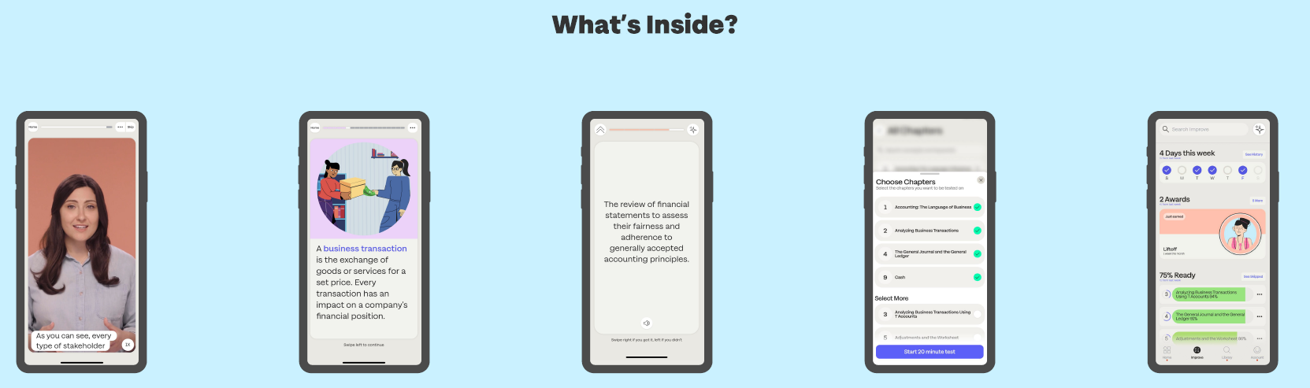
Sharpen is the ultimate college study app for exam prep
Getting Started with GO®
CHAPTER
SUMMARIES
QUIZ BANK FOR EXAM PREP
IMPROVE SECTION
VIDEOS
FLASHCARDS

Slide 10



Download the Sharpen College Study App – Scan This Code​
Getting Started with GO®

Slide 11
Getting Started with McGraw Hill GO® and Sharpen
Getting Started with GO®
Sharpen Companion Purchase Flow
GO: IA Integrated with a Learning Management System (LMS)
What to Know on Your
First Day of Class

Slide 12

Accessing McGraw Hill GO:
D2L Brightspace
Getting Started with GO®
Step 1
To access McGraw Hill GO, select a GO assignment in the Content area of your D2L Brightspace course.

Slide 13
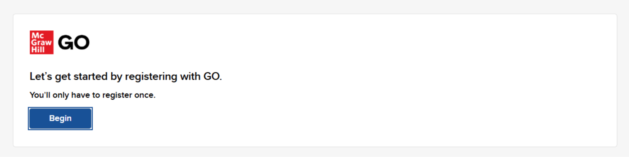
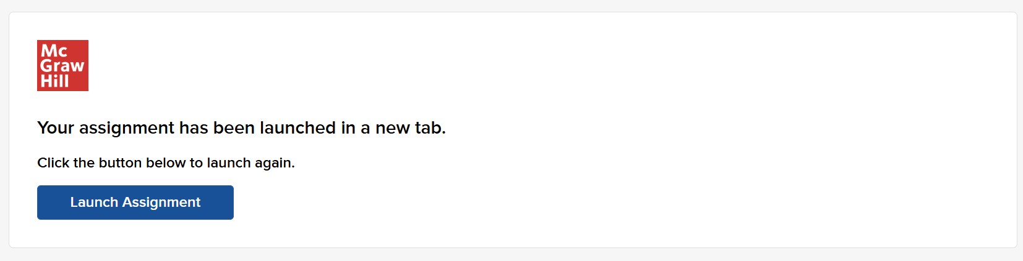
Accessing McGraw Hill GO:
Sharpen
Getting Started with GO®
Step 2
Clicking on a GO assignment launches the Course Access Page. On this page, click Begin.
If your assignment launches in a new tab but your browser does not open it, click Launch Assignment.

Slide 14
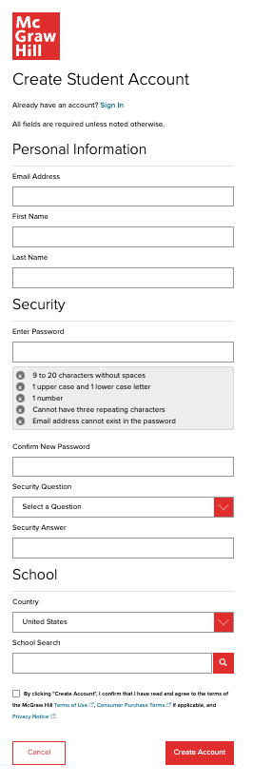
Step 3:
Getting Started with GO®
Create your account: Enter email, First and Last Name, create a password and select a security question.
We recommend using your school email address when creating an account.
To receive text alerts, enter your mobile number. Agree to the Terms and Conditions and then click Continue.

Slide 15
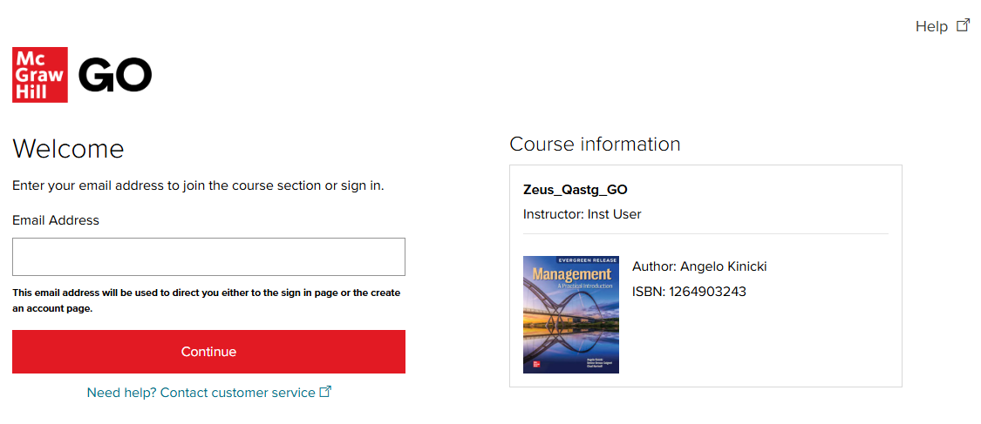
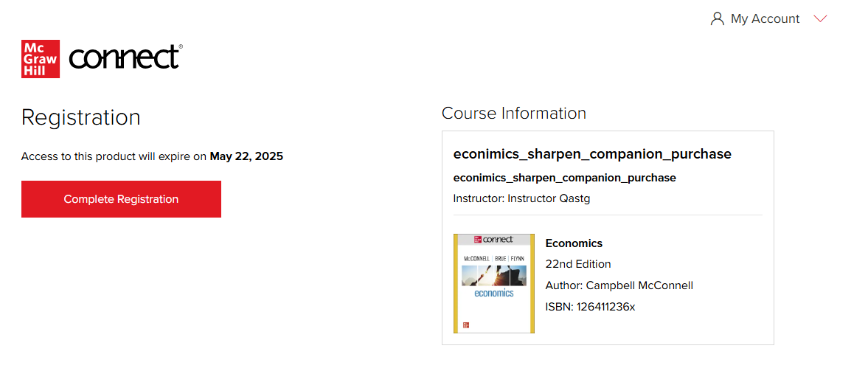
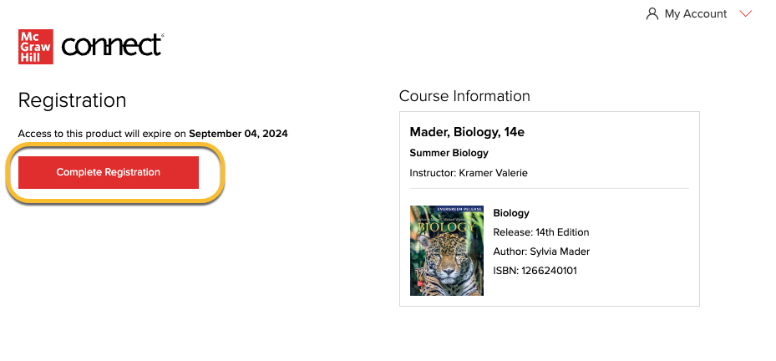
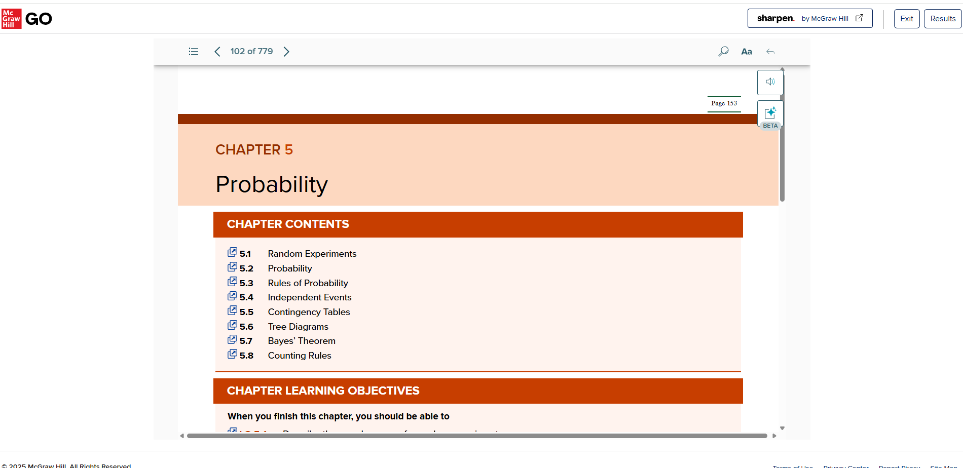
Step 4:
Getting Started with GO®
IA confirmation page
Click Complete Registration to access your learning content.
Congratulations! You have successfully joined your course.
Mader, Biology, 14e: Connect with Sharpen

Slide 16
What to Know on Your
First Day of Class
Getting Started with GO®
Sharpen Companion Log-In Flow
GO: IA and non-IA
Getting Started with McGraw Hill GO® and Sharpen

Slide 17
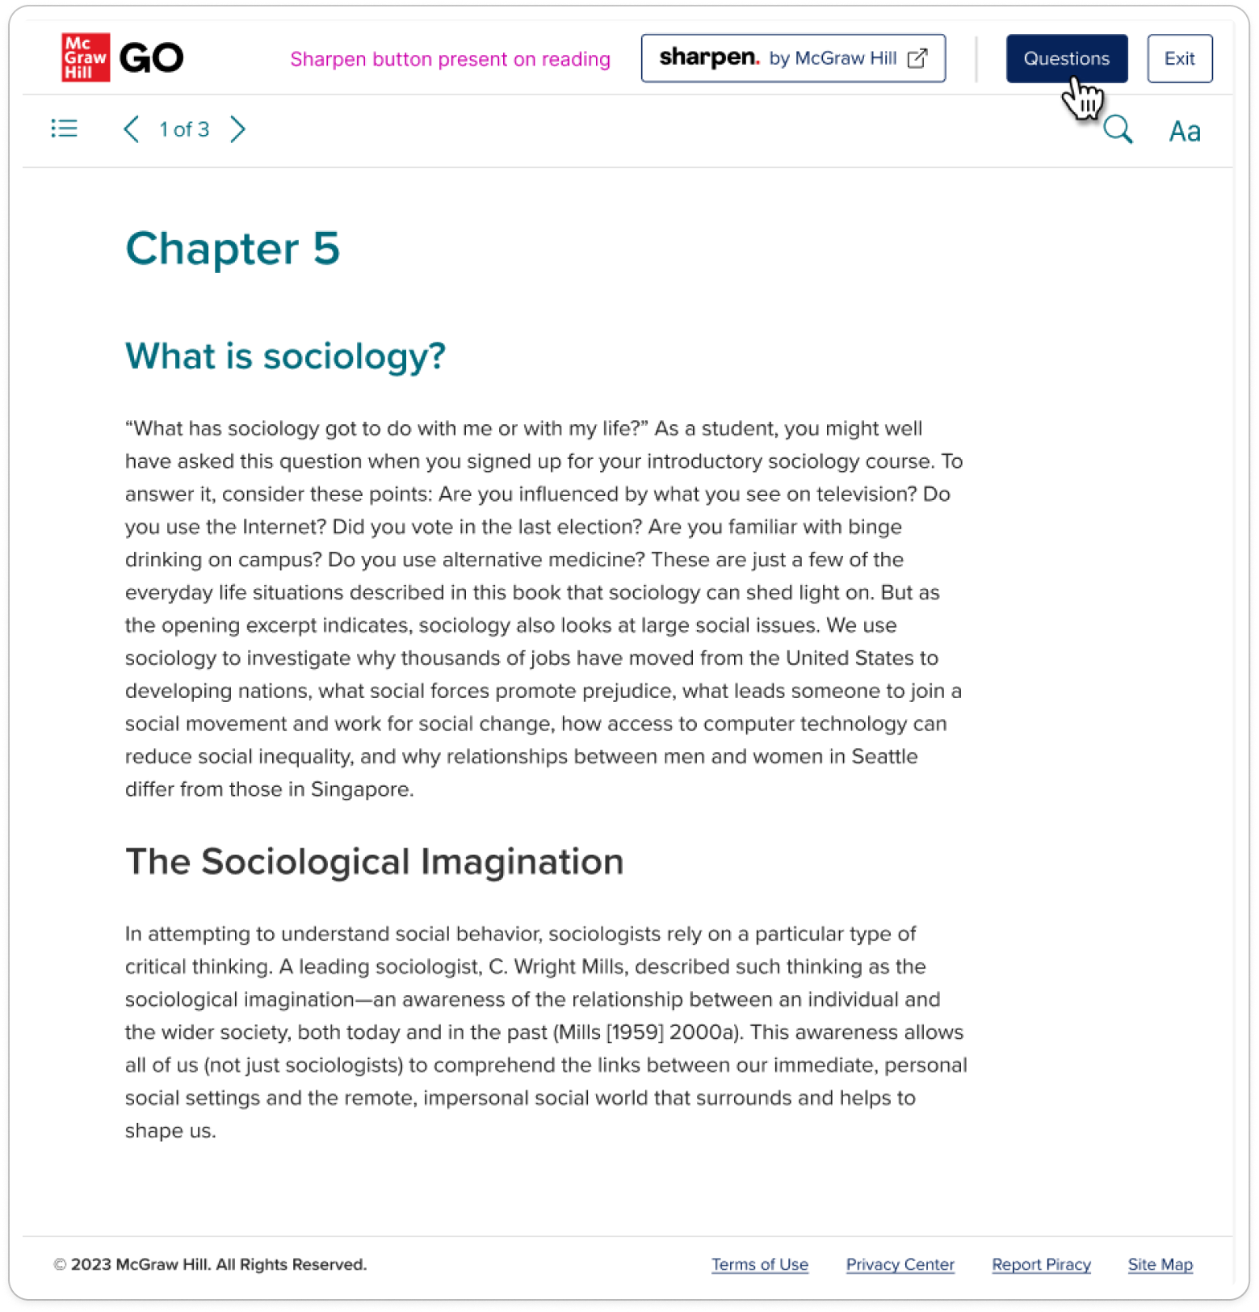
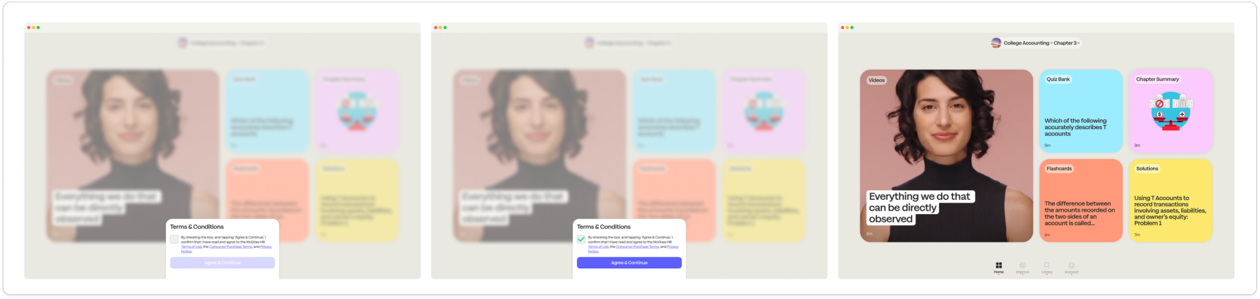
Logging into Sharpen: Registered Students
Getting Started with GO®
Step 1:
Sharpen Launch point: Once you have registered for Sharpen, you will always see the Sharpen launch point at the top of the GO reading screen. Click this to launch Sharpen in a new web window.

Slide 18
Thank you!
Getting Started with McGraw Hill GO and Sharpen
What to Know on Your
First Day of Class

