Slide 1
McGraw Hill Connect ®
Student Registration
Canvas with Inclusive Access LTIA Deep Integration

Slide 2

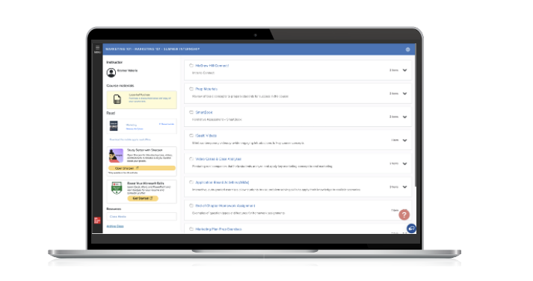
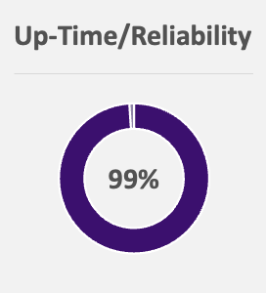
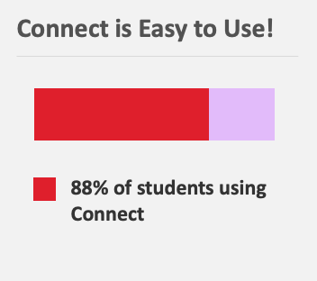
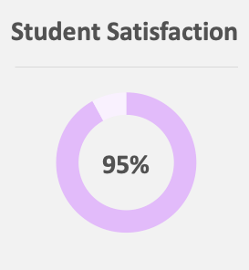
Connect is your personalized digital learning experience designed to help you optimize study time and ramp up your grade potential.
Personalized Learning
Interactive, Course-Specific Tools
Built-in AI
Mobile eBook Access
Affordable Materials
Quality Content
Support!

Slide 3





Make the Most of Connect!
Learn On-the-Go
Download the free ReadAnywhere app to take your eBook and SmartBook with you—online and offline.
Focus!
SUCCESS!
View the Reports in Connect to understand key concepts from the content.
Know What to Study
Recharge in SmartBook provides you with personalized studying of concepts you’ve learned. Built with the power of learning science, you’ll know just what to study!
Use Your Resources
Prep like a pro with exam-like quizzes, flashcards, videos, and study tools aligned with your textbook.
Get Support When Needed
Connect support is available 24/7 via chat or phone. Please reach out to them with any issues. They are there to help!
* ReadAnywhere supports newer eBooks and SmartBook - may not be available in your Connect course. Sharpen available in most courses.

Slide 4

Step 1
Login into your Canvas account and navigate to your course.
If you are not sure if you have a Canvas account, check with your instructor.

Slide 5
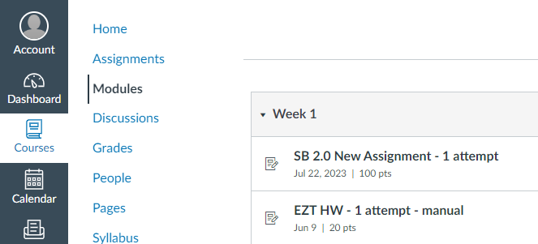
Step 2
Navigate to a Connect assignment link and click on it.

Slide 6
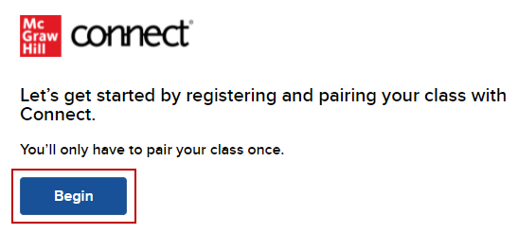
Step 3
Click Begin.

Slide 7
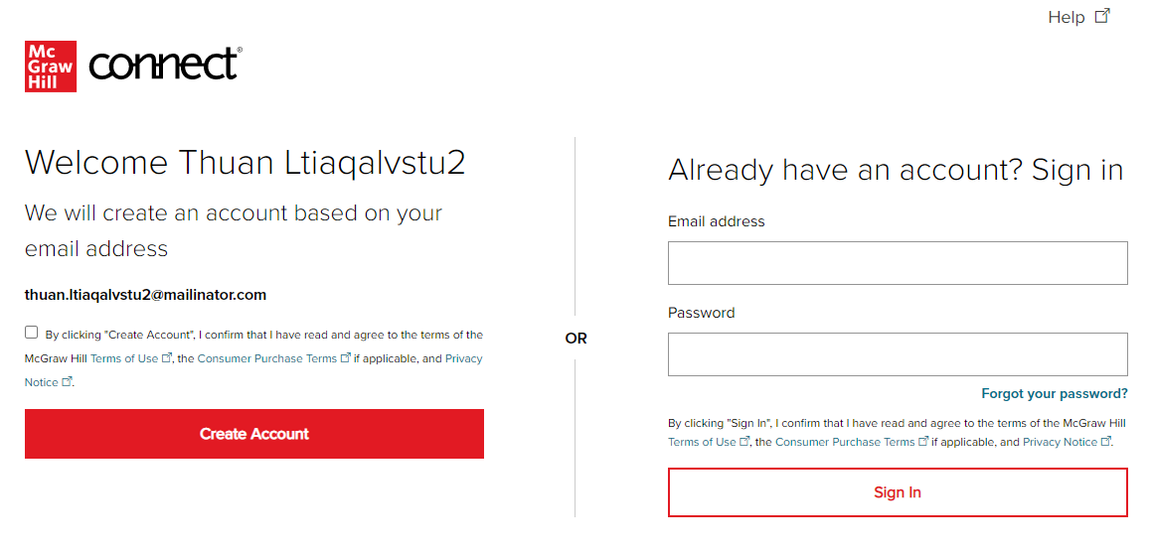
Step 4
Sign In with an existing Connect account or Create Account.

Slide 8
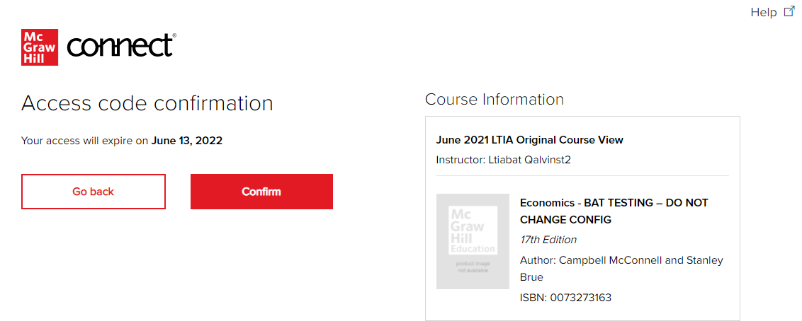
Step 5
Click Confirm. You are now registered.

Slide 9
Slides Available for the First Day of Class: Sharpen Companion, IA, Canvas
Getting Started with McGraw Hill
McGraw Hill Connect and Sharpen:
  Connect and Sharpen Companion FDOC Slides 2 – 9
  Connect Purchase Flows
    IA: Connect with an LMS: Canvas Slides 10 – 14
  Connect Log-In Flows
    Non-IA and IA: Connect with an LMS Slides 15 – 18

Slide 10

Getting Started with McGraw Hill Connect ® and Sharpen
What to Know on Your
First Day of Class

Slide 11
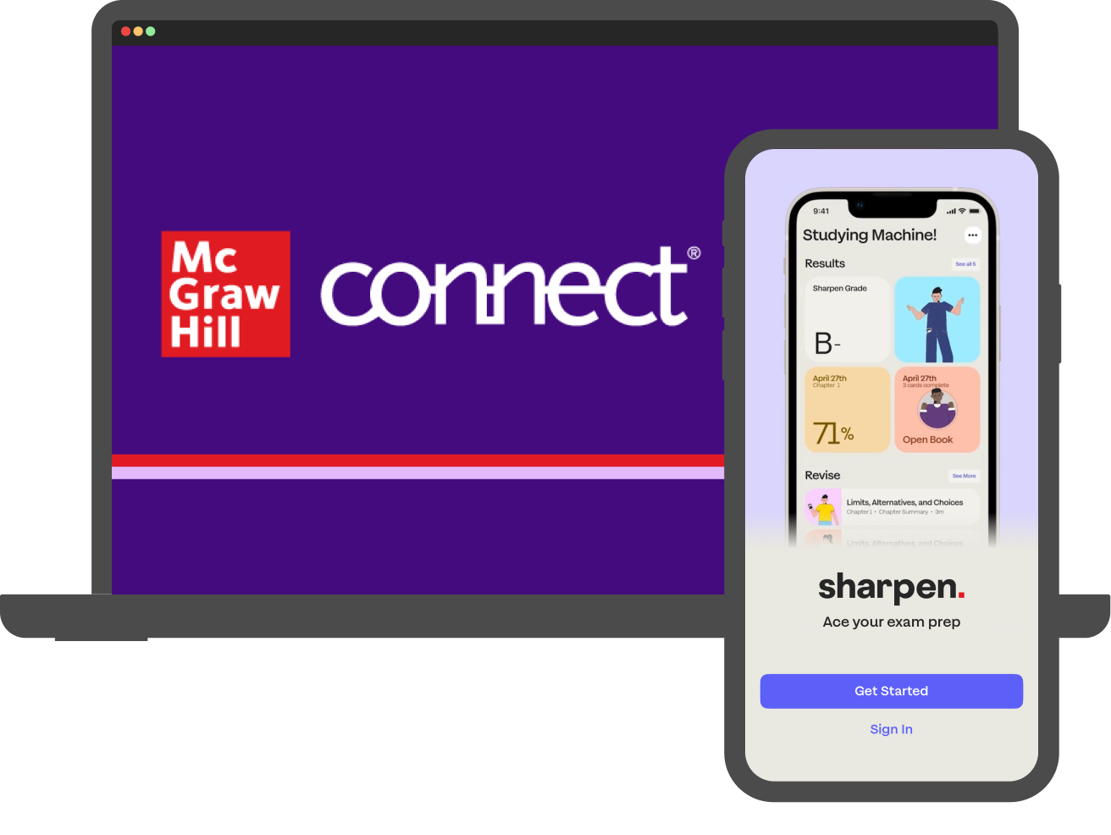
Students: What is Sharpen?
Getting Started with Connect®
Sharpen is McGraw Hill's newest study tool: an exam prep app included in Connect! By using these platforms together, you can master your course material and ace your exams.
Sharpen has hundreds of bite-sized tools customized for your course to help you learn in just 5 minutes. The app's AI engine delivers personalized study tips based on your progress, so you can see what you've mastered and what you need to review.
Since Sharpen is made by McGraw Hill, you can trust its content: accurate and focused on the most important concepts. You can launch Sharpen with one click from Connect or the LMS or log into Sharpen's web or mobile apps.

Slide 12
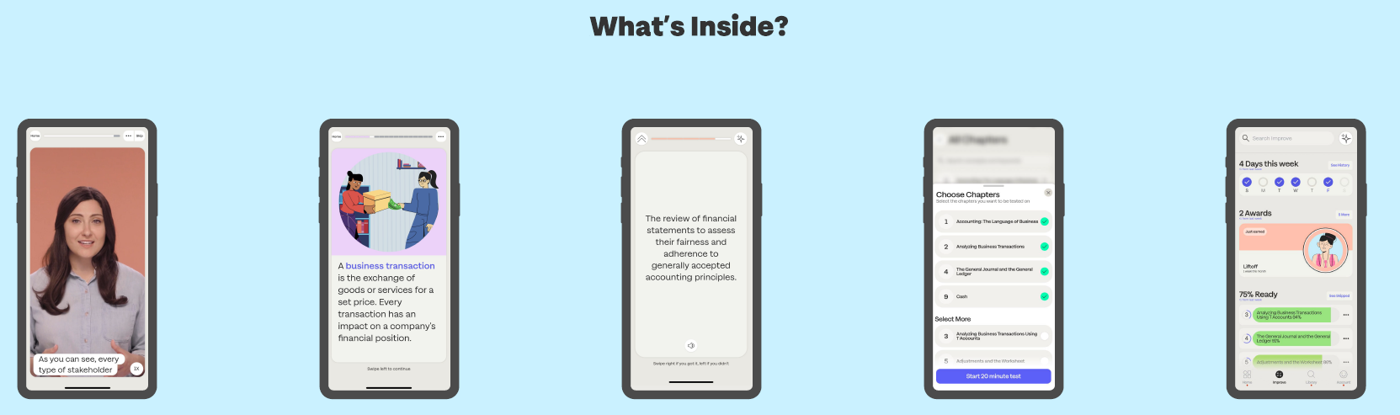
Sharpen is the ultimate college study app for exam prep
Getting Started with Connect®
CHAPTER
SUMMARIES
QUIZ BANK FOR EXAM PREP
IMPROVE SECTION
VIDEOS
FLASHCARDS

Slide 13



Download the Sharpen College Study App – Scan This Code​
Getting Started with Connect®

Slide 14
Students, here are tips to make the most of Connect:
Getting Started with Connect®
Stay Organized
  Digital Course Planner has all your upcoming Connect assignments in one place, and you can customize calendar alerts.
Focus On What Matters
  Use Reports to track your performance and understanding of key concepts.
Learn On-the-Go
  Download the free ReadAnywhere app to take your eBook* and SmartBook®* with you—online and offline, 24/7.
*ReadAnywhere supports newer eBooks and SmartBook. May not be available in your specific Connect course.

Slide 15
Students, here are some tips to ace your exams with Sharpen:
Getting Started with Connect®
Exam Prep
  Spend 10 minutes on Quiz Bank to confirm what you know and check Improve for tips to master concepts you missed.
Weekly Review
  Flip through Sharpen flashcards for 5 minutes to test yourself on chapters covered in class.
Refresher Before Class
  Spend 5 minutes on Sharpen summaries and videos to review key concepts.
24/7 Access
  Download the Sharpen mobile phone app for iOS or Android. On laptops or tablets, log into Sharpen at www.studysharpen.com or through Connect or LMS launch points.

Slide 16




Students: Study on your Smartphone or Tablet!
Getting Started with Connect®
ReadAnywhere® App
Download the free ReadAnywhere app to your Android or iOS smartphone or tablet and access your course eBook for offline study access anytime, anywhere.
More than 1 million students and instructors have downloaded the ReadAnywhere app, which has a 4.7 rating on the App Store.
Connect Tablet App
Log into Connect on your tablet browser and then add it to your home screen to complete assignments. The Connect Tablet App is not recommended for smartphone use.
Sharpen Exam Prep App
Find the Sharpen launch point in Connect, GO, or your LMS. Click get started!
Then download the Sharpen app to your Android or iOS smartphone to access your study content anytime, anywhere.
On your tablet or laptop? Log into Sharpen web at www.studysharpen.com to access your content. Always sign in with your school email address so your progress is up to date on any device.
Close to 1 million students have tried Sharpen, which has a 4.7 App Store rating.

Slide 17

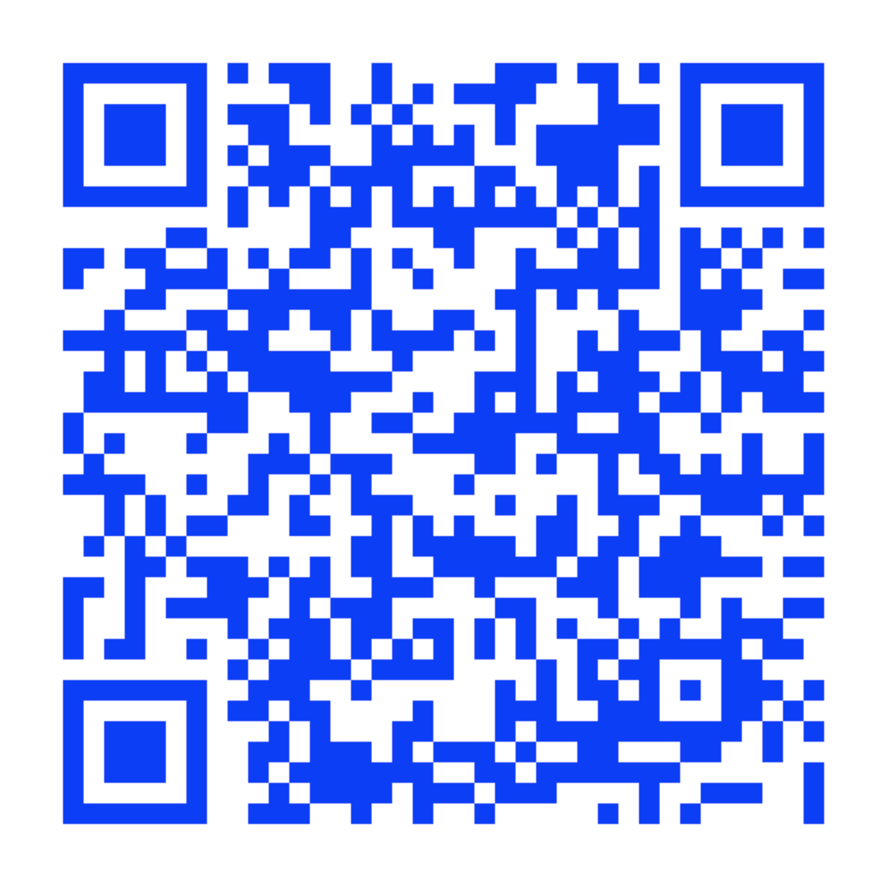
Connect Student Support
Getting Started with Connect®
Connect Student Support
Learn how to register, navigate Connect, use SmartBook®, download the ReadAnywhere® app, and more!
mheducation.com/highered/support/student/connect.html
Plus, access technical support via chat
or phone at (800) 331-5094.
Hours of Operation:
Sunday: 12 PM to 12 AM ET
Monday–Thursday: 24 hours
Friday: 12 AM to 9 PM ET
Saturday: 10 AM to 8 PM ET

Slide 18
Sharpen Companion Purchase Flow
IA Registration: Connect Integrated with a Learning Management System (LMS)
Getting Started with Connect®
Getting Started with McGraw Hill Connect ® and Sharpen
What to Know on Your
First Day of Class

Slide 19
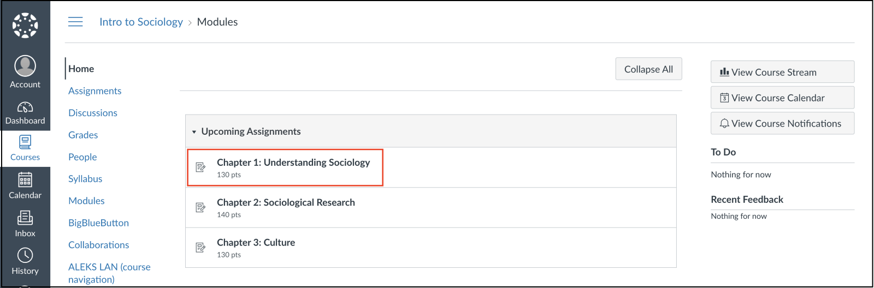

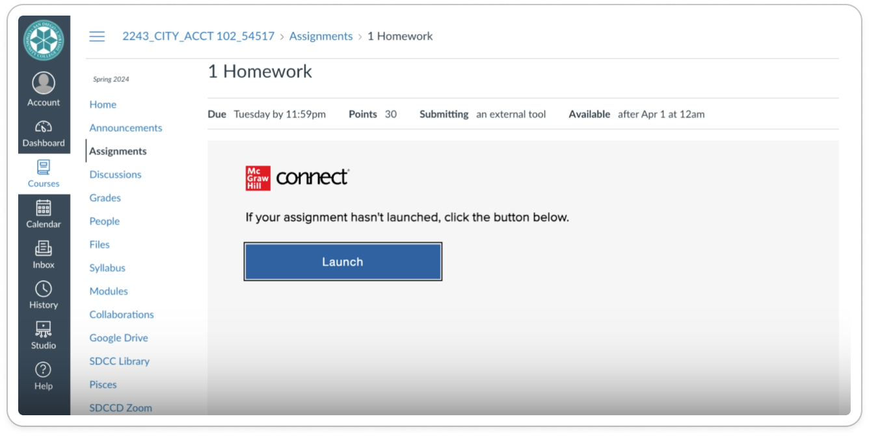
Accessing McGraw Hill Connect:
Canvas
Getting Started with Connect
Step 1
To access McGraw Hill Connect from your Canvas course, click to open the McGraw Hill Connect assignment. On the next screen, click again to launch it.

Slide 20
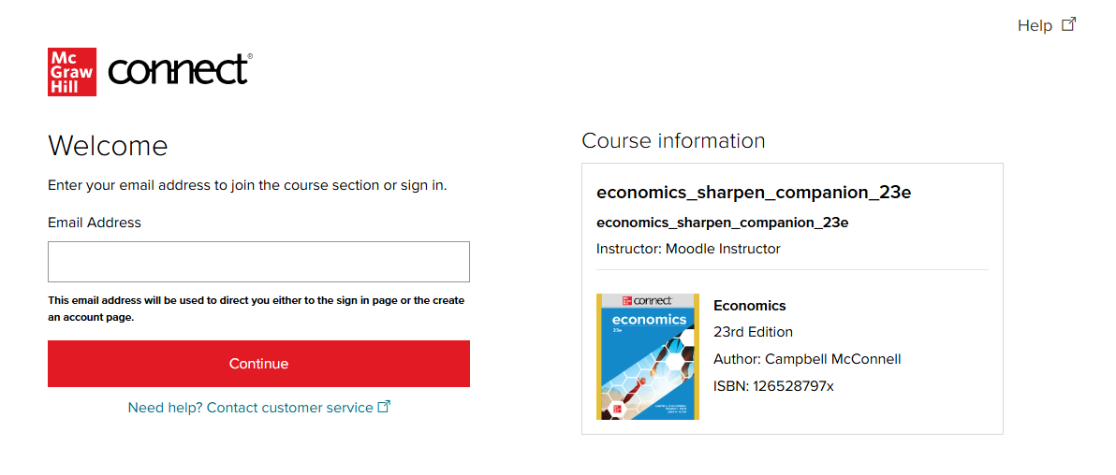
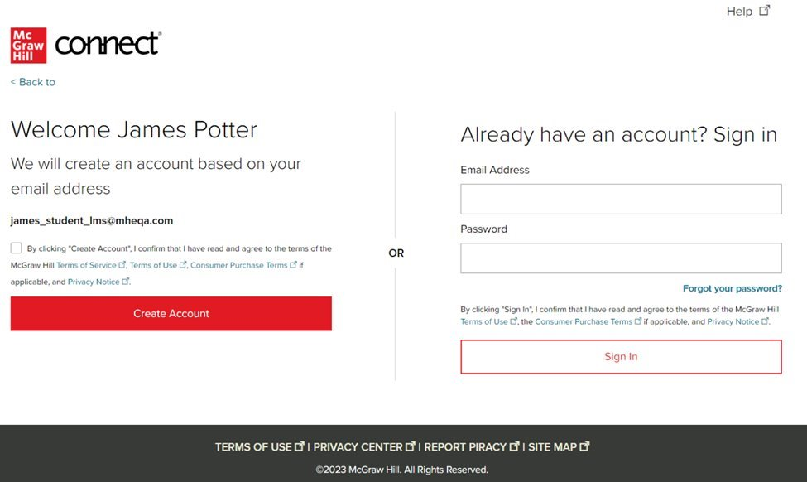
Step 2:
Getting Started with Connect®
Enter your email address and click Create Account.
If you receive the message "You have a Connect Account but have forgotten your password," click Forgot your password?.
*Depending on your school you might skip this step. That’s ok! Just continue the process from that step to the end.

Slide 21
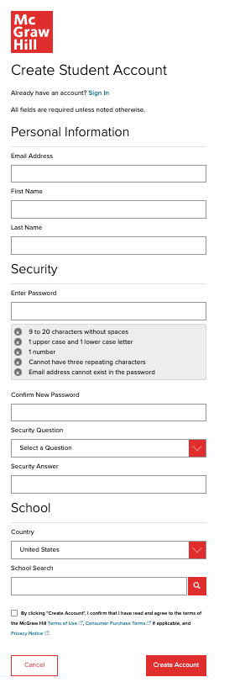
Step 3:
Getting Started with Connect®
Create your account: Enter email, First and Last Name, create a password and select a security question.
Always use your school email address when creating an account.
To receive text alerts, enter your mobile number. Agree to the Terms and Conditions and then click Continue.

Slide 22
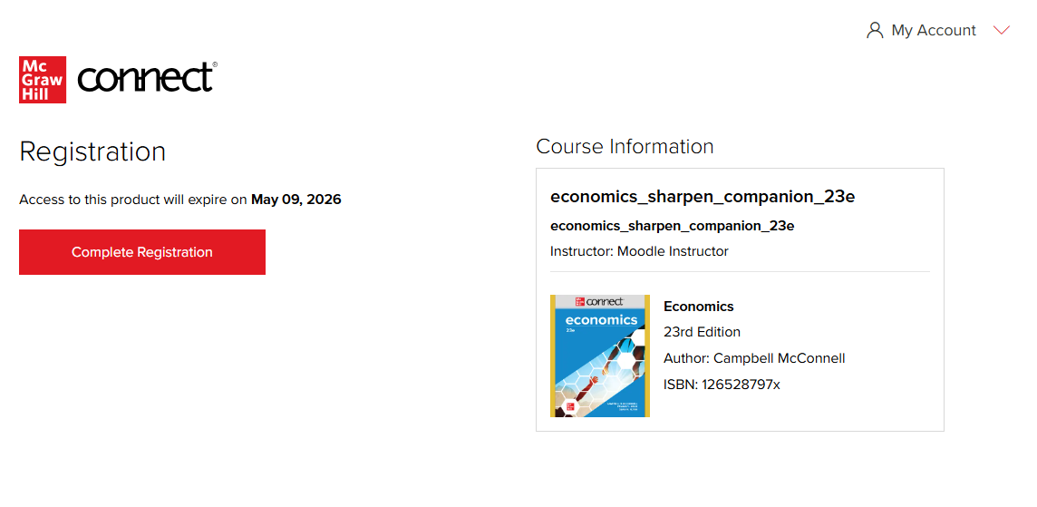
Step 4:
Getting Started with Connect®
Click Complete Registration to access your learning content.
Congratulations! You have successfully joined your course.
Mader, Biology, 14e: Connect with Sharpen

Slide 23
Sharpen Companion Log-In Flow
Non-IA and IA: Connect Integrated with a Learning Management System (LMS)
Getting Started with Connect®
Getting Started with McGraw Hill Connect ® and Sharpen
What to Know on Your
First Day of Class

Slide 24
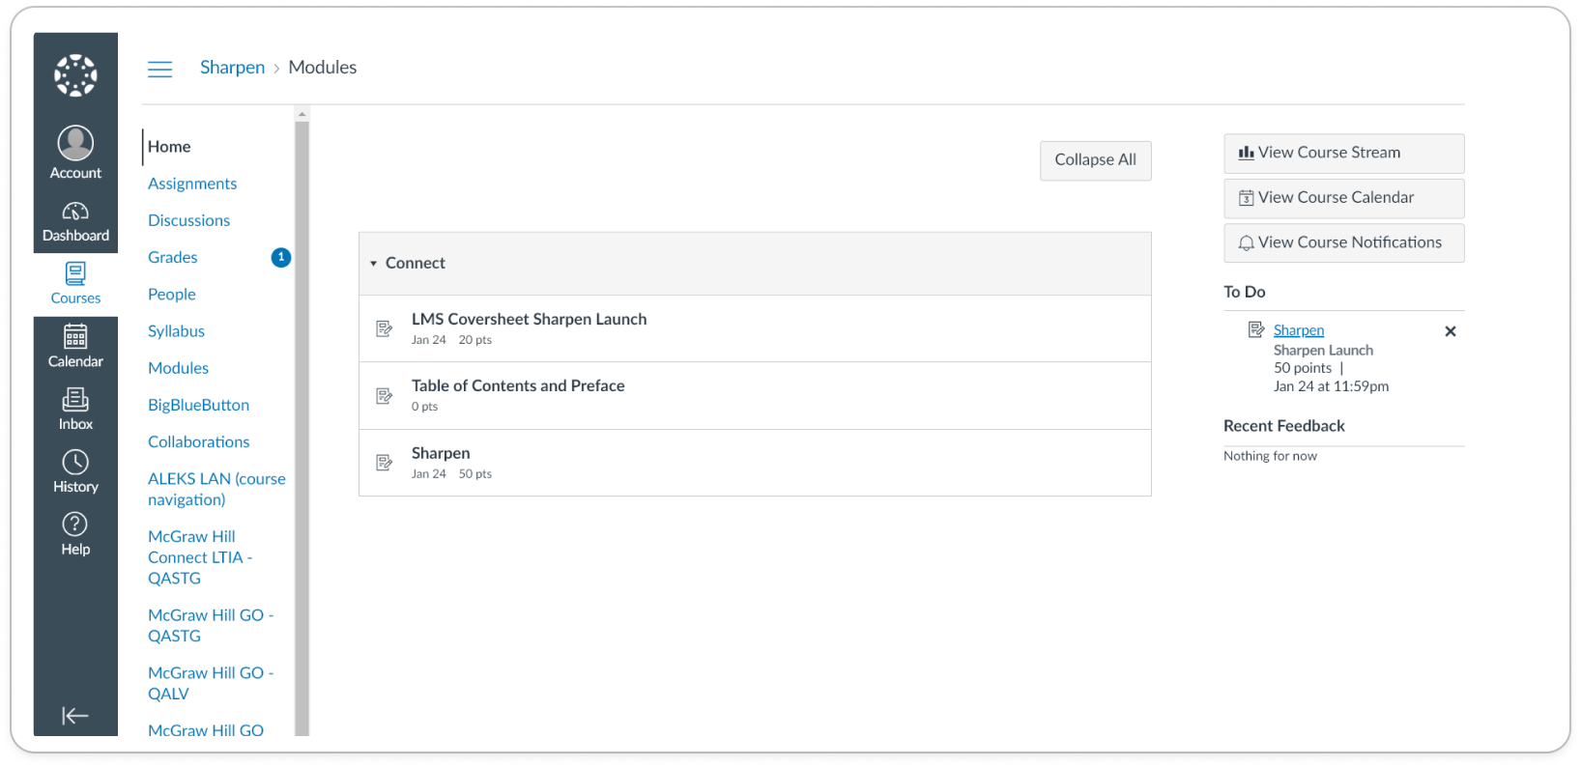
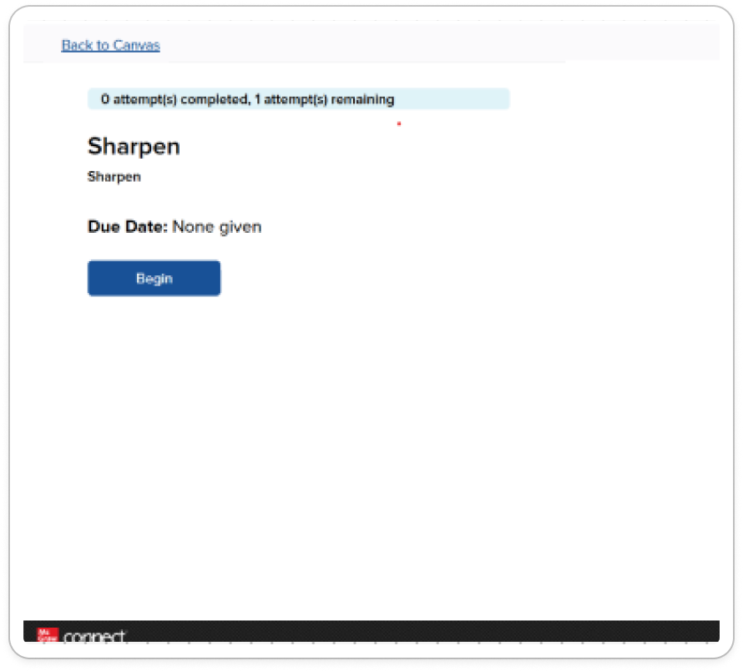
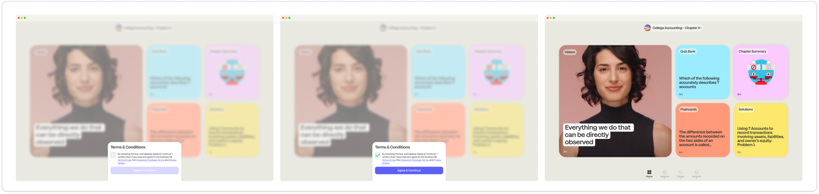
Sharpen Companion Log-In Flow
Part 1
Getting Started with Connect®
The LMS Cover Sheet includes two Sharpen launch points.
First, click on the top LMS Cover Sheet to open a new page with the Sharpen access point. Click Begin to launch Sharpen in a new web window.

Slide 25
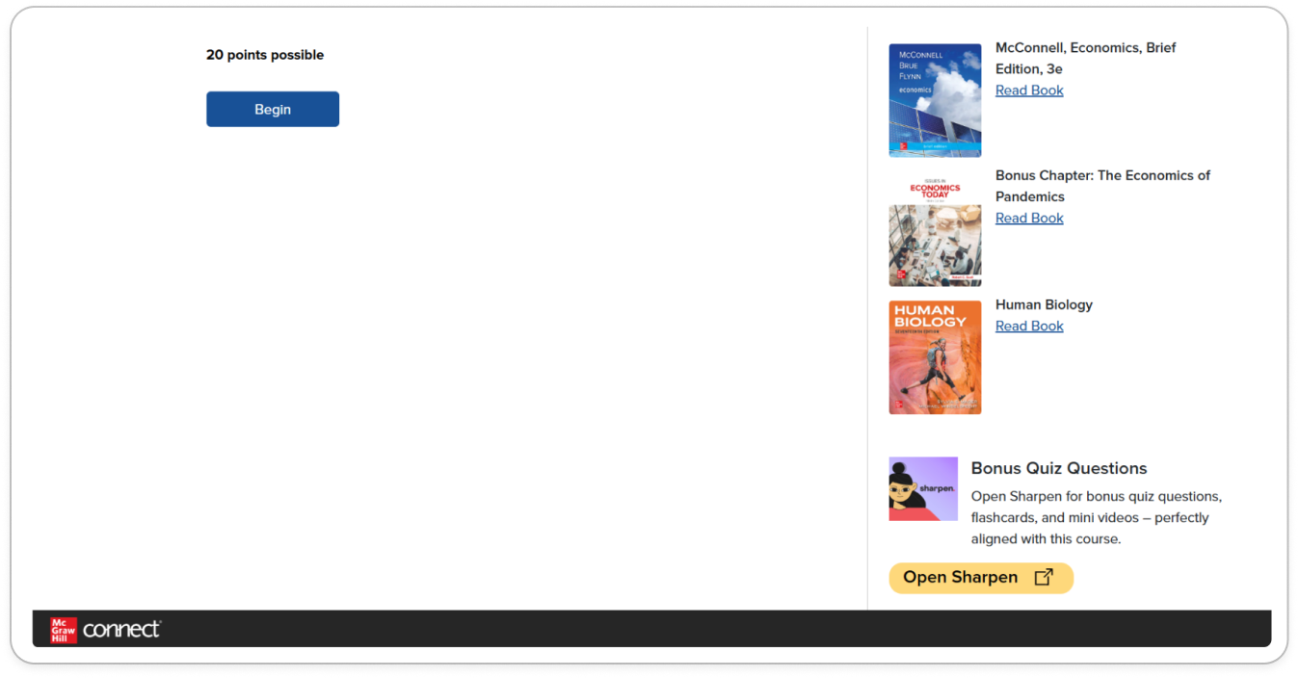
Sharpen Companion Log-In Flow Part 2
Getting Started with Connect®
LMS Cover Sheet:
Then, click on the bottom Sharpen assignment to open a new page with the Sharpen access point.
Click Begin to launch Sharpen in a new web window.

Slide 26
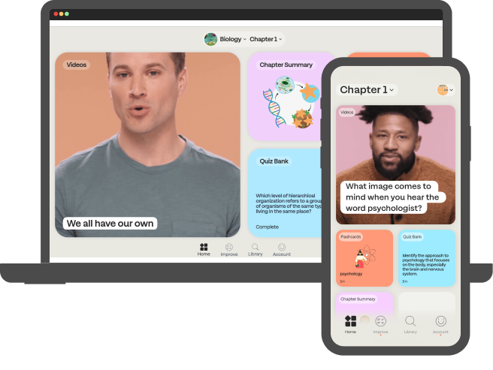
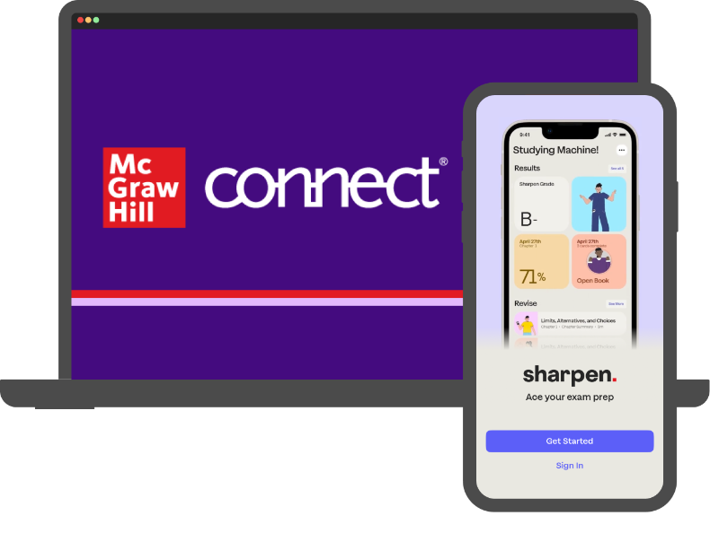
Thank you!
Getting Started with McGraw Hill Connect ® and Sharpen
What to Know on Your
First Day of Class

