Slide 1
Slides Available for the First Day of Class: Sharpen Companion, non-IA, Blackboard
Getting Started with McGraw Hill
McGraw Hill Connect and Sharpen:
  Connect and Sharpen Companion FDOC Slides 2 – 9
  Connect Purchase Flows
    Non-IA: Connect with an LMS: Blackboard Slides 10 – 18
  Connect Log-In Flows
    Non-IA and IA: Connect with an LMS Slides 19 – 22

Slide 2

Getting Started with McGraw Hill Connect ® and Sharpen
What to Know on Your
First Day of Class

Slide 3

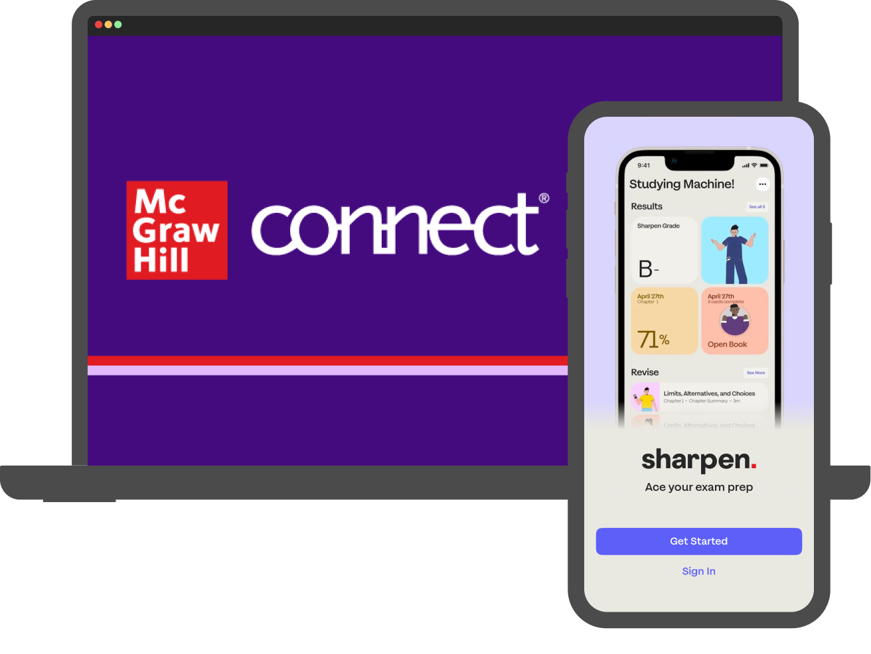
Students: What is Sharpen?
Getting Started with Connect®
Sharpen is McGraw Hill's newest study tool: an exam prep app included in Connect! By using these platforms together, you can master your course material and ace your exams.
Sharpen has hundreds of bite-sized tools customized for your course to help you learn in just 5 minutes. The app's AI engine delivers personalized study tips based on your progress, so you can see what you've mastered and what you need to review.
Since Sharpen is made by McGraw Hill, you can trust its content: accurate and focused on the most important concepts. You can launch Sharpen with one click from Connect or the LMS or log into Sharpen's web or mobile apps.

Slide 4
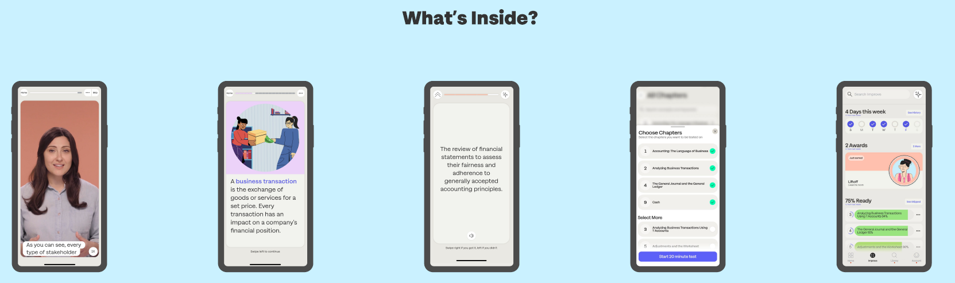
Sharpen is the ultimate college study app for exam prep
Getting Started with Connect®
CHAPTER
SUMMARIES
QUIZ BANK FOR EXAM PREP
IMPROVE SECTION
VIDEOS
FLASHCARDS

Slide 5



Download the Sharpen College Study App – Scan This Code​
Getting Started with Connect®

Slide 6
Students, here are tips to make the most of Connect:
Getting Started with Connect®
Stay Organized
  Digital Course Planner has all your upcoming Connect assignments in one place, and you can customize calendar alerts.
Focus On What Matters
  Use Reports to track your performance and understanding of key concepts.
Learn On-the-Go
  Download the free ReadAnywhere app to take your eBook* and SmartBook®* with you—online and offline, 24/7.
*ReadAnywhere supports newer eBooks and SmartBook. May not be available in your specific Connect course.

Slide 7
Students, here are some tips to ace your exams with Sharpen:
Getting Started with Connect®
Exam Prep
  Spend 10 minutes on Quiz Bank to confirm what you know and check Improve for tips to master concepts you missed.
Weekly Review
  Flip through Sharpen flashcards for 5 minutes to test yourself on chapters covered in class.
Refresher Before Class
  Spend 5 minutes on Sharpen summaries and videos to review key concepts.
24/7 Access
  Download the Sharpen mobile phone app for iOS or Android. On laptops or tablets, log into Sharpen at www.studysharpen.com or through Connect or LMS launch points.

Slide 8




Students: Study on your Smartphone or Tablet!
Getting Started with Connect®
ReadAnywhere® App
Download the free ReadAnywhere app to your Android or iOS smartphone or tablet and access your course eBook for offline study access anytime, anywhere.
More than 1 million students and instructors have downloaded the ReadAnywhere app, which has a 4.7 rating on the App Store.
Connect Tablet App
Log into Connect on your tablet browser and then add it to your home screen to complete assignments. The Connect Tablet App is not recommended for smartphone use.
Sharpen Exam Prep App
Find the Sharpen launch point in Connect, GO, or your LMS. Click get started!
Then download the Sharpen app to your Android or iOS smartphone to access your study content anytime, anywhere.
On your tablet or laptop? Log into Sharpen web at www.studysharpen.com to access your content. Always sign in with your school email address so your progress is up to date on any device.
Close to 1 million students have tried Sharpen, which has a 4.7 App Store rating.

Slide 9

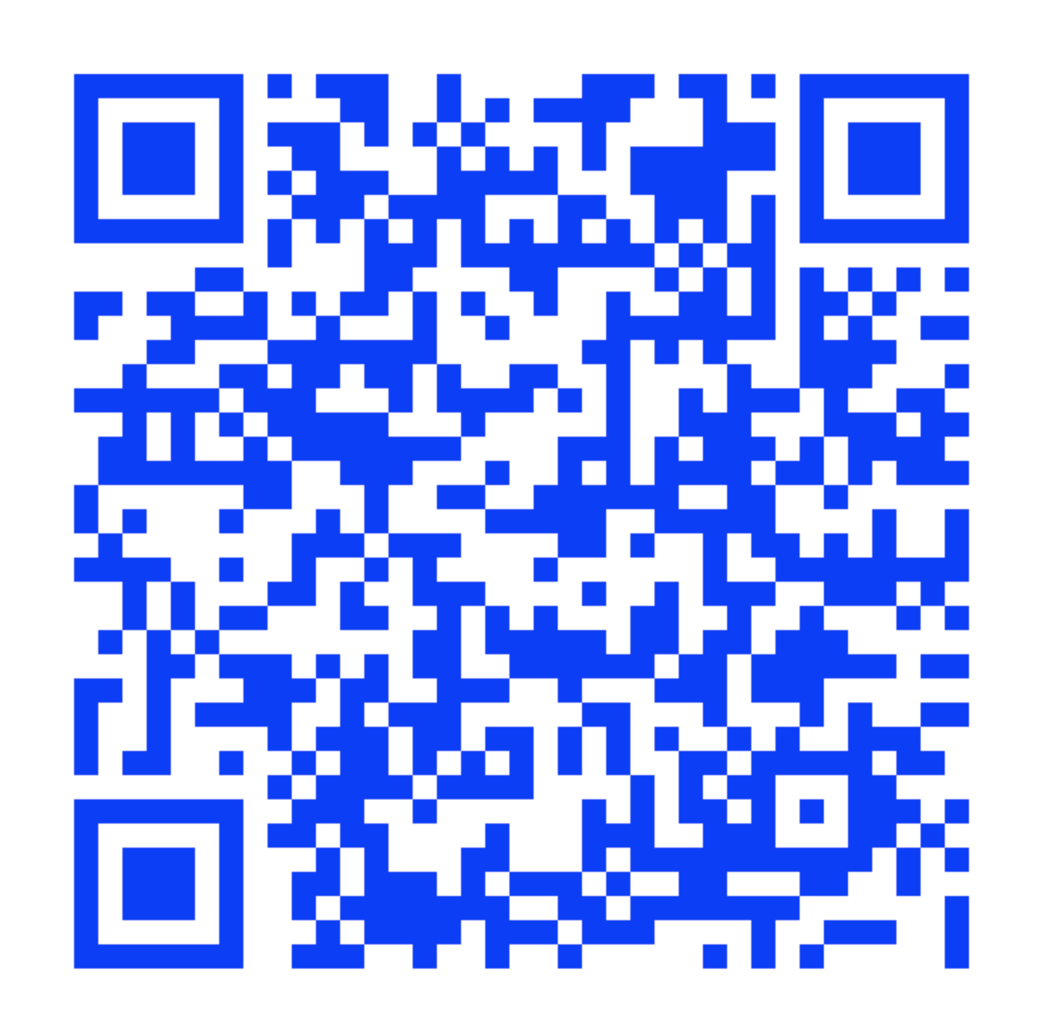
Connect Student Support
Learn how to register, navigate Connect, use SmartBook®, download the ReadAnywhere® app, and more! mheducation.com/highered/support/student/connect.html
Plus, access technical support via chat or phone at (800) 331-5094.
Hours of Operation:
Sunday: 12 PM to 12 AM ET
Monday–Thursday: 24 hours
Friday: 12 AM to 9 PM ET
Saturday: 10 AM to 8 PM ET
Getting Started with Connect®

Slide 10
Sharpen Companion Purchase Flow
Non-IA Registration: Connect Integrated with a Learning Management System (LMS)
Getting Started with Connect®
Getting Started with McGraw Hill Connect ® and Sharpen
What to Know on Your
First Day of Class

Slide 11
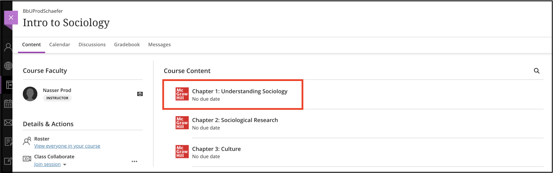

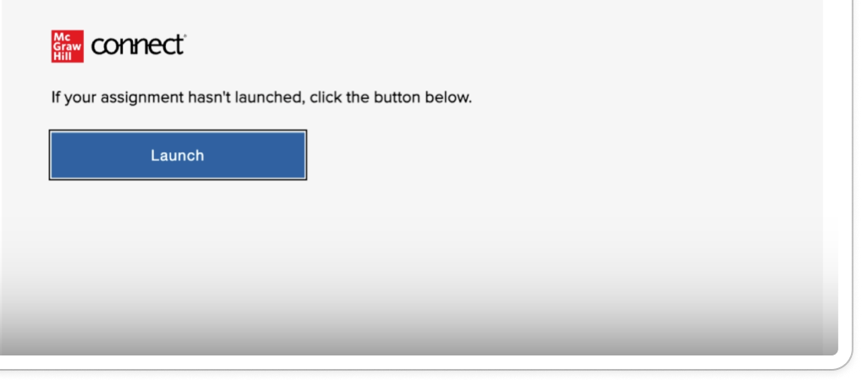
Accessing McGraw Hill Connect:
Blackboard
Getting Started with Connect
Step 1
To access McGraw Hill Connect from your Blackboard course, select a McGraw Hill Connect assignment. On the next screen, click to launch it.

Slide 12
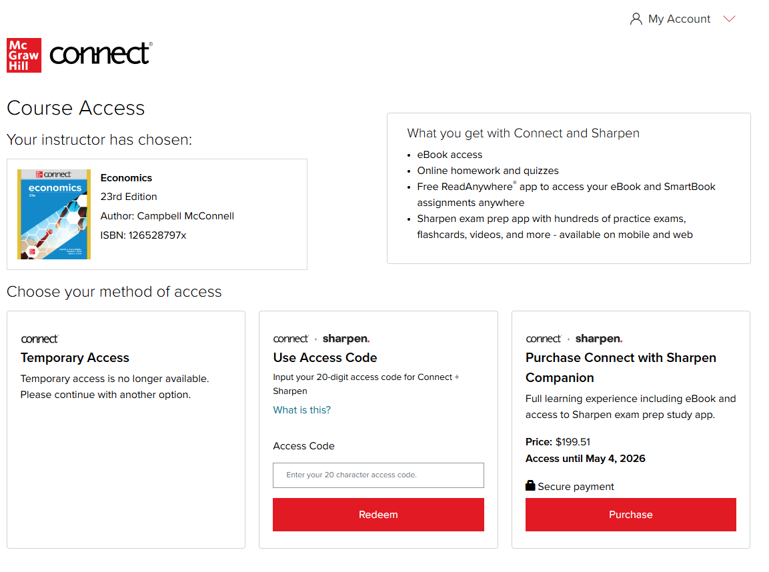
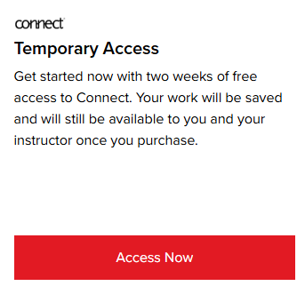
Step 2:
Getting Started with Connect®
You have three registration options (right to left):
Purchase Online: Click Purchase to use a credit card or PayPal.
Enter Code: Enter a Connect and Sharpen access code and click Redeem.
Temporary Access: Click Access Now for two-week temporary access. Note this unlocks Connect only and not Sharpen.

Slide 13
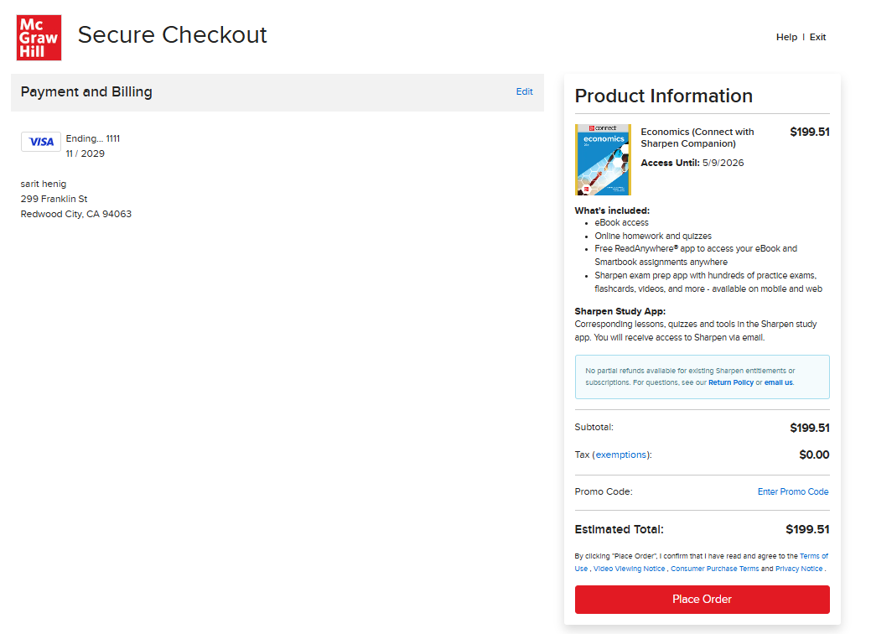
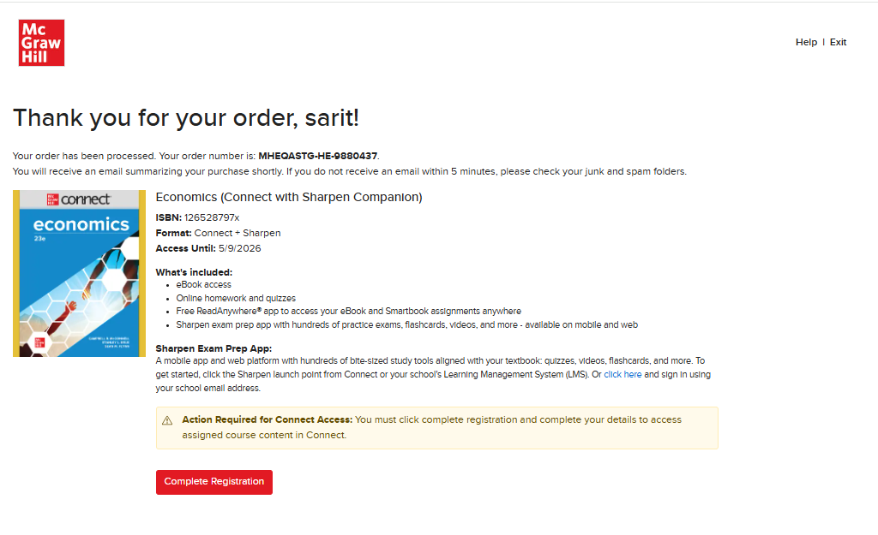
Step 3A:
Getting Started with Connect®
Purchase Online: Click Purchase to use a credit card or PayPal. Enter your payment information and click "Place Order". A purchase confirmation page will load.
Congratulations! You have successfully completed your Connect and Sharpen Companion purchase.

Slide 14
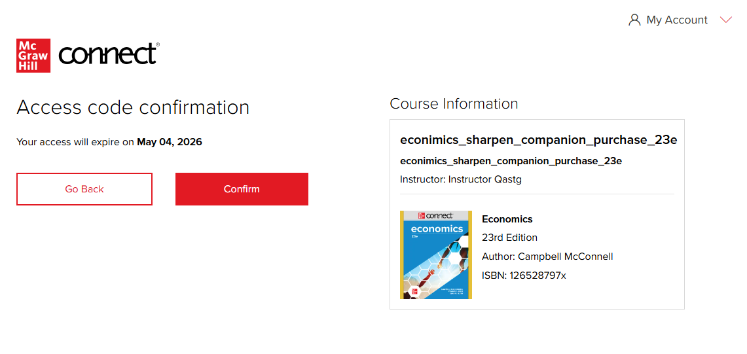
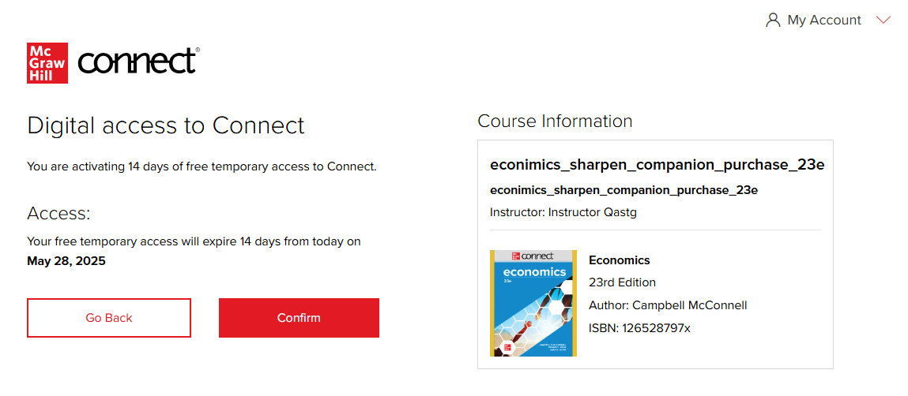
Step 3B-3C:
Getting Started with Connect®
B. Enter Code: The Access Code Confirmation Screen appears. Click Confirm.
C. Temporary Access: The Digital access confirmation screen appears. On the next screen, click Confirm.

Slide 15
Step 4A:
Getting Started with Connect®
Purchase Online: On the purchase confirmation page, click Complete Registration.
Congratulations! You have successfully joined your course.

Slide 16
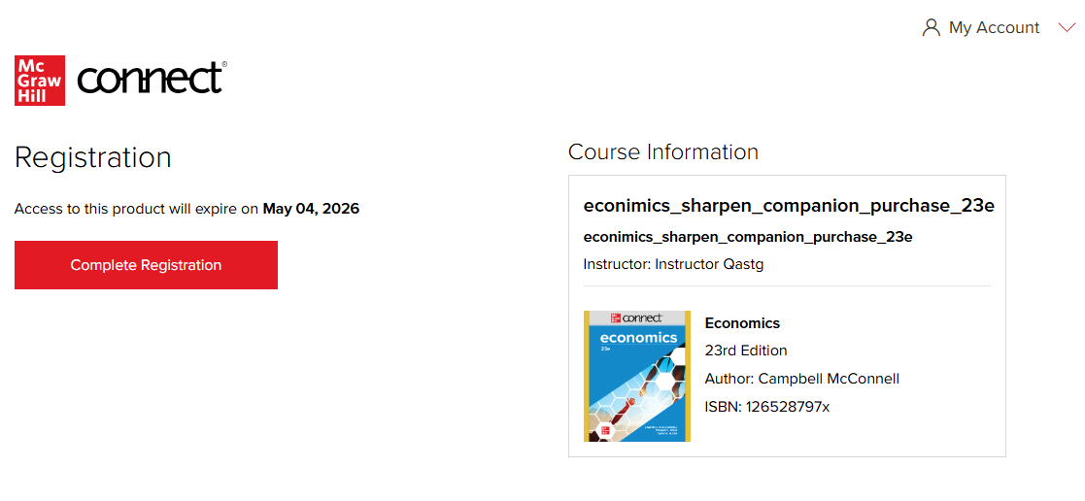
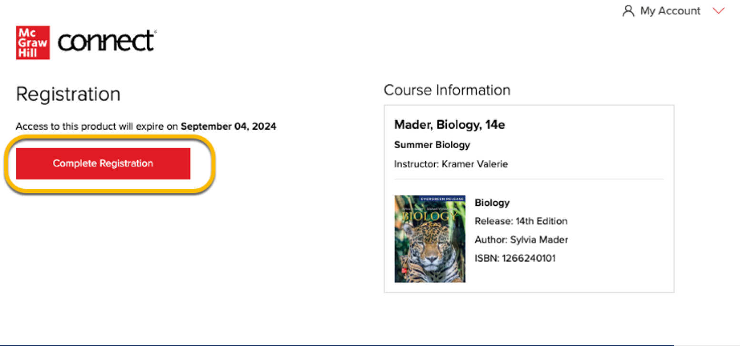
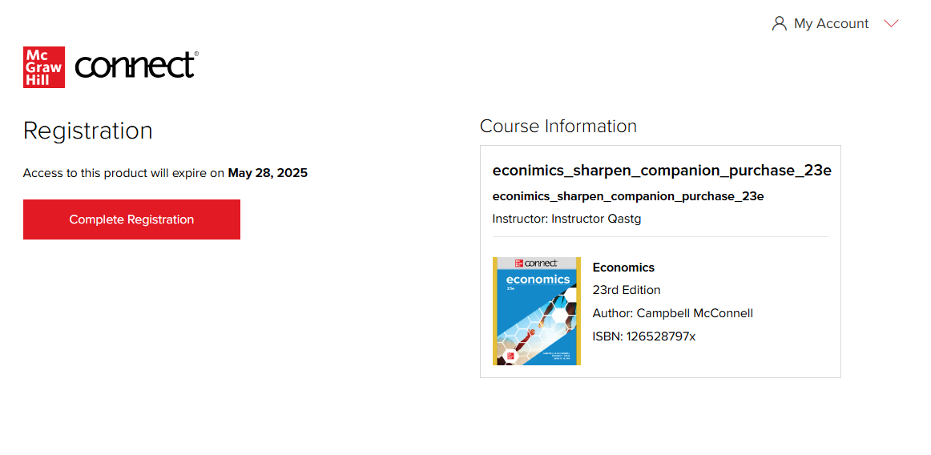
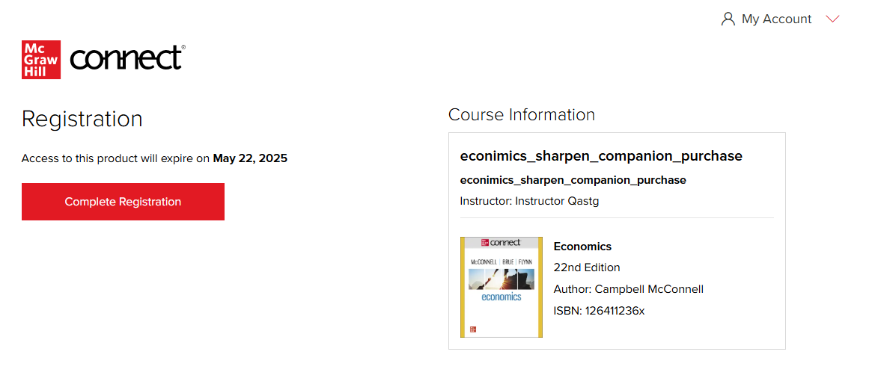
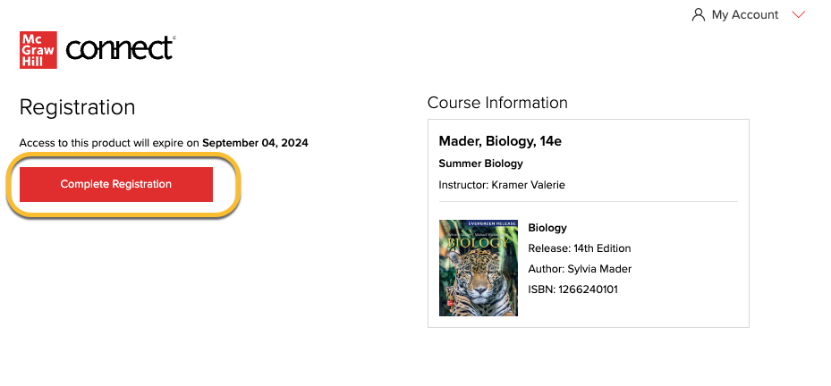
Step 4B-4C:
Getting Started with Connect®
B. Enter Code: Click Complete Registration.
Congratulations! You have successfully joined your course.
C. Temporary Access: Click Complete Registration.
Congratulations! You have successfully joined your course.
Reminder: if you used Temporary Access, this applies only to Connect and not Sharpen.

Slide 17
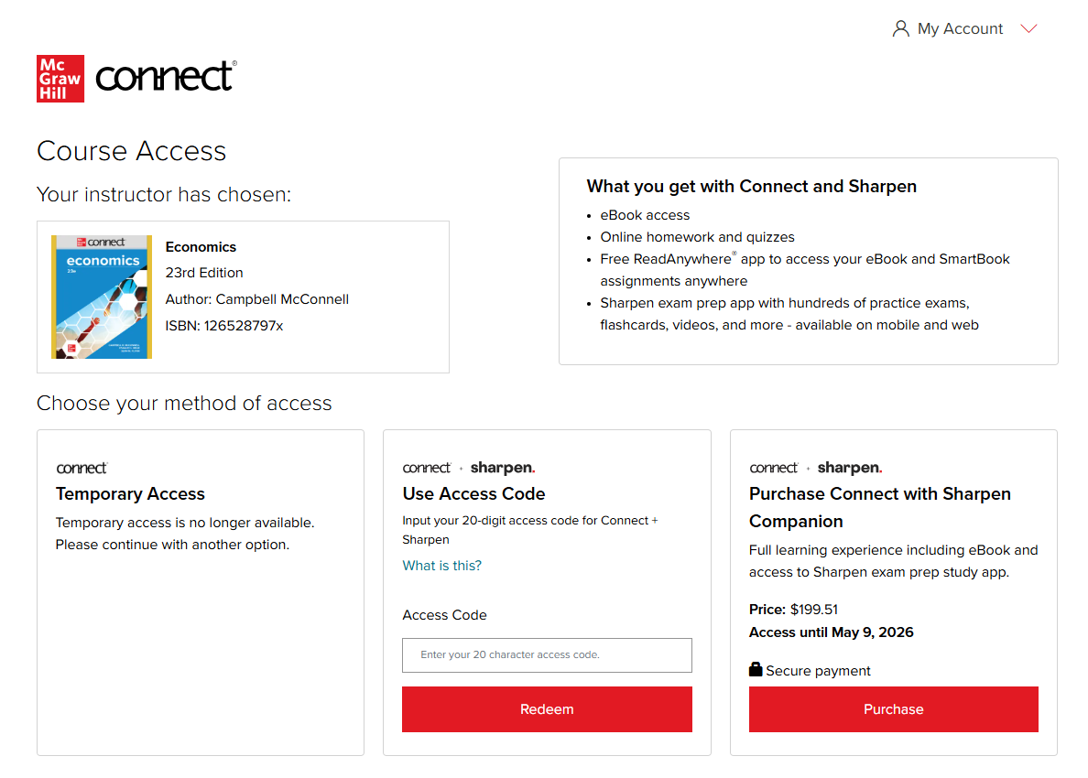
Step 5C:
Getting Started with Connect®
C. Temporary Access
When your two-week Temporary Access Expires, you will be directed to the Course Access Page to redeem the Connect and Sharpen Companion access code or purchase Connect and Sharpen Companion.
You can view more information and instructions here.

Slide 18
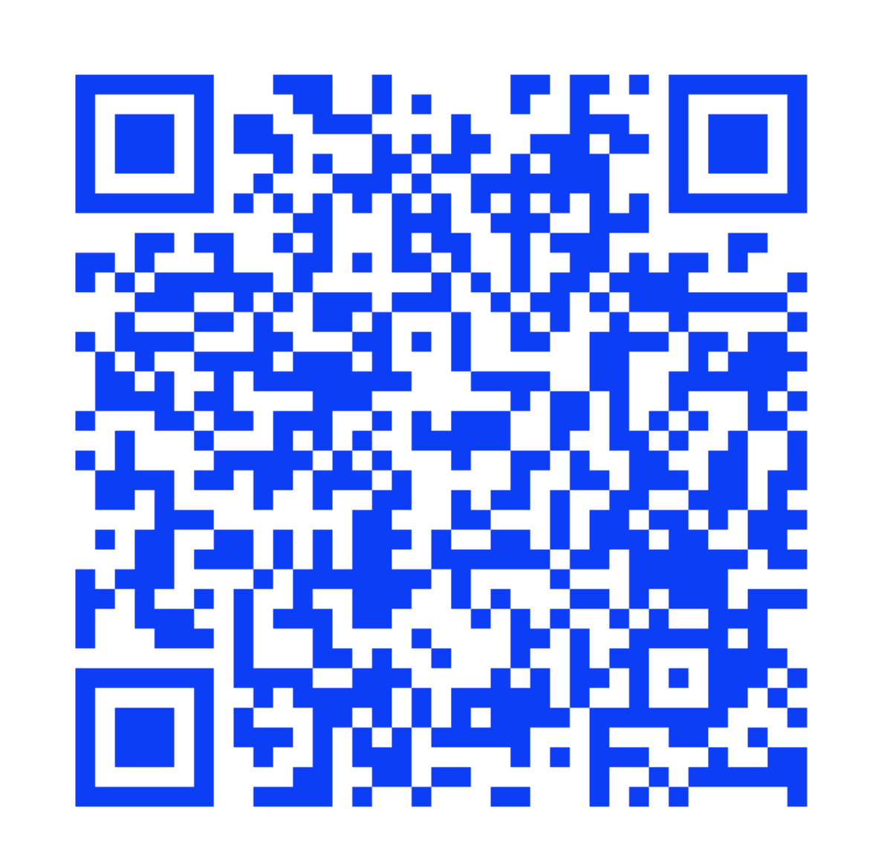
Register for Connect in Your School’s LMS
Getting Started with Connect®
For instructions specific to your school’s LMS, visit:
https://www.mheducation.com/highered/support/connect/first-day-of-class.html
Then create a new account or sign in with an existing account.
You will be prompted to create a new Connect account or sign in with an existing Connect account. Depending on your school's setup, some fields may need to be input to complete the registration. Click Create Account or Sign In to complete the pairing process.

Slide 19
Sharpen Companion Log-In Flow
Non-IA and IA: Connect Integrated with a Learning Management System (LMS)
Getting Started with Connect®
Getting Started with McGraw Hill Connect ® and Sharpen
What to Know on Your
First Day of Class

Slide 20
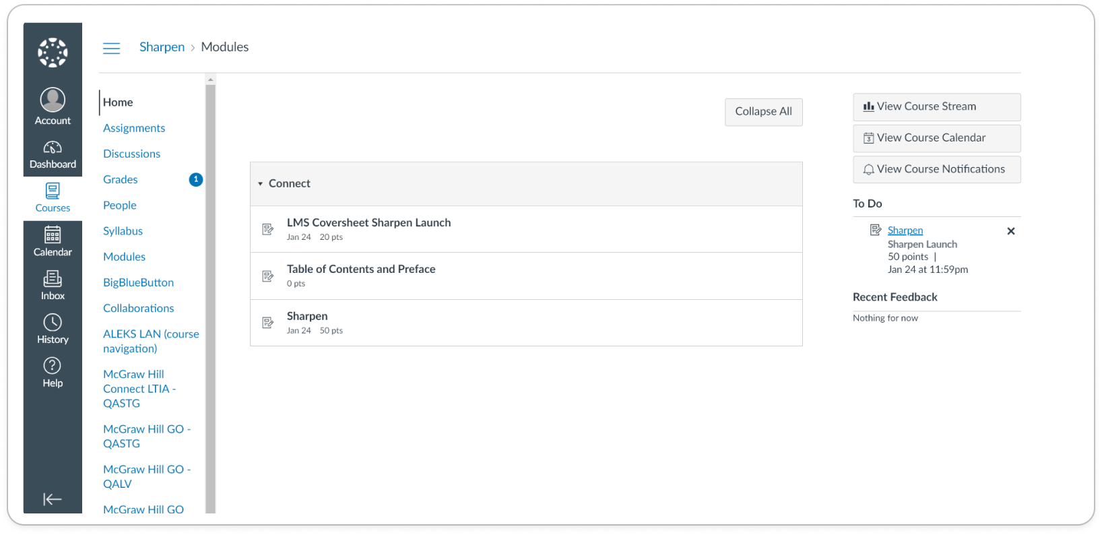
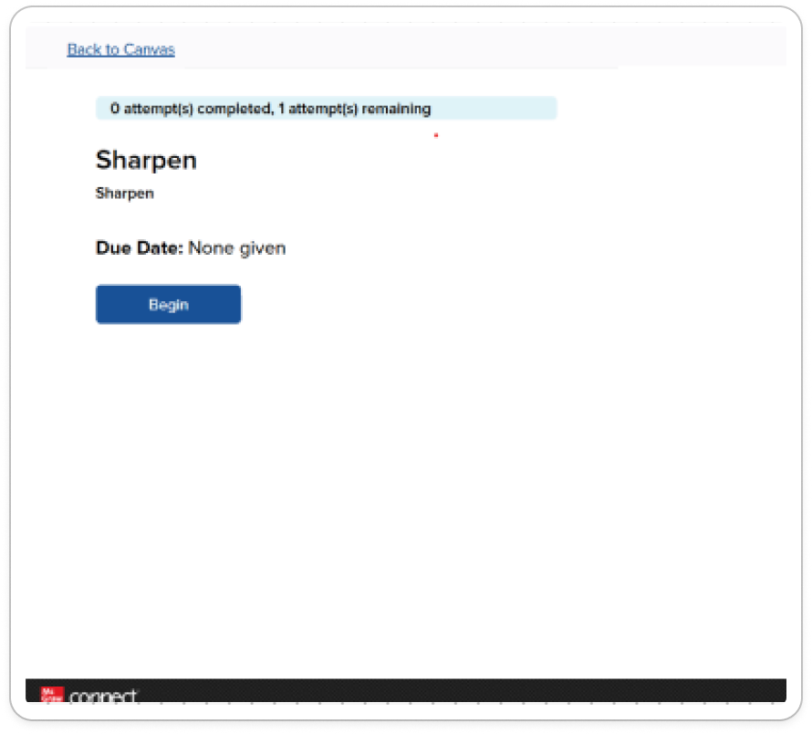
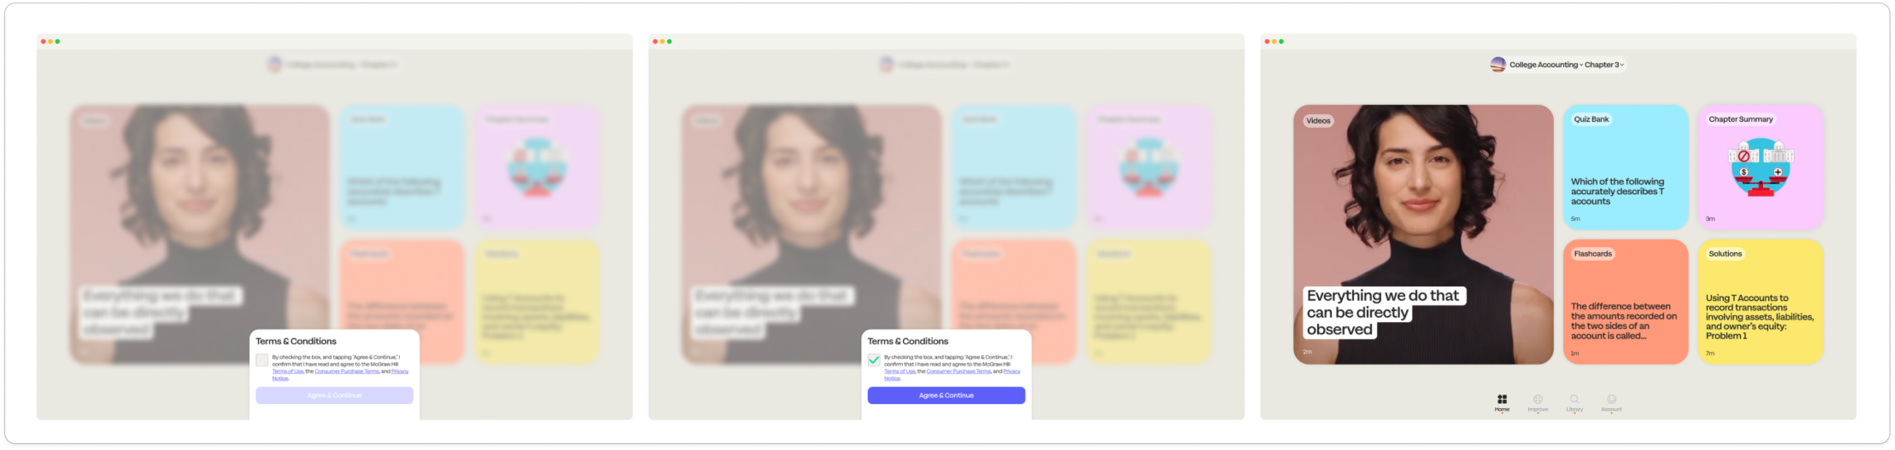
Sharpen Companion Log-In Flow
Getting Started with Connect®
The LMS Cover Sheet includes two Sharpen launch points.
First, click on the top LMS Cover Sheet to open a new page with the Sharpen access point. Click Begin to launch Sharpen in a new web window.

Slide 21
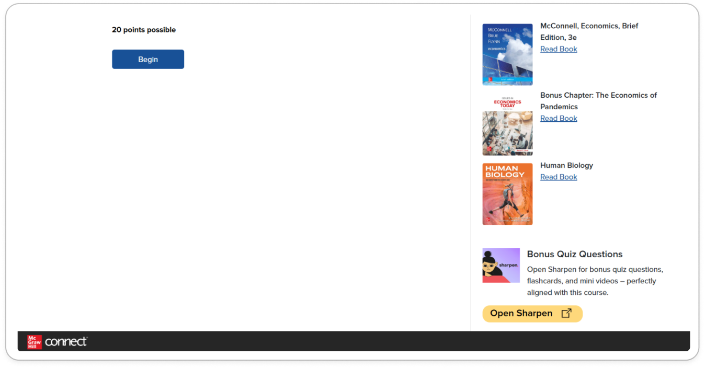
Sharpen Companion Log-In Flow
Getting Started with Connect®
LMS Cover Sheet:
Then, click on the bottom Sharpen assignment to open a new page with the Sharpen access point.
Click Begin to launch Sharpen in a new web window.

Slide 22
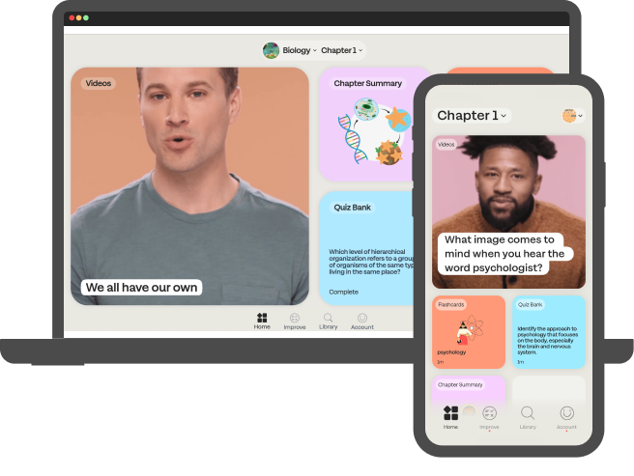
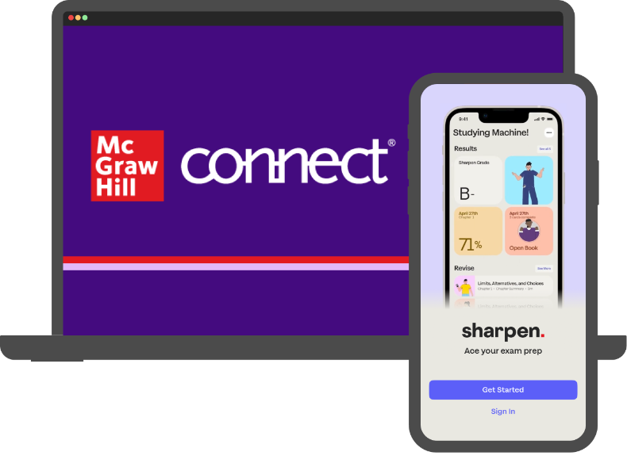
Thank you!
Getting Started with McGraw Hill Connect ® and Sharpen
What to Know on Your
First Day of Class

