Slide 1
McGraw Hill Connect ®
Student Registration
D2L Brightspace with Inclusive Access Integration

Slide 2
Make the most of Connect
Stay Organized
  Digital Course Planner has all your upcoming Connect assignments in one place and you can customize calendar alerts
Focus On What Matters
  Use Reports to track your performance and your understanding of key concepts
Learn On-the-Go
  Download the free ReadAnywhere app to take your eBook* and SmartBook* with you – online and offline
* ReadAnywhere supports newer eBooks and SmartBook - may not be available in your Connect course.

Slide 3
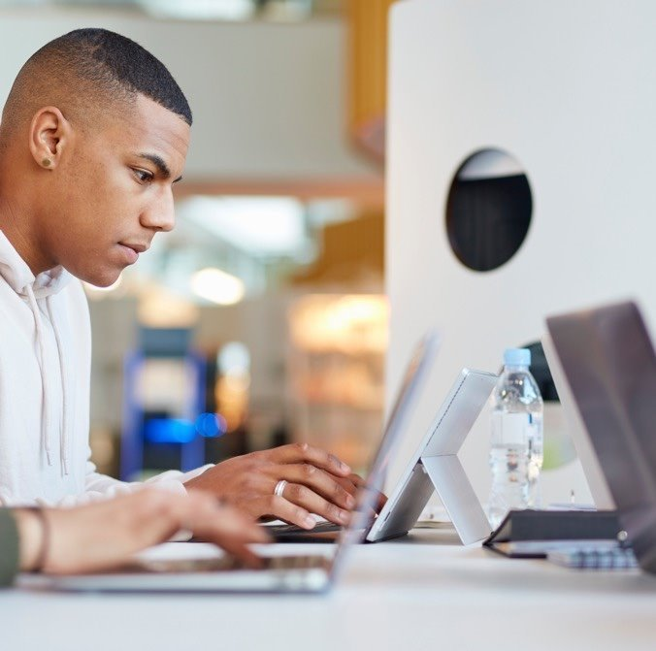
Step 1
Login into your D2L/Brightspace account and navigate to your course.
If you are not sure if you have a D2L/Brightspace account, check with your instructor.

Slide 4
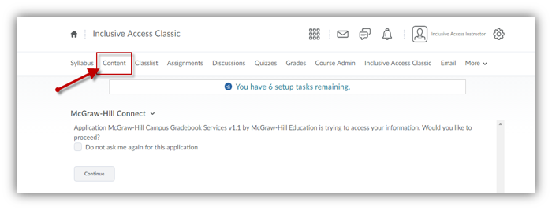
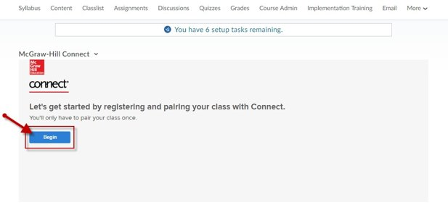
Step 2
In your course, navigate to your content area to find a Connect assignment link. If you are not sure where to go, just ask your instructor.
Go ahead and click on an assignment and then click Launch to start the registration process.

Slide 5
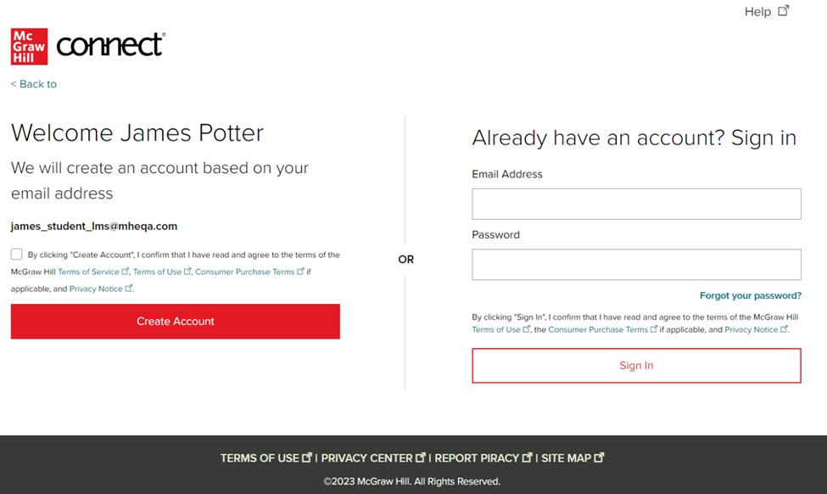
Step 3
Enter your email address and click Begin.
If you receive the message, You have a Connect Account but have forgotten your password, click Forgot Password.
*Depending on your school you might skip this step. That’s ok! Just continue the process from that step to the end.

Slide 6
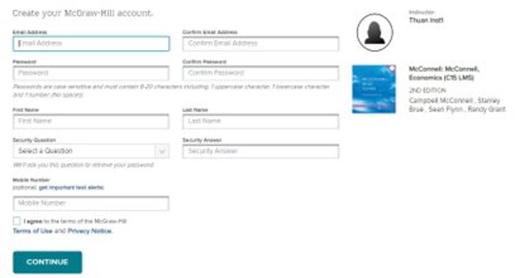
Step 4
Create your account: Enter email, First and Last Name, create a password and select a security question. We recommend using your school email address when creating an account.
To receive text alerts, enter your mobile number. Agree to the Terms and Conditions and then click Continue.

Slide 7
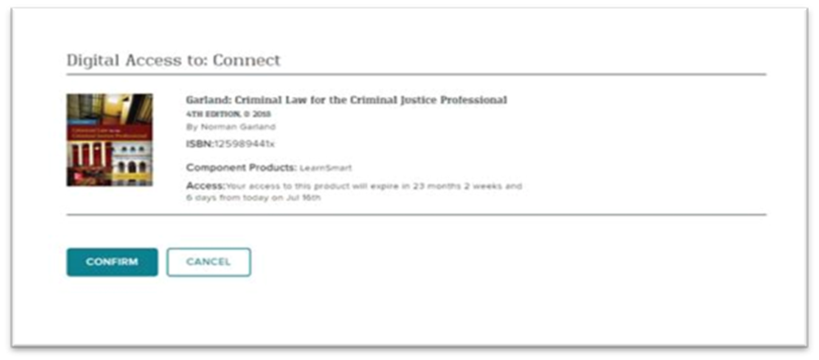
Step 5
You are almost done. Review the information on this screen. If it is correct, click Confirm.
You are now registered.

Slide 8
Support and Resources
TECH SUPPORT & FAQ:
CALL: (800) 331-5094
EMAIL & CHAT: WWW.MHHE.COM/SUPPORT
FIND MORE TIPS:
WWW.SUPPORTATEVERYSTEP.COM

Slide 9
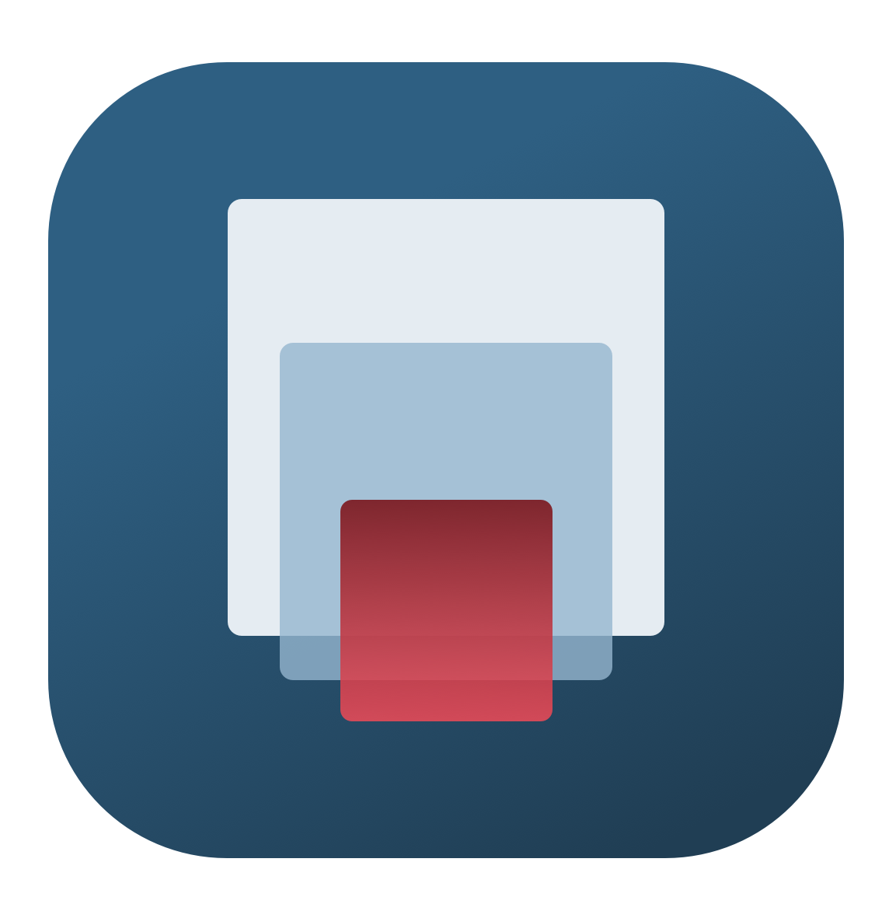
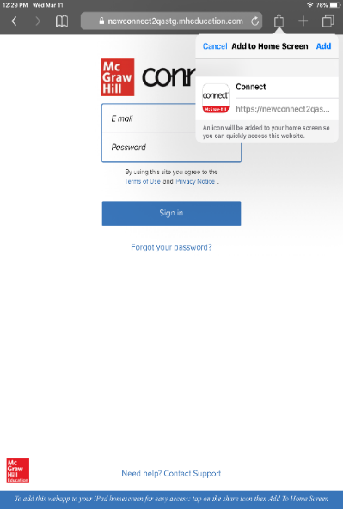
Study on your Smartphone or Tablet
ReadAnywhere App
Download the free ReadAnywhere app to your Android or iOS smartphone or tablet and access your course eBook for offline study access anytime, anywhere.
More than 1 million students and instructors have downloaded the ReadAnywhere app that has a 4.7 rating on the App Store.
Connect Tablet App
Login to Connect on your tablet browser and then add it to your home screen to complete assignments with ease – including pinch, pan, and zoom capability as you work.
*The Connect Tablet App is not recommended for smartphone use.

Slide 10
QUESTIONS?

Slide 11

McGraw Hill Connect and Proctorio
If your instructor uses remote proctoring for this course...
Proctoring and/or browser-locking services will be used within your Connect assignments.
Equipment needed may include a webcam and/or microphone.
Payment may be required.
A practiced proctored assignment may be available
Additional information regarding proctoring may be included in the syllabus.

