Slide 1
McGraw Hill Connect ®
Student Registration
Moodle or other LMS with Inclusive Access Integration

Slide 2
Make the most of Connect
Stay Organized
  Digital Course Planner has all your upcoming Connect assignments in one place and you can customize calendar alerts
Focus On What Matters
  Use Reports to track your performance and your understanding of key concepts
Learn On-the-Go
  Download the free ReadAnywhere app to take your eBook* and SmartBook* with you – online and offline
* ReadAnywhere supports newer eBooks and SmartBook - may not be available in your Connect course.

Slide 3
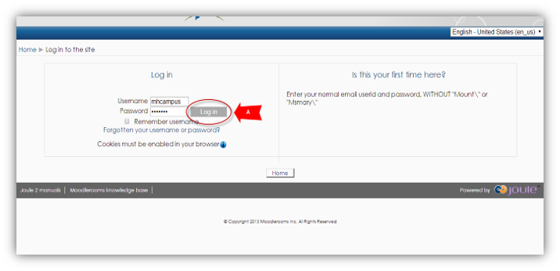
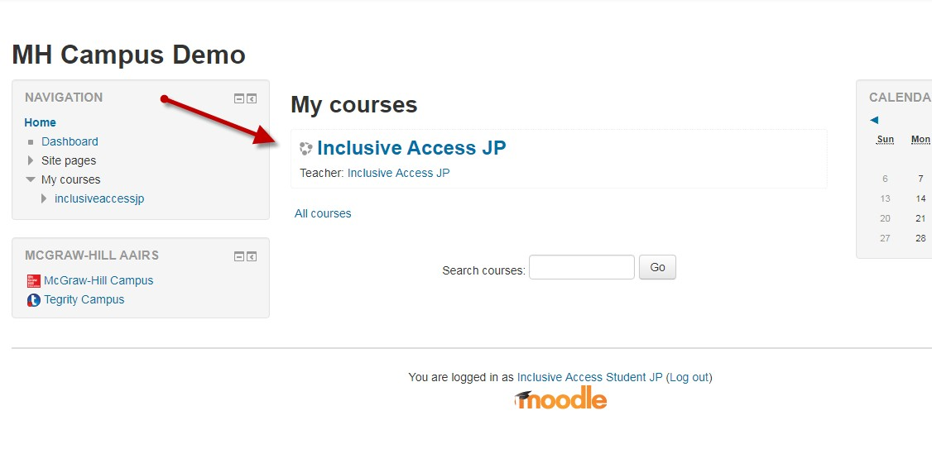
Step 1
Login to your Moodle or LMS account and navigate to your course.
If you are not sure if you have an LMS account, check with your instructor.

Slide 4
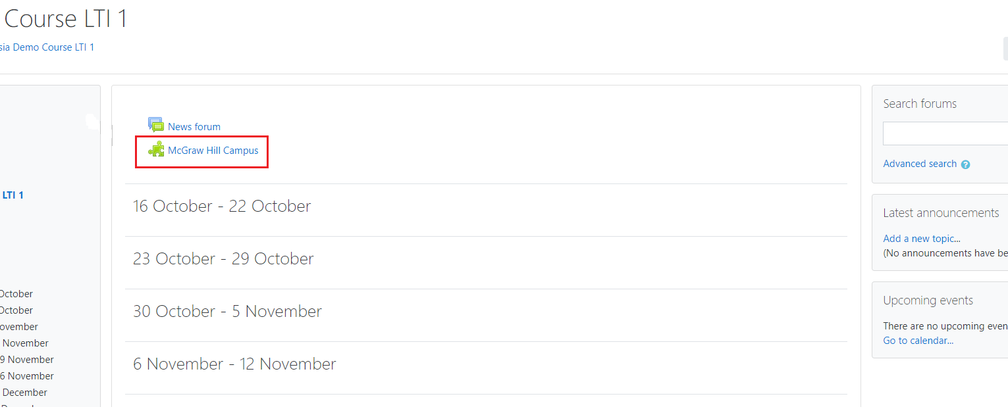
Step 2
On your course homepage, locate and click on the McGraw Hill Campus tool link.
Click on it to start the registration process.

Slide 5
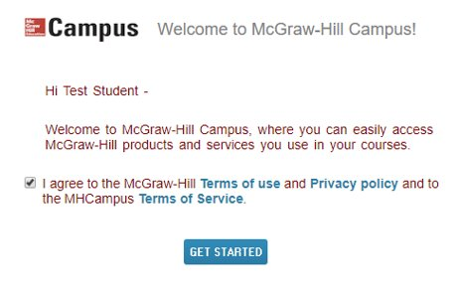
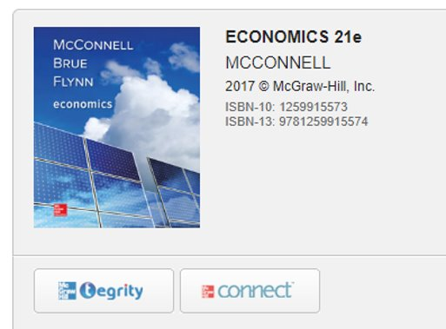
Step 3
If this is your first time using McGraw Hill Campus, you will need to agree to the terms of service and privacy policy and then click Get Started. ​​
Then click on the Connect button to continue.

Slide 6
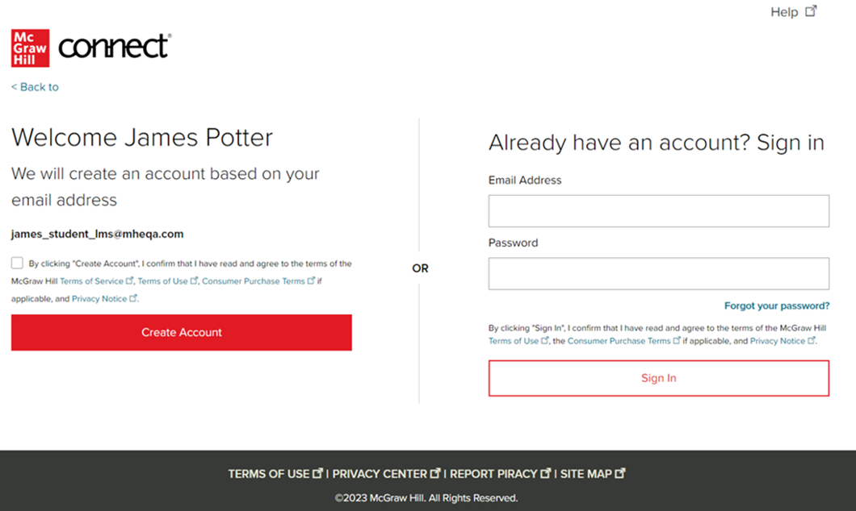
Step 4
Sign In with an existing Connect account or Create Account.
Connect will create an auto-paired account using information from the LMS launch.

Slide 7
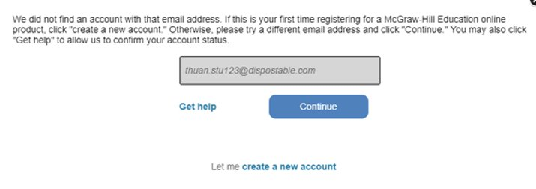
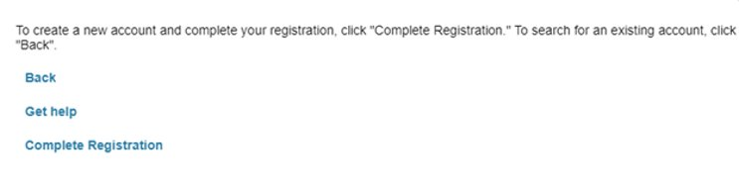
Step 5
If you are a new Connect user, a link to Create a new account will appear below the email form field. Click this link. ​
​On the next screen, click Complete Registration.

Slide 8
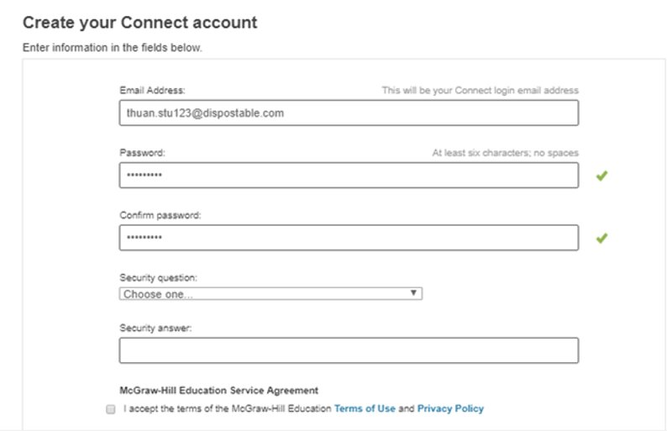
Step 6
Now you can enter in a password and set up a security question in case you need to reset your password.
Check the box to accept the Terms and Conditions and then click Continue.

Slide 9
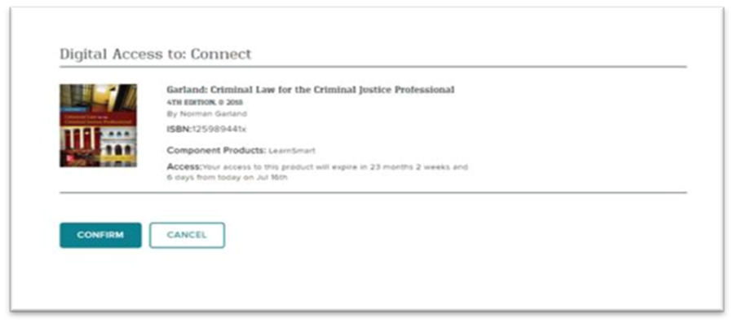
Step 7
You are almost done. Review the information on this screen. If it is correct, click Confirm.
You are now registered.

Slide 10
Support and Resources
TECH SUPPORT & FAQ:
CALL: (800) 331-5094
EMAIL & CHAT: WWW.MHHE.COM/SUPPORT
FIND MORE TIPS:
WWW.SUPPORTATEVERYSTEP.COM

Slide 11
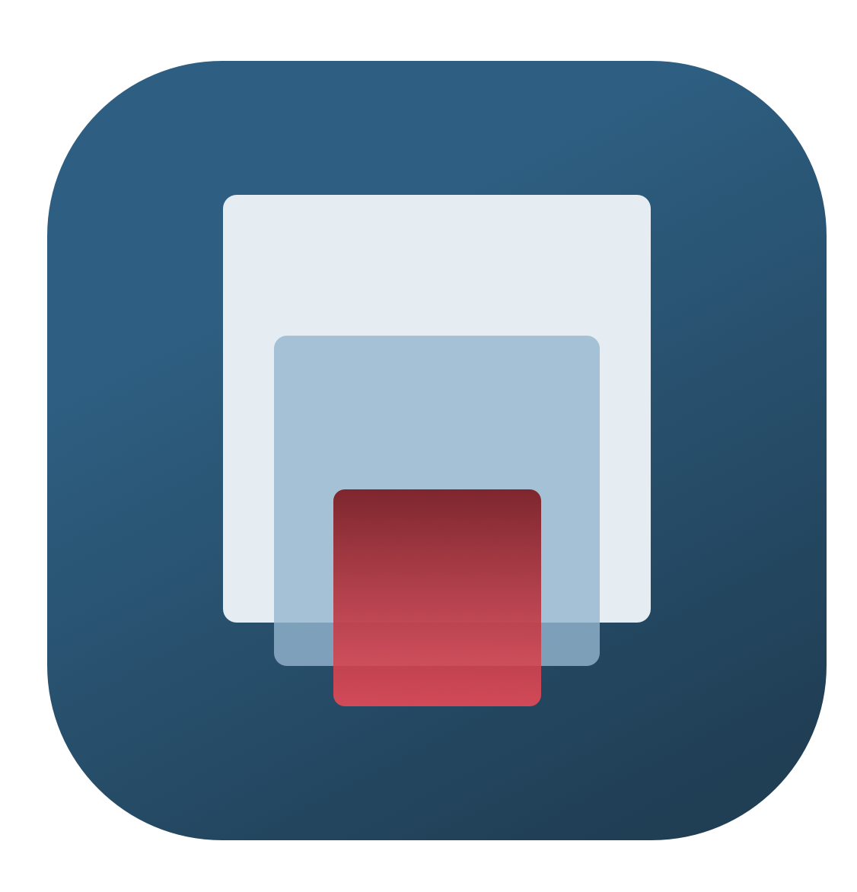
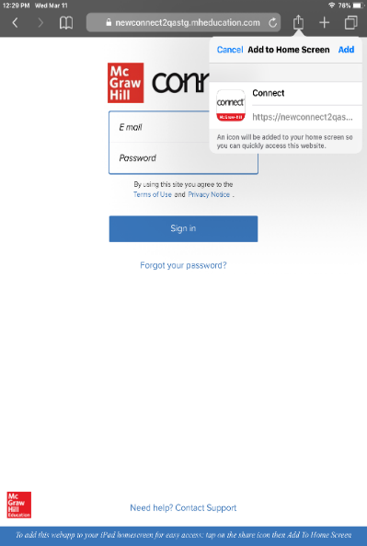
Study on your Smartphone or Tablet
ReadAnywhere App
Download the free ReadAnywhere app to your Android or iOS smartphone or tablet and access your course eBook for offline study access anytime, anywhere.
More than 1 million students and instructors have downloaded the ReadAnywhere app that has a 4.7 rating on the App Store.
Connect Tablet App
Login to Connect on your tablet browser and then add it to your home screen to complete assignments with ease – including pinch, pan, and zoom capability as you work.
*The Connect Tablet App is not recommended for smartphone use.

Slide 12
QUESTIONS?

Slide 13

McGraw Hill Connect and Proctorio
If your instructor uses remote proctoring for this course...
Proctoring and/or browser-locking services will be used within your Connect assignments.
Equipment needed may include a webcam and/or microphone.
Payment may be required.
A practiced proctored assignment may be available
Additional information regarding proctoring may be included in the syllabus.

