Slide 1
McGraw Hill Connect ®
Student Registration
Connect Standalone

Slide 2
Make the most of Connect
Stay Organized
  Digital Course Planner has all your upcoming Connect assignments in one place and you can customize calendar alerts
Focus On What Matters
  Use Reports to track your performance and your understanding of key concepts
Learn On-the-Go
  Download the free ReadAnywhere app to take your eBook* and SmartBook* with you – online and offline
* ReadAnywhere supports newer eBooks and SmartBook - may not be available in your Connect course.

Slide 3
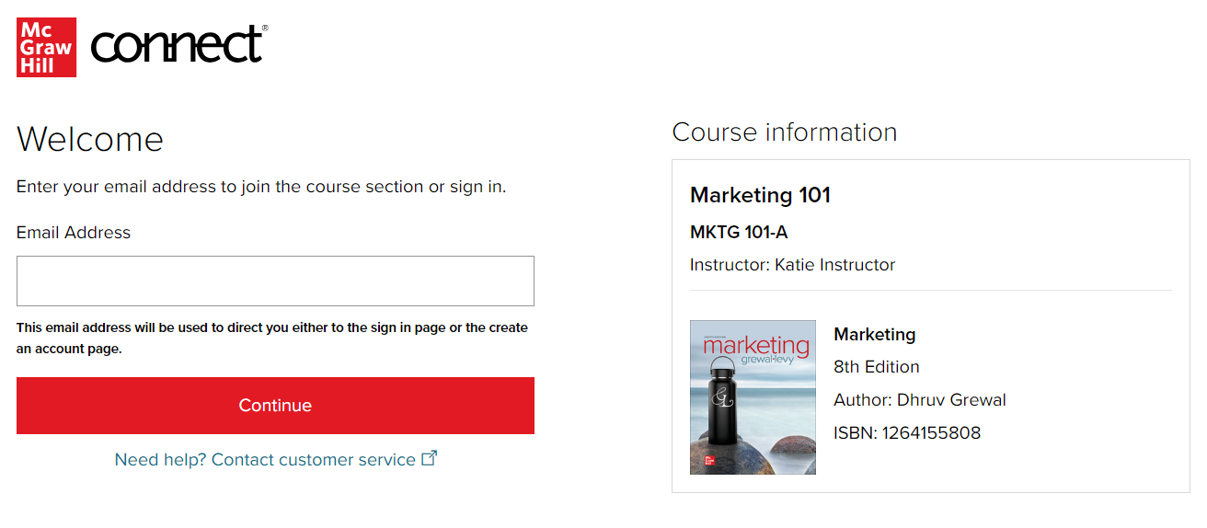
Step 1
Enter your course URL provided by your instructor.
Enter your email address and click Begin.
If you receive the message, You have a Connect Account but have forgotten your password, click Forgot Password.

Slide 4
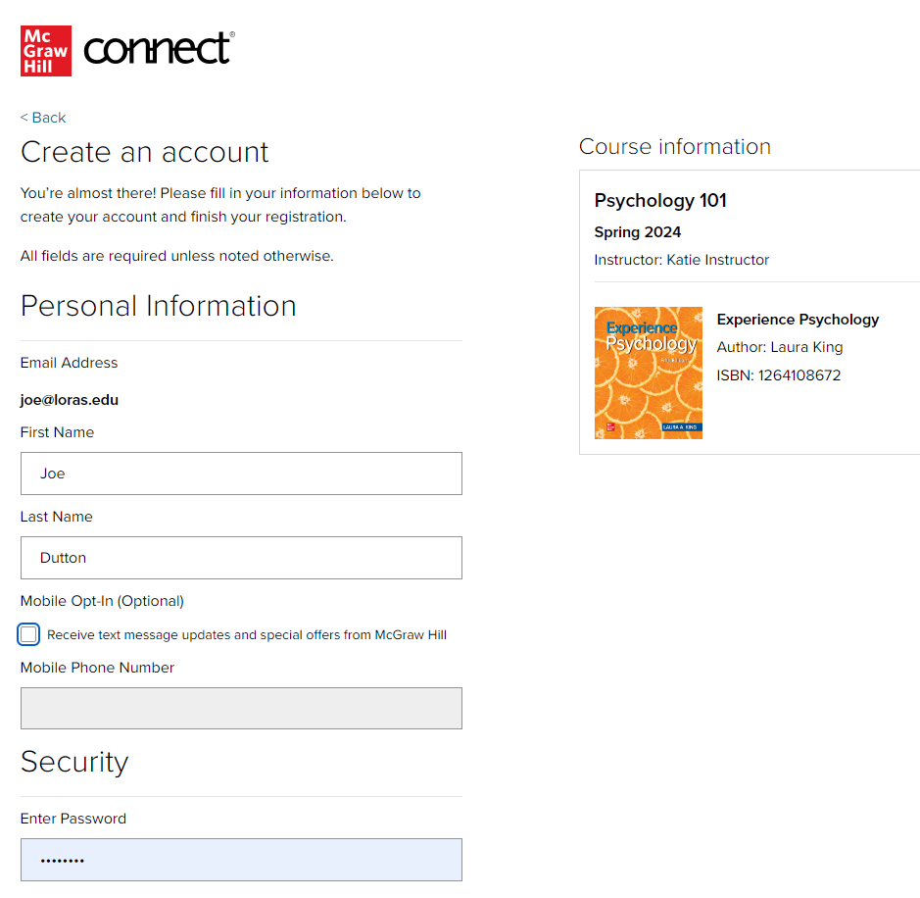
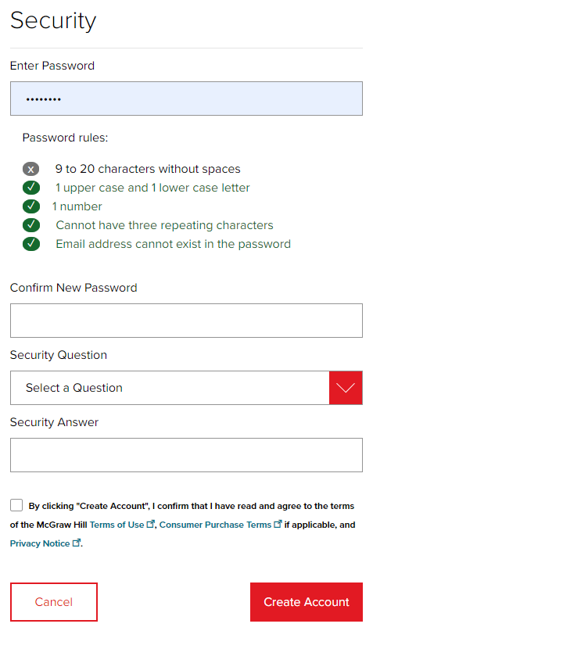
Step 2
Create your account: Enter email, First and Last Name, create a password and select a security questions.
We recommend using your school email address when creating an account.
To receive text alerts, enter your mobile number. Agree to the Terms and Conditions and then click Create Account.

Slide 5
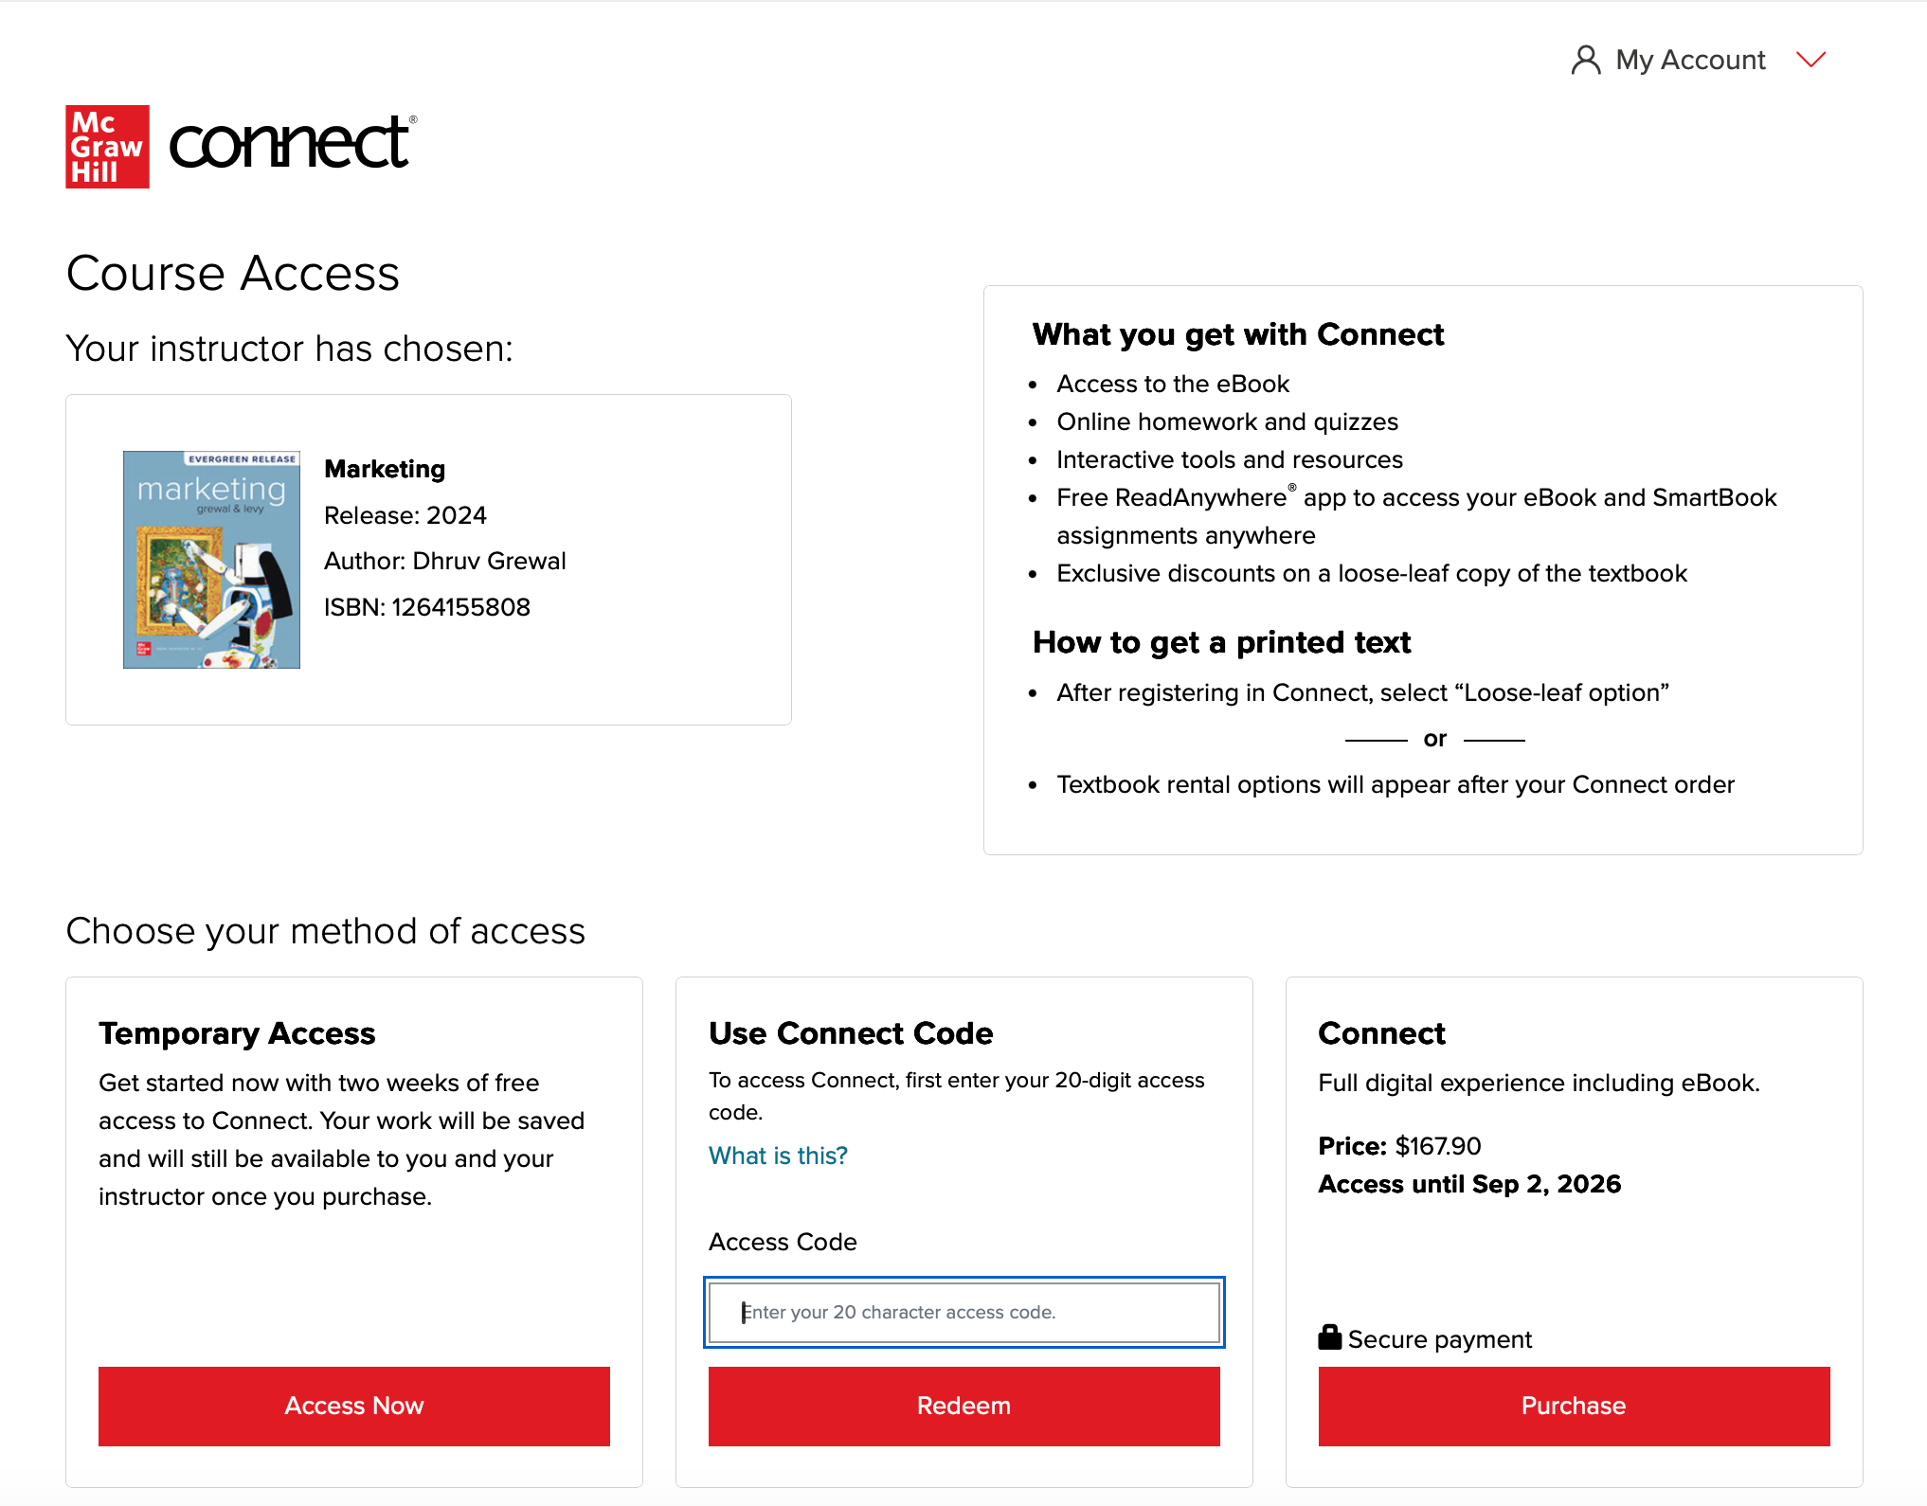
Step 3
You have three registration options.
Connect Code: Enter a Connect access code and click Redeem.
Purchase Online: Click Purchase to use a credit card, Google Pay, or PayPal.
Temporary Access: Click Access Now for two-week temporary access.

Slide 6
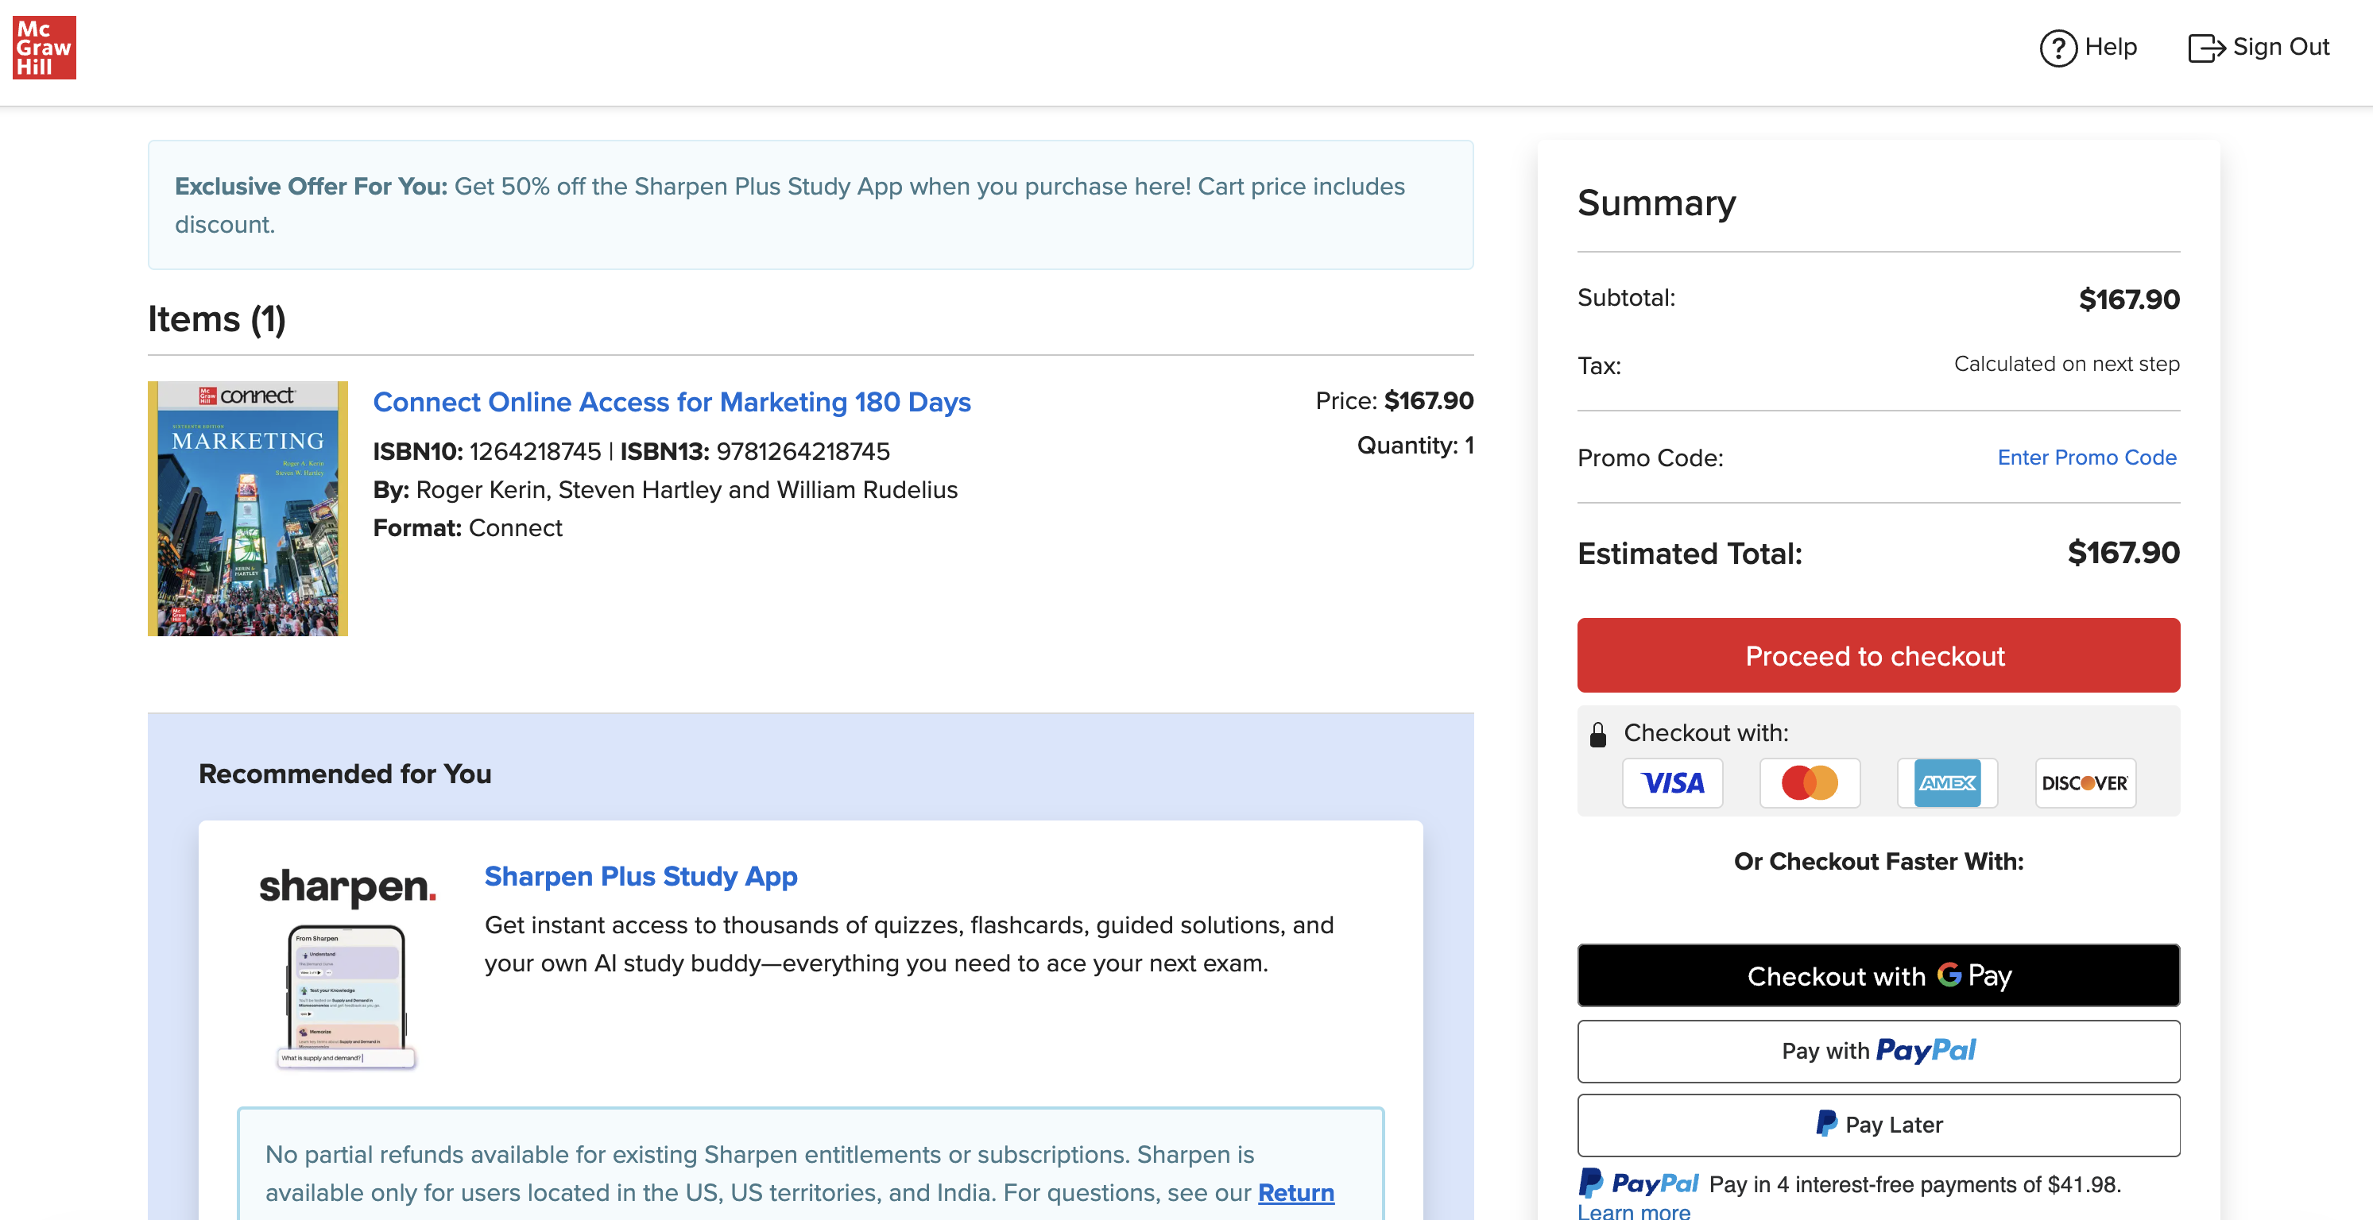
Step 4

Slide 7
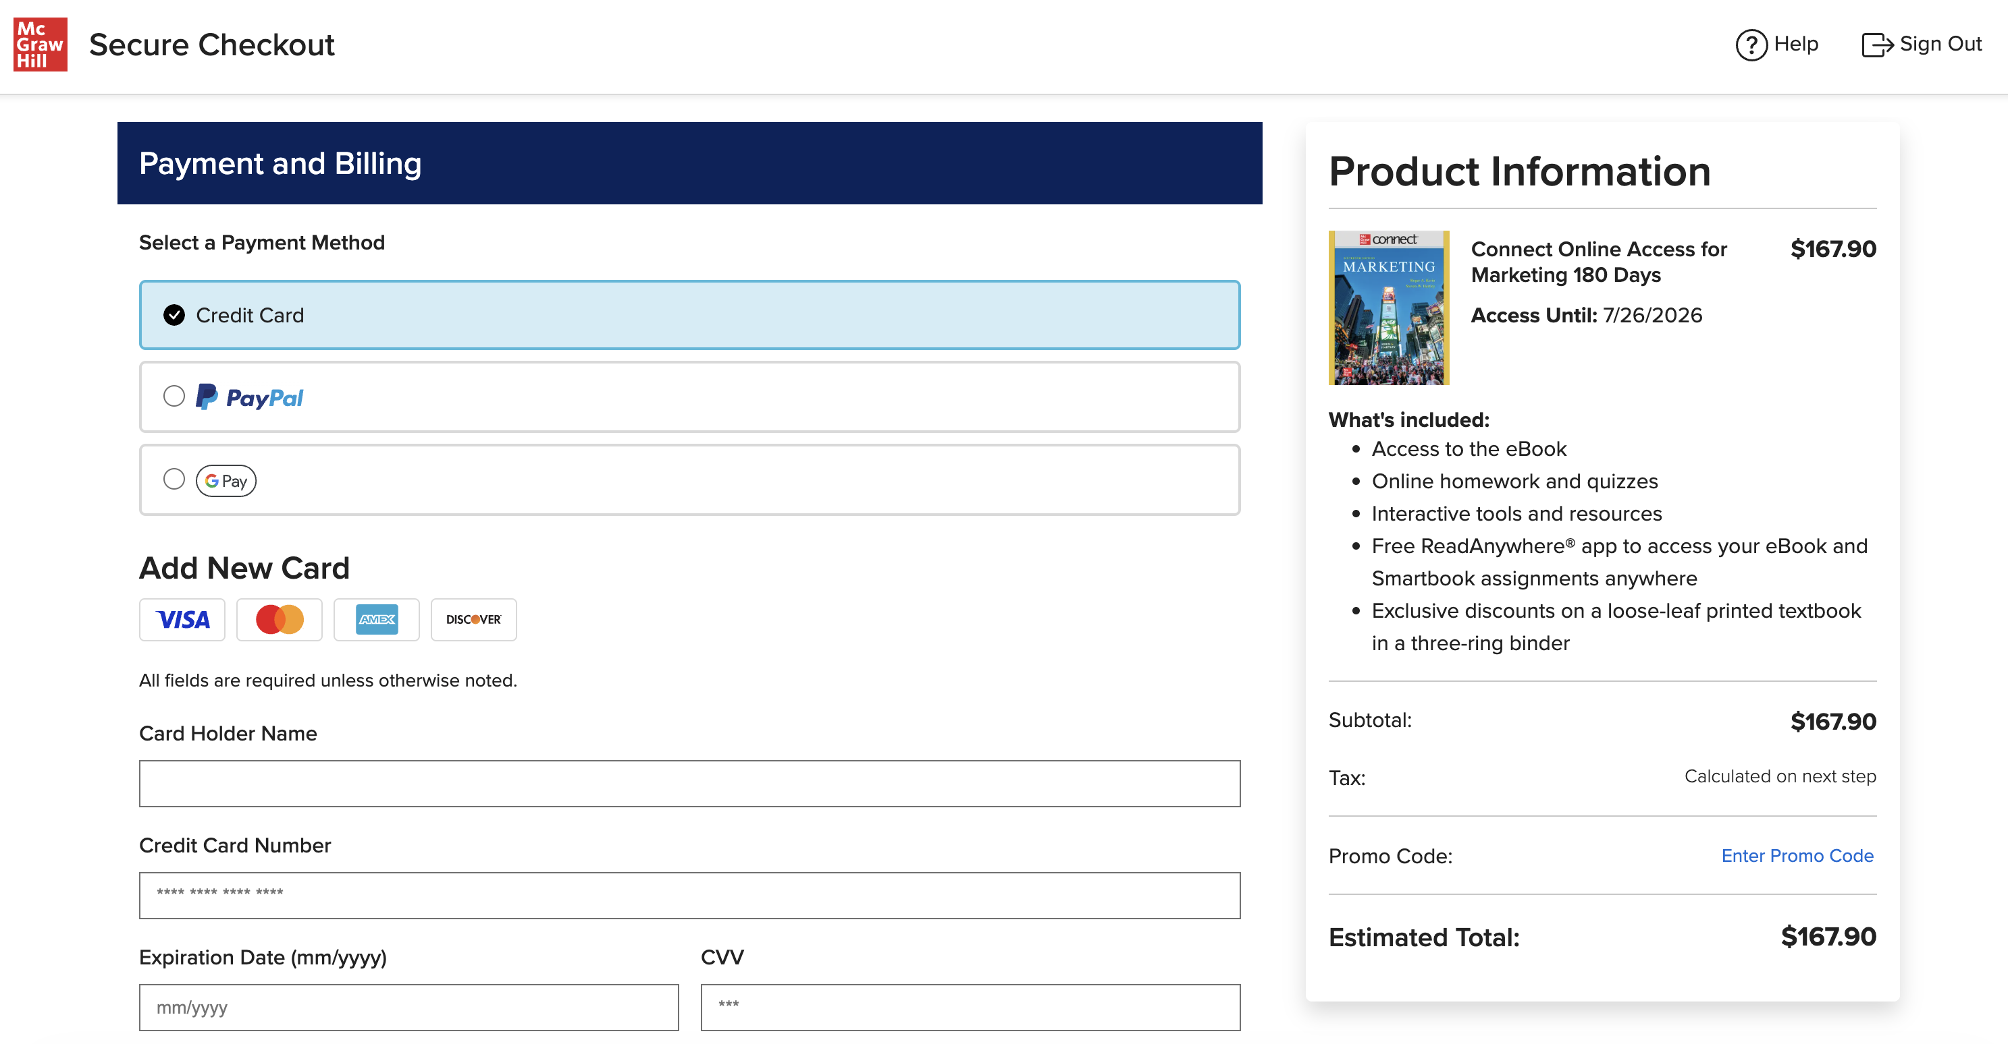
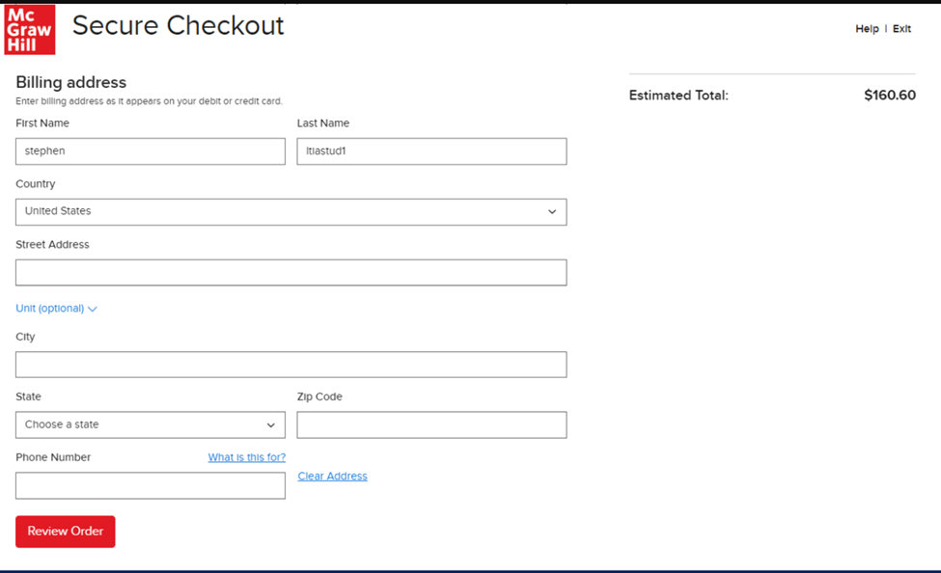
Step 5

Slide 8
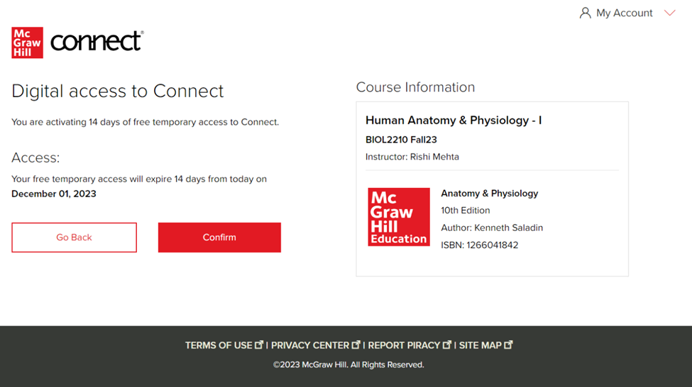
Step 6

Slide 9
Support and Resources
TECH SUPPORT & FAQ:
CALL: (800) 331-5094
EMAIL & CHAT: WWW.MHHE.COM/SUPPORT
FIND MORE TIPS:
WWW.SUPPORTATEVERYSTEP.COM

Slide 10
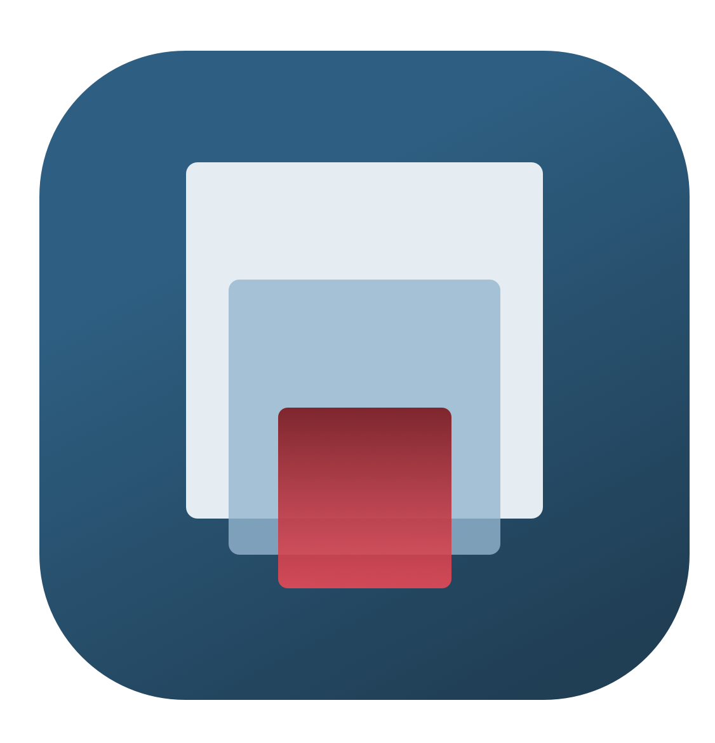
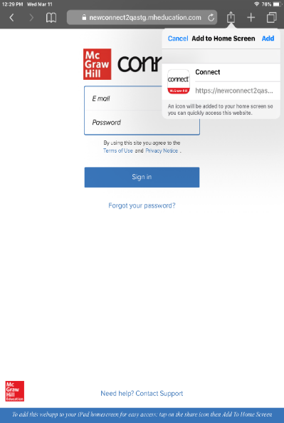
Study on your Smartphone or Tablet
ReadAnywhere App
Download the free ReadAnywhere app to your Android or iOS smartphone or tablet and access your course eBook for offline study access anytime, anywhere.
More than 1 million students and instructors have downloaded the ReadAnywhere app that has a 4.7 rating on the App Store.
Connect Tablet App
Login to Connect on your tablet browser and then add it to your home screen to complete assignments with ease – including pinch, pan, and zoom capability as you work.
*The Connect Tablet App is not recommended for smartphone use.

Slide 11
QUESTIONS?

Slide 12

McGraw Hill Connect and Proctorio
If your instructor uses remote proctoring for this course...
Proctoring and/or browser-locking services will be used within your Connect assignments.
Equipment needed may include a webcam and/or microphone.
Payment may be required.
A practiced proctored assignment may be available
Additional information regarding proctoring may be included in the syllabus.

