Slide 1
McGraw Hill Connect ®
Student Registration
D2L Brightspace with Regular Deep Integration

Slide 2
Make the most of Connect
Stay Organized
  Digital Course Planner has all your upcoming Connect assignments in one place and you can customize calendar alerts
Focus On What Matters
  Use Reports to track your performance and your understanding of key concepts
Learn On-the-Go
  Download the free ReadAnywhere app to take your eBook* and SmartBook* with you – online and offline
* ReadAnywhere supports newer eBooks and SmartBook - may not be available in your Connect course.

Slide 3
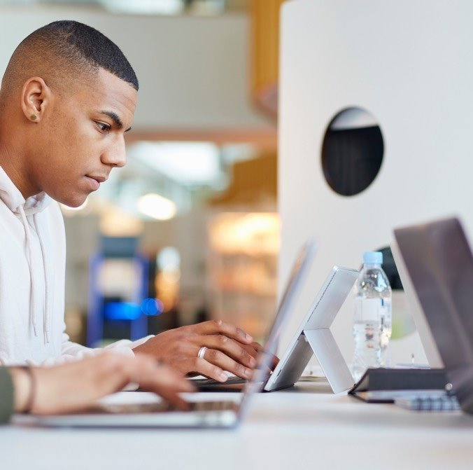
Step 1
Login into your D2L/Brightspace account and navigate to your course.
If you are not sure if you have a D2L/Brightspace account, check with your instructor.

Slide 4
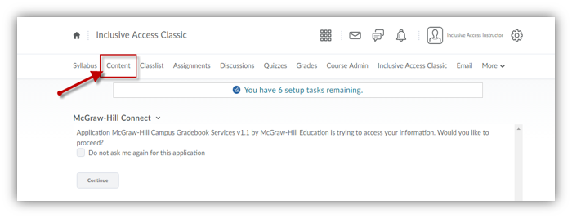
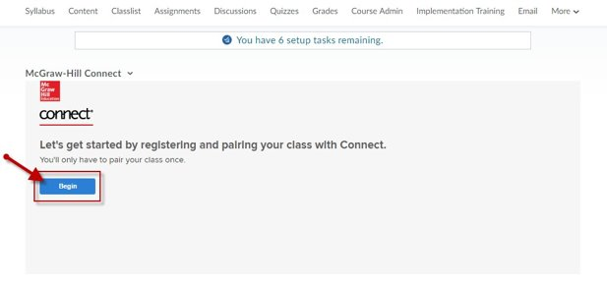
Step 2
In your course, navigate to your content area to find a Connect assignment link. If you are not sure where to go, just ask your instructor.
Go ahead and click on an assignment and then click Begin to start the registration process.

Slide 5
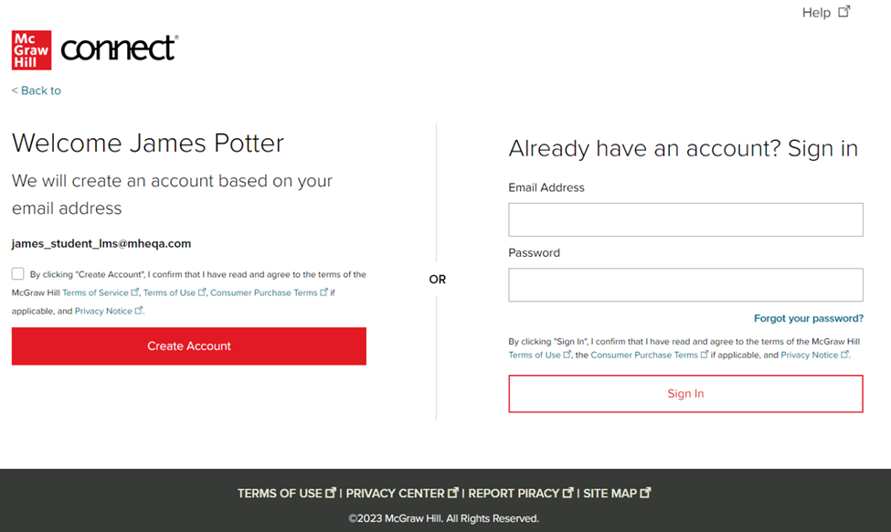
Step 3
Sign In with an existing Connect account or Create Account.
Connect will create an auto-paired account using information from the LMS launch.
*Depending on your school you might skip this step. That’s ok! Just continue the process from that step to the end.

Slide 6
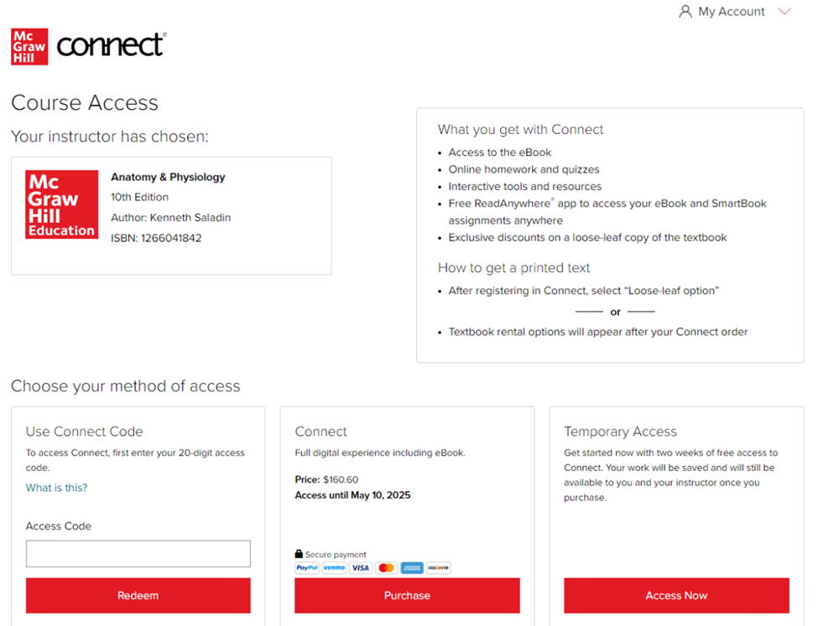
Step 4
You have three registration options.
Connect Code: Enter a Connect access code and click Redeem.
Purchase Online: Click Purchase to use a credit card, Venmo or PayPal.
Temporary Access: Click Access Now for two-week temporary access.

Slide 7
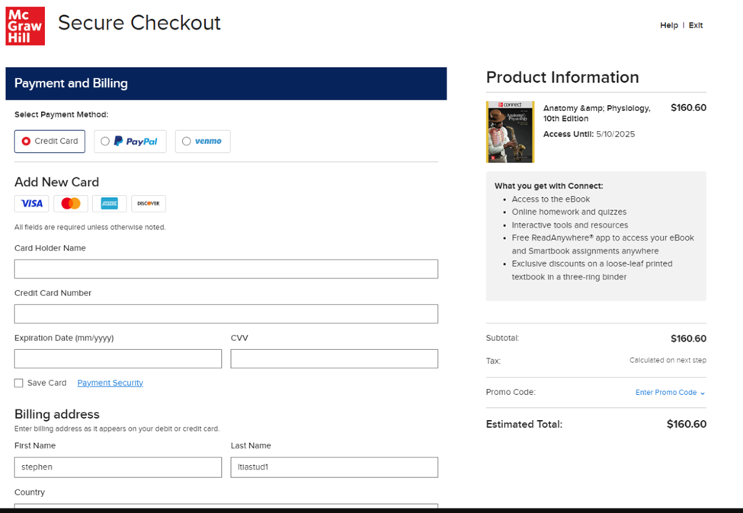
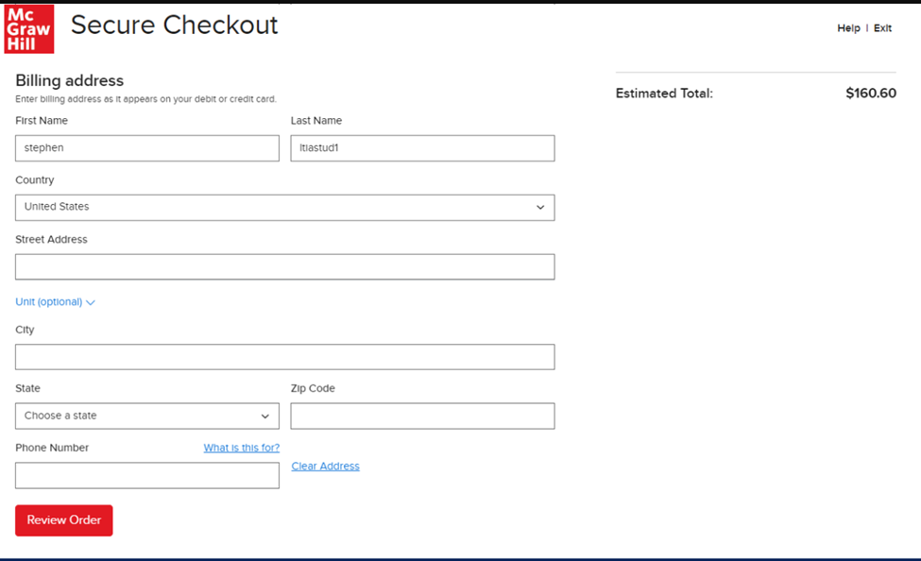
Step 5

Slide 8
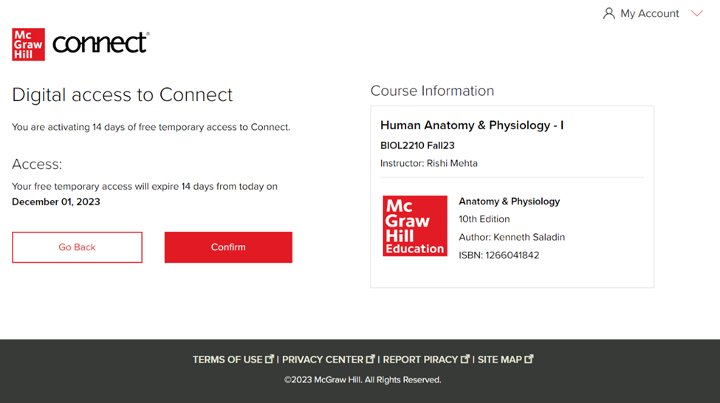
Step 6
Click Confirm. You are now registered.

Slide 9
Support and Resources
TECH SUPPORT & FAQ:
CALL: (800) 331-5094
EMAIL & CHAT: WWW.MHHE.COM/SUPPORT
FIND MORE TIPS:
WWW.SUPPORTATEVERYSTEP.COM

Slide 10
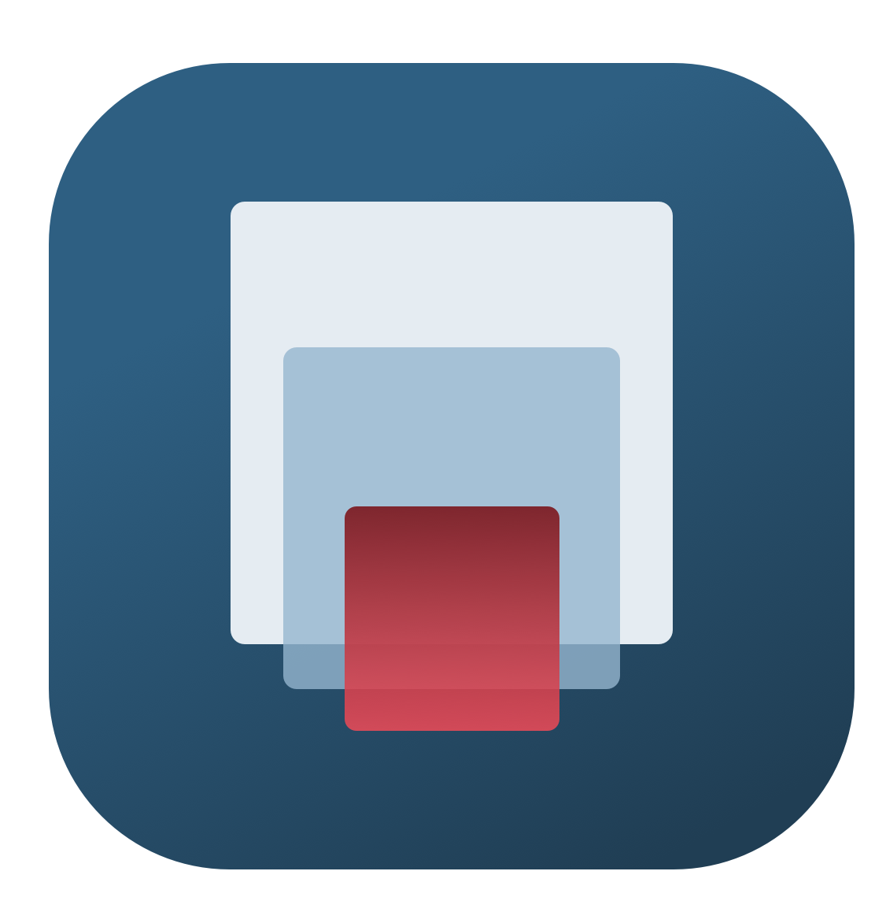
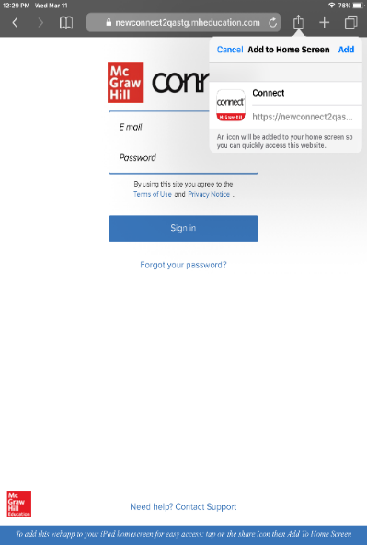
Study on your Smartphone or Tablet
ReadAnywhere App
Download the free ReadAnywhere app to your Android or iOS smartphone or tablet and access your course eBook for offline study access anytime, anywhere.
More than 1 million students and instructors have downloaded the ReadAnywhere app that has a 4.7 rating on the App Store.
Connect Tablet App
Login to Connect on your tablet browser and then add it to your home screen to complete assignments with ease – including pinch, pan, and zoom capability as you work.
*The Connect Tablet App is not recommended for smartphone use.

Slide 11
QUESTIONS?

Slide 12

McGraw Hill Connect and Proctorio
If your instructor uses remote proctoring for this course...
Proctoring and/or browser-locking services will be used within your Connect assignments.
Equipment needed may include a webcam and/or microphone.
Payment may be required.
A practiced proctored assignment may be available
Additional information regarding proctoring may be included in the syllabus.

