Slide 1
eBook Student Registration
Students

Slide 2
Get More–With a McGraw Hill eBook
More Affordable
Select the option that fits your budget—McGraw Hill eBooks offer affordable choices, including rental plans ranging from 180-day access to lifetime access.
Purchase access of the eBook from your campus bookstore or directly from McGraw Hill at https://www.mheducation.com/highered
More Freedom
The eBook is convenient and easy to access–whether on your laptop, through the Bookshelf website, or on a smartphone or tablet with the free ReadAnywhere app.
More Prepared
The eBook offers flexible learning opportunities with offline reading capabilities, allowing you to study anytime, anywhere.
McGraw Hill eBooks include features like highlighting and note-taking that seamlessly sync across devices, ensuring an efficient and streamlined study experience.
*ReadAnywhere supports newer eBooks and SmartBook may not be available in your Connect course.

Slide 3
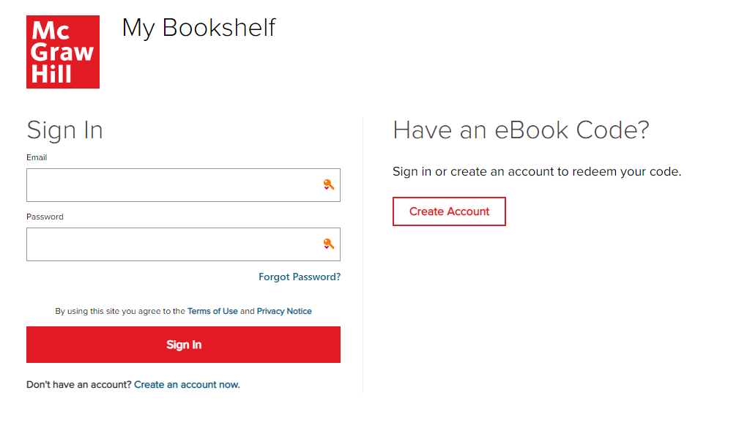
Step 1
Option 1) If you have not yet purchased your access code, you can do so at mheducation.com, and from there, you will be taken directly to your Bookshelf.
Option 2) If you already have an eBook access code, visit the Bookshelf website at myebooks.mheducation.com to sign in or create a new account. If you’ve previously used McGraw Hill’s learning platforms, such as Connect, you can sign in using the same email address and password.

Slide 4
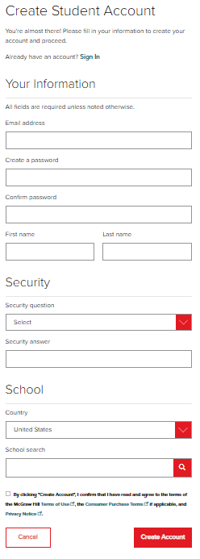
eBook Student Registration
If you haven’t used McGraw Hill’s Bookshelf or Connect platform before, you’ll need to create an account to redeem your eBook access. We recommend using your school email to keep all your courses in one place, though this is not required.
Be sure to use the same username and password for both the Bookshelf site and the ReadAnywhere app to ensure full access to your account.

Slide 5
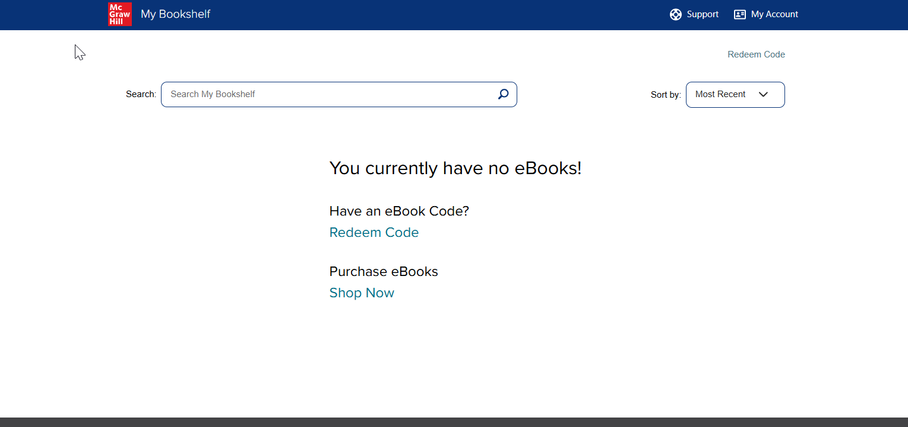
Step 2
Once logged in, if you purchased an access code card, click Redeem Code to enter it now.

Slide 6
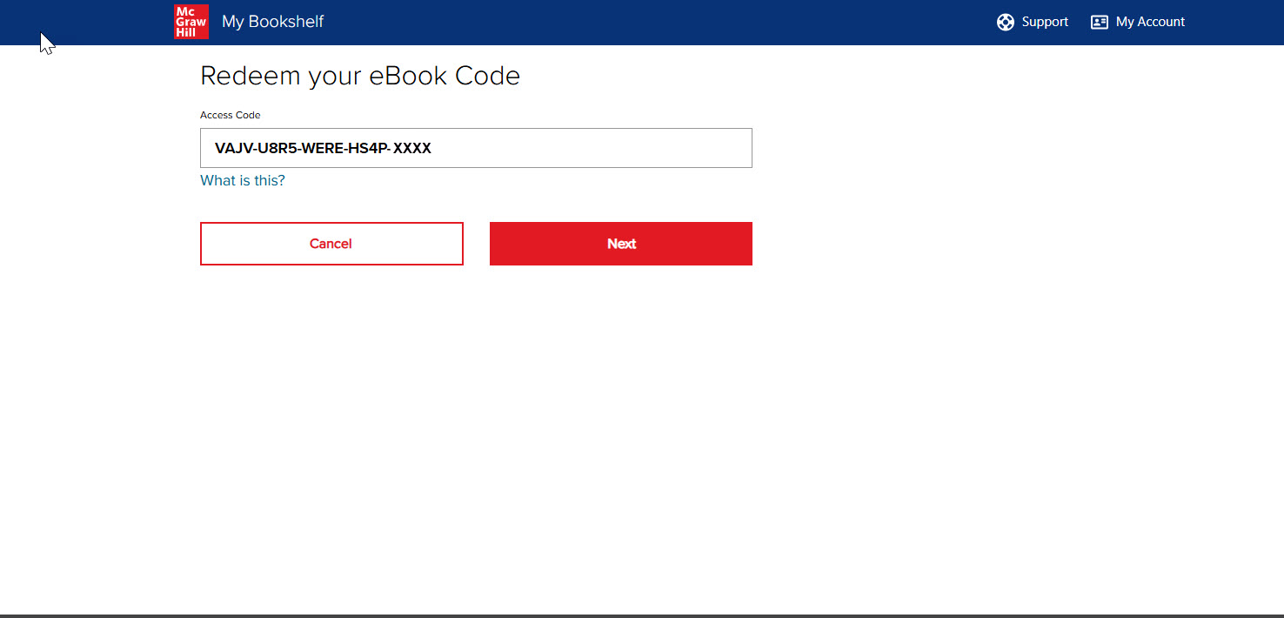
Step 3
Next, enter your 20-digit eBook access code and click Next.

Slide 7
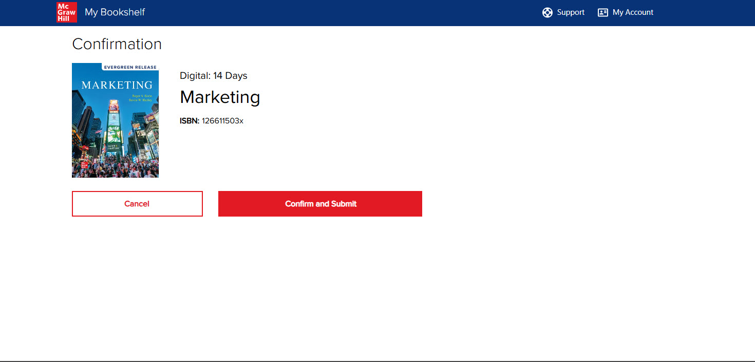
Step 4
Check that the correct title for your textbook comes up in the Bookshelf. Click Confirm and Submit to complete registration.

Slide 8
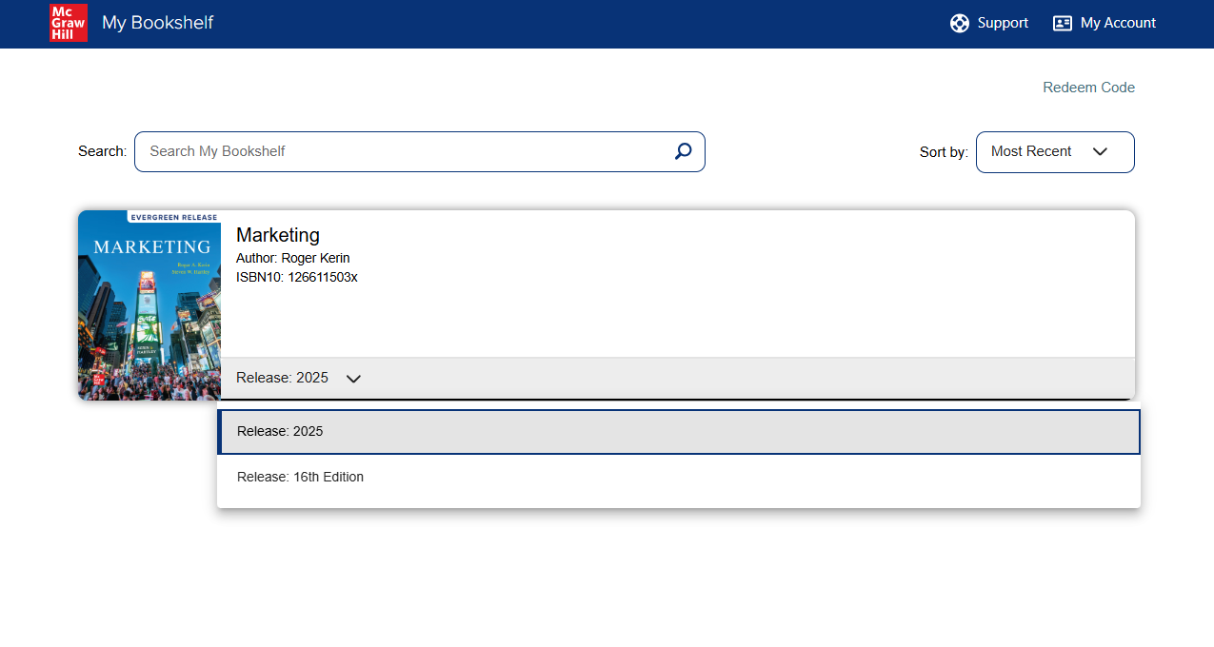
eBook Student Registration
After redeeming your eBook access, the new eBook will appear on your Bookshelf.
Use the release drop-down to select the eBook version you want to access.

Slide 9
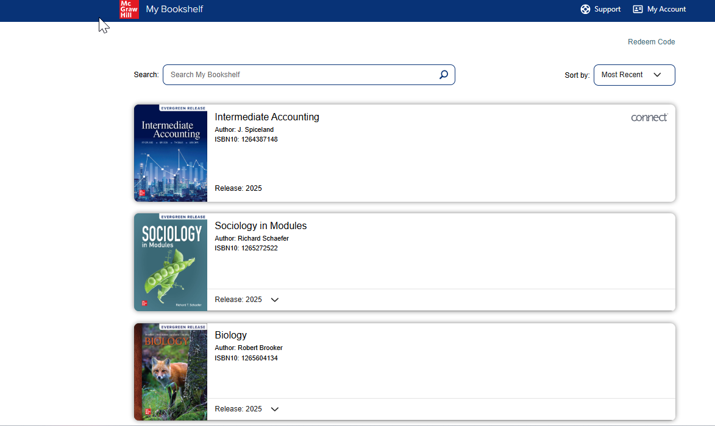
Moving forward, signing into your Bookshelf account will give you access to all your McGraw Hill eBooks, including those linked to Connect courses.
You can identify if an eBook is linked to a Connect course by the Connect logo displayed in the upper right corner of the product. eBooks tied to Connect courses only offer the release version used within Connect.

Slide 10
Support and Resources
TECH SUPPORT & FAQ:
CALL: (800) 331-5094
EMAIL & CHAT: WWW.MHHE.COM/SUPPORT
MONDAY-THURSDAY: 24 hours
FRIDAY: 12 AM - 9 PM EST
SATURDAY: 10 AM - 8 PM EST
SUNDAY: 12 PM – 12 AM EST
FIND MORE TIPS:
WWW.SUPPORTATEVERYSTEP.COM

