Slide 1
ALEKS ®
Student Registration
Standalone Access

Slide 2

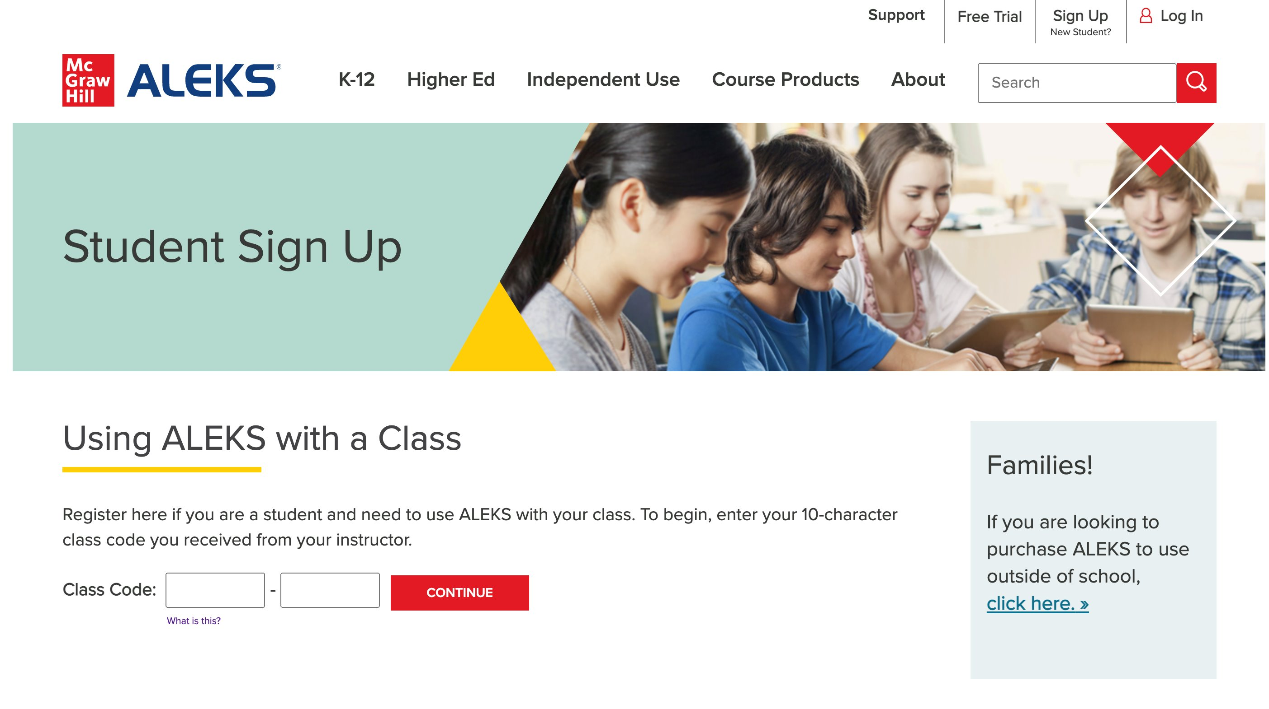
Step 1
Before you begin you will need the 10-character course code from your instructor.
​
Go to ALEKS.com and click Sign Up in the top right.
​
Enter your ten-digit course code and click Continue to be taken to the ALEKS registration process. ​

Slide 3
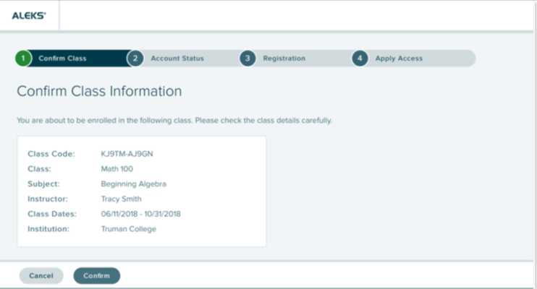
Step 2
Before continuing, check that you are enrolling in the correct class. ​
If all the information is correct click Confirm.​

Slide 4
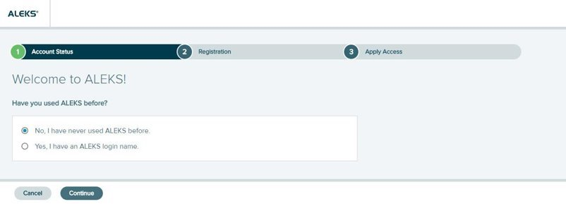
Step 3
Select an option.​
Existing user: Yes, I have an ALEKS login name. Then click Continue. You will have the option to reset your password.​
New User: No, I have never used ALEKS before. Then click Continue to create a new account. ​

Slide 5
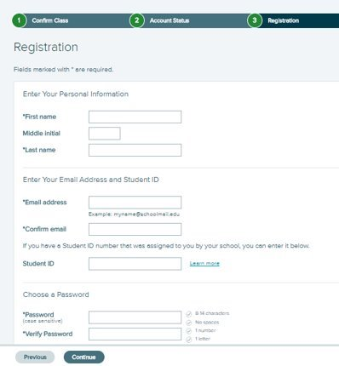
Step 4
To register, enter your first name, last name, email address, and password. We recommend using your school email address when creating an account. ​
Agree to the terms and then click Continue. ​
You will then see a screen with your username before being taken to the My Classes page in ALEKS.​​

Slide 6
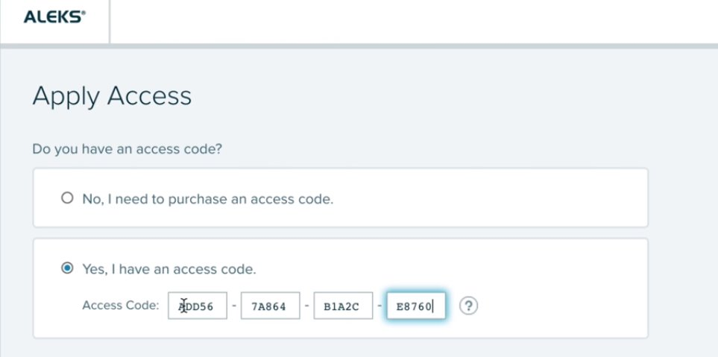
Step 5
You have three options.​
ALEKS Code: Select Yes, I have an access code and enter the code.​
Purchase Online: Select No, I need to purchase an access code to pay with a credit card or PayPal.​
Temporary Access: Enter the code provided by your instructor for two-week temporary access.​
Click Continue to be taken to your My Classes page in ALEKS.​

Slide 7
Support and Resources
TECH SUPPORT & FAQ:
CALL: (800) 331-5094
EMAIL & CHAT: WWW.MHHE.COM/SUPPORT
FIND MORE TIPS:
WWW.SUPPORTATEVERYSTEP.COM

Slide 8
QUESTIONS?

