Slide 1
ALEKS ®
Student Registration
Moodle with Regular Deep Integration

Slide 2
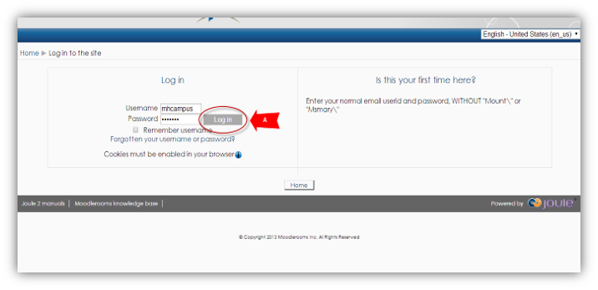
Step 1
Login into your Moodle account and navigate to your course.
If you are not sure if you have a Moodle account, check with your instructor.

Slide 3
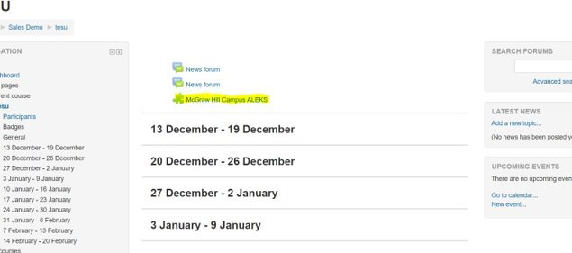
Step 2
On your course homepage, locate and click on the McGraw-Hill Campus ALEKS link to start the registration process.​

Slide 4
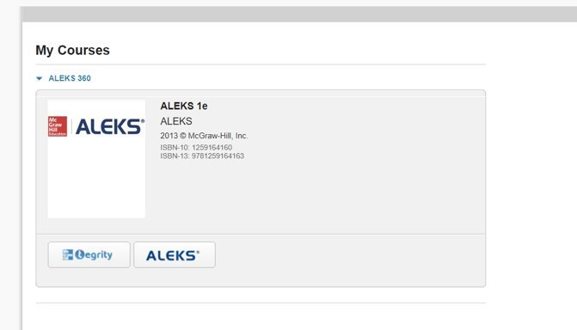
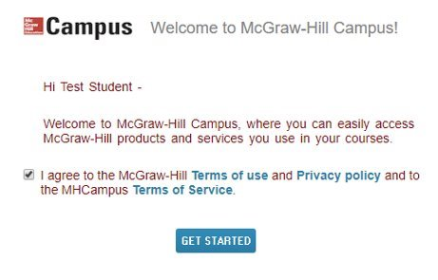
Step 3
If this is your first time using McGraw-Hill Campus, you will need to agree to the terms of service and privacy policy and then click Get Started. ​​
​​
Then click on the ALEKS button to continue.​

Slide 5
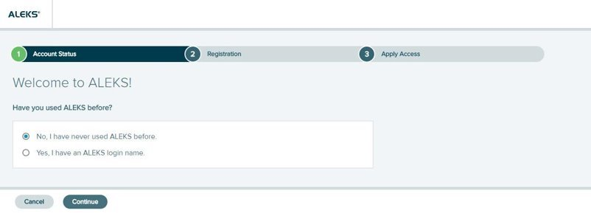
Step 4
Select an option.​
Existing user: Yes, I have an ALEKS login name. Then click Continue. You will have the option to reset your password.​
New User: No, I have never used ALEKS before. Then click Continue to create a new account. ​

Slide 6
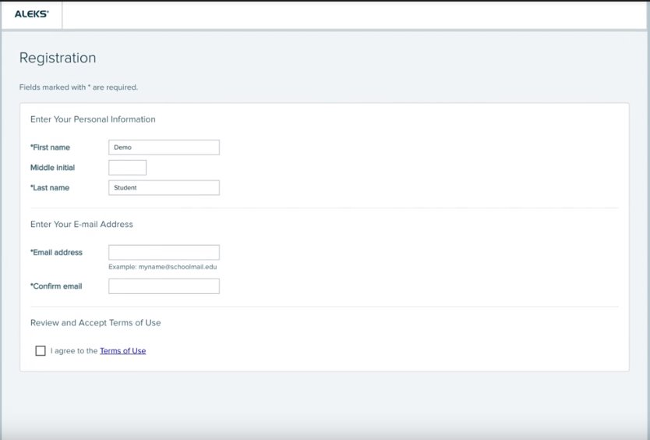
Step 5
To register enter your First name, Last name and Email address. We recommend using your school email address when creating an account.
Agree to the Terms of Use and then click Continue.
On the next screen click Continue again to be taken to your purchasing options.

Slide 7
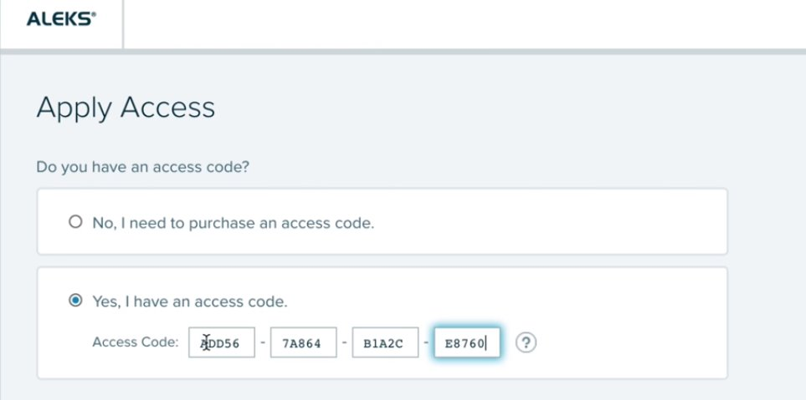
Step 6
You have three options.
ALEKS Code: Select Yes, I have an access code and enter the code.
Purchase Online: Select No, I need to purchase an access code to pay with a credit card or PayPal.
Temporary Access: Enter the code provided by your instructor for two-week temporary access.
Click Continue to be taken to your My Classes page in ALEKS.

Slide 8
Support and Resources
TECH SUPPORT & FAQ:
CALL: (800) 331-5094
EMAIL & CHAT: WWW.MHHE.COM/SUPPORT
FIND MORE TIPS:
WWW.SUPPORTATEVERYSTEP.COM

Slide 9
QUESTIONS?

