Slide 1
ALEKS®
Student Registration
Canvas with Inclusive Access

Slide 2
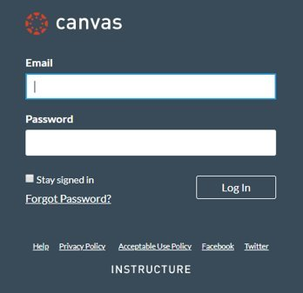
Step 1
Login in to your Canvas account and navigate to your course. ​
If you are not sure if you have a Canvas account, please ask your instructor.

Slide 3
Step 2
Now you'll want to find the McGraw-Hill Campus link under Modules. ​
Once you have found the link, go ahead and click it to start the registration process.​

Slide 4
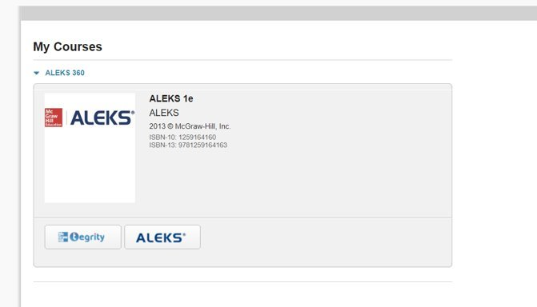
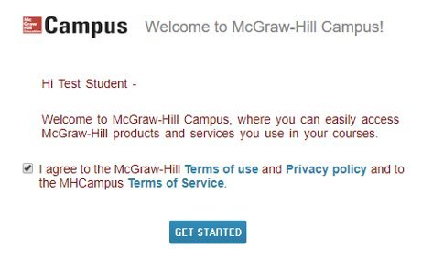
Step 3
If this is your first time using McGraw-Hill Campus, you will need to agree to the terms of service and privacy policy and then click Get Started. ​​ ​​
Then click on the ALEKS button to continue.​

Slide 5
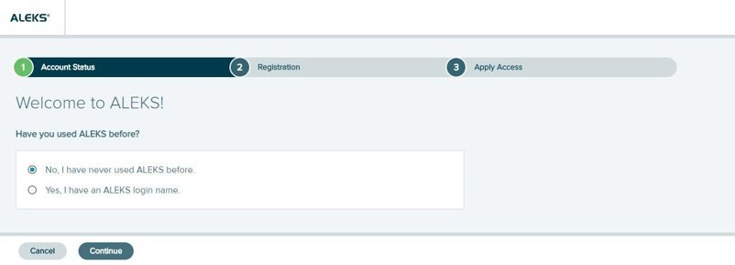
Step 4
Select an option.​
Existing user: Yes, I have an ALEKS login name. Then click Continue. You will have the option to reset your password.​
New User: No, I have never used ALEKS before. Then click Continue to create a new account. ​

Slide 6
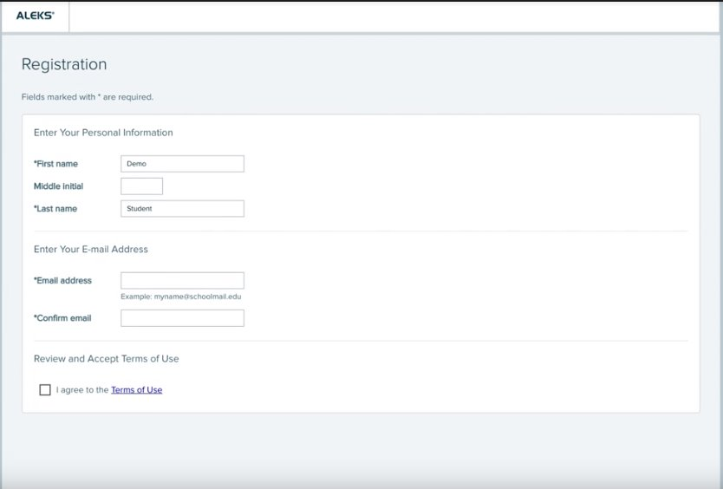
Step 5
To register enter your First name, Last name and Email address. We recommend using your school email address when creating an account. ​
Agree to the Terms of Use and then click Continue. ​
On the next screen click Continue again to be taken to your My ALEKS Courses page.​

Slide 7
Support and Resources
TECH SUPPORT & FAQ:
CALL: (800) 331-5094
EMAIL & CHAT: WWW.MHHE.COM/SUPPORT
FIND MORE TIPS:
WWW.SUPPORTATEVERYSTEP.COM

Slide 8
QUESTIONS?

